Slide 1
IDS PROJECT - DATA ANALYSIS
Rithvik K(PES1201700152)
Pranav Badami(PES1201701267)
T
REND SETTERS

Slide 2
Overview/intro
The assignment is to perform Exploratory Data Analysis on a dataset where data is analysed to summarize the main characteristics of the dataset. The dataset we have chosen as the name suggests contains information regarding the medal winners in different Olympic games since its inception in 1896. We looked at the structure of the data and posed an initial question that the data could answer. Then we accessed the fitness of the data and checked if it needs any cleaning. We cleaned the data before we started the visual analysis on it. And then we visualized the data into different types of graphs like Bar Chart, Box Plot, Line Graphs, etc. and found out the patterns from these graphs and arrived at a few conclusions.

Slide 3
Dataset
It is a dataset with 10000 rows and 12 features - ID, Name, Sex, Age, Height, Weight, Team, Year, City, Sport, Medal.
The purpose of the dataset is to analyse the heights, weights, age and type of medal that the athletes won over the years and make suitable conclusions after the analysis.
We selected this dataset from the Kaggle Website (https://www.kaggle.com/datasets).

Slide 4
Data cleaning
Data Cleaning : Data cleaning is the process of detecting and correcting (or removing) corrupt or inaccurate records from a dataset and refers to identifying incomplete, incorrect, inaccurate or irrelevant parts of the data and then replacing, modifying, or deleting the dirty or coarse data.

Slide 5
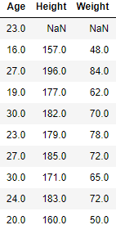
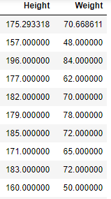
Data cleaning cont.
All the NAN’s numerical columns to be replaced with the average of that column.

Slide 6


Data cleaning cont
All the NAN’s for categorical columns to be replaced with its previous row values.

Slide 7
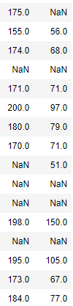
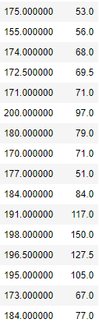
Data cleaning cont.
Interpolation of immediate data before and after it.

Slide 8
Normalization
In the simplest cases, normalization of ratings means adjusting values measured on different scales to a notionally common scale, often prior to averaging. In more complicated cases, normalization may refer to more sophisticated adjustments where the intention is to bring the entire probability distributions of adjusted values into alignment.
The goal of normalization is to change the values of numeric columns in the dataset to use a common scale, without distorting differences in the ranges of values or losing information.

Slide 9
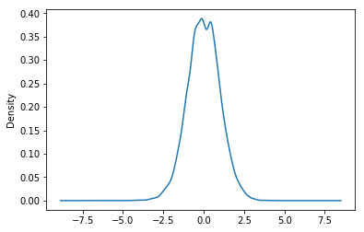
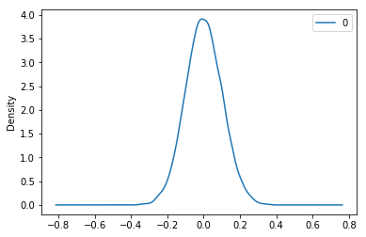
Graphs showing normalized data
Normalized column height before and after Central Limit Theorem.

Slide 10
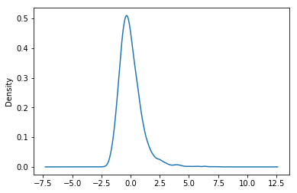
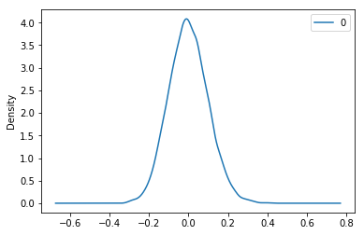
Graphs normalisation cont.
Normalized column age before and after Central Limit theorem.

Slide 11
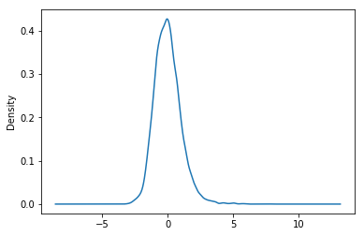
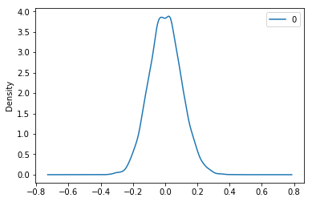
Graphs normalisation cont.
Normalized column weight before and after Central Limit Theorem.

Slide 12
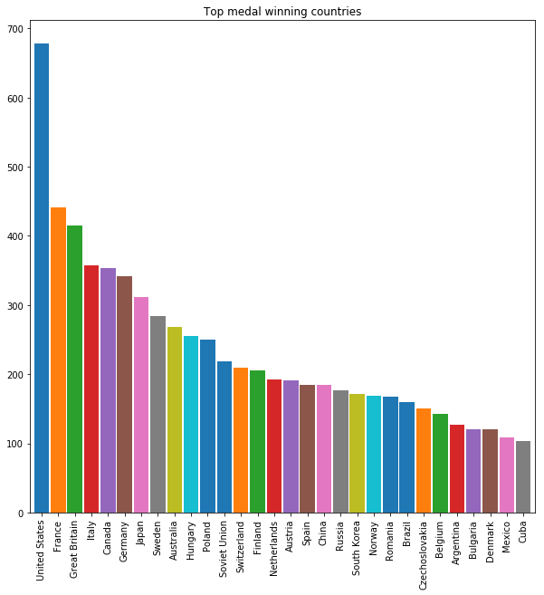
Visualization of data
Richer countries win more medals.

Slide 13
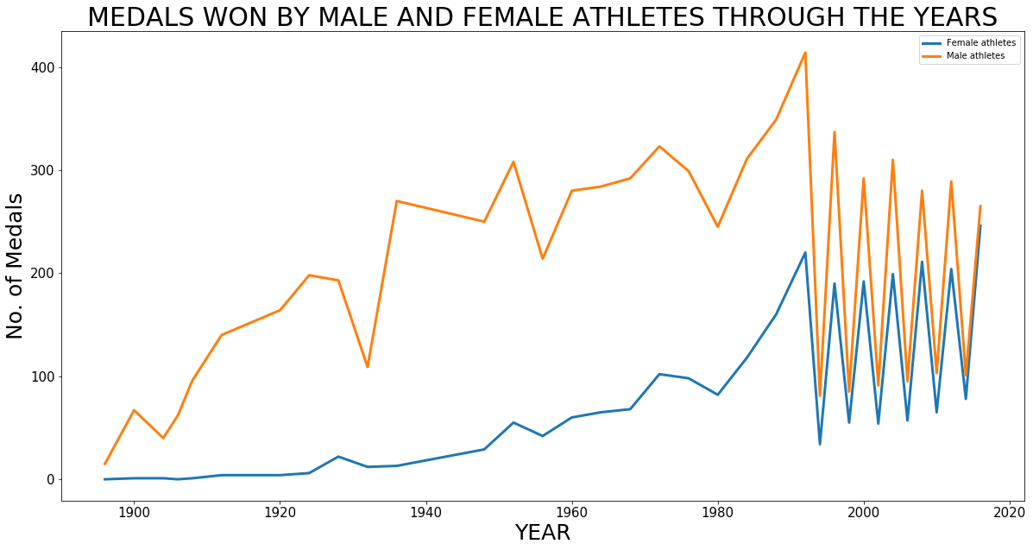
Visualization cont

Slide 14
Visualization cont.
The number of medals won by men were a lot more than those won by women because of lack of events and encouragement for women in sports.
This trend however has improved in recent years with the number of events for men and women almost comparable.
Huge distortions in the graph in starting in the 1990s is due to the introduction of the Winter Olympics where the number of events and medals are much less compared to the Summer Olympics.

Slide 15
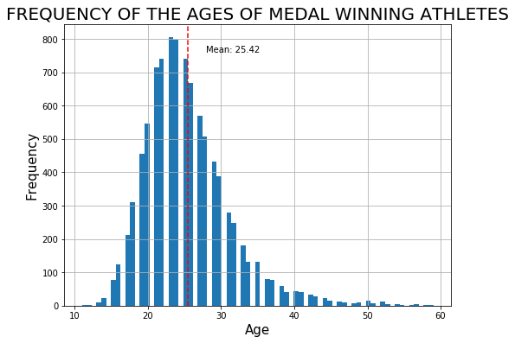
Visualization cont

Slide 16
Visualization cont
Maximum number of medals are won by athletes aged between 20 to 30.
Though the mean of the ages of the medal winning athletes is around 25, the maximum number of medals are won by athletes aged around 22-23.

Slide 17
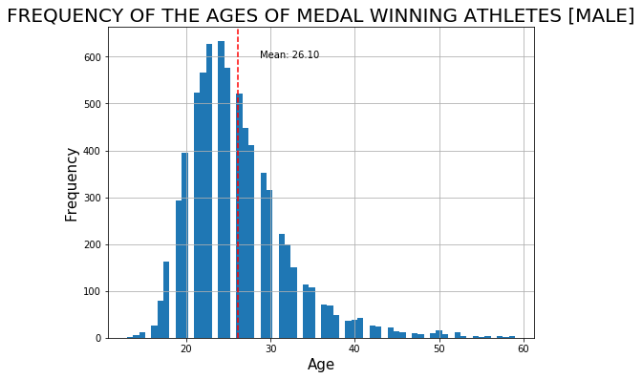
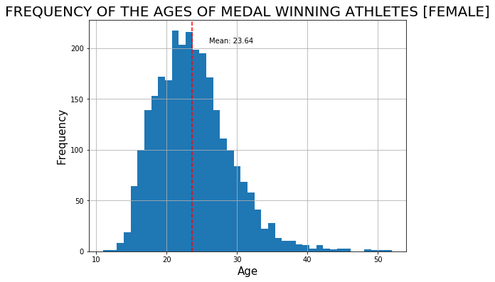
Visualization cont.

Slide 18
Visualization cont.
Women tend to win medals when they’re younger compared to men.

Slide 19
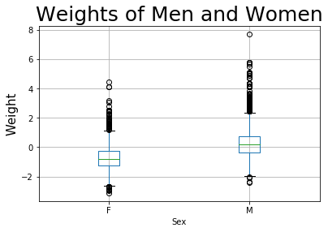
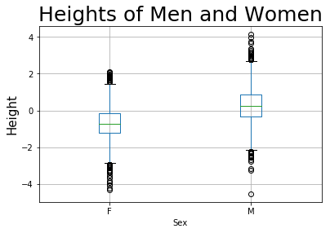
Visualization cont
As expected, the heights and weights of men are greater than compared to women.

Slide 20
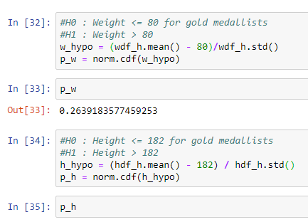
Hypotheses testing
Since the p-values for the both the tests are much greater than the accepted 0.05 level, we cannot reject the null hypotheses. This doesn’t mean that the alternate hypotheses is acceptable.

Slide 21
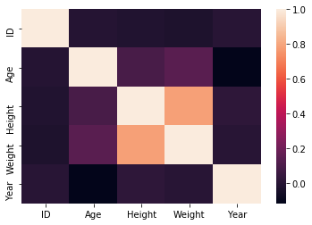
Correlation
As we can see, most of the columns have a high correlation coefficient.
Height and weight seem to have the highest correlation coefficient. So, possibly all athletes of certain heights maintain their weight at a certain level.
Weight and Age of the athlete are have a very weak correlation.

Slide 22
Thank you

