Slide 1





Folder Encryption and Decryption
Folder encryption is a crucial security measure that protects sensitive data from unauthorized access. It involves scrambling data within a folder, making it unreadable without a decryption key. This safeguards confidential information, such as financial records, personal documents, and business secrets.
by Pranav Rao

Slide 2

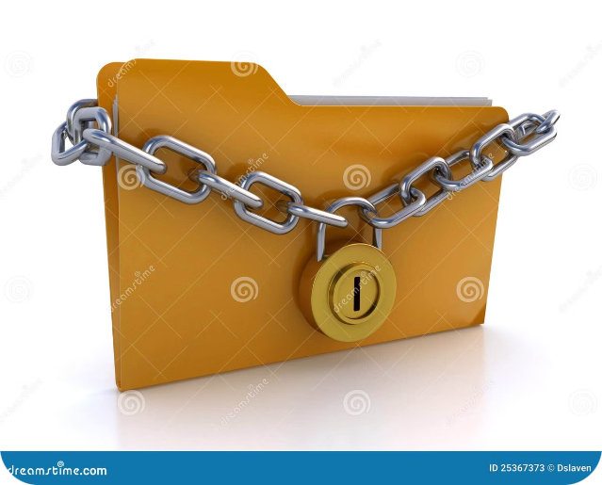
What is Folder Encryption?
Data Transformation
Access Control
Folder encryption transforms data into an unreadable format, rendering it useless to unauthorized individuals. This scrambling process uses algorithms and keys to secure sensitive information.
Encryption restricts access to data within a folder, ensuring that only authorized individuals with the correct decryption key can view or modify the information. This effectively prevents data breaches and unauthorized access.

Slide 3

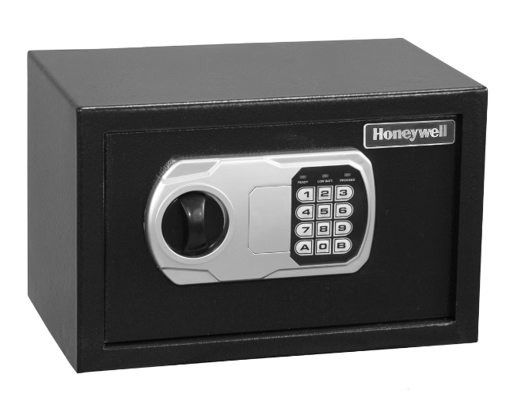
Benefits of Folder Encryption
1
Confidentiality
2
Data Integrity
Folder encryption ensures that your sensitive data is only accessible to authorized individuals, protecting it from unauthorized access and data breaches.
Encryption helps maintain the integrity of your data by preventing unauthorized modifications, ensuring that the information remains unchanged and trustworthy.
3
Compliance
4
Peace of Mind
For businesses and organizations that handle sensitive data, folder encryption can help meet industry standards and regulatory requirements.
Knowing that your sensitive data is securely protected gives you peace of mind, allowing you to focus on other aspects of your work or life.

Slide 4


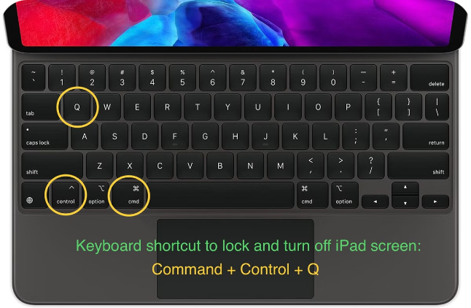


How Does Folder Encryption Work?
Encryption Key Generation
A unique encryption key is generated to encrypt the data within the folder.
Data Encryption
The encryption algorithm uses the key to transform the data into an unreadable format.
Data Storage
The encrypted data is stored within the folder, protected from unauthorized access.

Slide 5
Encrypting Folders on Windows
File Explorer
Command Prompt
Navigate to the folder you want to encrypt using File Explorer.
Open Command Prompt as an administrator.
Use the following command to encrypt a folder:
Right-click on the folder and select "Properties".
Select the "Advanced" tab and check the box for "Encrypt contents to secure data".
cipher /e /i "C:\folder path"

Slide 6
Encrypting Folders on macOS
Finder
Terminal
Locate the folder you want to encrypt using Finder.
Open Terminal.
Right-click on the folder and select "Get Info".
Use the following command to encrypt a folder:
Check the box for "Encrypt contents to secure data".
diskutil apfs encrypt "path to folder" -key "your password"

Slide 7


Decrypting Encrypted Folders
1
Windows
Follow the same steps as encrypting, but uncheck the box for "Encrypt contents to secure data" in the folder's properties.
2
macOS
Uncheck the box for "Encrypt contents to secure data" in the folder's Get Info.
3
Password
If you used a password to encrypt the folder, you will need to enter it when prompted to decrypt the data.

Slide 8





Best Practices for Folder Encryption
Strong Passwords
Regular Backups
Security Software
Security Awareness
Use a strong password for encrypting your folders, combining uppercase and lowercase letters, numbers, and symbols.
Create backups of your data to prevent data loss in case of accidental deletion or system failure.
Install and use reputable antivirus and anti-malware software to protect your system from threats that could compromise your encryption.
Be mindful of phishing scams and avoid clicking on suspicious links that could lead to malware infections.

