Slide 1
LocalFix
Home Service Booking Platform
Professional & Reliable Solutions

Slide 2
Project Overview
Connecting users with elite home service providers.
Key Objectives:
  • Simplify home maintenance & repairs
  • Provide certified & background-checked professionals
  • Seamless role-based user experience (User, Provider, Admin)

Slide 3
Key Features
Premium Modern UI with Glassmorphism
Role-Based Dashboards
Real-time Service Tracking
Secure Managed Bookings
Review & Rating System
Interactive Admin Control Panel

Slide 4
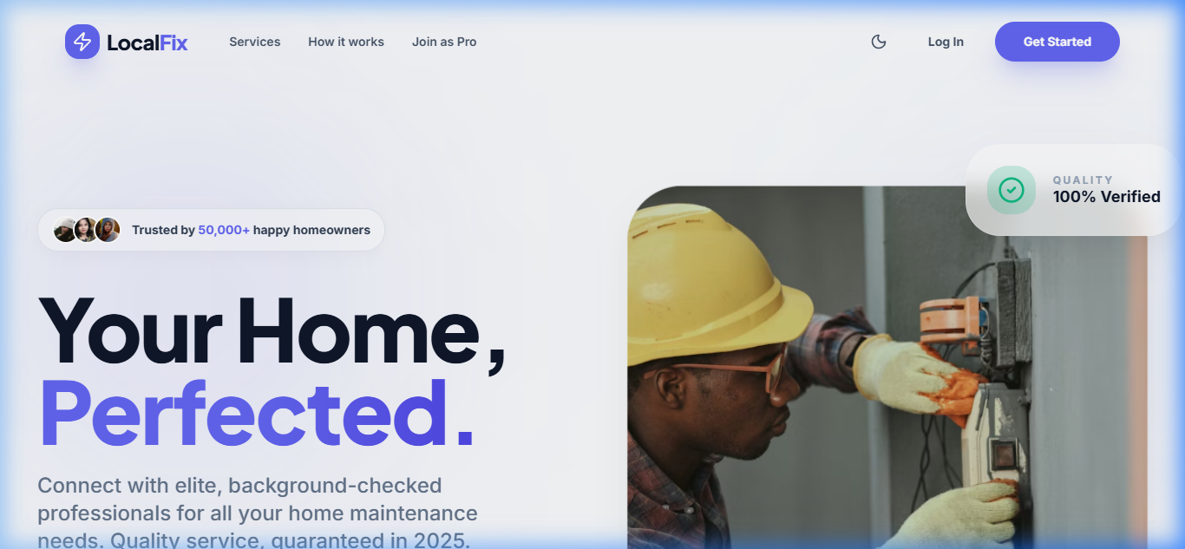
Landing Page interface

Slide 5
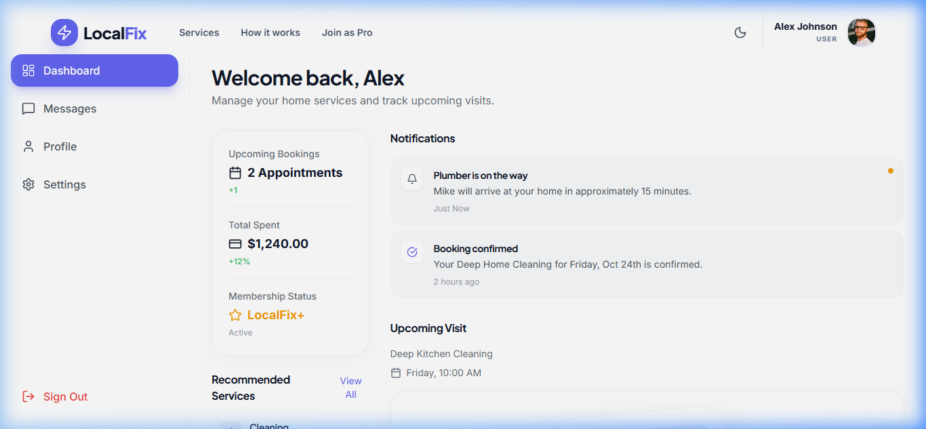
User Dashboard

Slide 6
Technology Stack
Frontend: React, TypeScript, Vite
Styling: Tailwind CSS, Framer Motion
State Management: Zustand
Backend: Node.js, Express
Database: MongoDB

