Slide 1

Machine Learning model for prediction of Ethane selectivity by
Oxidative Coupling of Methane
Presented at
ICPHD’23,IIT Guwuhati
Date: 5/10/23
Pranav Sarda
Department of Chemical Engineering
Indian Institute of Petroleum and Energy, Visakhapatnam
Co-Authors
Dr. Hemanth Kumar Tanneru,
Assistant Professor,
Indian Institute of Petroleum and Energy,
Visakhapatnam
Iradat Hussain Mafat,
Research Scholar,
Indian Institute of Petroleum and Energy,
Visakhapatnam
OP No: 67

Slide 2
Outline
Introduction
Aim
Methodology
Results and discussion
Conclusion
References

Slide 3
Introduction
Oxidative coupling of methane (OCM)
Hydrogen atom extraction from methane by an oxygen atom on the catalyst's surface.
This extraction leaves behind a methyl radical (*CH3), which is then released from the catalyst's surface.
The *CH3 radical couples with another methyl radical, ultimately forming ethane and higher hydrocarbons.
Another hydrogen atom is extracted from methane, by the OH group on the catalyst's surface, resulting in the desorption of water.

Slide 4
Introduction
The majority of research efforts in OCM
Catalysts to maximize the yield of desired C2 products. (ethane and ethylene )
Catalyst favorable for high-temperature.
Challenges in achieving high C2 yields
under high-temperature reaction conditions, the thermodynamically favorable formation of undesired products(CO, CO2, and solid graphitic carbon) hinders the process.

Slide 5
Objective
Aim
Inputs for models were:
Develop Machine Learning models for predicting conversion of methane into ethane (and propane).
Surface Area of Catalyst, GHSV, Flow rate, Catalyst used, CH4 conversion, Reactor used.
Output:
C2 selectivity.

Slide 6
Materials and Methods
Data was collected from research papers which were then preprocessed.
Data Cleaning was done. MICE was used for data imputation.
Basic data analysis was done using Pair-plot and PCC heatmap which gave us a idea about relationship between inputs.
Models were built on top this dataset.
.

Slide 7
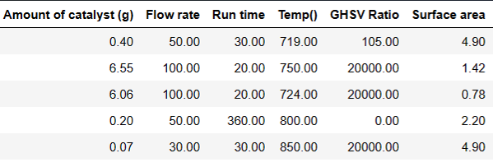
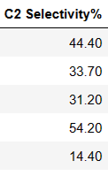
Typical Dataset
X in dataset:
Y in dataset:

Slide 8
Models | R² (%) |  | RMSE
XG boost | Testing set | 0.75 | Testing set | 7.01
 | Training set | 0.89 | Training set | 5.45
Gradient Boost | Testing set | 0.71 | Testing set | 7.75
 | Training set | 0.98 | Training set | 1.89
Decision Tree | Testing set | 0.98 | Testing set | 1.49
 | Training set | 0.99 | Training set | 1.48
Random Forest | Testing set | 0.94 | Testing set | 2.82
 | Training set | 0.96 | Training set | 3.43

Slide 9
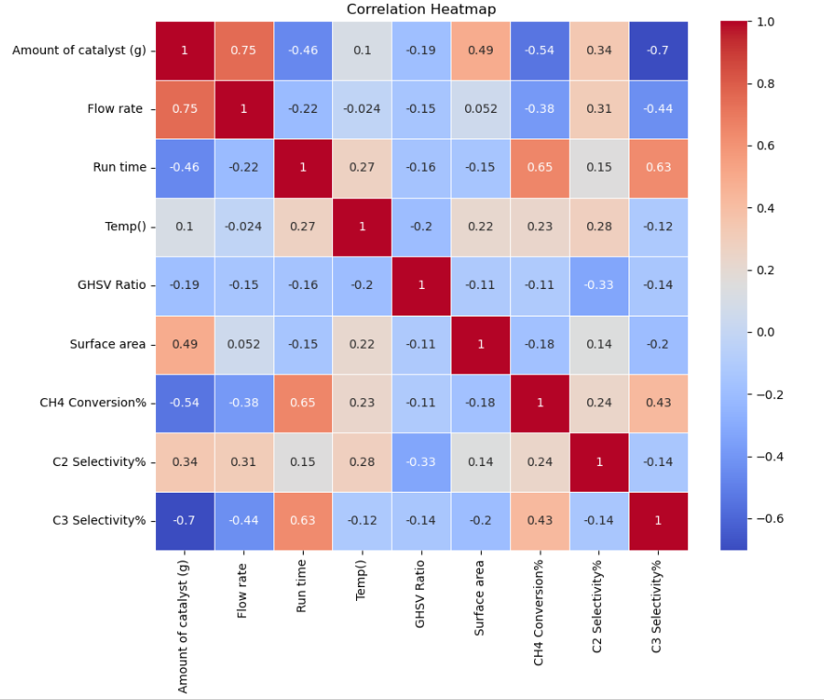
Heatmap Analysis Of Data
C2 selectivity is negatively proportional to (gas hourly)space velocity.
More amount of catalyst and Flow rate, Better C2 selectivity as observed in PCC.
C3 selectivity and CH4 conversion is directly proportional to Run time.

Slide 10
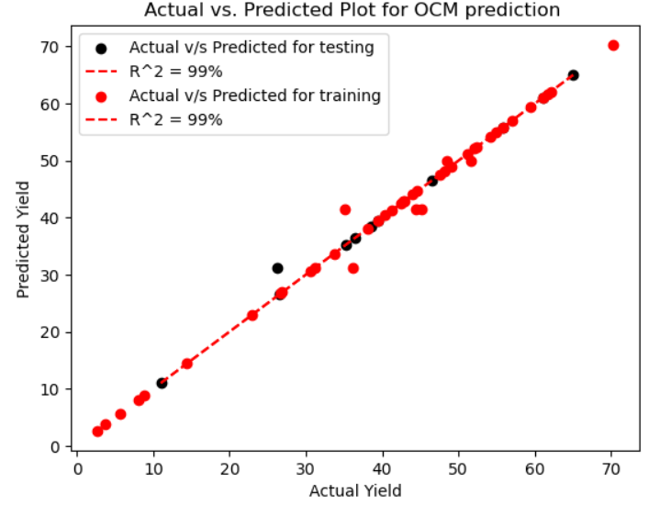
Actual VS Predicted
Model | R² (%) | RMSE
Decision Tree | Testing set | 0.99 | Testing set | 1.49
 | Training set | 0.99 | Training set | 1.48

Slide 11
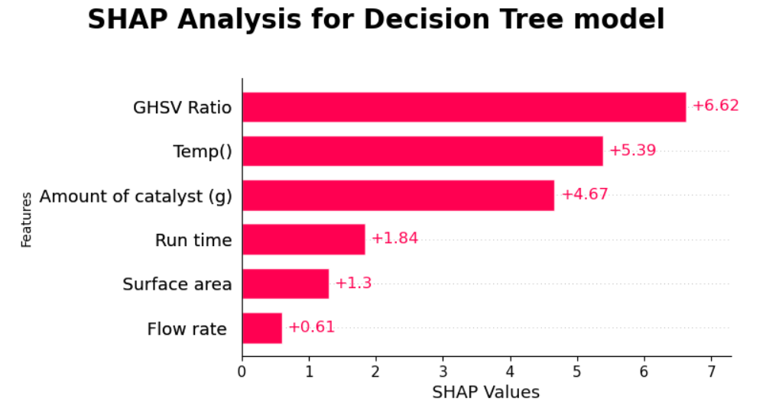
SHAP analysis

Slide 12
Conclusion and Summary
Tree based models are giving good accuracy:
Non-linear relationship
With highest accuracy, RMSE of 1.49 and R2 of 0.98.
Decision model performed best.
From SHAP analysis, Space Velocity, Temperature and Amount of catalyst are important factors affecting this reaction.
Irregular patterns

Slide 13
Thank you
Questions?
Contact:
hemanth.che@iipe.ac.in pranavramchandra@iipe.ac.in

