Slide 1


Data Analytics using R
OPIM 5503
smaRt
Shaik Shavali
Deepak Sisodiya
Mir Akram Ali Yadullahi
Project-2
Harsha Chandar
Pranav Sachdev

Slide 2
Agenda
What is H2o?
Architecture of H2o
Advantages
Accessibility
Important H2o functions
Data Preparation
Machine Learning using H2o

Slide 3

What is H2o
Written in Java
Open source
In-memory computing
Distributed computing
Scalable
Machine Learning and Predictive Analytics platform

Slide 4
Architecture of H2o
Distributed Key/Value store is used to access and reference data, models and objects across all nodes and machines.
The architecture is built upon H2O’s distributed Map/Reduce framework.
Utilizes the Java Fork/Join framework for multi-threading.
Supports REST API - allows access to external program (or script) via JSON over HTTP.
Notes:
H2O’s data parser has built-in intelligence to guess the schema of the incoming dataset and supports data ingest from multiple sources in various formats.

Slide 5
Architecture of H2o
Data
Read in parallel
Distributed across cluster
Stored in memory
columnar, compressed
Notes:
H2O’s data parser has built-in intelligence to guess the schema of the incoming dataset and supports data ingest from multiple sources in various formats.

Slide 6
Advantages of H2o
Speed
Quality
Ease-of-use
Model-deployment
Algorithms like Deep Learning, Tree Ensembles, and GLRM
Powerful API for big data analytics.
Notes:
H2O’s data parser has built-in intelligence to guess the schema of the incoming dataset and supports data ingest from multiple sources in various formats.

Slide 7
Accessibility of H2o
Supported file formats:
CSV
ARFF
Avro
Language support:
Java
R
ORC
XLS
Parquet
Scala
SVMLite
XLSX
Python
Notes:
H2O’s data parser has built-in intelligence to guess the schema of the incoming dataset and supports data ingest from multiple sources in various formats.

Slide 8
Some H2o Functions
h2o.init()
h2o.importFile()
h2o.asFactor
Data Manipulation
h2o.group_by()
h2o.merge()
h2o.interaction()
h2o.rm()
h2o.cbind()
as.h2o()
h2o.glm()
Machine Learning
h2o.gbm()
h2o.glm()
h2o.randomForest()
h2o.deeplearning()
Notes:
H2O’s data parser has built-in intelligence to guess the schema of the incoming dataset and supports data ingest from multiple sources in various formats.

Slide 9
H2o initialize
nthreads = -1 Utilize all the CPU cores
local_H2O <- h2o.init( ip = "localhost", port = 54321, nthreads = -1, max_mem_size = NULL, min_mem_size = NULL)
This instructs H2o to start and connect with the h2o instance:
ip = IP address of the server where h2o is running
port = Port number of h2o server
max_mem_size = maximum size (bytes) of memory allocation pool to h2o
min_mem_size = minimum size (bytes) of memory allocation pool to h2o
Notes:
H2O’s data parser has built-in intelligence to guess the schema of the incoming dataset and supports data ingest from multiple sources in various formats.

Slide 10
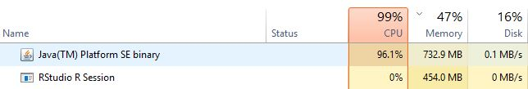
H2O Execution
Notes:
H2O’s data parser has built-in intelligence to guess the schema of the incoming dataset and supports data ingest from multiple sources in various formats.

Slide 11
Data Preparation
Notes:
H2O’s data parser has built-in intelligence to guess the schema of the incoming dataset and supports data ingest from multiple sources in various formats.

Slide 12
The Problem
Predict the purchase amount of customers given information about the customers purchase in the last month, product information and customer demographics
Variable | Definition
User_ID | User ID
Product_ID | Product ID
Gender | Sex of User
Age | Age in bins
Occupation | Occupation (Masked)
City_Category | Category of the City (A,B,C)
Stay_In_Current_City_Years | Number of years stay in current city
Marital_Status | Marital Status
Product_Category_1 | Product Category (Masked)
Product_Category_2 | Product may belongs to other category also (Masked)
Product_Category_3 | Product may belongs to other category also (Masked)
Purchase | Purchase Amount (Target Variable)

Slide 13
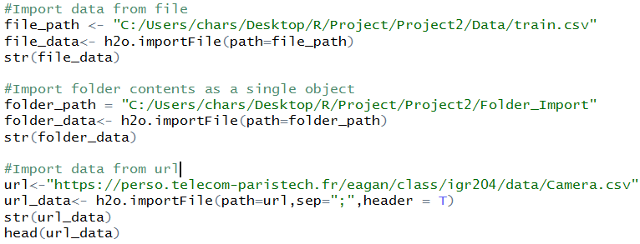
Data Preparation – Reading Data
H2O supports multiple data import methods
Command: h2o.importFile
Consolidated function – allows data to be read from file, import entire folder, HDFS, SQL Database
Notes:
H2o support a number of import methods to import data to the H2O cloud
This function is similar to the R data import functions, where you would need to specify the path to the data
Notes about Folder import: It needs all files to have the same number of columns and matched column names

Slide 14
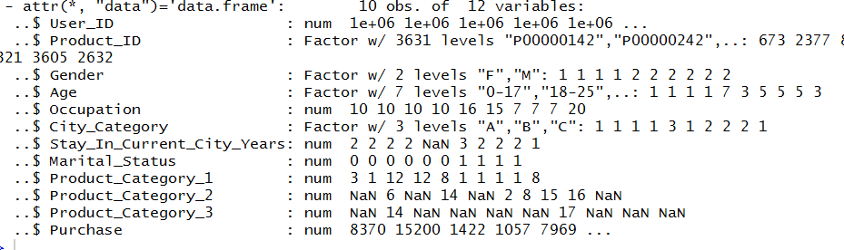
Black Friday Dataset
Incorrectly identified data type resulting in NaN
Notes:
Our data was a local file. The import function guesses the data type for each column based on a few entries. For our data, this process was incorrectly identifying the column Stay in current city years as a numerical field. This field is actually a factor which contains the value 4+ years. Due to this the rows with value 4+ is marked as NaN.

Slide 15
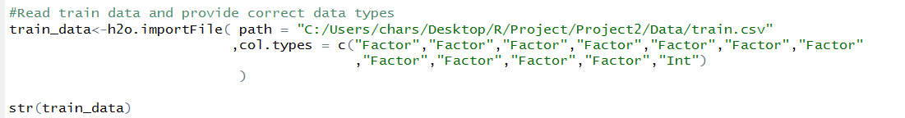
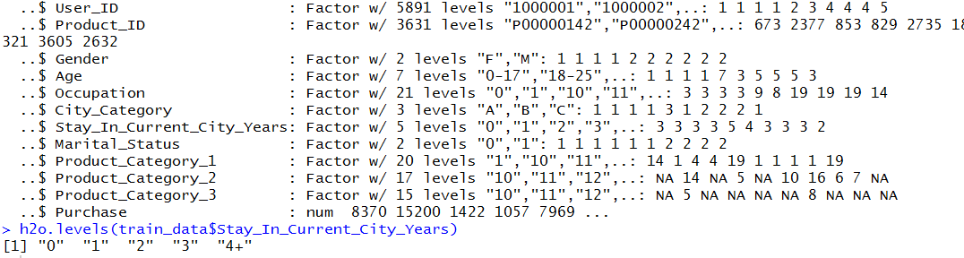
Corrected Data Import
Notes:
To overcome this issue, and to improve the performance, it would be better to specify the column data types. One useful function to check whether the levels of categorical fields are expected, you can use h2o.levels

Slide 16
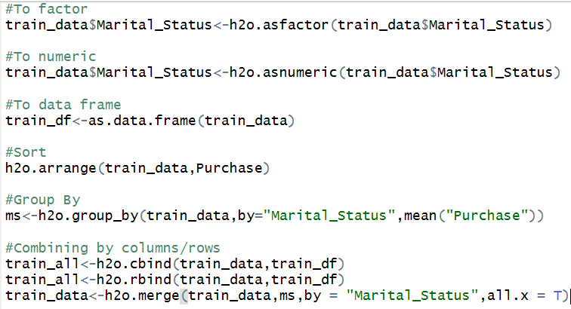
Data Manipulation Functions
Converting between types
h2o.asfactor
h2o.asnumeric
as.data.frame
Sorting
H2o.arrange
Aggregate functions
H2o.group_by
Combing frames
cbind
rbind
h2o.merge

Slide 17
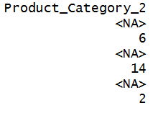
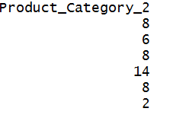
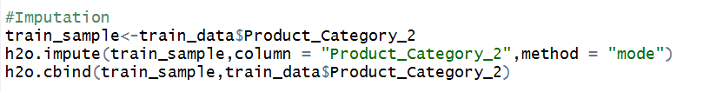
Data Preparation Functions Useful for Modeling
Imputation
H2o.impute
Data Split
H2o.splitFrame

Slide 18
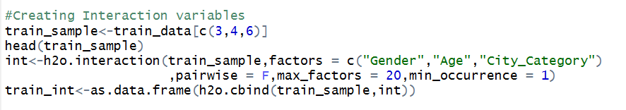
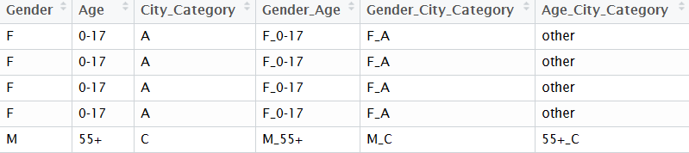
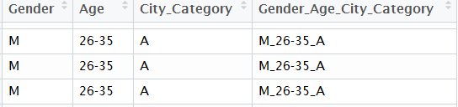
Data Preparation Functions Useful for Modeling - Interactions
Pairwise = True
Pairwise =False

Slide 19
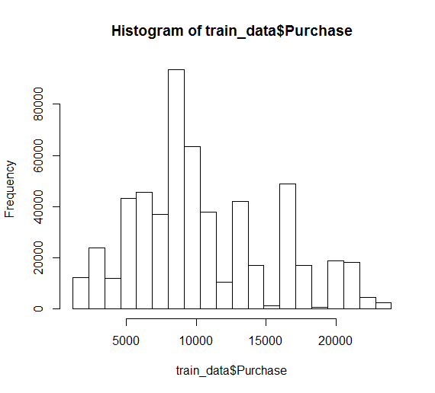
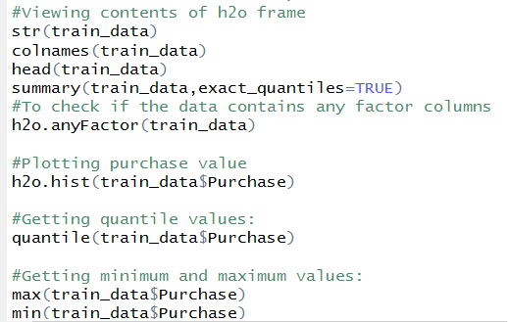

Other Useful Functions

Slide 20
Final Data Set
Derived Variables:
Average Purchase amount for each categorical variable
Frequency of occurrence of each categorical variable
Count of how many product categories an item belongs to
Imputation:
Missing product category values were imputed with 9999
Columns to indicate if the values have been imputed
Interaction variables
Encoding categorical variables
Notes:
In addition to the original dataset, we created a few other variables

Slide 21
Machine Learning using H2O
Notes:
H2O’s data parser has built-in intelligence to guess the schema of the incoming dataset and supports data ingest from multiple sources in various formats.

Slide 22

Random Forests
One of the most popular ensemble learning methods
A group of ‘Weak Learners’ (decision trees) can combine to form a ‘Strong Learner’
Reduces the variance in the data by constructing many decision trees
Attains a great bias-variance tradeoff by reducing variance for lower bias models

Slide 23
Algorithm Implementation
N – Number of rows in the dataset
P – Number of input parameters
m – Number of variables randomly selected by the algorithm to be used at every node of the decision trees
ntrees – Number of decision trees constructed
Depth of the decision tree is kept as large as possible and is not pruned

Slide 24
Algorithm Implementation
A Bootstrap sample (sample with replacements) of size N, is chosen from the input training dataset.
A decision tree is constructed on this dataset
Only a subset of the variables are randomly chosen (m variables) for the decision at every node
Steps 1-3 are repeated a number of times (total number of trees)
Ensemble of all the trees is the final model
Tuning the value of parameter m can optimize the performance

Slide 25
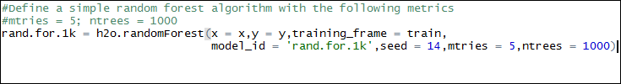
Random Forest - Implementation in H2O
Training a simple random forest model with the following parameters
m = 5
ntrees = 1000

Slide 26

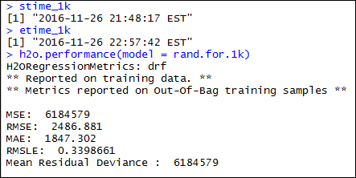
Random Forest – Model Performance metrics
Model Performance on the training data

Slide 27

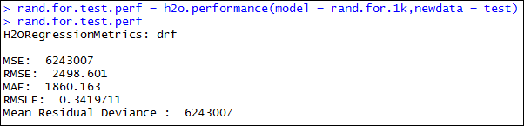
Random Forest – Model Performance metrics
Model Performance on the test data

Slide 28
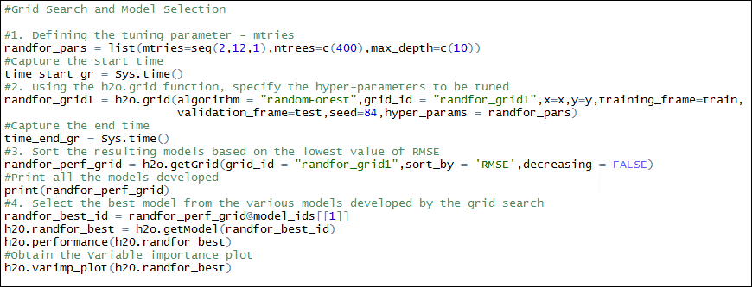
Grid Search and Hyperparameter Tuning in H2O
Tuning the hyperparameter ‘m’ (number of random variables selected at each node) for an optimal random forest model

Slide 29
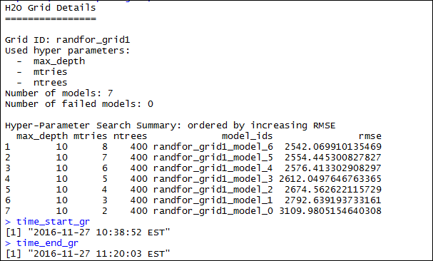
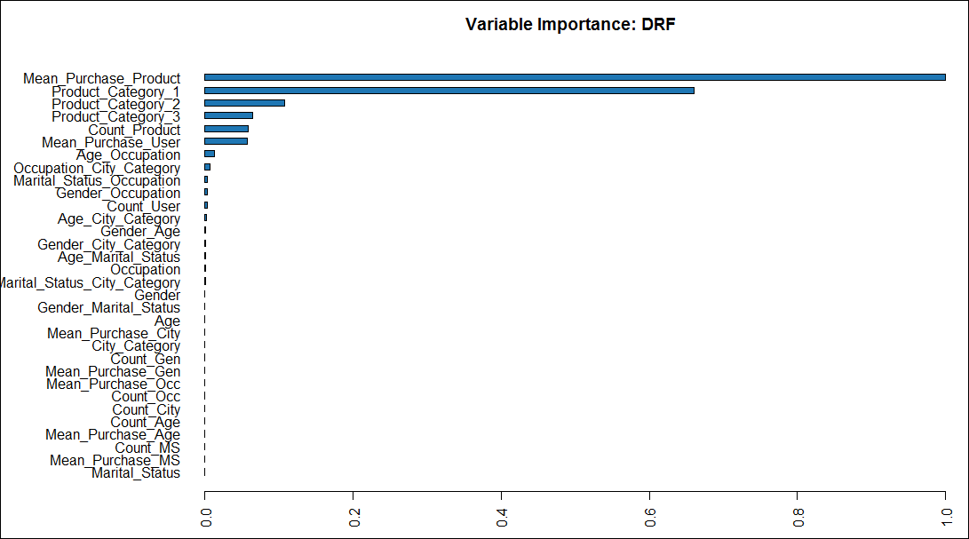
Grid Search and Hyperparameter Tuning in H2O
Listing of all the models developed by the grid search function, sorted in ascending order of RMSE, and selecting final model

Slide 30
Gradient Boosting Model (GBM)
Ensemble learning Technique – sequential ensemble
Add new models that do well where previous models lack
Combine multiple weak learners into a single complex model
Aim to decrease Bias
Tree based method

Slide 31
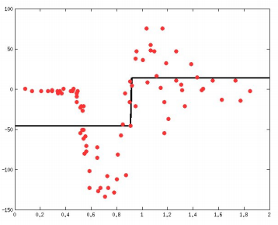
How GBM Works?
Weak learner is trained (Model 1)
Decision Tree with a single layer
Threshold at x=0.87

Slide 32
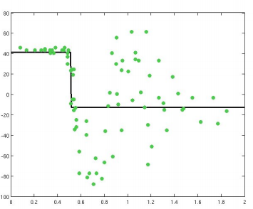
Compute and Predict Residuals
Compute Residuals
Learn to predict the
Residual(Model 2)
Threshold at x=0.5

Slide 33
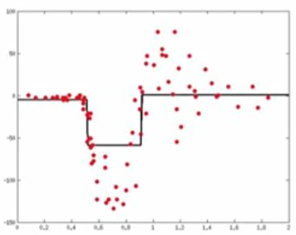
Combine the Weak Learners
Threshold at x=0.87
Model 3 =Model 1 + Model 2
Threshold at x=0.5

Slide 34
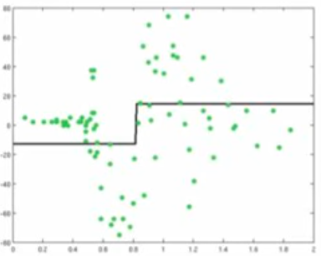
Compute and Predict Residuals
Compute Residuals
Learn to predict the
Residual(Model 4)
Threshold at x=0.8

Slide 35
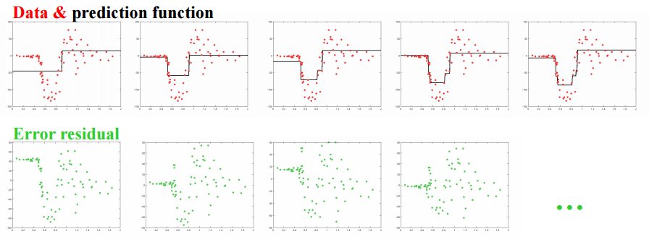
Iterations in GBM
Model complexity increasing
Bias Error decreasing

Slide 36
GBM Implementation (H2O package)
Basic GBM Model
gbm.performance.1 = h2o.performance(model = gbm.model.1,newdata = valid)

Slide 37
GBM with Cartesian Grid Search
Train a bunch of models in one go by using the Cartesian grid search
Output :

Slide 38
GBM with Random Grid Search
Random search for a fixed no. of models or a fixed time period

Slide 39
Grid Search and Hyperparameter Tuning in H2O
Tuning the hyperparameter ‘m’ (number of random variables selected at each node) for an optimal random forest model

Slide 40
Grid Search and Hyperparameter Tuning in H2O
Listing of all the models developed by the grid search function, sorted in ascending order of RMSE, and selecting final model

Slide 41
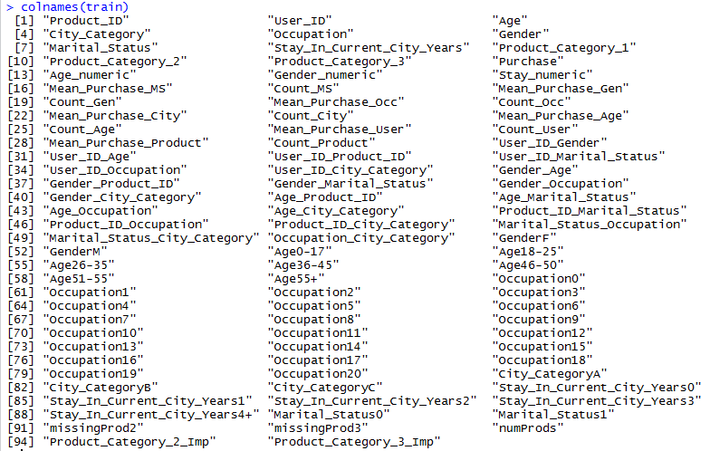
General Linear Model (GLM)
Columns in training dataset:

Slide 42
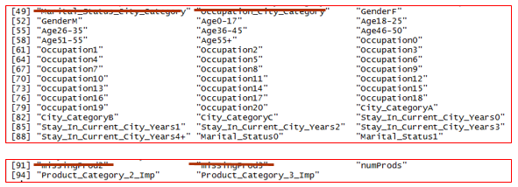
General Linear Model (GLM)
Model: Input Variables

Slide 43
General Linear Model (GLM)
Model: Fitting Model

Slide 44
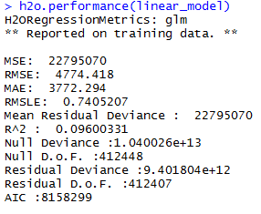
General Linear Model (GLM)
Model Performance
Time taken to execute: 2.41 seconds
Statistics:

Slide 45

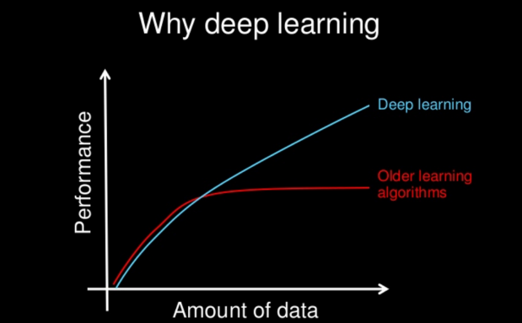
DeepLearning
Deep learning refers to artificial neural networks that are composed of many layers.
Scalable : Performance just keeps getting better as you feed more data
Feature Learning: Ability to perform automatics feature extraction from raw data
Applications: speech recognition , Image recognition, Natural language processing.

Slide 46
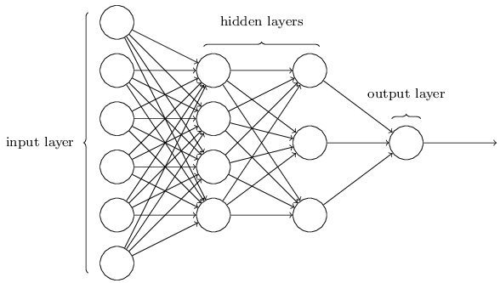
Architecture
Input Layer : Raw features are feed to input layers
Hidden Layer: Actual processing is done in these layers which try to identify the patterns among the features
Output Layer: Output layers collect information and outputs the results

Slide 47
Model
h2o.deeplearning(x, y, training_frame,
validation_frame, nfolds,
activation, hidden, stopping_rounds , L1 Regularization,
L2 Regularization, Classification Stop, Regression Stop)
Parameters | Definition
X,Y | Column name of dependent and independent variables
training_frame | Data source
validation_frame | Unique dataset with same shape as training dataset, used in model validation
activation | Activation function to be used in neuron ["Tanh", "Rectifier", "Maxout"]
nfolds | Number of folds of cross validation
Hidden | Number and Size of hidden layer Ex: (20,20,20) ; three layers with each layer 20 nodes.
Epochs | Number of passes over the training dataset. Can be tuned for better performance.
L1,L2 Regularization | Regularization that can be used to reduce the complexity of model and avoid overfitting.

Slide 48
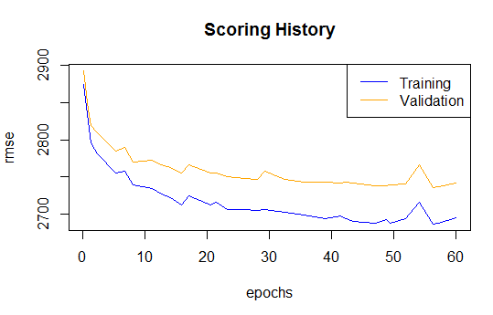
Model
Model Performance with change in epochs value
Tuning of hyper parameters can be done using “h2o.grid”
hyper_params <- list(hidden=list(c(32,32,32),
c(64,64,64)),
input_dropout_ratio=c(0,0.05),
rate=c(0.01,0.02) )
search_criteria <- list(strategy = "RandomDiscrete“)
h2o.grid(hyper_params = hyper_params,
search_criteria = search_criteria )

Slide 49
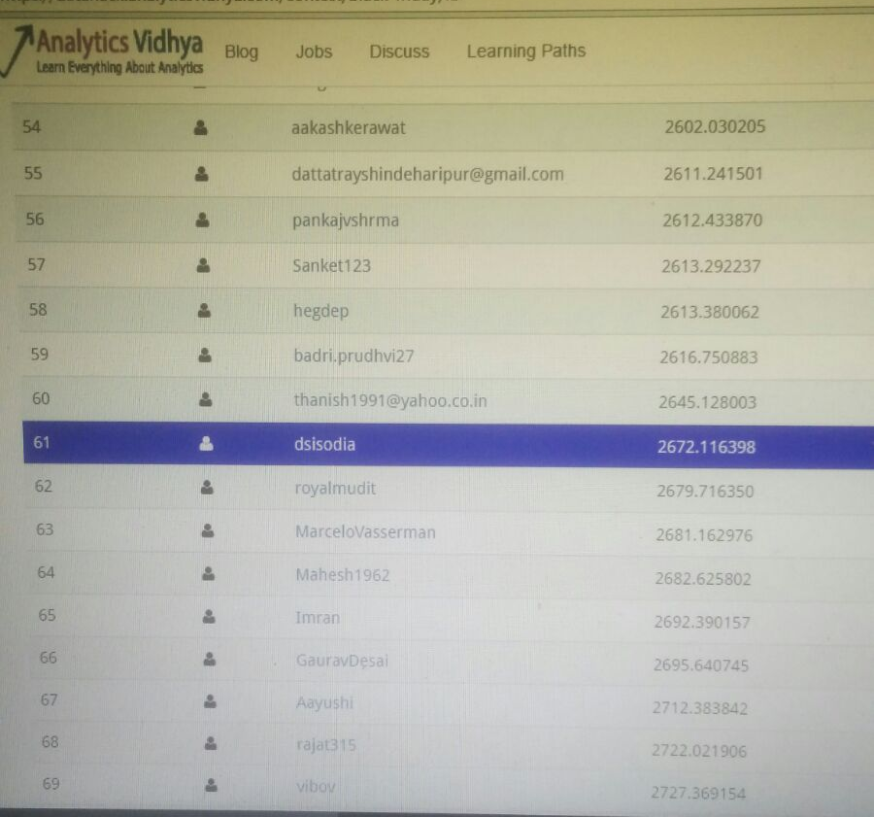
Competition Leaderboard

Slide 50


