Slide 1
Assignment 3
Aerial Image Retrieval
PRANAV SAI DEENUMSETTI A20370660
KARTHIK N V A20381713
DHEERAJRAM A20376500

Slide 2
Objective:
The main objective is to develop a program to automatically download an aerial imagery from Bing imagery rest service for a given latitude / longitude bounding box using the Bing Maps Tile System.

Slide 3
Retrieving QuadKey:
To optimize the indexing and storage of tiles, the two-dimensional tile XY coordinates of Bing map tile system are combined into one-dimensional strings called quadtree keys, or “Quadkeys” for short.
Retrieving quad key requires 3 steps
Converting given lat, lon to pixels
Converting pixels to tiles
Converting tiles to qudakey
All the three methods are referred from Microsoft Bing map tile system documentation

Slide 4
Retrieving Quadkey Matrix(Bounding Box):
Quadkey matrix represents a group of tiles in a map which comes under over required bounding box. Steps to retrieve this matrix involves
Get max tile which is on top left of bounding box using input 1
Get min tile which is on bottom right of bounding box using input 2
Tile 1 has max longitude and min latitude
Tile 2 has max latitude and min longitude
An Iterator function is written to calculate all the remaining tiles in between max y value to min y value with respect to max X value to min v value
The polynomial is converted to matrix of quadkeys with Y max rows and X max columns
Quad matrix = (YMAX) X (XMAX)

Slide 5
Obtaining level which has highest resolution:
Level is obtained by following steps:
Default level is considered as 23.
At level 23 tile 1 image is retrieved using quad key.
This image is considered as scrap image.
Iterate through every level and check if the O/P image is equal to scrap image.
Forbidden the level if they are equal.
Level where the image not equal to the scrap image is considered as best level.

Slide 6
Downloading and stitching all the tiles:
For every key in QuadKey download its respective tile.
Each tile can be downloaded from Bing Image Rest API.
Every downloaded image is stitched or added to the final output image.

Slide 7
Sample Input:
lat1 = 41.879769 lon1 = -87.643842 lat2 = 41.879981 lon2 = -87.643715

Slide 8
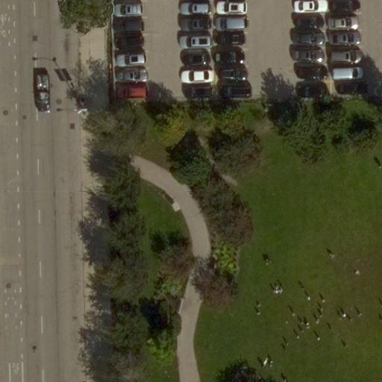
Sample Output Aerial retrieved image:

Slide 9
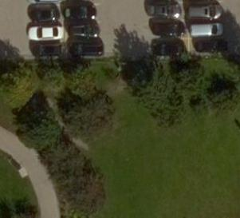

Sample Output Cropped and Scrap Image:

Slide 10
Requirements & Resources:
Pycharm
Python.Math
Python.url
Python.JSON
Bind Maps Tile System : http://msdn.microsoft.com/en-us/library/bb259689.aspx
Sample Output Tile : http://h0.ortho.tiles.virtualearth.net/tiles/h023131022213211200.jpeg?g=131

Slide 11
THANK YOU

