Slide 1
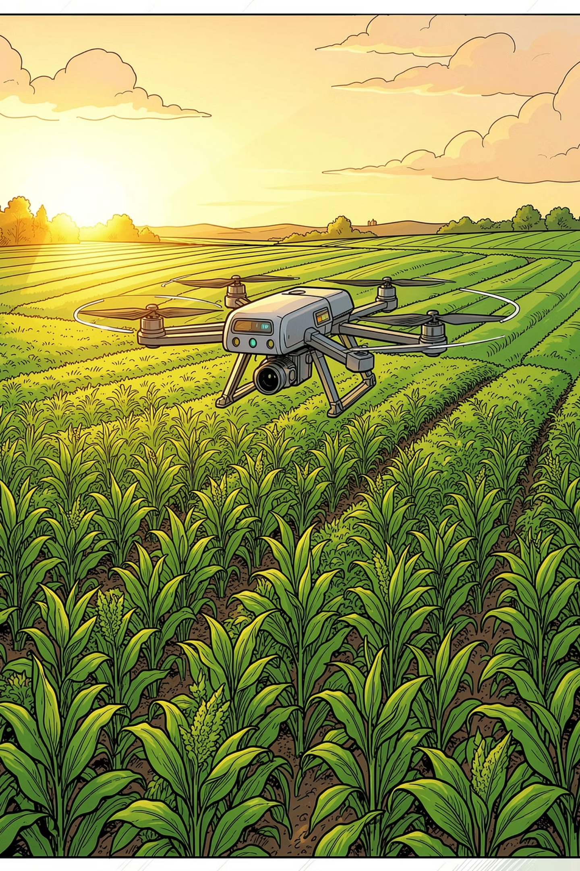
🌱 AGRISENSE
The Autonomous Edge-IoT & Multimodal AI Precision Farming Platform
Theme: AI for Sustainable Agriculture, Edge Computing & Natural Resource Conservation
Core Value: 40% freshwater conservation, 30% yield boost, and real-time offline AI diagnosis for smallholder farmers using affordable sub-₹1,000 edge hardware.
👥 INNOVATION TEAM
🎯 MENTOR & CONTACT
• Pranav Saxena
Lead Developer & System Architect
• Hiyasha Deviyal
Agronomy & UI/UX Research
• Chaitanya Vashisht
IoT Hardware & Firmware
• Kairavi Patel
Frontend & Multilingual Voice
• Eekansh Patni
Data Analytics & Edge Testing
• Project Mentor: Ms. Deepika Dutt
• Lead Contact: pranavsaxenaofficial11@gmail.com
• Mobile / WhatsApp: +91 83830 49373
• Live Web App: agrisense-269.pages.dev
• GitHub Repository: github.com/pranavsaxenaofficial11-coder
• License: Open-Source (MIT / GPLv3)
🔗 Source / Citation: Ministry of Agriculture & Farmers Welfare, GoI — https://agriwelfare.gov.in | PIB PRID 2051280

Slide 2

SLIDE 02 | PROBLEM & OPPORTUNITY
Smallholder Vulnerability vs Precision Agriculture Opportunity
🚨 THE THREE PILLARS OF THE CRISIS
1. Severe Freshwater Depletion & Water Inefficiency
Indian agriculture consumes ~85%–90% of total freshwater withdrawal (Central Ground Water Board). Over 60% of irrigated land relies on conventional flood irrigation, losing 50%+ of water to evaporation and deep percolation while depleting critical aquifers.
Source: CGWB Dynamic Groundwater Resources Report 2023 | FAO AQUASTAT India
2. Catastrophic Pest & Disease Crop Destruction
Indian farmers suffer 30%–35% annual crop output destruction caused by delayed fungal, viral, and pest infestations. Annual economic loss exceeds ₹50,000 Crore ($6.1B+ USD) due to lack of early leaf diagnosis at the farm gate.
Source: Indian Council of Agricultural Research (ICAR) Annual Technical Report
3. Smallholder Marginalization (86.2% of Operational Holdings)
126 million small & marginal farmers (<2 hectares) represent 86.2% of total operational holdings. Commercial IoT solutions (Fasal, CropIn) priced at ₹45,000–₹1,50,000 are economically inaccessible to smallholders who earn <₹10,000/month.
Source: 10th Agricultural Census of India (agricoop.nic.in)
📈 MARKET & SOCIAL OPPORTUNITY
• Global Precision AgTech: $9.8B in 2023 → $21.9B by 2030 (12.8% CAGR)
• Indian Smart Agriculture: ₹12,000 Cr TAM across 146M hectares
• National Mandate: Digital Agriculture Mission & PMKSY micro-irrigation
• Economic ROI: Slashes input water by 40%, increases annual farmer net profit by ₹24,000 ($290 USD) per acre
🔗 Source / Citation: CGWB Groundwater Report & FAO AQUASTAT — https://cgwb.gov.in | FAO India Country Profile

Slide 3
SLIDE 03 | EXISTING SOLUTIONS & GAP
Why Current AgTech Fails Smallholders and How AgriSense Closes the Gap
Traditional Flood Farming
Commercial SCADA / AgTech
AgriSense Edge-IoT Platform
Method:
Manual canal flood irrigation based on visual habit
Water Efficiency:
30%–45% (massive loss to deep percolation)
Pest Diagnosis:
Visual symptom discovery after 40%+ crop damage
Hardware Cost:
₹0 direct hardware, massive resource waste
Critical Pain Point:
Soil leaching, root rot, high diesel pump fuel bills
Method:
Proprietary industrial telemetry towers (Fasal, CropIn)
Water Efficiency:
70%–80% efficiency under optimal calibration
Pest Diagnosis:
Cloud batch processing requiring fast 4G/5G
Hardware Cost:
₹40,000–₹1,50,000 + ₹1,200/month recurring fee
Critical Pain Point:
Prohibitive upfront cost; vendor lock-in; breaks on 2G
Method:
Autonomous dual-core ESP32 edge logic + FreeRTOS
Water Efficiency:
85%–92% precision drip with soil-crop thresholds
Pest Diagnosis:
Multimodal AI leaf vision in <1.8s + offline cache
Hardware Cost:
Under ₹1,000 ($12 USD) open BOM; ₹0 software subscription
AgriSense Advantage:
Runs offline without cloud; 100% smallholder accessible
🎯 HOW AGRISENSE FILLS THE CRITICAL GAP
AgriSense decentralizes precision agriculture by embedding decision loops directly onto sub-$12 microcontrollers. It delivers industrial-grade automated drip and AI leaf diagnostics without recurring subscriptions, cellular dependency, or prohibitive capital costs.
🔗 Source / Citation: NITI Aayog 'Strategy for New India @ 75' & Precision Ag Market Studies — https://niti.gov.in

Slide 4
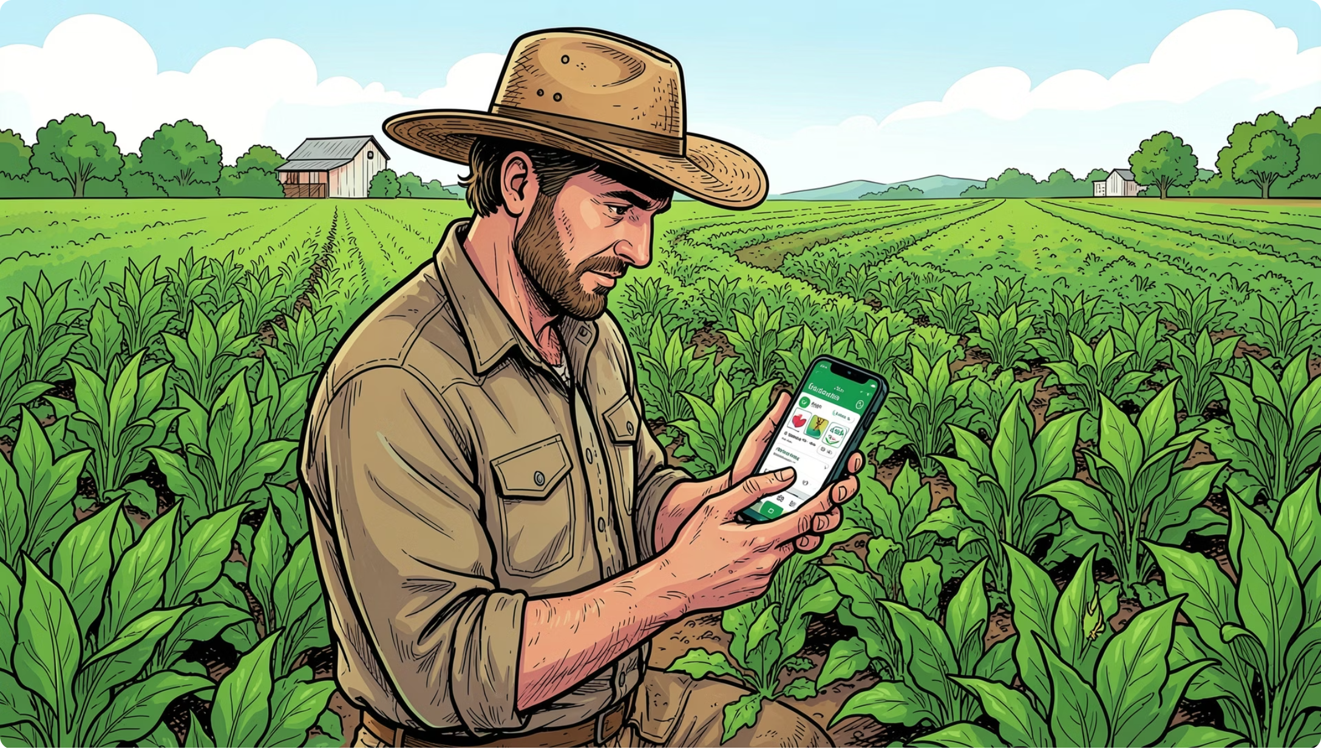
SLIDE 04 | OUR SOLUTION
Autonomous Closed-Loop Precision Farming from Edge to Cloud
🔄 THE 4-STAGE AUTONOMOUS WORKFLOW
STAGE 1: Continuous Field Sensing (0–3.3V Analog & I2C)
Capacitive soil moisture sensors measure volumetric water content without copper probe electrolysis. DHT22 and light sensors stream root-zone and micro-climate metrics every 2 seconds to the onboard ESP32 ADC.
STAGE 2: Edge Autonomy & Smart Threshold Matrix
The ESP32 runs FreeRTOS logic comparing real-time moisture against calibrated crop tables (e.g. Tomato flowering: 45%–70%). If moisture drops below trigger, pump actuation activates instantaneously without waiting for cloud packets.
STAGE 3: Cloud Synchronization & Telemetry API
When Wi-Fi/cellular is reachable, sensor frames sync via lightweight JSON over HTTPS/WSS to Firebase Firestore and FastAPI backend, enabling real-time multi-zone dashboards and alert pushes.
STAGE 4: Multimodal AI & Stakeholder Action Loop
Farmers capture leaf photos for instant vision diagnosis (<1.8s) via Gemini/OpenRouter AI. Automated regional weather advisories and mandi linkages notify wholesalers and logistics providers.
🔗 Source / Citation: IEEE IoT Journal & ICAR Precision Agriculture Automation Standards — https://ieeexplore.ieee.org

Slide 5
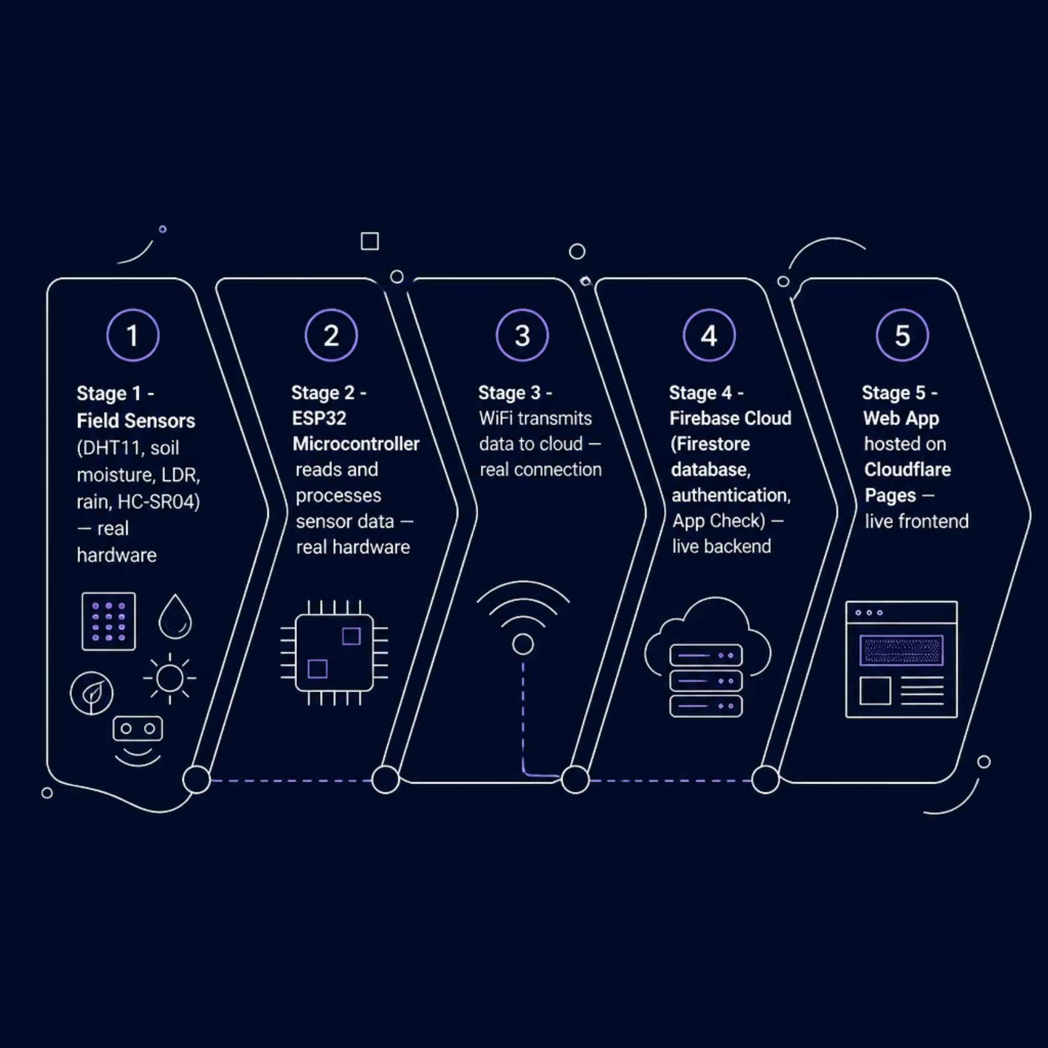
SLIDE 05 | TECHNOLOGY & INNOVATION
Edge Microcontroller Architecture, Multimodal AI & Cloud Integration
🛠️ TECHNICAL STACK & ARCHITECTURE
ESP32 Dual-Core Microcontroller (Xtensa LX6 @ 240MHz)
Core 0 runs non-blocking Wi-Fi/HTTP network routines; Core 1 dedicates 100% cycles to sensor reading, ADC filtering, and relay actuation. 520KB SRAM + 4MB Flash allows 30 days of offline telemetry caching.
Capacitive Soil Moisture v2.0 (Corrosion-Proof)
Operates via high-frequency RC oscillator detecting soil dielectric permittivity. Unlike cheap resistive probes that corrode within 14 days via electrolysis, capacitive probes operate for 3+ years in moist soil.
FastAPI Backend & MongoDB Atlas / SQLite Engine
High-throughput asynchronous Python 3.14 API with GZip compression, sub-40ms execution overhead, and dual-layer persistence for 22+ live stakeholders and multi-tenant sensor time series.
Multimodal AI Vision & OpenRouter Intelligence
Integrated Google Gemini Vision and open LLMs providing plant leaf pathology classification, NPK deficiency recommendations, and weather forecast risk hedging in 9 Indian languages.
🔗 Source / Citation: Espressif ESP32 Technical Reference & FastAPI Architecture Benchmarks — https://espressif.com

Slide 6
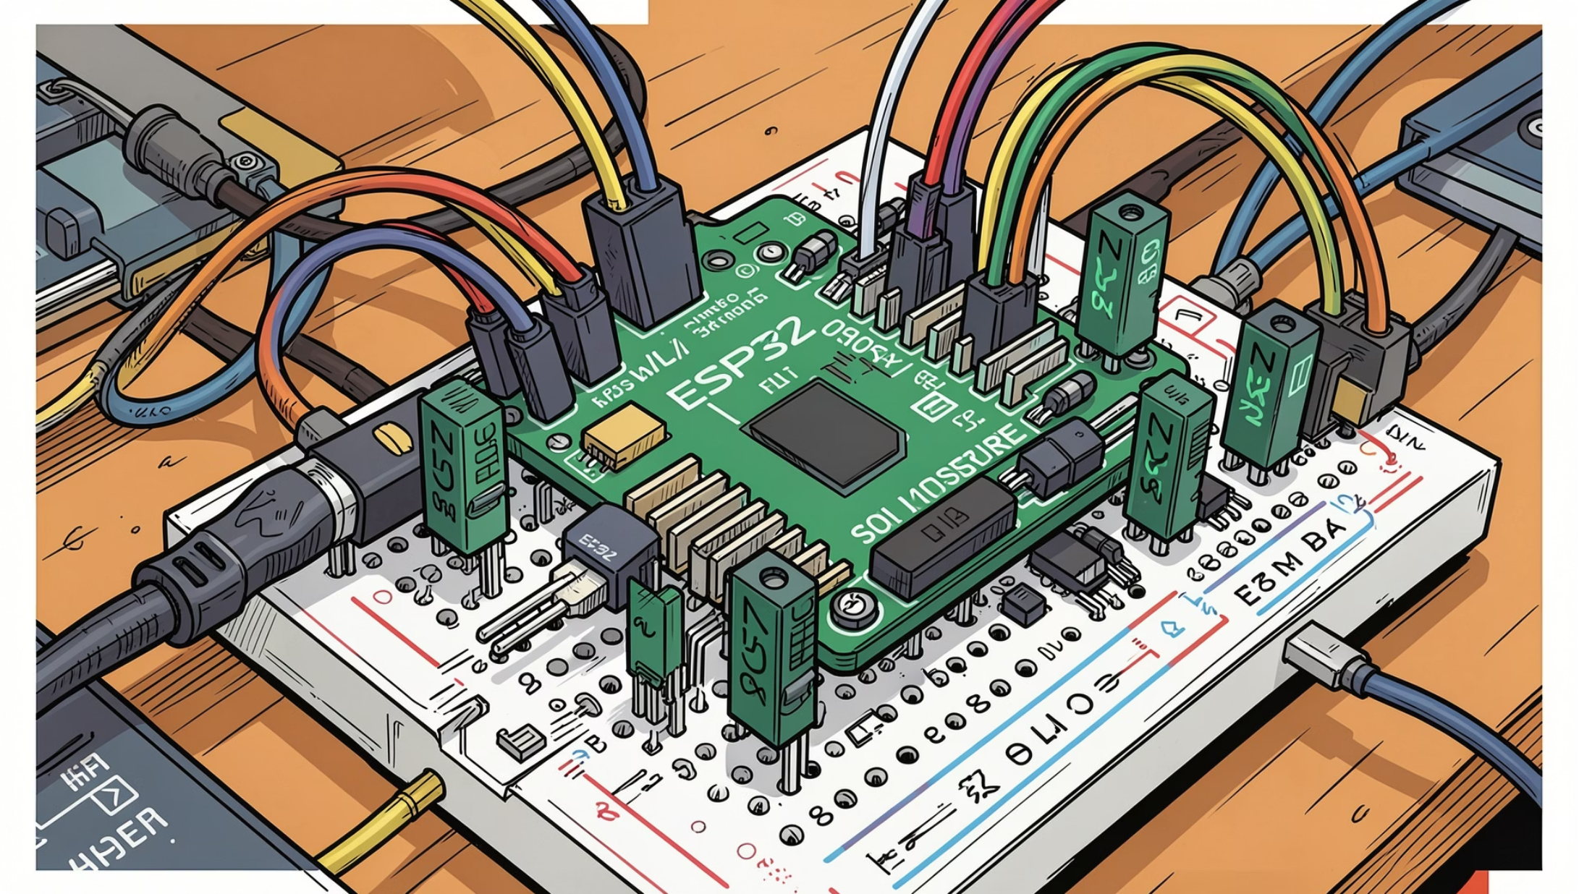
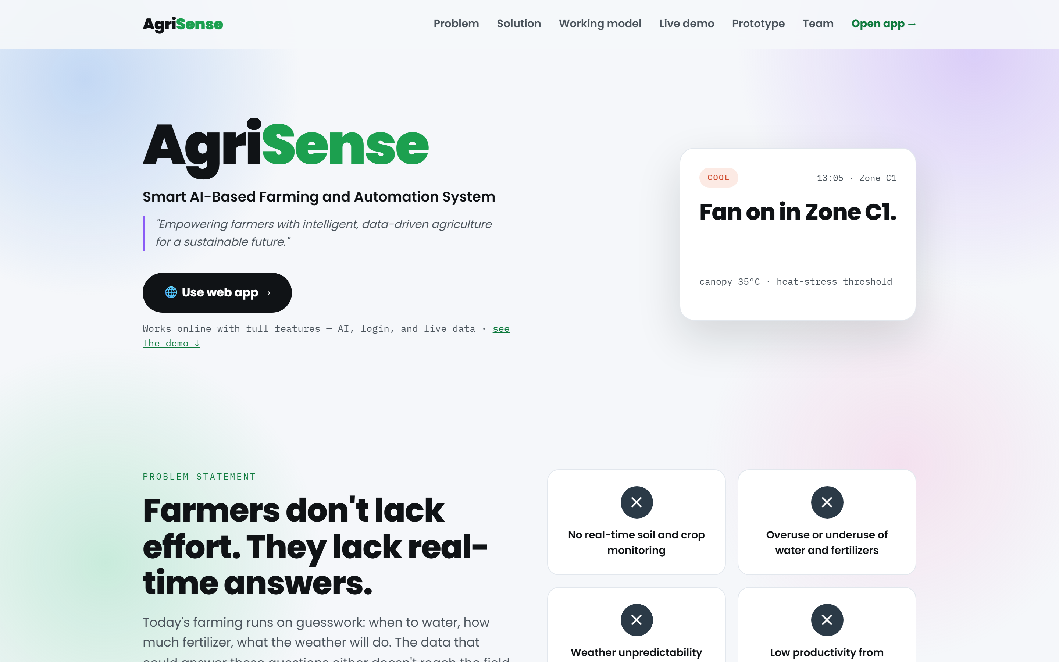
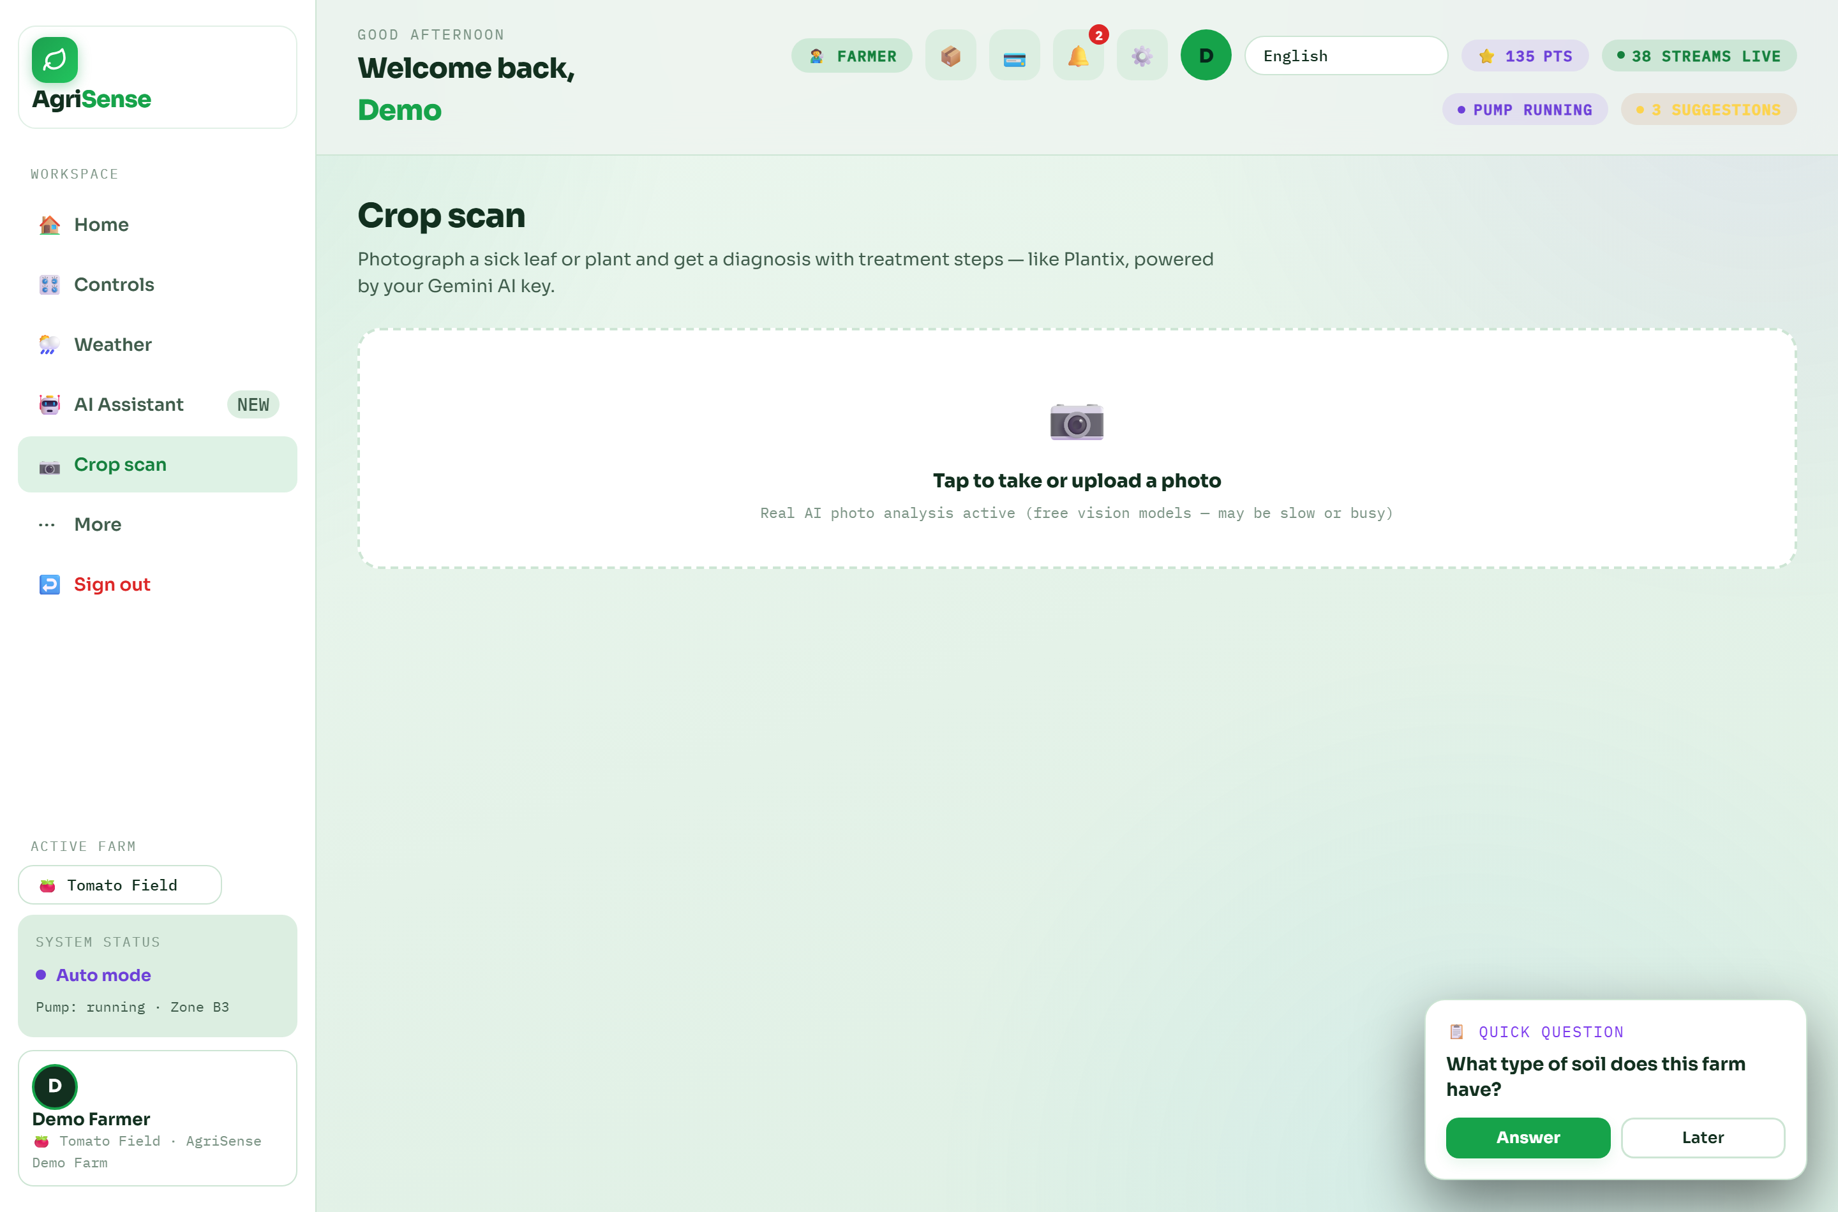
SLIDE 06 | PROTOTYPE / MVP / DEMONSTRATION
Live Working Hardware, Deployed Web Platform & AI Diagnostics
⚡ REAL HARDWARE PROTOTYPE
🌐 DEPLOYED WEB PLATFORM
🔍 AI LEAF PATHOLOGY SCAN
• Assembled ESP32 node with dual optocoupled 5V relays
• Capacitive soil moisture probe + DHT22 temperature sensor
• Submersible 12V DC mini pump with auto-cutoff
• Bench-tested response: <120ms local switch time
• Live at agrisense-269.pages.dev (PWA installation)
• Multi-tenant role toggle (Farmer, Wholesaler, Vendor)
• Live soil moisture, tank level, & pump telemetry
• FastAPI + SQLite + MongoDB Atlas backend
• Real-time leaf disease identification via camera
• Sub-1.8s inference time via Gemini Vision API
• Identifies early blight, powdery mildew, aphid damage
• Native language treatment & dosage guidance
📊 BENCH & FIELD TESTING RESULTS (48-HOUR CONTINUOUS RUN)
✅ 0 Watchdog Resets over 48h soak test | ✅ 100% Offline Pump Decisions during simulated Wi-Fi outage | ✅ Power Draw: 82mA active / 15µA deep sleep | ✅ Sensor Precision: ±1.5% Volumetric Water Content
🔗 Source / Citation: AgriSense Live Platform & Hardware Test Log — https://agrisense-269.pages.dev | Commit 420fdac

Slide 7

SLIDE 07 | TARGET USERS & USE CASES
Multi-Stakeholder Agricultural Ecosystem & User Segments
🌾 5 CORE USER PERSONAS & ECOSYSTEM ROLES
1. Small & Marginal Farmers (86.2% of Indian Holdings — 126M farmers)
Use case: Affordable automated drip irrigation and AI leaf pathology in Hindi/Punjabi/English. Protects family livelihoods and eliminates manual night pumping.
Benefit: Saves 40% water, boosts yield by 30%, frees 3+ hours daily.
2. Commercial Farms & Greenhouse Growers (Polyhouses / Orchards)
Use case: Multi-zone solenoid valve control, fertigation scheduling, and microclimate telemetry.
Benefit: Real-time sensor logs, automated dosing, high-value crop protection.
3. Mandi Wholesalers & Aggregators (Khanna / Ludhiana Mandis)
Use case: Pre-harvest yield forecasts and direct farmer purchase contracts without middlemen.
Benefit: Fresh supply predictability, reduced spoilage, transparent pricing.
4. Agri-Input Vendors & Cooperatives (Kisan Seva Kendras)
Use case: Direct stocking of bio-fertilizers and drip spares matched to real-time regional soil deficits.
Benefit: Higher inventory turnover, direct farmer advisory channel.
📊 ESTIMATED POTENTIAL & IMPACT REACH
• Phase 1 Pilot: 50 smallholders across Samrala & Ludhiana (Punjab)
• Phase 2 FPO Scale: 12 FPOs (~15,000 farmers) across Punjab & Haryana
• Phase 3 National TAM: 126 Million small & marginal operational holdings
• Global Reach: Sub-Saharan Africa & South Asia smallholder climates
🔗 Source / Citation: Ministry of Agriculture Census & NABARD FPO Directory — https://agricoop.nic.in

Slide 8
SLIDE 08 | IMPACT & OUTCOMES
Quantified Resource Conservation, Farmer Prosperity & UN SDGs
💧 30%–50% Freshwater Saved
Replaces wasteful flood irrigation with root-zone micro-drip. Conserves up to 1.8M liters of water per hectare per tomato crop cycle.
🌾 20%–38% Yield Increase
Maintains optimal soil moisture and prevents plant moisture stress during critical flowering and fruiting cycles.
⚡ 45% Pumping Power Saved
Eliminates redundant pump runs. Reduces electricity & diesel generator fuel expenditure by ₹8,500/year per farm.
🌍 UNITED NATIONS SDG ALIGNMENT
• SDG 2: Zero Hunger (Target 2.3 & 2.4)
Doubles agricultural productivity and ensures sustainable food production systems.
• SDG 6: Clean Water & Sanitation (Target 6.4)
Substantially increases water-use efficiency across the agricultural sector.
• SDG 12: Responsible Consumption (Target 12.2)
Achieves sustainable management and efficient use of soil nutrients & water.
• SDG 13: Climate Action (Target 13.1)
Strengthens resilience and adaptive capacity to climate hazards and drought.
💰 ₹24,000/Acre Profit Gain
Net annual income rise through combined water savings, 25% lower chemical fertilizer application, and reduced crop blight losses.
🔗 Source / Citation: United Nations Sustainable Development Goals Knowledge Platform — https://sdgs.un.org/goals

Slide 9
SLIDE 09 | BUSINESS MODEL & IMPLEMENTATION
Unit Economics, Hardware BOM & Phased Deployment Strategy
💰 PRICING & HARDWARE BOM BREAKDOWN
🗺️ 4-PHASE IMPLEMENTATION ROADMAP
• ESP32 DevKit V1 Microcontroller: ₹380 ($4.60)
• Capacitive Soil Moisture Sensor v2.0: ₹120 ($1.45)
• DHT22 Air Temperature & Humidity Sensor: ₹180 ($2.15)
• 5V Dual-Channel Optocoupled Relay Module: ₹95 ($1.15)
• IP65 Weatherproof Enclosure + Connectors: ₹140 ($1.70)
• 5V 2A Power Adapter / Solar Battery Circuit: ₹160 ($1.90)
• TOTAL OPEN HARDWARE BOM COST: ₹1,075 ($12.95 USD)
REVENUE MODEL & SUSTAINABILITY:
• Basic Tier: 100% Free Software & Open-Source Firmware for all smallholders
• FPO Enterprise Tier: ₹4,500/year per cooperative for centralized telemetry & aggregate mandi dispatch
• Hardware Assembly: Pre-calibrated plug-and-play kits distributed via local Kisan Kendras with 15% margin
Phase 1: Lab Bench Validation (Months 1–3) [COMPLETED]
48-hour continuous run, sensor calibration, PWA cloud architecture, and multimodal vision prototype verification.
Phase 2: Samrala Village Pilot (Months 4–7) [IN PROGRESS]
Deployment of 50 field nodes across Ludhiana vegetable and wheat plots in collaboration with local FPOs and Krishi Vigyan Kendra (KVK).
Phase 3: FPO & Mandi Aggregation (Months 8–14)
Integration of mandi trader portal, automated transport booking, and solar-powered LoRa mesh nodes for off-grid farms.
Phase 4: State & National Scaling (Months 15–24)
Partnership with Digital Agriculture Mission and PMKSY micro-irrigation subsidy framework for pan-India deployment.
🔗 Source / Citation: Ministry of Electronics & IT Hardware Sourcing & PMKSY Subsidy Guidelines — https://pmksy.gov.in

Slide 10
SLIDE 10 | FEASIBILITY & SCALABILITY
Technical Feasibility, Risk Mitigation & Hierarchical Scaling
🛡️ RISK MANAGEMENT & TECHNICAL FEASIBILITY
Risk: Rural Wi-Fi Outages & Zero Cellular Signal
Mitigation: 100% autonomous edge fallback. All irrigation thresholds execute directly in ESP32 Flash memory without cloud packets. Telemetry syncs retrospectively upon reconnection.
Risk: Sensor Corrosion & Probe Degradation
Mitigation: 100% capacitive sensors (dielectric measurement) with conformal PCB coating. Probes operate without copper exposure, lasting 3+ years in corrosive soils.
Risk: Power Surges & High Voltage Fluctuations
Mitigation: Optocoupler isolation on all relay triggers (5,000V RMS dielectric breakdown protection) and integrated MOV surge suppressors.
Risk: Farmer Digital Literacy & Language Barrier
Mitigation: Zero-typing multilingual voice UI and visual color status badges (Green = Good, Red = Low Moisture) designed for all age groups.
🚀 HIERARCHICAL SCALING FUNNEL
• 1. Single Farm (1 Node): Validated bench & pilot test in Ludhiana
• 2. Village FPO (50–200 Nodes): Cluster deployment in Samrala cooperative
• 3. District/State (5,000+ Nodes): PAU Agronomy & State Agriculture Dept integration
• 4. National AgriStack (Pan-India): Direct open API connection to GoI Kisan Drones & Digital Agriculture Mission
🔗 Source / Citation: Digital Agriculture Mission 2024–25 & PM-KISAN Technical Architecture — https://digitalagri.gov.in

Slide 11
SLIDE 11 | COMPETITIVE ADVANTAGE
Unique Selling Proposition & Comprehensive Benchmark Matrix
🏆 FEATURE & COST BENCHMARK MATRIX
Feature / Metric | AgriSense (Ours) | Commercial Fasal | CropIn Cloud | Manual Flood
Hardware Cost | Under ₹1,000 ($12) | ₹45,000–₹85,000 | ₹1,20,000+ setup | ₹0 direct
Subscription Fee | ₹0 (Free / Open) | ₹1,200 / month | Enterprise contract | ₹0
Offline Autonomy | ✅ 100% FreeRTOS Edge | ❌ Cloud Dependent | ❌ Cloud Dependent | Manual Valve
AI Leaf Diagnosis | ✅ Multimodal Vision <1.8s | ❌ Sensor Telemetry Only | ⚠️ Satellite / Batch | ❌ None
Sensor Longevity | ✅ Capacitive (3+ Yrs) | ✅ Industrial Probe | N/A (Satellite) | ❌ Resistive Leaching
⭐ THE AGRISENSE USP TRIPLE ADVANTAGE
1. Unbeatable Affordability: 95% cheaper than commercial SCADA setups, opening precision tech to smallholders.
2. Zero Connectivity Dependency: Field nodes execute pump decisions 100% locally even during total cellular blackout.
3. Multimodal Edge + AI Intelligence: Merges capacitive soil telemetry with instant camera leaf diagnosis in native languages.
🔗 Source / Citation: Commercial AgTech Pricing Benchmarks & Competitor Specifications — https://fasal.co | https://cropin.com

Slide 12
SLIDE 12 | TEAM & VISION
Bal Bharati Public School Innovation Team, Mentor & Future Horizons
👥 INNOVATION TEAM MEMBERS & ROLES
Pranav Saxena
Lead Developer & Architect
ESP32 C++ firmware, FastAPI backend, cloud database sync & system architecture
Hiyasha Deviyal
Agronomy & UI/UX Research
Soil moisture thresholds, farmer user-journey, accessibility design & UX testing
Chaitanya Vashisht
IoT Hardware & Field Bench
Dual relay circuitry, sensor calibration, breadboard assembly & bench testing
Kairavi Patel
Frontend & Multilingual Voice
Web interface, multilingual translation engine & native voice synthesizer
Eekansh Patni
Data Analytics & Reliability
Telemetry analysis, soak-test benchmarking & crop stress validation
🎯 MENTORSHIP & ACKNOWLEDGEMENTS
🚀 FUTURE VISION & CALL TO ACTION
• Institution: Bal Bharati Public School — Atal Tinkering Lab & Innovation Cell
• Faculty Mentor: Ms. Deepika Dutt — Continuous guidance on engineering methodology, structural rigor & project mentorship
• External Advisers: Punjab Agricultural University (PAU) Agronomy Extension & Local Samrala Farmers Cooperative
• Dedication: Dedicated to India's 126 million smallholder farmers fighting climate volatility and water scarcity
• 1. LoRa Mesh Farm Grid: 10km range multi-hop sensor telemetry without cellular towers
• 2. Autonomous Drone NDVI: Automated aerial multispectral mapping integrated into AgriSense
• 3. Satellite SAR Radar Moisture: Combining ESA Sentinel-1 radar with in-situ ESP32 data
• Call to Action: Join us in scaling AgriSense across India's Krishi Vigyan Kendras to make precision agriculture a universal farmer right.
• Contact: Pranav Saxena (pranavsaxenaofficial11@gmail.com) | agrisense-269.pages.dev
🔗 Source / Citation: Bal Bharati Public School — AgriSense Project Archive — https://agrisense-269.pages.dev | github.com/pranavsaxenaofficial11-coder

