Slide 1
Aspect Based Job Review Analysis
Guided By
Prof. Ansamma John
Prof. H A RahulNath
Submitted By
Muhammed Huvais
Pranav A Shenoy
Vysakh V

Slide 2
Overview
Introduction
Motivation
Literature Review
Proposed Work
Scraper and Aspect Extraction
Dataset Preparation
Sentiment Analysis
Results
Objective Achieved
Limitations
Conclusion
Future Work
References

Slide 3
Introduction
Sentiment Analysis computationally identifies and categorizes opinions expressed in a piece of text, in order to determine whether the writer's attitude is positive, negative, or neutral.
Aspect based sentiment analysis(ABSA) classifies a sentence to an aspect followed by computing its polarity.

Slide 4
Motivation
Number of Job reviews for some companies could be in thousands
Reading all reviews for understanding the company is very difficult
Analysing the reviews and computing aspect wise polarity for a company will give a detailed overview to the user, thus helping people to understand a company without reading all reviews.

Slide 5
Literature Review
Hu and Liu,2012, classified aspects using frequency counts,phrase counts, training models with labeled dataset
Polarity were analysed using machine learning algorithms like naivebayes with unigrams as features

Slide 6
Proposed Work
The proposed work is to analyse all reviews of a company and graphically display the polarity for each aspects
An overall polarity should also be computed
There are two models for aspect classification :Lexical Approach and Naive Bayes model
There are two models for computing the polarity: Naive Bayes model and Support Vector Machine
The above two models use unigram and bigrams as features

Slide 7
Flow Chart
Scraper
Aspect Extraction
Preprocessing
Lexical Approach
Aspect Classifier
Naive Bayes Approach
NB (BG)
SVC
(BG)
NB (UG)
SVC
(UG)
NB (BG)
SVC
(BG)
NB (UG)
SVC
(UG)

Slide 8
Scrapper
Scraped reviews from indeed.com
Sample url : https://www.indeed.co.in/cmp/Samsung/reviews?fcountry=ALL&start=0
BeautifulSoup module is used for extracting reviews from html code
Pagination is also implemented.The ‘start’ value in the url is incremented by 20 for each page.
List of companies are stored as JSON in a file
HTML tags are removed after scraping
Reviews stored in files with directory name as that of company
Notes:
Initially page count are accessed

Slide 9
Aspects
There are six aspect and a general category.
The six aspects :Learning, Salary, Management, Work-Life Balance, Culture, Infrastructure.
An aspect contains a pool of words.Eg: Salary aspect includes ‘bonus’, ‘hike’, ‘promotion’, ‘incentive’, ‘compensation’, ‘rewards’
To improve the model, a Word2Vec model is used which gives similar words corresponding to words in each aspects.
Word2Vec increases pool of words for each aspects
If a sentence doesn’t belong to any of the above aspects, it is considered to be in general category.

Slide 10
Aspect Extraction
Reviews are tokenized to word using word_tokenizer of nltk module.
POS tagging is used to retrieve all nouns.
Count of each nouns are taken.
Words having high counts are analysed and aspects are decided.
Aspects are stored in a file with the name of aspect as that of file name

Slide 11
Dataset Preparation(1/5)
Required Format
There are 7 directories(6 aspect + 1 general)
Each aspect contains five files :neg, sli_neg, neutral, sli_pos, pos
Filename indicates polarity of sentences within it.
Dataset should contain only valid words
There should not be any stopwords

Slide 12
Dataset Preparation(2/5)
The steps are:
Preprocessing
Aspect Sentence Classifier
Lexical Model
NaiveBayes Classifier
Analysing polarity of each sentence and storing it in corresponding file.
Notes:
If we had preprocessed before classification, we would have lost punctuations ….
dictionary was used before, stemmed words cannot be stored

Slide 13
Dataset Preparation(3/5)
Preprocessing
The reviews are split into sentences based on words like ‘and’, ‘but’ and punctuation like ‘.’ .
Each sentence is split into words using regular expression ([a-zA-Z]+) .
Stopwords are removed
Words are passed to enchant dictionary which removes all non-english words.
The words are stemmed

Slide 14
Dataset Preprocessing(4/5)
Aspect Sentence Classifier-Lexical Approach
Each word in the pool of words corresponding to each aspects is compared with all words of sentence
If any word is present, the sentence belongs to the corresponding aspect.
If the word count for each sentence is greater than 1, the words are joined to form sentence which is preprocessed.

Slide 15
Dataset Preprocessing(5/5)
Aspect Sentence Classifier-NaiveBayes Approach
Features are unigram.
60,000 reviews are preprocessed and trained.
The trained model is saved in a file using pickle module in python.
The test set =10,000
accuracy-> 75.16%

Slide 16
Sentiment Analysis(1/4)
Five classes are there for classifying: neg, sli_neg, neutral, sli_pos, pos
There are two models
NaiveBayes Classifier
Feature = Unigram
Size of feature = 6544
Entire vocabulary has been used as feature
Size of train Dataset = 1,91,378
Size of test Dataset = 10,000
Most Informative Feature :horribl, terribl, good, best
Accuracy = 73.91%

Slide 17
Sentiment Analysis(2/4)
NaiveBayes Classifier
Feature = Bigram
Bigram counts are analysed and a threshold is fixed.threshold count= 10
Size of feature = 10863
Two stemmed words are combined
Size of train Dataset = 1,91,378
Size of test Dataset = 10,000
Most Informative Feature :(great place),(experi good)....
Accuracy = 76.15%

Slide 18
Sentiment Analysis(3/4)
Support Vector Classifier
Feature = unigram
Size of feature = 6544
The features are vectors of vocabulary.Value is 1 If a word is present, 0 otherwise
Sparse matrix representation is used to save memory and execution time
Size of train Dataset = 50,000
Size of test Dataset = 15,000
Accuracy = 87.44%

Slide 19
Sentiment Analysis(4/4)
Support Vector Classifier
Feature = bigram
Size of feature = 10863
The features are vectors of vocabulary.Value is 1 If a word is present, 0 otherwise
Sparse matrix representation is used to save memory and execution time
Size of train Dataset = 50,000
Size of test Dataset = 15,000
Accuracy = 69.99%

Slide 20
Result(1/6)
Required Result : A graph representing the corresponding values of each aspect for a particular company.
Reviews of Samsung is fetched from indeed.com
The reviews are split into sentences and preprocessed, which removes stopwords, non-english words.
Each words are stemmed
Aspect of each sentence is obtained using lexical approach and naivebayes approach.

Slide 21
Result(2/6)
The polarity of each sentence is computed using different models and added to the polarity of corresponding aspect.
The average polarity of individual aspects are computed and displayed.
Overall polarity is computed by taking average polarity of all the 7 aspects.

Slide 22
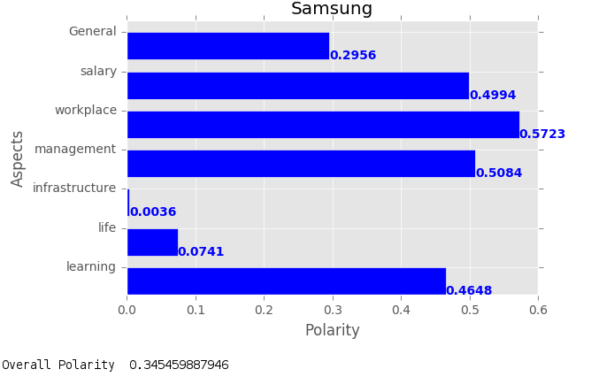
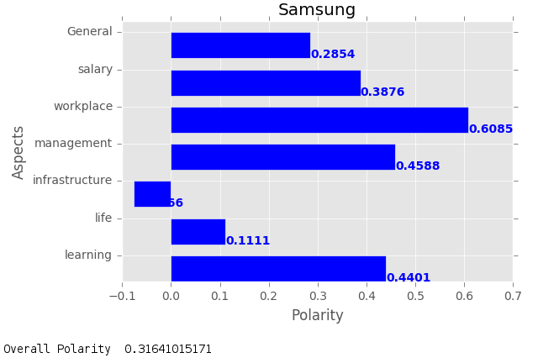
Result(3/6)
NaiveBayes Classifier(Unigram) - (Aspect Classifier Lexical Approach: Left and NaiveBayes: Right )

Slide 23
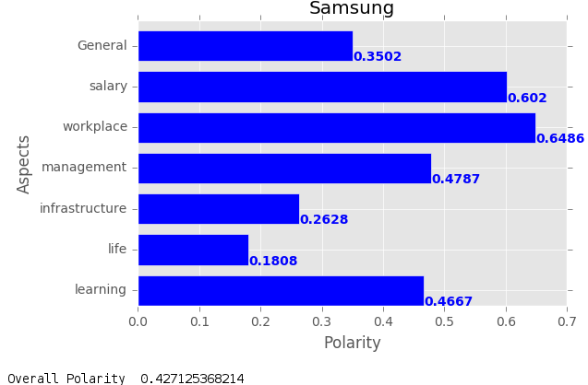
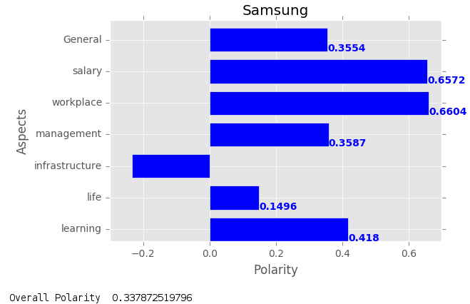
Result(4/6)
NaiveBayes Classifier(Bigram) - (Aspect Classifier Lexical Approach: Left and NaiveBayes: Right )

Slide 24
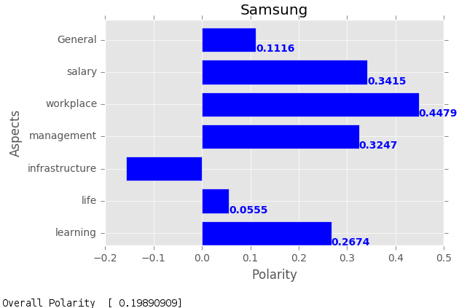
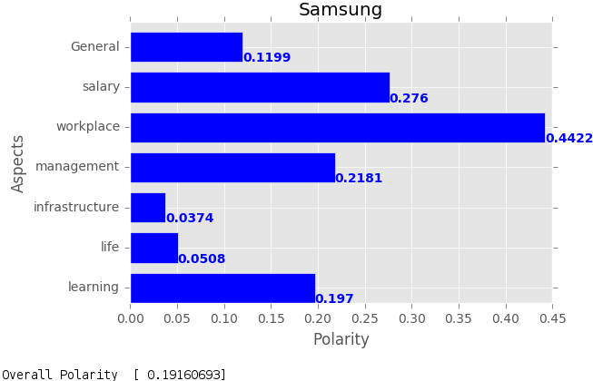
Result(5/6)
SVC(Unigram) - (Aspect Classifier Lexical Approach: Left and NaiveBayes: Right )

Slide 25
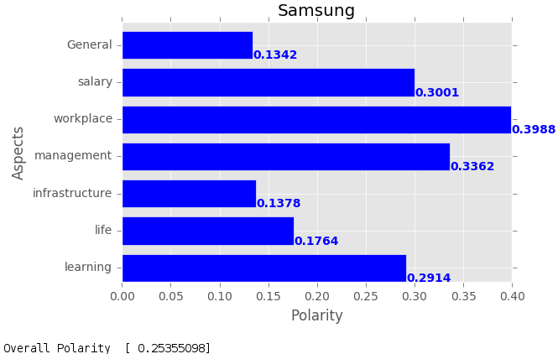
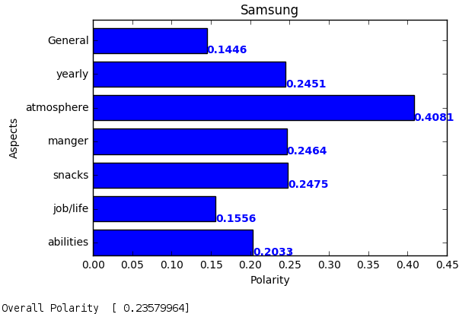
Result(6/6)
SVC(Bigram) - (Aspect Classifier Lexical Approach: Left and NaiveBayes: Right )

Slide 26
Objective Achieved
Implemented aspect classification using Lexical and NaiveBayes approach.
Implemented sentiment classification using NaiveBayes and SVC.

Slide 27
Limitations
Since the dataset is large, training process is slow and requires more memory
The number of sentences for each labels is non-uniform
Executing all reviews of a company for computing result is taking more time

Slide 28
Conclusion
This project has trained multiple models with different set of features.
Implemented and analysed all models based on reviews of a company.
Two machine learning algorithms have been implemented using unigram and bigrams as features
Aspects have been analysed using Naive Bayes and Lexical approach.

Slide 29
Future Work
To implement an algorithm which also considers the sequence of words.
To fetch reviews of a company and compute polarity for each aspect using a user interface.
Analysing individual sentence to make dataset more accurate

Slide 30
References
Aspect Based Sentiment Analysis in Reviews, by Satarupa Guha Guha, Aditya Joshi, Vasudeva Varma,4th Joint Conference on Lexical and Computational Semantics,2015.

