Slide 1

PercEF: Exploiting Empirical Percentiles for Adaptive HNSW Search Beyond the Gaussian Assumption
Project review · Department of Computer Science and Engineering, PES University
Pranav.N.Shenvi (PES1UG23CS912) · M.G.Shrivardhan Swaroop (PES1UG23CS334)
Megha H Shah (PES1UG23CS354) · Kiran Hombal (Alumnus, PhD at UIUC)
Guide: Dr Shylaja S S, Centre Director for CCBD/CDSAML
Notes:
(0:05) Hi, we are [team]. Our project is PercEF: making adaptive vector search work when the data is not bell-shaped.

Slide 2
Background: vector search and HNSW
Vector search. Text, images and audio are turned into vectors (embeddings); similar items get nearby vectors. A query is answered by finding its nearest vectors.
Why it matters. Semantic search, recommendations and retrieval for LLMs (RAG) all run on it.
Why an index. Comparing a query with millions of vectors is too slow, so an index searches only a small part of the data and returns approximate neighbours.
HNSW. A layered graph: the search enters at the sparse top layer, moves towards the query and drops down a layer at a time.
ef. How many candidates the bottom-layer search keeps. Larger ef: more accurate, but slower.
Layer 2: few nodes
entry
Layer 1
Layer 0: every vector
ef candidates
query
Notes:
(0:12) Vector search finds the items closest to a query among millions of embeddings. To be fast, an index like HNSW walks a layered graph from the top down. A setting called ef decides how many candidates the search keeps: more is more accurate, but slower.

Slide 3
One ef for every query does not fit
Vector databases answer a query with an HNSW graph search. One setting, ef, decides how much of the graph each search explores; most systems use the same ef for every query.
Easy query
Hard query
Goal
Finds its neighbours with a small ef.
A large shared ef wastes work on it.
→ over-searching
Needs a large ef.
A small shared ef leaves it short of its neighbours.
→ under-searching
Choose ef per query: meet the target recall (95%), help the worst queries, and cost no more than one well-tuned ef.
Recall = share of a query's 100 true nearest neighbours that the search finds.
Notes:
(0:08) Most systems use one ef for every query. Easy queries waste work, and hard queries miss some of their neighbours.

Slide 4
Existing work: two ways to adapt ef
Learned early termination
Distribution-aware: Ada-ef
LAET (SIGMOD 2020), DARTH (SIGMOD 2026)
• A trained model watches each search and predicts when the target recall is reached
• Needs training data and a model per dataset
• Model calls run inside every search
Zhang & Miller, SIGMOD 2026
• Models a query's similarities to the data as a bell curve (central limit theorem)
• A short probe scores how hard the query is; a table maps score to ef
• No training; claims to meet a target recall while avoiding under- and over-searching, and up to 4x lower latency than learned methods
Our question: does Ada-ef's bell-curve assumption hold on real data?
Notes:
(0:08) Existing fixes either train a model per dataset, like DARTH, or, like Ada-ef from SIGMOD 2026, assume that a query's similarities follow a bell curve.

Slide 5
Ada-ef assumes a bell curve
Database mean and covariance
Predicted bell curve of similarities, per query
5 thresholds at the 0.1–0.5% closest
Probe 1,025 distances; count those under each threshold
Score → ef from a calibrated table
The thresholds come from the bell curve. If the real similarities are not bell-shaped, they sit in the wrong place, and the score can no longer tell easy queries from hard ones.
The gap
Ada-ef's paper states this assumption but never measures it on data. Neither does any other ANN paper we found.
Notes:
(0:08) Ada-ef places its difficulty thresholds using that bell curve. Nobody had checked whether real data is bell-shaped.

Slide 6
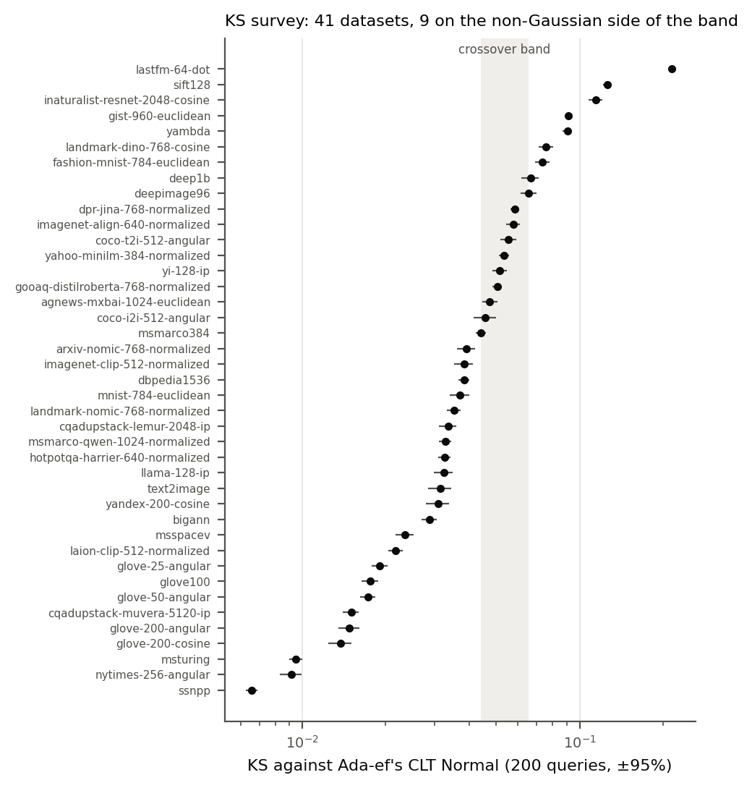
The assumption fails on 9 of 41 datasets
KS statistic: how far each query's similarities are from Ada-ef's bell curve (0 = perfect fit)
Measured on 41 public datasets (ann-benchmarks, Big-ANN, VIBE, Ada-ef's sources)
9 clearly non-Gaussian, including SIFT, GIST, Fashion-MNIST, DeepImage, Deep1B
6 of the 9 are learned embeddings, inside Ada-ef's stated scope
Data type does not predict it: SIFT-1M 0.126 vs SIFT-1B 0.029; Fashion-MNIST 0.073 vs MNIST 0.037
There, Ada-ef stops adapting: on SIFT it gives every query the same ef
Notes:
(0:10) We tested it on 41 datasets. Nine are clearly not bell-shaped, including SIFT and GIST, and you cannot tell from the kind of data. On those, Ada-ef stops adapting.

Slide 7
PercEF: measure the thresholds, don't assume them
Offline, once per dataset
One change
Corpus vectors
Empirical distance percentiles (0.1–0.5%)
Calibrate ef table on 200–2,000 queries
Same mechanism as Ada-ef; only the thresholds come from the data instead of a bell curve.
Online, per query
Probe the first 100 distances
Score: how many fall under each threshold
Look up ef; continue the same search
Works whatever the shape of the similarity distribution
Probe of 100 distances instead of 1,025; the search does not restart after it
No covariance matrix: a few kilobytes instead of up to 9.4 MB
Notes:
(0:10) Our method, PercEF, keeps Ada-ef's design but measures the thresholds from the data's own distance percentiles, with a ten times shorter probe and no covariance matrix.

Slide 8
A seconds-long test picks the method
KS measured on the raw vectors (200 queries, no index needed)
KS ≤ 0.044: near-Gaussian → Ada-ef
band
KS ≥ 0.066: non-Gaussian → PercEF
18 / 19
1 miss
datasets where KS picked the method that ranks queries better
SIFT-1B: KS said Ada-ef, but PercEF ranked better
Every KS prediction was recorded before running the dataset, so the test was checked out of sample.
Notes:
(0:08) A KS test on the raw vectors, which takes seconds, tells you which method to use. It picked the right one on 18 of 19 datasets, with every prediction written down before the run.

Slide 9
What is new
1 First test of the assumption
2 A distribution-free score
Ada-ef's Gaussian model measured on 41 datasets; fails on 9, including 6 learned embeddings.
PercEF: thresholds from the data's own percentiles. No covariance, no training.
3 A cost floor
4 An offline test
Never more than 2.5% costlier than the best fixed ef in hindsight; Ada-ef has no such floor.
KS on raw vectors predicts the better method on 18 of 19 datasets, before any index exists.
Also: an evaluation guide for adaptive search (interpolation bias, timing noise, probe cost), from errors we caught in our own runs.
Notes:
(0:08) So we contribute the first test of this assumption, a distribution-free score, a cost floor, and an offline test.

Slide 10
Setup: Ada-ef's protocol, 20 datasets
20 datasets end to end: text, image, audio, music, CLIP; 60K to 19.6M vectors
HNSW M = 16, efConstruction = 500; k = 100 (1,000 for MS MARCO, Cohere, LAION)
Target recall 0.95; calibration on 200 corpus points (P) or real queries (R)
Ada-ef run through its authors' own code; DARTH through its authors' code
One thread; latency timed in 3 rotated rounds
Metric | Meaning
Mean recall | Average share of the true 100 neighbours found
p1 (worst-case) recall | Recall of the worst 1% of queries: under-searching
Distance computations | Work per query, hardware-independent: over-searching
Latency | Time per query (µs)
Tuned fixed ef | One ef for all queries, picked in hindsight for the same mean recall: the reference
Notes:
(0:05) We followed Ada-ef's own protocol on 20 datasets and compared everything against the best fixed ef.

Slide 11
Non-Gaussian data: better worst-case recall
16 / 16
runs where PercEF ranks queries better than Ada-ef
15 / 16
runs where PercEF's worst-case gain is at least Ada-ef's (the 16th: a tie near zero)
13 vs 1
runs faster than a fixed ef with the same worst case: PercEF vs Ada-ef (of 16)
16 runs = the 8 non-Gaussian datasets x 2 calibration settings
Notes:
(0:10) Each pair of bars is a dataset; longer to the right is better. On the non-Gaussian datasets PercEF ranks queries better in every run and beats Ada-ef's worst case in 15 of 16: on DeepImage by 8.5 recall points, against 4.3. To match that worst case, a fixed ef is slower in 13 of 16 runs.

Slide 12
Within 2.5% of a tuned fixed ef's cost
32 / 34
runs where PercEF does less work than the tuned fixed ef (Ada-ef: 10 / 34)
31 / 34
runs where PercEF is faster than a fixed ef with the same worst-case recall (Ada-ef: 11 / 34)
18 / 18
near-Gaussian runs where PercEF is both cheaper and faster than the fixed ef
At the same mean recall on non-Gaussian data, PercEF's time is within 2.4% of the fixed ef's except DeepImage (7-9% slower): it spends saved work on hard queries, which cost more per distance.
34 runs = 17 benchmarked datasets x 2 settings (3 cross-modal sets left out); work and time measured on all 34
Notes:
(0:10) PercEF does less work than the best fixed ef in 32 of 34 runs, never more than 2.5 percent extra. Matched on the worst case, it is faster than the fixed ef in 31 of 34 runs, and up to 1.8 times faster than Ada-ef. On bell-shaped data it is cheaper and faster in every run; Ada-ef's advantage there is a larger worst-case gain.

Slide 13
Two checks: probe length and DARTH
Ranking quality |ρ| with matched probe lengths
DARTH (learned) vs PercEF, setting R
Dataset | Ada-ef 1,025 | Ada-ef 100 | PercEF 100 | PercEF 1,025
SIFT-1M | 0.04 | 0.03 | 0.45 | 0.40
Deep1B | 0.41 | 0.43 | 0.67 | 0.63
DeepImage | 0.38 | 0.33 | 0.62 | 0.59
SIFT-1B | 0.42 | 0.27 | 0.74 | 0.72
GloVe | 0.80 | 0.62 | 0.61 | 0.76
MS Turing | 0.48 | 0.21 | 0.40 | 0.58
Dataset | p1 gain DARTH | p1 gain PercEF | Time vs fixed DARTH | Time vs fixed PercEF
GloVe | +0.080 | +0.029 | 6% slower | 1% faster
MS Turing | +0.044 | +0.010 | 42% slower | 1% faster
SIFT-1M | +0.048 | +0.028 | 2.3x slower | 0.4% faster
Deep1B | +0.098 | +0.081 | 1.9x slower | 2.4% slower
The advantage comes from the thresholds, not the shorter probe.
DARTH has the best tail but costs time and training; PercEF gets much of the gain at almost no time cost.
Notes:
(0:08) The gain comes from the thresholds, not the shorter probe. The learned method DARTH has a better worst case, but is up to 2.3 times slower.

Slide 14
Tested: our score + Ada-ef's table
Idea: if Ada-ef's better tail on Gaussian data came from its ef table, PercEF's score with that table should match it.
Dataset | p1 gain: PercEF | p1 gain: combined | Combined + WAE: time vs fixed ef | p1 gain: Ada-ef
SIFT-1M | +0.028 | +0.024 | 1.5% slower | 0.000
Deep1B | +0.081 | +0.076 | 2.9% faster | +0.052
DeepImage | +0.088 | +0.073 | 3.7% faster | +0.048
SIFT-1B | +0.056 | +0.056 | 2.7% faster | +0.016
GloVe (Gaussian) | +0.029 | +0.031 | 3.1% faster | +0.073
MS Turing (Gaussian) | +0.013 | +0.012 | 1.3% faster | −0.038
Not adopted: on GloVe the table lifts PercEF only from +0.029 to +0.031, far from Ada-ef's +0.073
Ada-ef's tail edge on Gaussian data needs its own score and its table together
Plain PercEF keeps the best or tied-best worst-case recall on 5 of 6 datasets
Notes:
(hidden slide, skipped when presenting) Tested idea that did not hold: PercEF's score with Ada-ef's table.

Slide 15
Limits and next steps
Limits, stated openly
Next steps
• Near-Gaussian text: Ada-ef gives larger worst-case gains (PercEF still cheaper and faster than the fixed ef)
• Non-Gaussian, same mean recall: PercEF up to 2.4% slower than the fixed ef (DeepImage 7-9%)
• Cross-modal queries (text searching images): neither method adapts
• One failed KS prediction (SIFT-1B)
• Cohere and LAION run as subsets (62 GB RAM)
• Understand why Ada-ef's score and table together win the tail on GloVe
• arXiv preprint and code release
• Submit: PVLDB Experiments, Analysis & Benchmarks track
Notes:
(0:06) On bell-shaped text data Ada-ef gives larger worst-case gains, on DeepImage PercEF is a few percent slower than the fixed ef at the same mean recall, and cross-modal queries remain open.

Slide 16
Measure, don't assume
Ada-ef's bell-curve assumption fails on 9 of 41 datasets. PercEF measures the thresholds instead: better worst-case recall where the assumption fails, never meaningfully costlier than a tuned fixed ef, and a seconds-long test that says which method to use.
Thank you. Questions?
Notes:
(0:05) In short: measure the distribution, don't assume it. Thank you.

