Slide 1



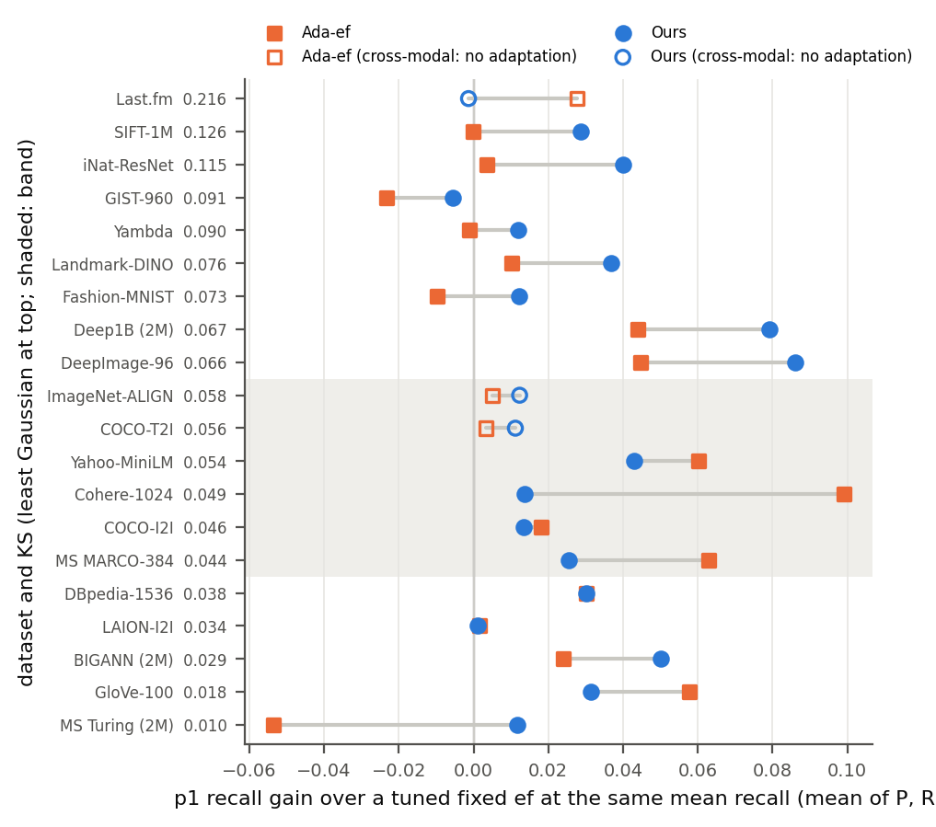
PercEF: Exploiting Empirical Percentiles for Adaptive HNSW Search Beyond the Gaussian Assumption
Center for Data Science and Applied Machine Learning (CDSAML)
Department of Computer Science and Engineering, PES University, RR Campus, Bengaluru-560085
PROBLEM STATEMENT
SYSTEM ARCHITECTURE
RESULTS & DISCUSSION
a) Vector search engines answer every query with the same search breadth (ef) in HNSW. Easy queries waste work; hard queries miss neighbours.
b) Ada-ef (SIGMOD 2026) sets ef per query by assuming each query's similarities to the data are Gaussian. The assumption was never tested. We test it, and fix the method where it fails.
Offline, once per dataset
16/16
Corpus vectors
KS test: are similarities Gaussian?
Percentile bins + calibrated ef table
runs on non-Gaussian data: PercEF's tail recall at least Ada-ef's
Online, per query
Query vector
HNSW probe: first 100 distances
Difficulty score from empirical bins
32/34
OBJECTIVES
runs cheaper than the best fixed ef (Ada-ef: 10/34); never over +2.5%
Measure how often the Gaussian assumption holds on public embedding datasets.
Build a distribution-free difficulty score that works where it does not.
Give a quick offline test that says which method to use.
Compare fairly with Ada-ef and a learned method (DARTH).
Top-k neighbours
Continue the same search at that ef
Look up ef for this query
18/19
PROPOSED METHODOLOGY
datasets where the KS test picks the better method
Tail-recall gain over the best fixed ef, 20 datasets sorted by KS (top: least Gaussian).
DATASET AND FEATURES
a) Approach
Test: KS distance between each query's similarities and Ada-ef's Gaussian (seconds, no index).
Score: Ada-ef's binned score, with thresholds from the data's own distance percentiles.
Calibrate: isotonic fit of true minimum ef to score; no restart after the probe.
b) Constraints and assumptions
Ada-ef's protocol: M = 16, efC = 500, target recall 0.95, one thread.
Small calibration set; Cohere and LAION run as subsets (62 GB RAM).
Limits: on near-Gaussian text embeddings Ada-ef keeps the better tail; neither method adapts when queries come from another modality (text searching images).
41 public datasets surveyed (ann-benchmarks, Big-ANN, VIBE, Ada-ef's own sources).
20 benchmarked end to end: text, image, audio, music and CLIP embeddings; 60K to 19.6M vectors, 65 to 2048 dimensions.
Measured per query: similarity distribution, true minimum ef for 95% recall. Per dataset: KS statistic.
CONCLUSIONS AND FUTURE WORK
a) Ada-ef's Gaussian model fails on 9 of 41 datasets (6 learned embeddings); there PercEF gives better tail recall, at most 2.5% over the best fixed ef.
b) DARTH (learned): best tail, up to 2.3x slower. Next: the SIFT-1B miss, cross-modal queries.
Photo
Photo
Photo
Photo
Photo
Member 1: Name
SRN
Member 2: Name
SRN
Member 3: Name
SRN
Member 4: Name
SRN
Guide: Name
Designation

