Slide 1
Mutual Fund Analytics Capstone Project
Bluestock Fintech
Data Analyst Internship Capstone Project
Prepared by:
Pranav Shinde
B.Sc. Information Technology
July 2026

Slide 2
Project Overview
The Mutual Fund Analytics Capstone Project was developed to analyze mutual fund performance, investor behavior, and portfolio risk using Python, SQL, SQLite, and Power BI. The project covers the complete analytics workflow from data ingestion and cleaning to advanced financial metrics and interactive dashboards, enabling data-driven investment analysis.
Technology Stack
Python
Pandas & NumPy
SQLite
SQL
Jupyter Notebook
Power BI
Git & GitHub

Slide 3
Project Objectives
Analyze mutual fund performance using historical NAV data.
Build a robust ETL pipeline for data ingestion, cleaning, and processing.
Store cleaned data efficiently in a SQLite database.
Perform Exploratory Data Analysis (EDA) to identify investment trends.
Calculate key financial performance metrics such as CAGR, Sharpe Ratio, Alpha, Beta, Sortino Ratio, Maximum Drawdown, VaR, and CVaR.
Develop an interactive Power BI dashboard for visualization.
Build a rule-based mutual fund recommendation system.

Slide 4
Dataset Overview
The project uses ten primary datasets covering mutual fund schemes, NAV history, investor transactions, portfolio holdings, SIP inflows, benchmark indices, and industry statistics.
Dataset | Records | Purpose
Fund Master | 40 | Mutual fund scheme information
NAV History | 46,000 | Historical NAV prices
AUM by Fund House | 90 | Assets under Management
Monthly SIP Inflows | 48 | SIP market trends
Category Inflows | 144 | Category-wise fund inflows
Industry Folio Count | 21 | Industry folio statistics
Scheme Performance | 40 | Performance metrics
Investor Transactions | 32,778 | Investor behaviour analysis
Portfolio Holdings | 322 | Portfolio composition
Benchmark Indices | 8,050 | Market benchmark comparison

Slide 5
ETL Pipeline
ETL Workflow
The ETL (Extract, Transform, Load) pipeline automates the complete data processing workflow. Raw mutual fund datasets are validated, cleaned, transformed, and finally loaded into a SQLite database for analysis and dashboard development.
RAW CSV
Ingestion
Cleaning
Key Features
Automated ingestion
Data cleaning
Missing value handling
SQLite loading
Error validation
SQLite
Analytics
Dashboard

Slide 6
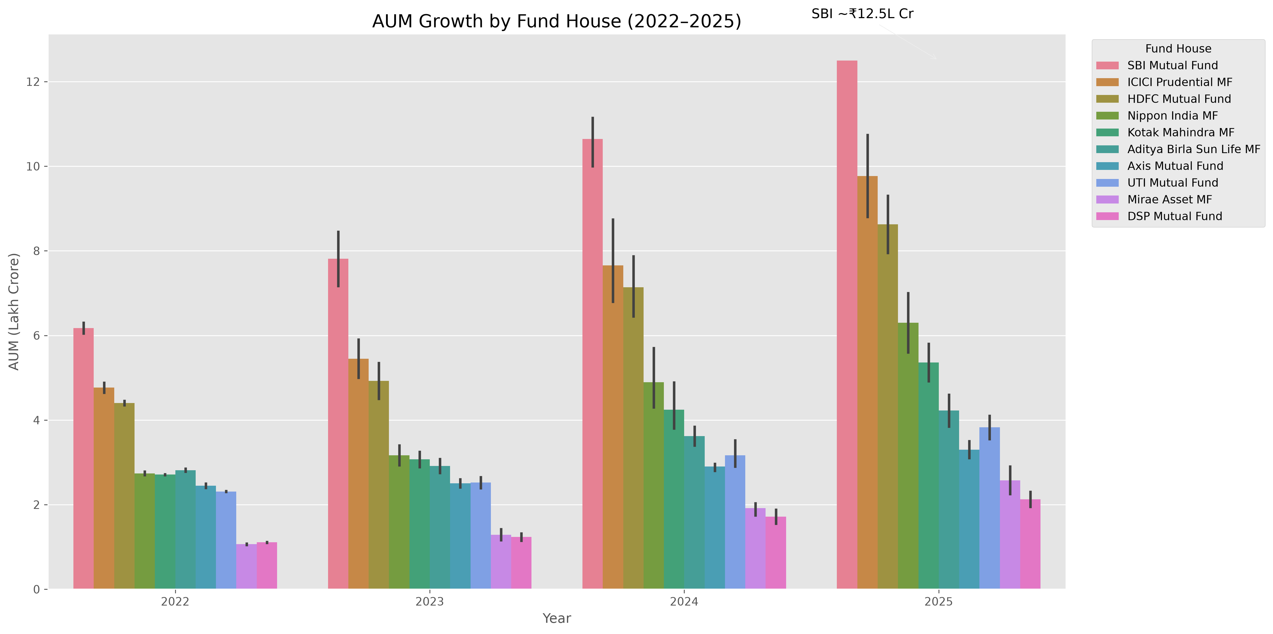
Exploratory Data Analysis (EDA)
Exploratory Data Analysis was performed to identify investment trends, fund growth patterns, investor behaviour, and category-wise inflows using Python and Pandas
AUM Growth by Fund House
Key Insights
Assets Under Management (AUM) increased steadily from 2022 to 2025, indicating consistent industry growth.
Large fund houses such as SBI Mutual Fund, HDFC Mutual Fund, and ICICI Prudential MF maintained higher AUM compared with others.
The upward trend reflects increasing investor confidence and continued inflows into mutual funds.

Slide 7
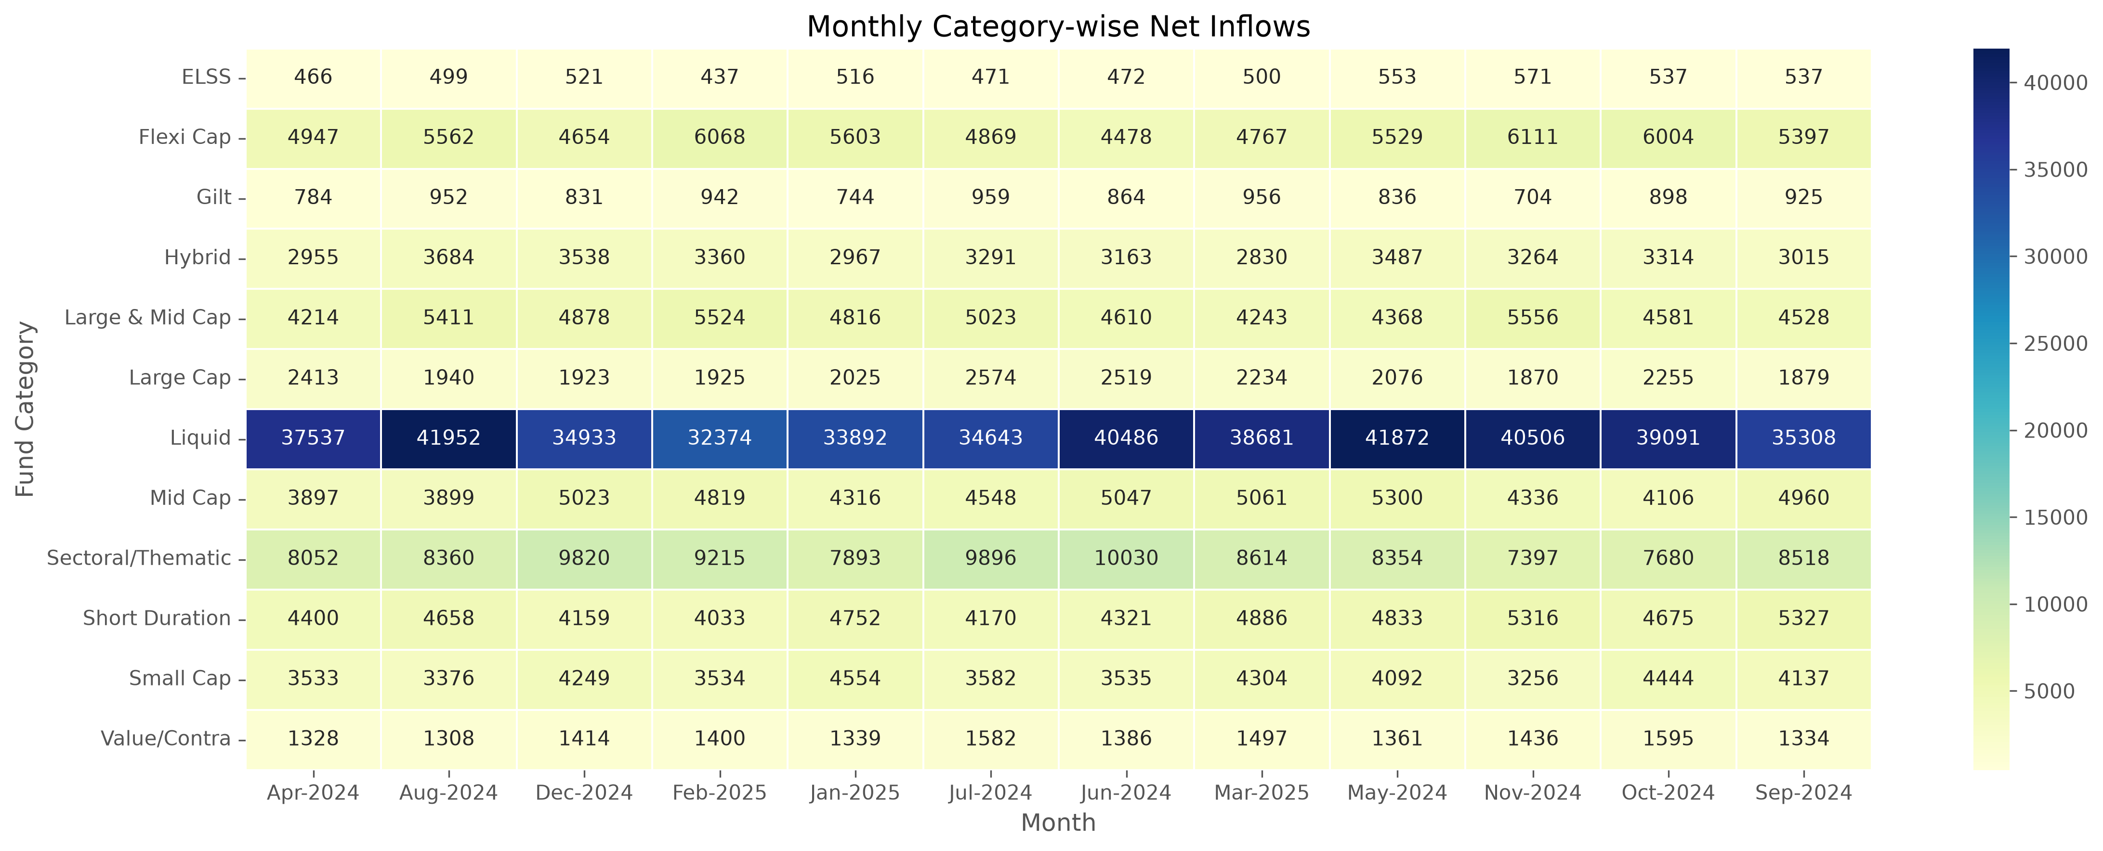
Category-wise Net Inflow Heatmap
Key Insights
Flexi Cap, Mid Cap, and Large & Mid Cap categories recorded comparatively higher net inflows across multiple months.
Category-wise inflows varied over time, showing changing investor preferences.
Most categories maintained positive inflows during the analysis period, indicating healthy market participation.

Slide 8
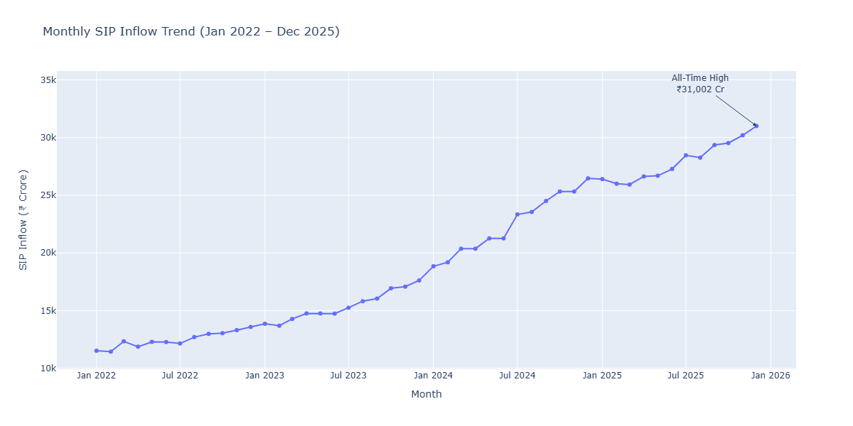
Monthly SIP Inflow Trend
Key Insights
Monthly SIP collections showed an overall upward trend during the study period.
Regular SIP investments indicate growing participation from retail investors.
Consistent SIP inflows demonstrate increasing long-term investment discipline.

Slide 9
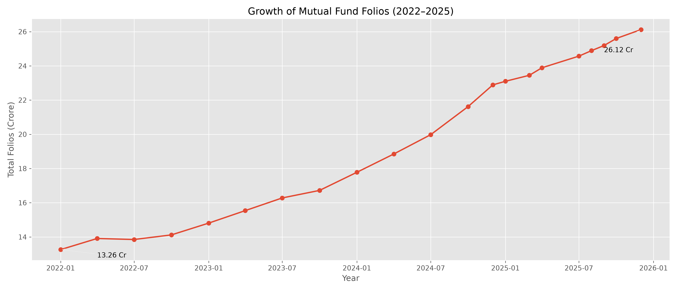
Industry Folio Growth
Key Insights
Total mutual fund folios increased steadily between 2022 and 2025.
The rise in folios indicates expanding retail investor participation in mutual funds.
Continuous folio growth reflects increasing awareness and adoption of mutual fund investments.

Slide 10
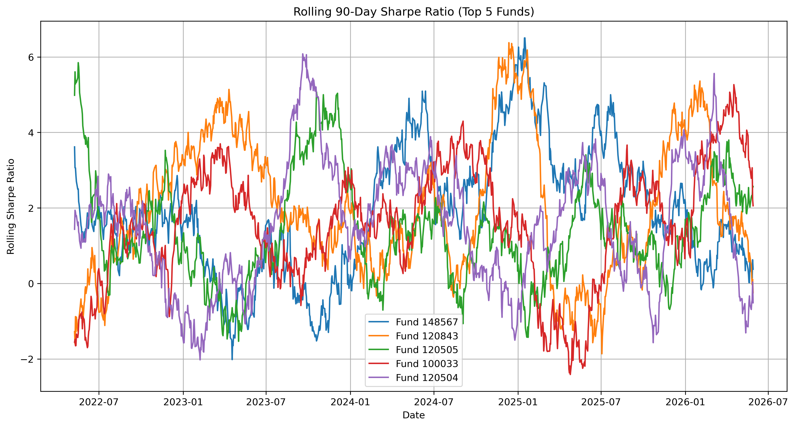
Performance Analytics
Key Insights
Rolling Sharpe Ratio fluctuated over time, reflecting changing market conditions.
Higher Sharpe values indicate better risk-adjusted returns during those periods.
The metric helps compare fund performance while considering both return and volatility.

Slide 11
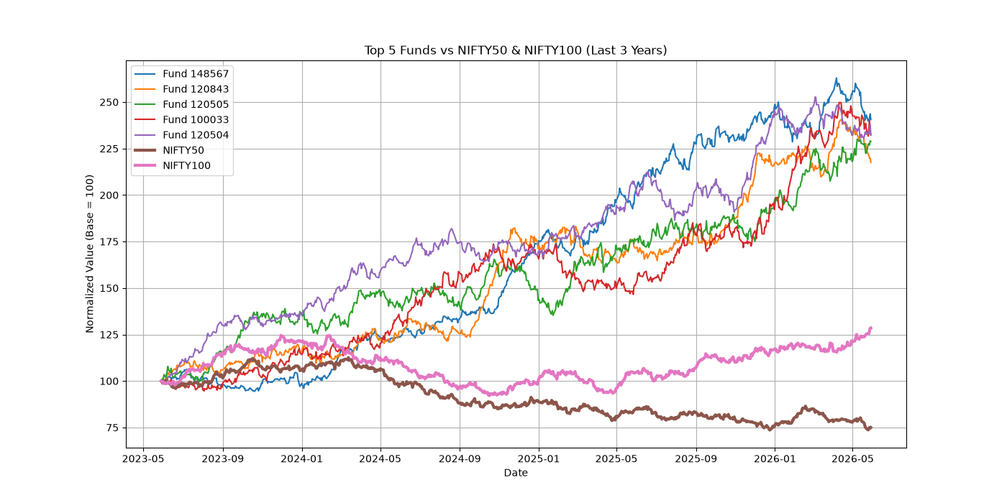
Advanced Analytics
Key Insights
Benchmark comparison helps measure whether funds outperform or underperform the market.
VaR estimates the maximum expected loss at a chosen confidence level.
CVaR measures the average loss beyond the VaR threshold, providing deeper downside risk analysis.

Slide 12
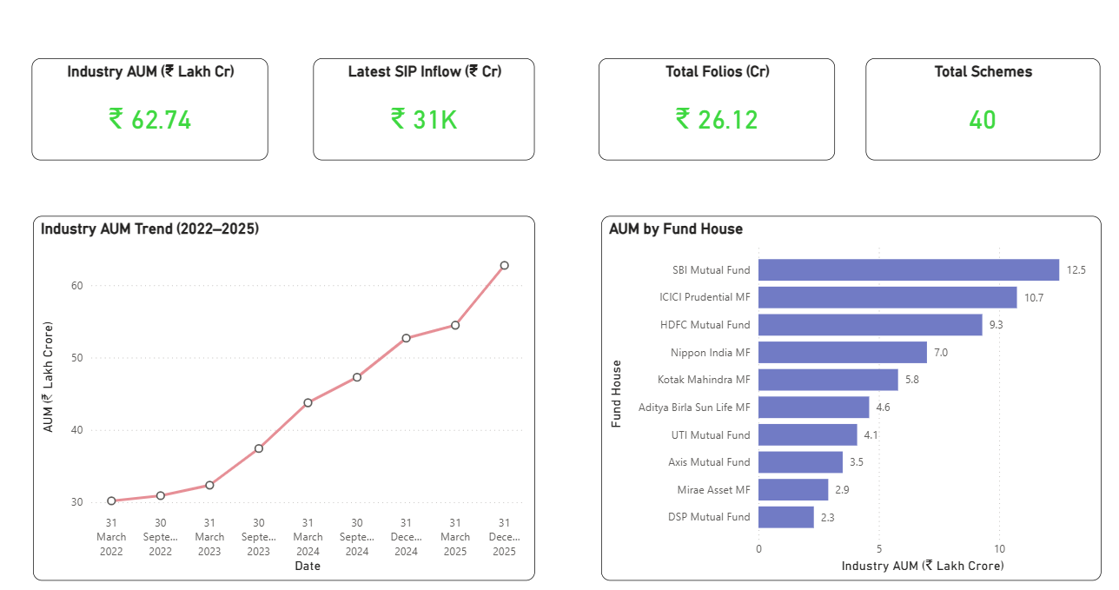
Industry Overview
Key Features
Presents key mutual fund industry KPIs in a single view.
Shows AUM growth and category-level trends.
Interactive slicers enable dynamic data exploration.

Slide 13
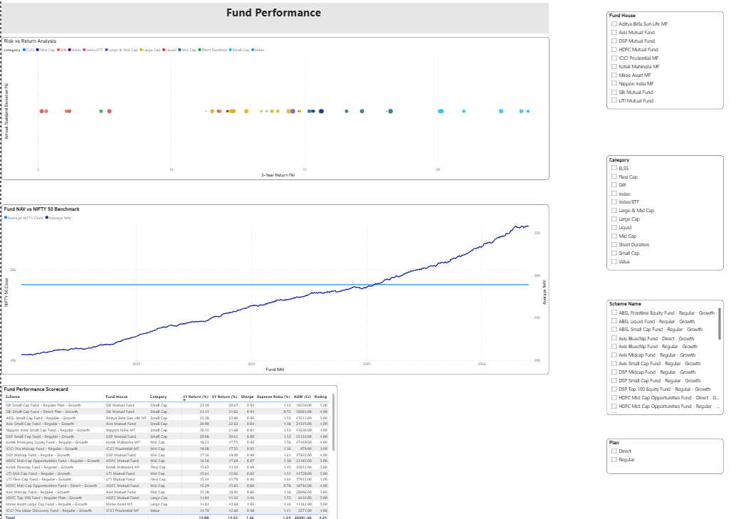
Fund Performance
Key Features
Compares fund performance using return and risk metrics.
Highlights top-performing schemes across categories.
Enables performance comparison through interactive visuals.

Slide 14
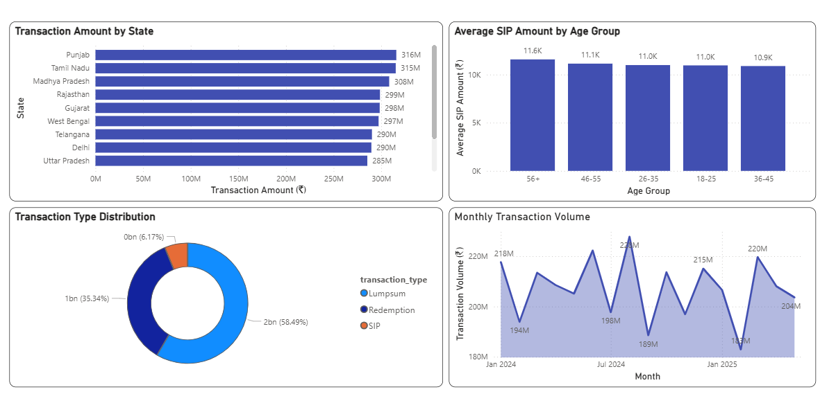
Investor Analytics
Key Features
Analyzes investor demographics and transaction patterns.
Displays participation across different regions and age groups.
Helps understand investor behaviour using interactive filters.

Slide 15
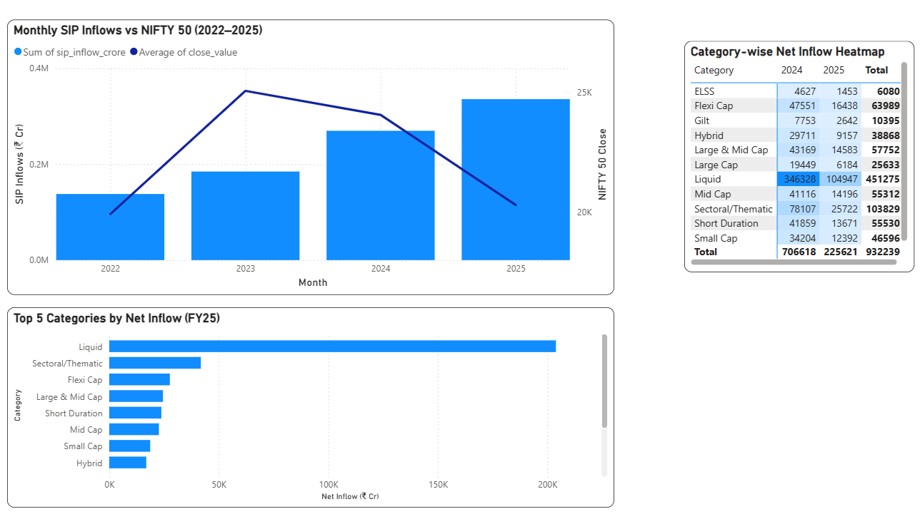
SIP & Market Trends
Key Features
Visualizes monthly SIP inflows and market activity.
Tracks industry folio growth over time.
Supports trend analysis for long-term investment behaviour.

Slide 16
Key Findings
Successfully developed an end-to-end Mutual Fund Analytics solution using Python, SQLite, and Power BI.
Automated the ETL pipeline for data ingestion, cleaning, validation, and database loading.
Performed Exploratory Data Analysis (EDA) to identify fund growth, SIP trends, and investor participation.
Calculated financial performance metrics such as CAGR, Sharpe Ratio, Alpha, Beta, Maximum Drawdown, VaR, and CVaR.
Built an interactive Power BI dashboard with multiple analytical views for fund performance and investor insights.
Implemented a rule-based mutual fund recommendation system to support investment decisions.

Slide 17
Conclusion
Successfully transformed raw mutual fund datasets into meaningful business insights.
Integrated ETL, data analytics, financial analysis, and interactive dashboards into a single workflow.
The project demonstrates practical application of data analytics techniques for investment analysis.

Slide 18
Thank You
Thank You!
Questions & Discussion
Presented By
Pranav Shinde
B.Sc. Information Technology
Mutual Fund Analytics Capstone Project

