Slide 1
PATTERN RECOGNITION
SEMESTER PROJECT

Slide 2
Human Activity Recognition Using Smartphone Accelerometer Data
A Classical Machine Learning Perspective
  Pranav Krishna Suraparaju (S20230020353)
  Peddireddy Eswar Reddy (S2023002333)
  Punnam Rahul (S20230020340)
  Poornachandar Degavath (S20230020336)
Indian Institute of Information Technology, Sri City
Notes:
1

Slide 3
Abstract
Human Activity Recognition (HAR) is crucial for fitness, healthcare, and motion monitoring.
1
2
WISDM Dataset
Feature Extraction
Uses smartphone accelerometer data.
60-sample windowing, 12 statistical features.
3
4
ML Models
Top Accuracy
Benchmarks four classical models.
Random Forest achieved 83.53%.
Lightweight ML models are effective for real-time HAR.
Notes:
2

Slide 4
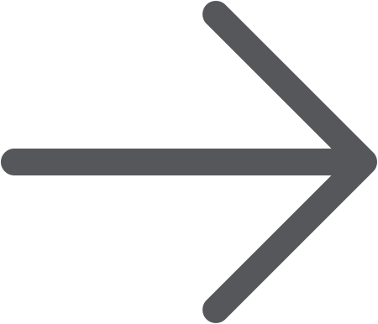
Introduction
Smartphone Accelerometers
HAR Activities
Enable continuous motion detection.
Identifies walking, jogging, sitting, standing, stairs.
Real-World Challenges
Project Goal
Inconsistent motion, orientation changes, human variability.
Efficient, small-feature ML pipeline for mobile deployment.
Notes:
3

Slide 5





Dataset Description
WISDM Dataset
51 Subjects
18 Activities
Smartphone Activity Dataset.
Diverse participant base.
Variety of daily actions.
3-axis Accelerometer
Device Position
Phone in front pants pocket.
20 Hz sampling rate.
Natural variability ensures a challenging and realistic benchmark for HAR.
Notes:
4

Slide 6
Preprocessing
1
2
3
Feature Computation
Missing Values
Windowing
12 features: Mean, Std Dev, Max, Min for X, Y, Z axes.
Handled using median imputation.
Signals divided into 60-sample windows (≈ 3 seconds).
4
5
Standardization
Final Dataset
Z-score normalization applied.
10 selected features after feature selection.
Notes:
5

Slide 7
Feature Selection
Two methods used to reduce redundancy and improve classifier performance:
Recursive Feature Elimination (RFE)
SelectKBest (ANOVA F-score)
Selects 10 best features for RF, KNN, Logistic Regression.
With Linear SVM, selects top 10 features.
Notes:
6

Slide 8
Models Used
Random Forest
K-Nearest Neighbors
500 trees for robust classification.
K = 7, distance-weighted for proximity-based classification.
Support Vector Machine
Logistic Regression
RBF kernel for non-linear decision boundaries.
Multinomial, L2 regularization for linear classification.
Training/Test Split: 70/30 with standardized features.
Notes:
7

Slide 9
Results: Accuracy Comparison
Random Forest
83.53
KNN
82.32
SVM (RBF)
44.26
Logistic Regression
23.86
Random Forest performed best due to strong handling of nonlinear patterns.
SVM and Logistic Regression underperformed due to overlapping motion features.
Notes:
8

Slide 10
Analysis
RF & KNN
SVM
Logistic Regression
Strong diagonal confusion matrix, good classification.
Confusion across similar activities (walking vs. upstairs).
Limited capability for nonlinear patterns.
HAR is inherently difficult due to noise, orientation shifts, and inter-person variability.
Notes:
9

