Slide 1
INTRODUCTION TO
MACHINE LEARNING

Slide 2
An Introduction to
MACHINE LEARNING
Credits: Digital Widzards

Slide 3
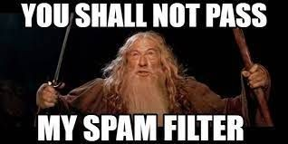
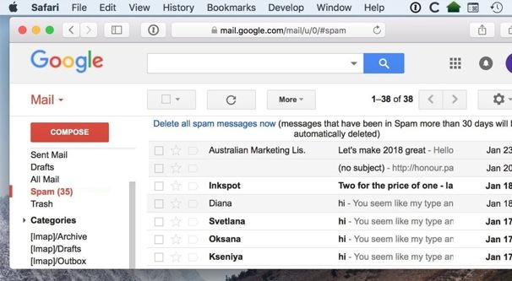
SPAM FILTERS SAVE YOU FROM DANGEROUS SCAMS
And precious time.

Slide 4

SUGGESTED VIDEOS TO WATCH
SUGGESTED PRODUCTS TO BUY
Tech giants make millions from user data

Slide 5

SUGGESTED THOUGHTS TO THINK
thinking
SUGGESTED PERSON TO BECOME
It plays a much more influential role in your life than you even realise

Slide 6
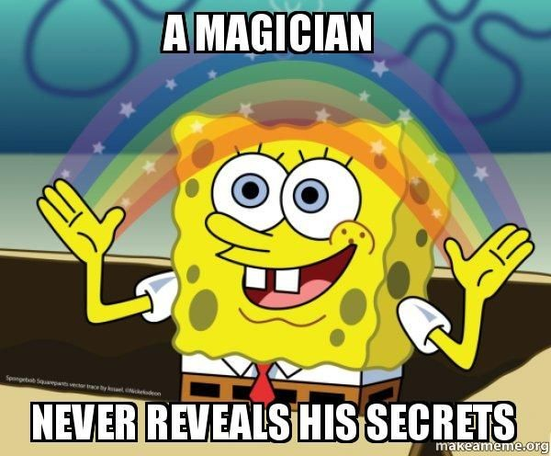
It’s almost
MAGICAL

Slide 7
Why should I try Machine Learning?

Slide 8
Because YOU get to be the magician.

Slide 9
A critical part of making magic happen using data -
is
MACHINE LEARNING

Slide 10
It’s fun.
*Terms and Conditions apply
*ML is challenging and takes patience. Doesn’t always work.

Slide 11
You’ll be able to pick up a larger variety of projects

Slide 12
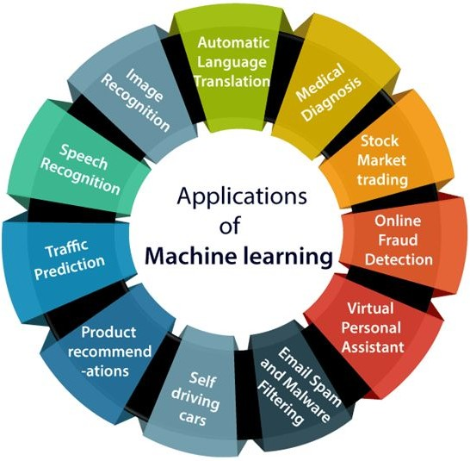
https://www.javatpoint.com/applications-of-machine-learning

Slide 13
Why do ML now?
We all have limited time and different priorities.

Slide 14
You get to explore and get some sense of direction about your career interests

Slide 15
Yes, it helps with internships and placements.
*Terms and Conditions apply
*Some companies look for ML projects based on their requirements. DSA is still more important in this respect.

Slide 16
You’ll have a better experience when you do the actual course.

Slide 17
What is Machine Learning?

Slide 18
Machine learning (ML) is the study of computer algorithms that can improve automatically through experience and by the use of data.
--- Wikipedia

Slide 19
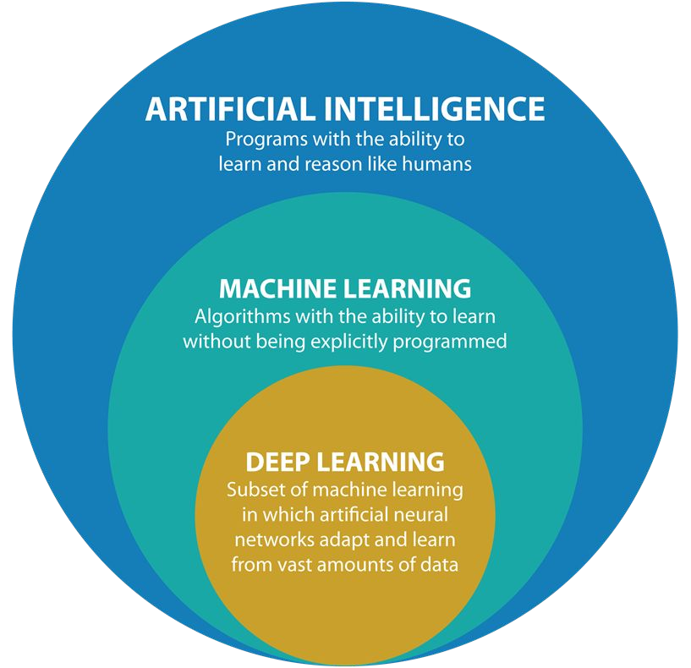
Source: https://medium.com/datadriveninvestor/deep-learning-2025e8c4a50

Slide 20
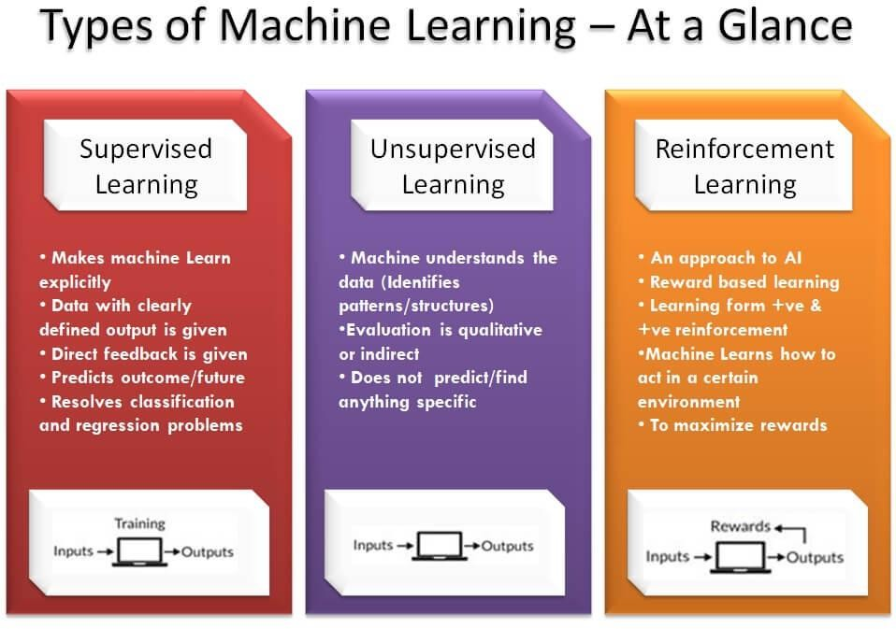
https://www.newtechdojo.com/wp-content/uploads/2018/03/Types-of-Machine-Learning-%E2%80%93-At-a-Glance-optimized.jpg

Slide 21
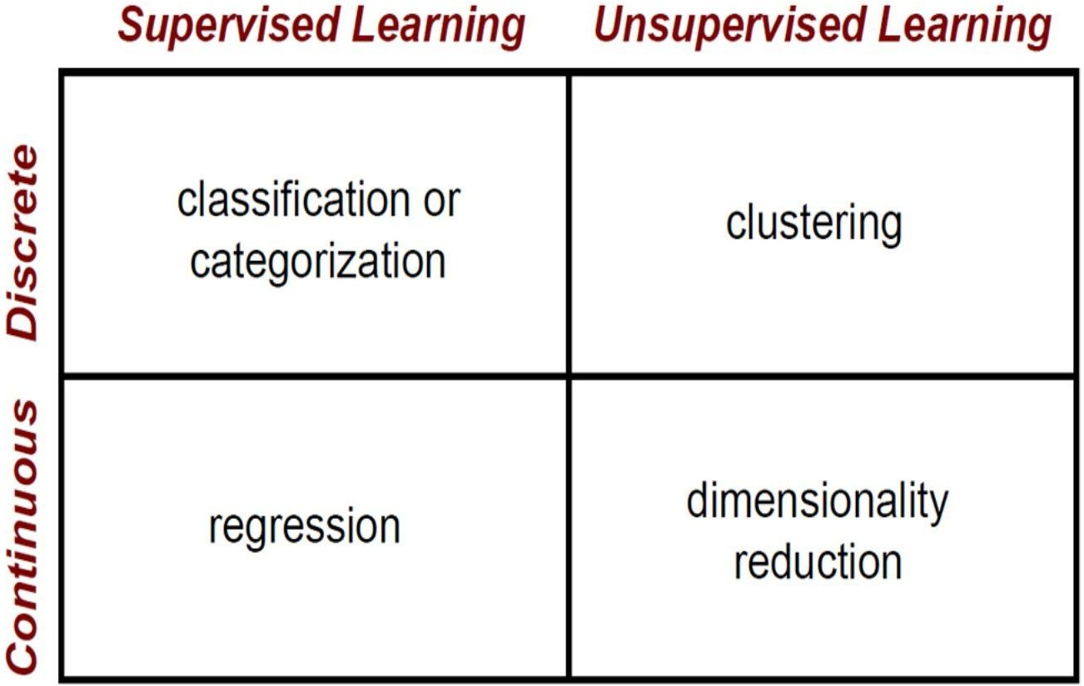
https://i.pinimg.com/originals/8b/23/3e/8b233e2d7f26b00d0c594894917a127b.jpg

Slide 22
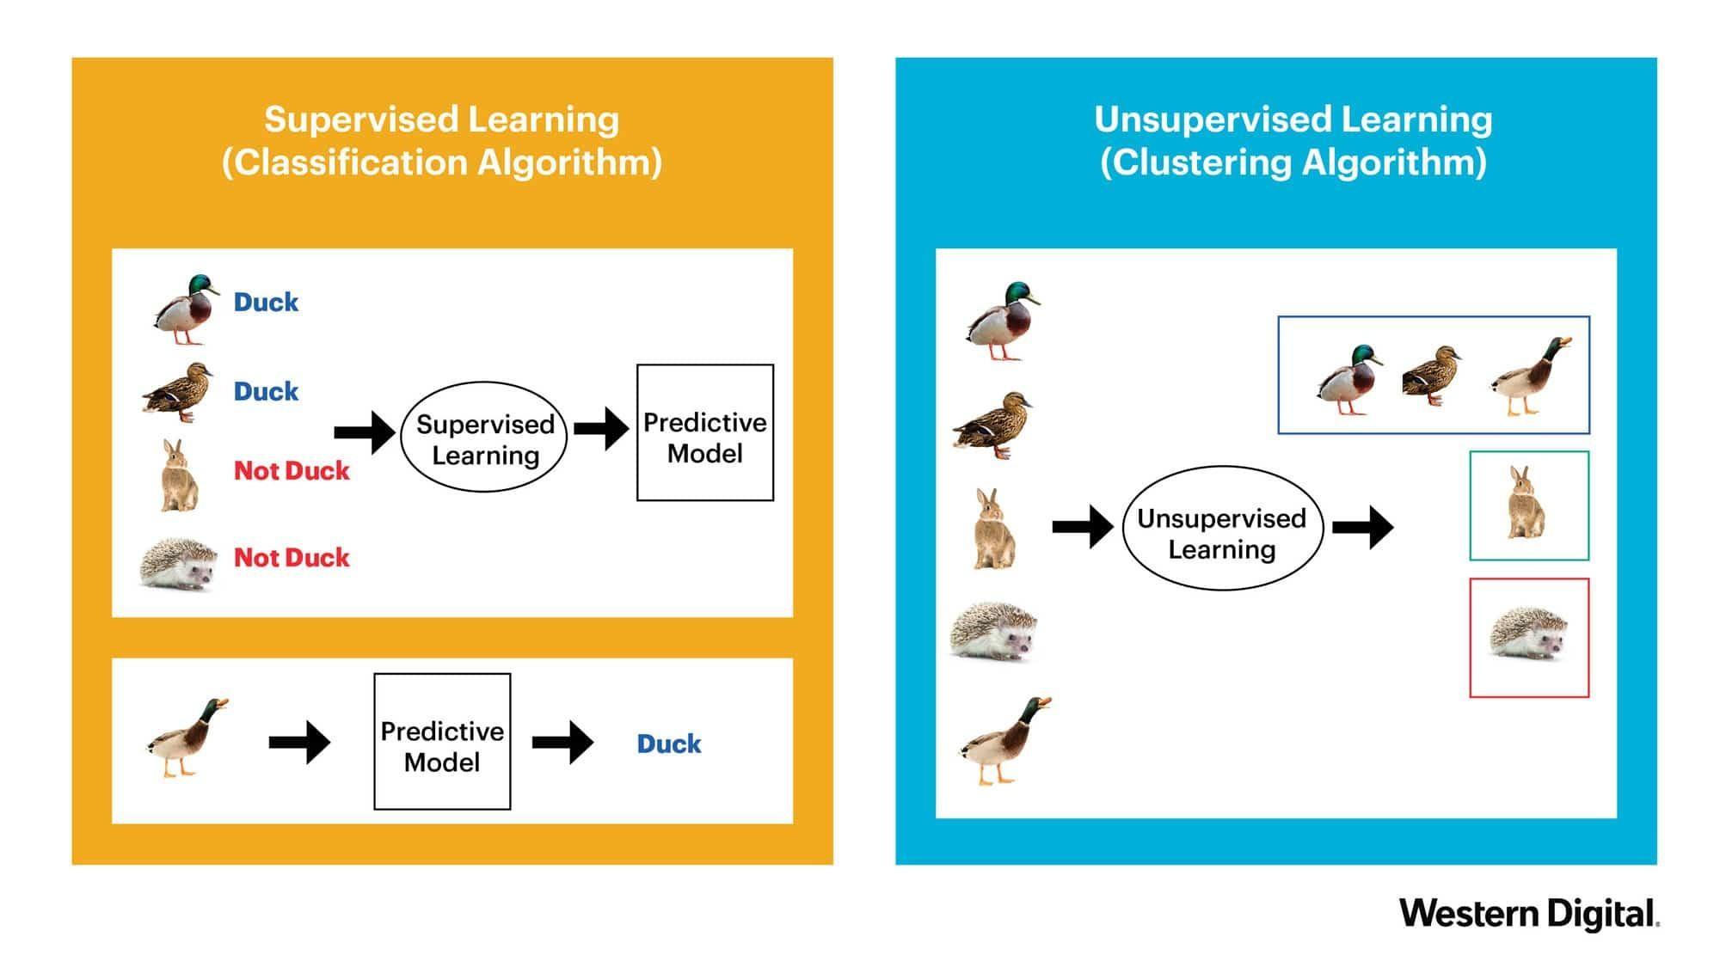
https://blog.westerndigital.com/machine-learning-pipeline-object-storage/supervised-learning-diagram/

Slide 23
Machines understand
Numbers only!

Slide 24
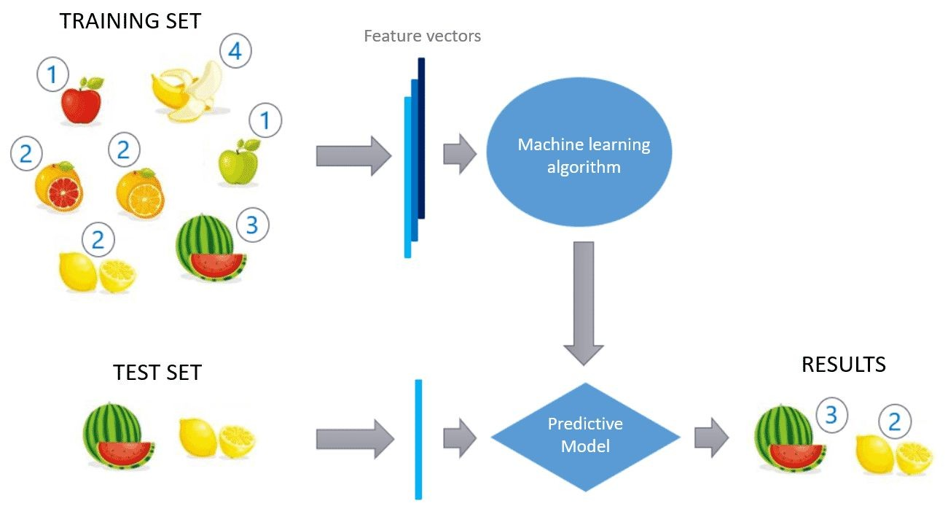
https://www.diegocalvo.es/wp-content/uploads/2020/02/supervised-learning.png

Slide 25
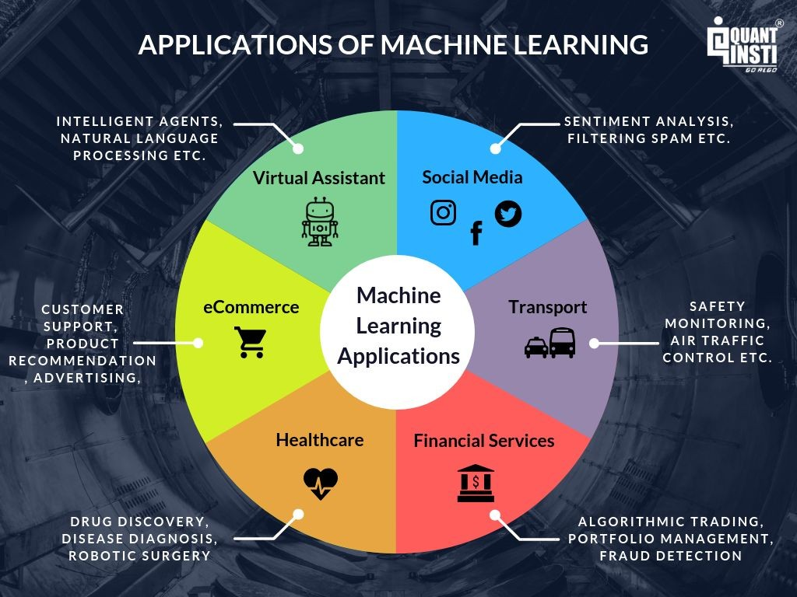
https://d1rwhvwstyk9gu.cloudfront.net/2019/09/Applications-of-Machine-Learning-1024x768-1.png

Slide 26
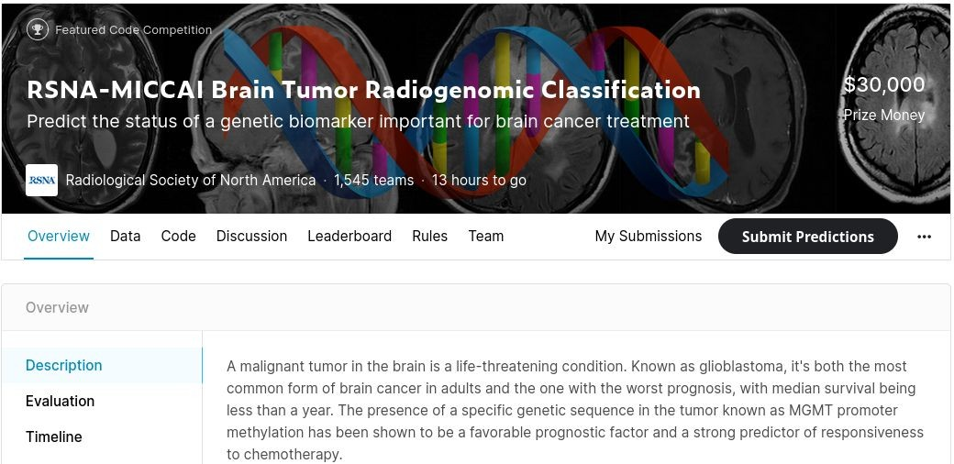
An Example

Slide 27
What do you do in ML?
The Machine Learning Workflow

Slide 28
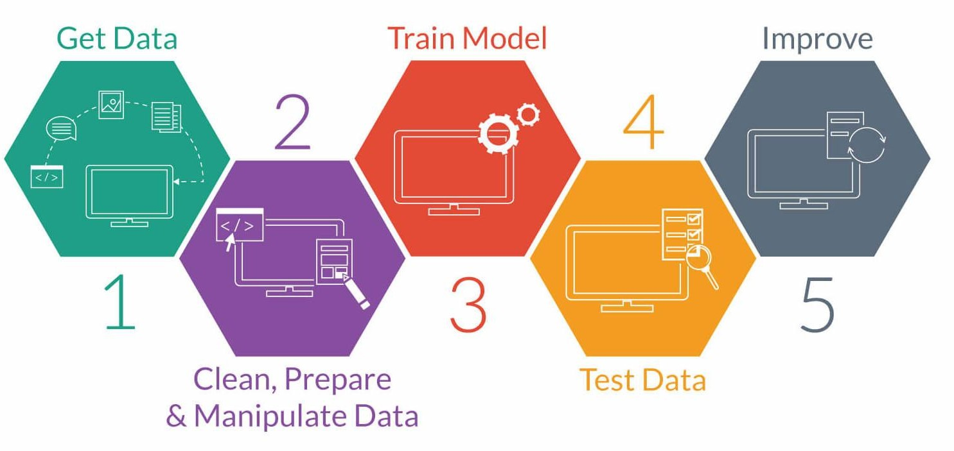
https://www.classcentral.com/report/wp-content/uploads/2017/05/ml-workflow.jpg

Slide 29
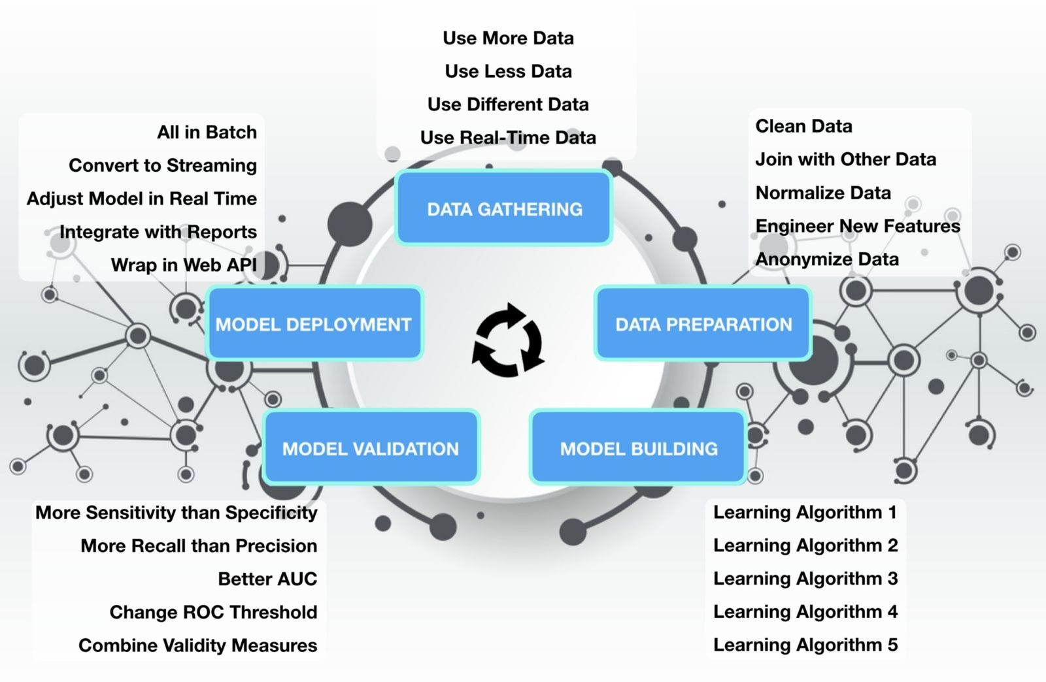
https://towardsdatascience.com/gui-fying-the-machine-learning-workflow-towards-rapid-discovery-of-viable-pipelines-cab2552c909f

Slide 30
How does a model learn?
The Machine Learning Problem

Slide 31
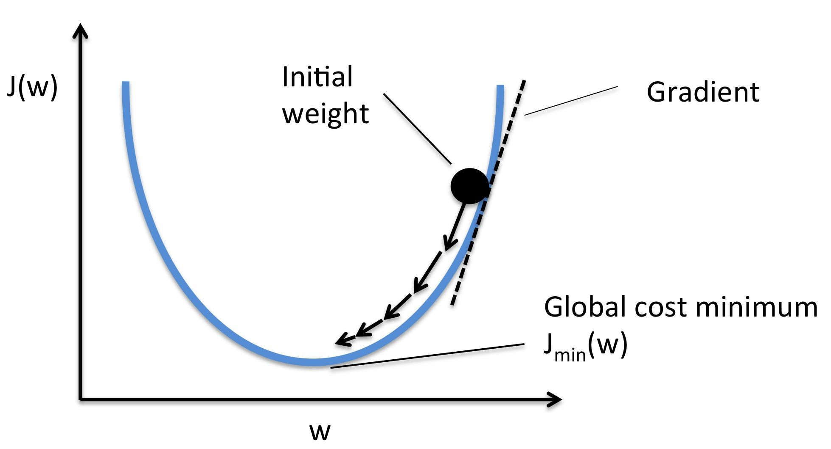
Cost/Loss function
Quantize your end goal.
Optimizer
Reduce your loss.
http://rasbt.github.io/mlxtend/user_guide/general_concepts/gradient-optimization_files/ball.png
Objective
Minimize the Loss function

Slide 32
How to get started?

Slide 33



The Tridev
Andrew Ng
Machine Learning course
Google Colab
Hit the ground running
Kaggle
ML version Hackerrank/Codechef

Slide 34
What about the math?
You don’t need a lot of math.
Linear Algebra helps. Calculus helps.
Essence of Linear Algebra playlist Essence of Calculus playlist
If you are a math person.
Prof. Gilbert Strang - Linear Algebra course - and the associated Textbook
Math for Machine Learning Book

Slide 35
What about programming?
A critical part of Machine Learning, is working with diﬀerent libraries.
They make life much easier.
But you don’t have to “learn” libraries. When you try to do something, you often realise there’s a library that can help you. Then you go learn how to use it.
Popular names that you’ll hear
A little bit of Python is good enough to start oﬀ.
Python for beginners tutorial
Introduction to Machine Learning with Python
Hands–On Machine Learning with Scikit–Learn and TensorFlow

Slide 36
OK, now what?

Slide 37
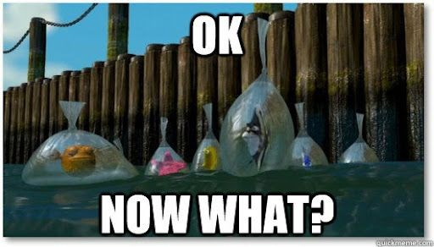
Kaggle competitions.
Try projects that use ML.
Look up existing notebooks and projects and make them your own.
Apply ML EVERYWHERE.
Conquer the world.

Slide 38
Tips for learning ML (or anything else!)
Know what you want before you start
Or you’ll get lost!
Try to learn one thing at a time
Set short term goals.
Continuous learning > One shot learning
Learning ≠ Exam prep
Embrace mistakes
Cause you’ll definitely make them.
Stay Curious
Everything is a learning opportunity!
Ask Questions!
Learning is best when made interactive.

Slide 39
Possible end goals?

Slide 40
For Research
For projects
Get better at fundamentals in Mathematics and Statistics!
Do more hands-on stuff! As much as possible! (Opportunities in mails, open hackathons, approach profs.)
For job
Exploring chumma
No need for a lot of math, but understand how everything works. Focus more on implementation and coding.
Read, watch, play around!
Blogs about exciting developments and concepts

Slide 41


Slide 42
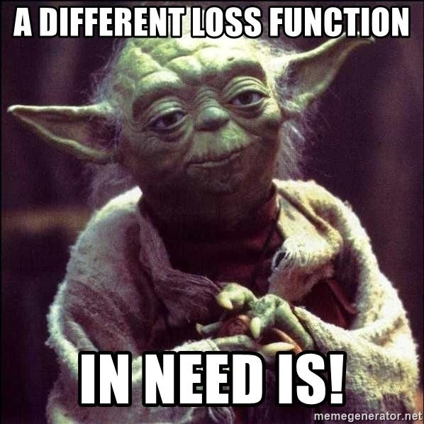
What is your loss function?
People are just loss functions after all.

Slide 43
THANK YOU.

