Slide 1



Xamarin.UITest
Presented By :Pranav Tiwari
Pranavtechnocrat16@gmail.com

Slide 2
Agenda
Introduction to Xamarin.UITest
Xamarin.UITest Architecture.
Local Setup.
Selector and Quaries.
What to do with the functionality which can’t be Automated Directly ???

Slide 3
Xamarin.UITest
Xamarin.UITest is a testing framework using which we can automate our application in C# using the Nunit framework which will run on Android and iOS.
Each UITest is written as methods and is referred to as tests.
The test cases will interact with the UI and perform the operations just as a user does like tapping on buttons, entering text and performing gestures like swiping or pinching.

Slide 4
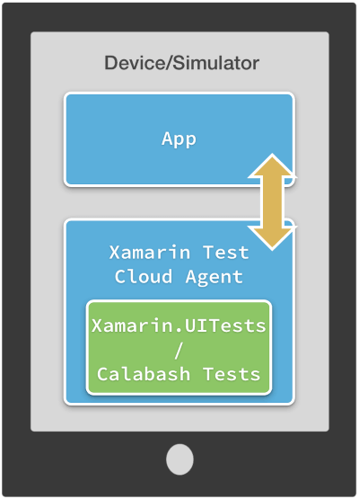
Xamarin.UITest Architecture
Tests interact with the app Using calabash .
Perform gestures and advance quaries and returns the result.

Slide 5
Xamarin.UITest Setup
StartApp is the first to execute when we are running our test cases .
# Android Setup
return ConfigureApp
.Android
.Debug()
.InstalledApp(“com.Abc.XYZ”)// Package name of Application .
.ApkFile(“../../../com.Abc.XYZ”)//APK will be part of the solution.
.DeviceSerial(“ce081718341fbf1f01")//Pass DeviceSerial, in case more than one device
.StartApp();
Even the Android solution can be executed to run the Automation test .

Slide 6
Xamarin.UITest Setup
StartApp is the first to execute when we are running our test cases .
# iOS Setup
return ConfigureApp
.iOS
.Debug()
.InstalledApp("com.Abc.XYZ")// Bundle id
.AppBundle("../../../iOSAppProject/bin/iPhoneSimulator/Debug/iosapp.app")//APK will be part of the solution.
.StartApp();

Slide 7
Selectors
Tap(App.Tap("Accessibility id of element ");)
Enter text(App.EnterText(c=>c.id("Accessibility id of element"),”text”);)
Clear text (App.ClearText(c=>c.id("Accessibility id of element");)
Wait for element.(App.WaitForElement(c=>c.id("Accessibility id of element");)

Slide 8
Quaries
App.Query(“Accessibility id of element”);
App.Query(x => x.id("Accessibility id of element"));
App.Query(x => x.Marked("Accessibility id of element"));
App.Query(x => x.TextField("Accessibility id"));
App.Query(x => x.Text("Accessibility id"));

Slide 9

What to do with the functionality which can’t be Automated Directly ???

Slide 10

Backdoor
Methods

Slide 11
Backdoor Method
Backdoor methods are an implementation introduced in Xamarin Native to achieve special actions while automating your App. Some of the scenarios are:
Sending app to background and bringing it back(function is available in xamarin.UItest for IOS. In Android, we can achieve it using backdoor ).
Map-related applicability's (like getting a polyline count)
Introducing some Test values in DB and testing whether it's reflected in Ui.
Key Points
The backdoor method return type will be either string or void.
The backdoor method accepts string, int, or bool as a parameter, and can even be empty.

Slide 12
Questions ??

