Slide 1
BLUESTOCK
Mutual Fund Analytics
Capstone Project — Final Presentation
40 Funds · 46,000 NAV Records · 5 Years · 4 Categories · 7 Benchmarks
Data Source: AMFI India via mfapi.in | Bluestock Analytics Team | 2025

Slide 2
Problem Statement & Objectives
📊 Data Fragmentation
🔍 No Performance Ranking
Mutual fund data spread across NAV feeds, AUM reports, SIP data, and transaction records with no unified analytical layer.
Investors and advisors lack a systematic way to compare 40+ funds on risk-adjusted metrics — Sharpe, Sortino, Alpha, and composite score.
📉 Risk Blind Spots
🎯 Our Solution
Tail risk (VaR/CVaR), drawdown patterns, and SIP continuity are rarely analysed together for retail investors.
End-to-end data pipeline: ETL → Star Schema → EDA → Performance Analytics → Advanced Analytics → Interactive Dashboard.
2 / 12

Slide 3
Data Sources — 10 CSVs from AMFI India
#
Filename
Rows
Description
01
fund_master.csv
40
Fund name, AMC, category, expense ratio, benchmark
02
nav_history.csv
46,000
Daily NAV per fund — Jun 2021 to Jun 2026
03
aum_by_fund_house.csv
90
Annual AUM by AMC — SBI, HDFC, Axis, etc.
04
monthly_sip_inflows.csv
48
Industry SIP inflows Jan 2022 – Dec 2025
05
category_inflows.csv
144
Monthly net inflows per fund category
06
industry_folio_count.csv
21
Total investor folios each month
07
scheme_performance.csv
40
Sharpe, Alpha, Beta, Drawdown, 1Y/3Y/5Y returns
08
investor_transactions.csv
32,778
SIP/Lumpsum/Redemption with demographics
09
portfolio_holdings.csv
322
Stock-level holdings for equity funds
10
benchmark_indices.csv
8,050
NIFTY50, NIFTY100, NIFTY_MIDCAP150, NIFTY500...
3 / 12

Slide 4
Pipeline Architecture — 5-Layer Design
L1
L2
L3
L4
L5
Ingestion
Cleaning
Transform
Analytics
Delivery
mfapi.in API
+ CSV Adapter
Dedup · FFill
Outlier Flag
Returns · Vol
52W H/L
15 Metrics
4 Periods
DB · Notebooks
Dashboard
Star Schema:
dim_fund
dim_date
fact_nav
fact_txn
fact_perf
fact_aum
40 funds
1,297 dates
46K rows
32K rows
40 rows
90 rows
Tech Stack:
Python 3.10
pandas / numpy
SQLAlchemy
Streamlit
Plotly
ReportLab
pytest
4 / 12

Slide 5
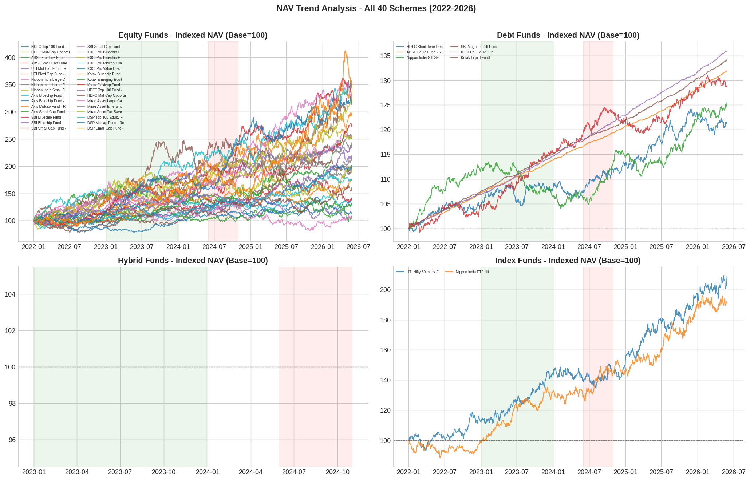
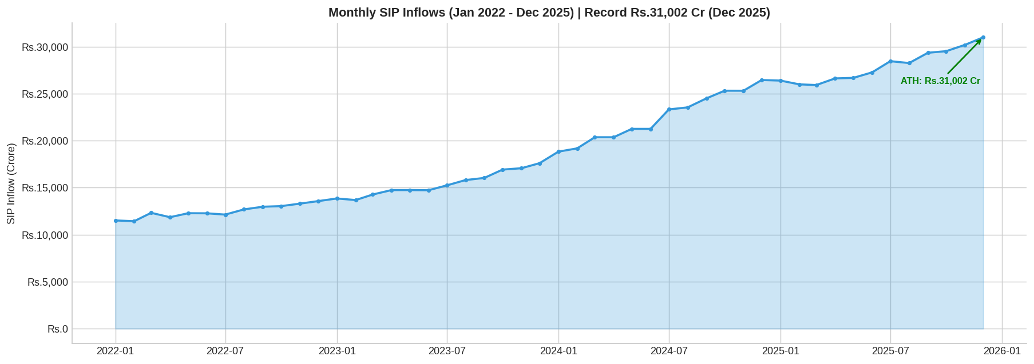
EDA Highlights — NAV Trends & SIP Growth
SIP Inflows — Rs.31,002 Cr ATH (Dec 2025)
Rs.62.74L Cr
Rs.31,002 Cr
26.12 Cr
14.4%
Total AUM
Latest SIP
Folios
Avg 1Y Return
Indexed NAV (Base=100) — All 40 Funds
Green = 2023 Bull Run | Red = 2024 Correction
5 / 12

Slide 6
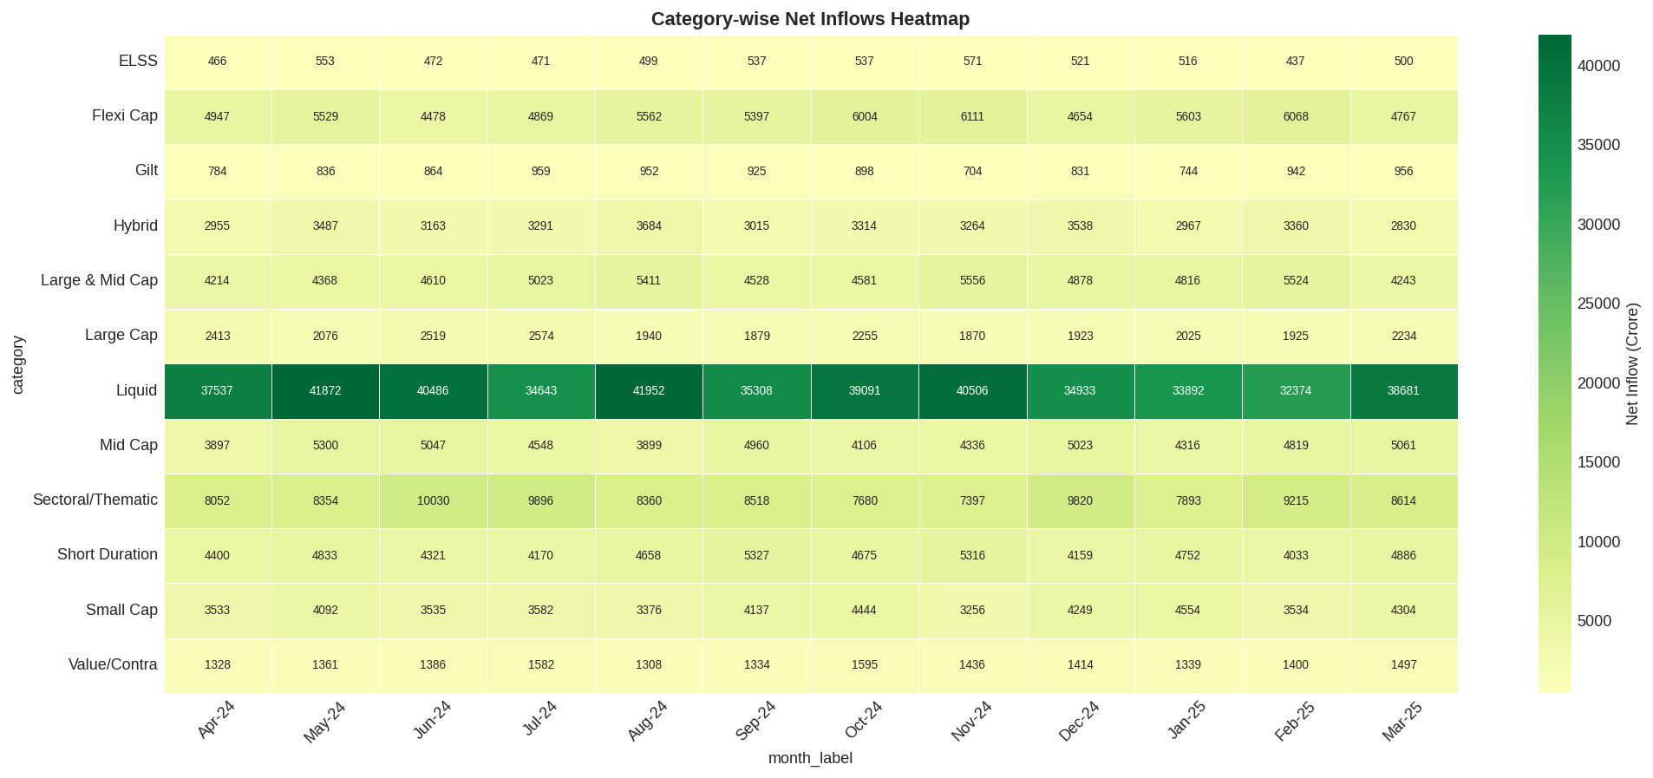
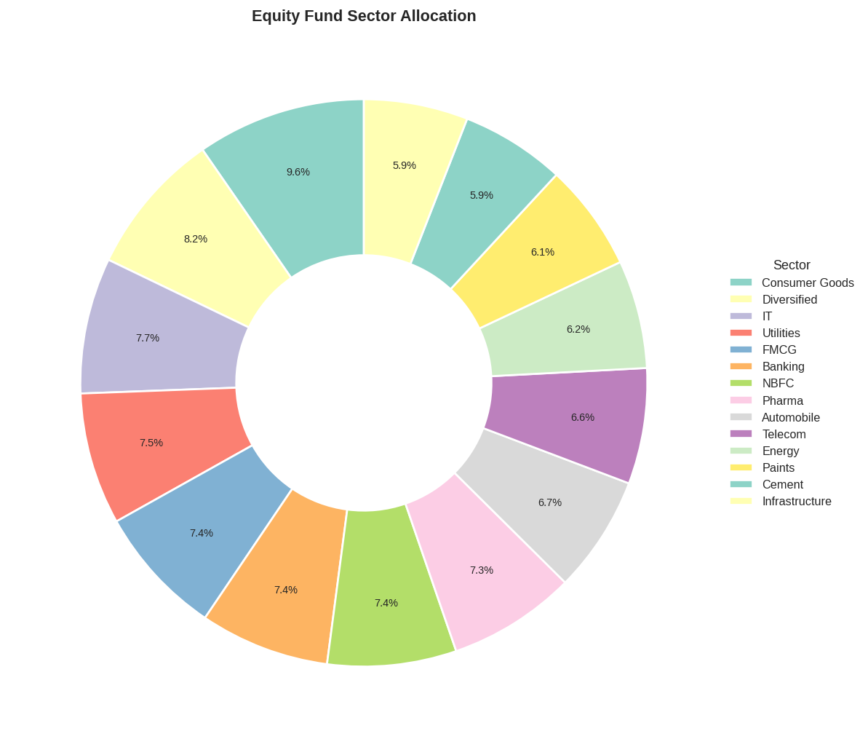
EDA Highlights — Category Inflows & Sector Allocation
Category Inflow Heatmap | Green=Inflow Red=Outflow
Equity Fund Sector Allocation
▸ Equity consistently net inflow; Debt shows outflows
▸ Financial Services ~28% — largest sector weight
▸ SIP grew 2.7x: Rs.11,500 Cr → Rs.31,002 Cr
▸ Maharashtra + Karnataka + Delhi = 50%+ of SIP
6 / 12

Slide 7
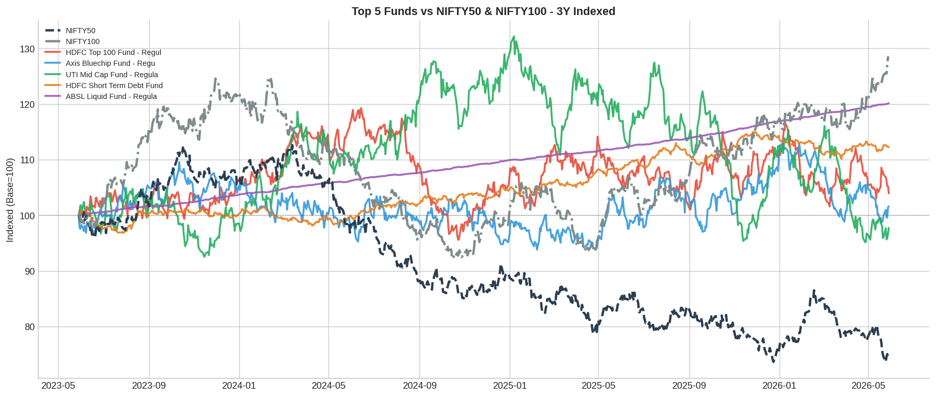
Performance Analytics — Returns & Benchmark
Best 1Y Return
24.9%
ABSL Small Cap
Best 3Y Return
23.4%
SBI Small Cap
Top Sharpe
7.680
ICICI Liq Fund
Avg 1Y CAGR
14.4%
All 40 Funds
Top 5 Funds vs NIFTY50 & NIFTY100 | 3-Year Indexed | TE = Tracking Error
Sharpe >= 1
25%
10 of 40 Funds
7 / 12

Slide 8
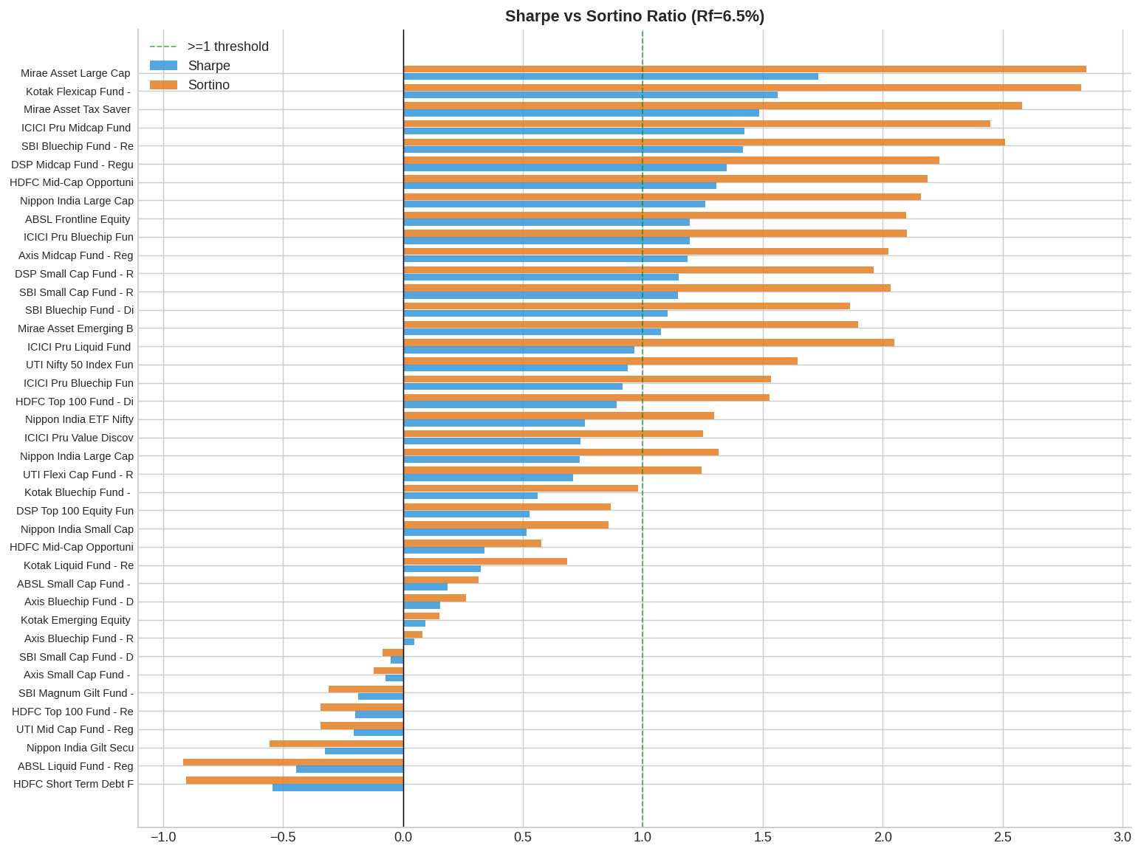
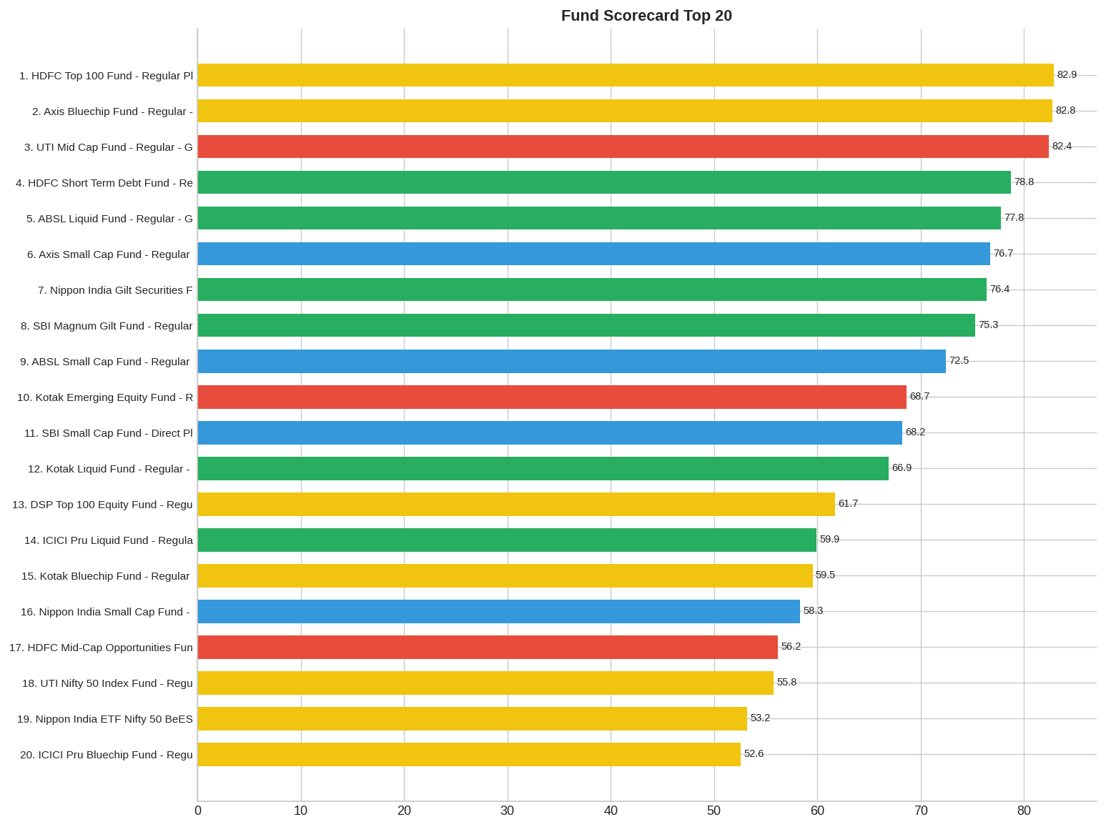
Performance Analytics — Sharpe Ratio & Fund Scorecard
Sharpe vs Sortino (Rf=6.5%) | Green>=1 Amber=0-1 Red<0
Composite Scorecard: 30% 3Y + 25% Sharpe + 20% Alpha + 15% ER + 10% MDD
8 / 12

Slide 9
Streamlit Dashboard — 6 Interactive Pages
1
Executive Summary
6 KPI cards · Top/Bottom performers · Risk-return scatter · Full fund table with slicers
2
Fund Performance
Indexed NAV trends · Rolling 1Y return · 90d volatility · Benchmark comparison
3
Risk Analytics
Volatility ranking · Drawdown history · Daily VaR · Full risk metrics table
4
Industry Analytics
SIP ATH annotation · Folio growth · AUM by AMC · Category heatmap · Demographics
5
Portfolio Optimiser
Markowitz frontier (2,000 simulations) · Max Sharpe & Min Vol weights · SIP calculator
6
Fund Comparison
Side-by-side metrics · Winner column · Indexed NAV comparison · Radar chart
9 / 12
streamlit run scripts/day5_dashboard.py → localhost:8501

Slide 10
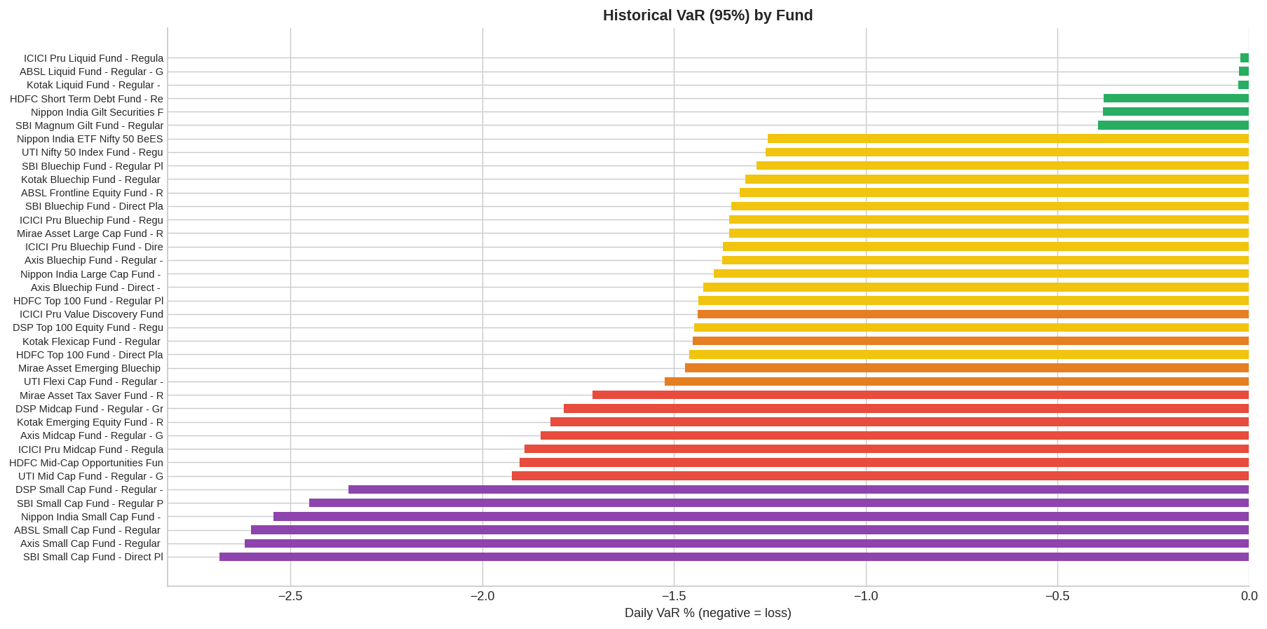
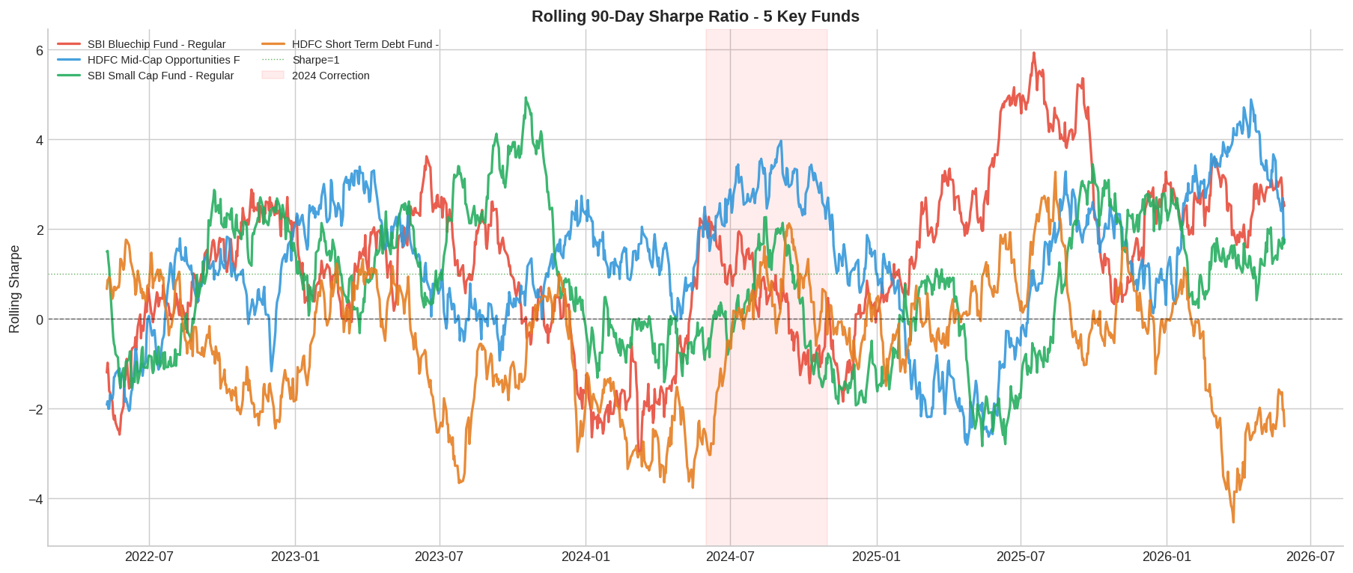
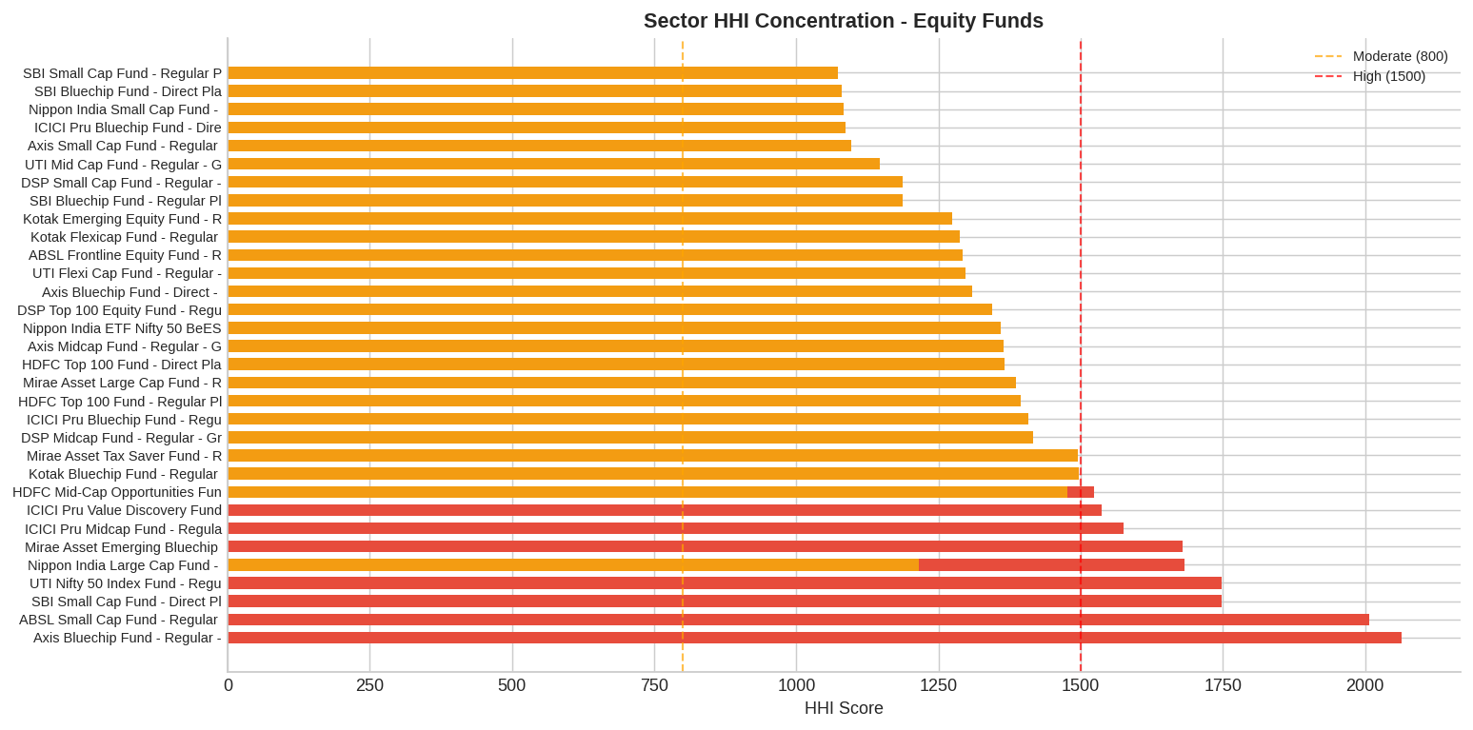
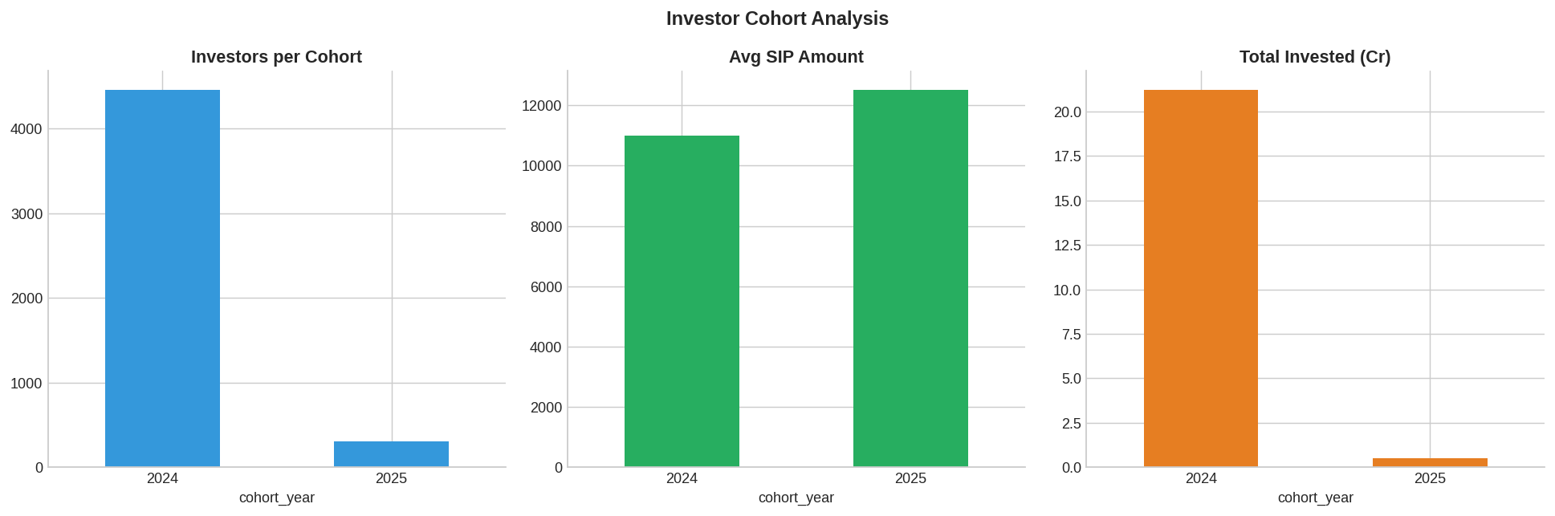
Advanced Analytics — VaR, Cohort & Sector HHI
Historical VaR (95%) — Liquid <0.01% | Small Cap -2.5%
Rolling 90-Day Sharpe — 5 Key Funds | Note 2024 correction dip
Sector HHI — Small Cap most concentrated; Index most diversified
10 / 12
Cohort Analysis — 2025 investors show higher avg SIP ticket

Slide 11
Key Findings & Recommendations
SIP Structural Growth
Small Cap Leads Returns
Monthly SIP grew 2.7x from Rs.11,500 Cr to Rs.31,002 Cr (Jan 2022–Dec 2025). Now a core savings instrument for Indian retail.
ABSL Small Cap: 24.9% 1Y | SBI Small Cap: 23.4% 3Y CAGR. Accept 20%+ drawdowns for long-term alpha.
Liquid Funds: Best Sharpe
Index vs Active
Sharpe of 7.68 for ICICI Liquid Fund — best risk-adjusted return. Zero drawdown, ideal for short-term capital.
Large Cap Index funds outperform most active large-cap funds on a risk-adjusted basis at 50% lower expense ratios.
2024 Correction Impact
SIP At-Risk Rate ~35%
Rolling Sharpe dropped sharply Jun–Sep 2024 across all equity categories. VaR spikes confirm tail risk materialised.
1 in 3 regular SIP investors has a gap exceeding 35 days — key retention risk and AMC engagement opportunity.
11 / 12

Slide 12
Thank You
Bluestock Mutual Fund Analytics Capstone
📊 40 Funds · 46,000 NAV Records · 32,778 Transactions · 7 Benchmarks · 5 Years
🔧 D1–D7 Complete · B1 B2 B3 B4 Bonus Delivered · 21 Charts · 31 Unit Tests
🌐 Data: AMFI India via mfapi.in · Run: streamlit run scripts/day5_dashboard.py
Questions & Discussion

