Slide 1
MINI HACKATHON 1
Early Chronic Kidney
Disease Prediction
A comparative study of XGBoost and LightGBM on clinical tabular data
Problem Statement • Dataset Selection • EDA • Literature • ML Models • Prototype
Koneru Lakshmaiah University • August 2026
Mini Hackathon 1 • CKD Prediction • 2026
1

Slide 2
1. Problem Statement
Why early CKD screening is worth investigating with machine learning
Clinical challenge
11,933
CKD can progress with limited early symptoms.
Timely identification can support earlier clinical review and risk management.
Clinical records contain multiple interacting renal, metabolic and demographic signals.
A useful screening model must balance discrimination with interpretability and leakage control.
records in primary dataset
29
available fields
69.9%
CKD-positive labels
Mini Hackathon 1 • CKD Prediction • 2026
2

Slide 3
2. Objectives
A focused scope for the mini-hackathon
01
Audit 3 datasets
Select the most defensible dataset for the project.
02
Understand the data
Perform EDA, missingness, imbalance and relationship analysis.
03
Compare models
Train and evaluate XGBoost and LightGBM on the same split.
04
Interpret results
Identify influential clinical variables and discuss limitations.
05
Demonstrate
Package the trained models into a small screening prototype.
Mini Hackathon 1 • CKD Prediction • 2026
3

Slide 4
3. Dataset Identification
Three supplied datasets were audited before model building
Dataset
Rows
Cols
Missing cells
Target
Decision
CKD_NHANES_2021_2023
11,933
29
114,393
ckd_present
PRIMARY
Testing_CKD_dataset
4,800
36
0
Target
SECONDARY
kidney_disease
400
26
1,009
classification
REFERENCE
Selection rationale
Largest sample among the supplied files and strong clinical feature coverage.
The 400-row reference dataset is useful academically but is too small and has substantial missingness.
The 4,800-row file has no missing values but its feature ranges look more synthetic; it is better treated as secondary/sanity-check data.
Mini Hackathon 1 • CKD Prediction • 2026
4

Slide 5
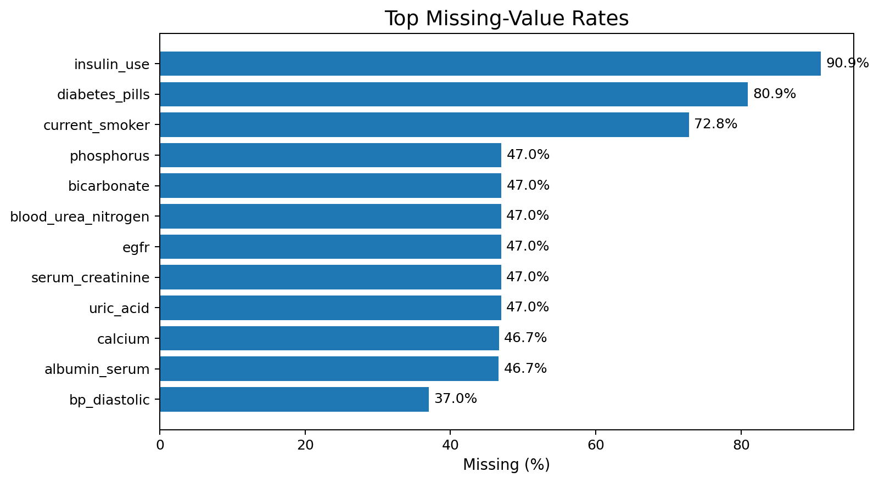
4. Data Quality & Preprocessing
Cleaning choices are part of the model, not an afterthought
Pipeline
1
Age cleanup
Treat implausible age < 1 as missing
2
Missing values
Median numeric / most-frequent categorical
3
Categorical encoding
One-hot encoding with unknown handling
4
Train/test split
80/20 stratified, random_state = 42
5
Tree models
No feature scaling required for XGBoost/LightGBM
Mini Hackathon 1 • CKD Prediction • 2026
5

Slide 6
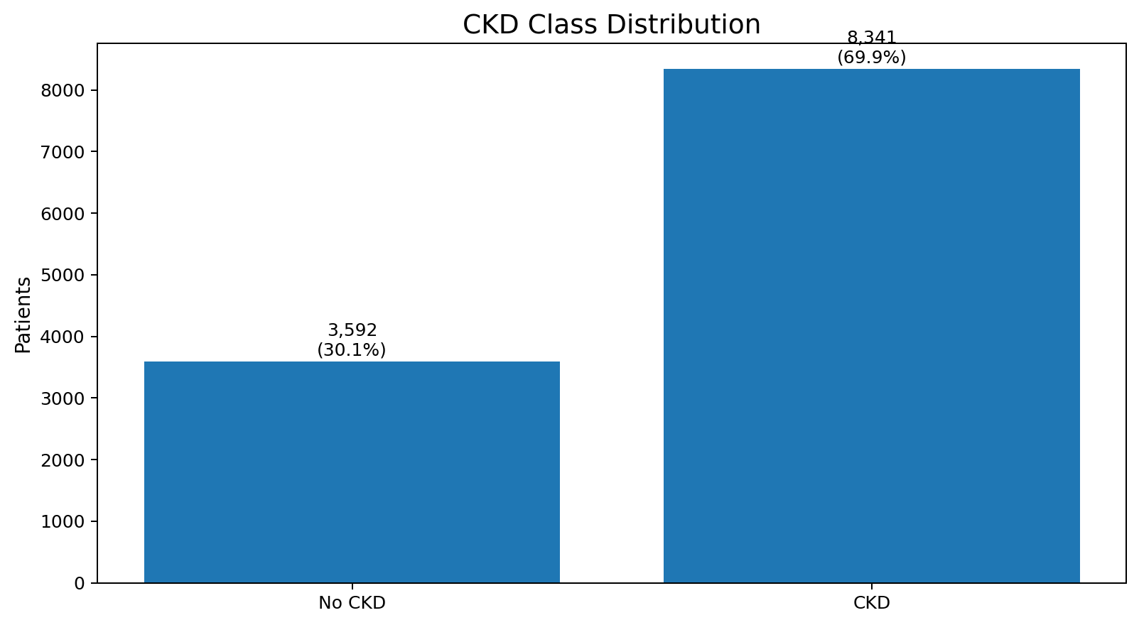
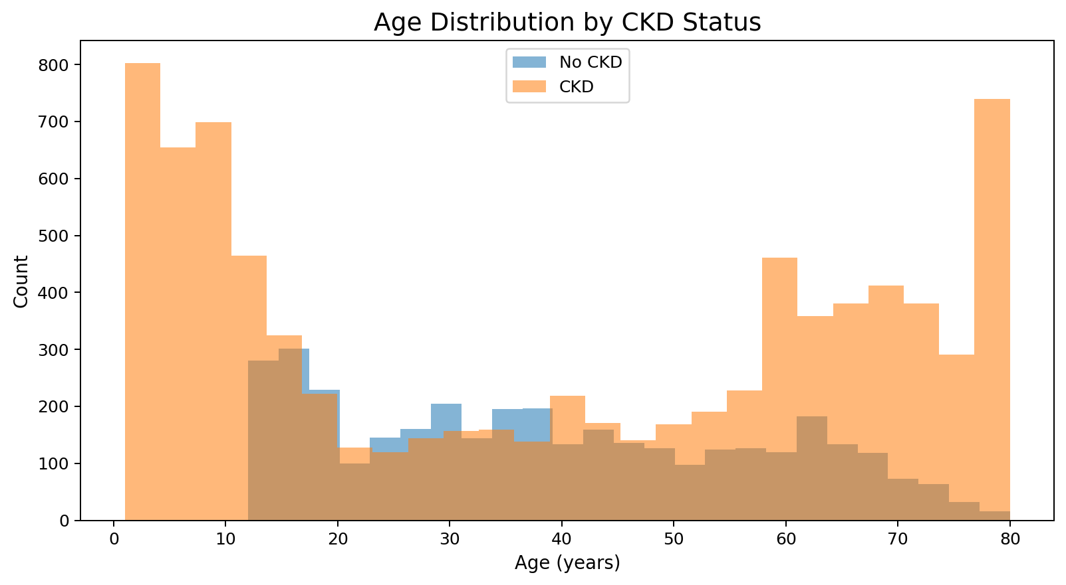
5. EDA — Target & Demographics
The project begins with distribution, not modeling
Key observations
Target is imbalanced toward CKD-positive cases (8,341 vs 3,592), so stratification is used.
Age distributions overlap substantially; age alone is not a sufficient classifier.
Mini Hackathon 1 • CKD Prediction • 2026
6

Slide 7
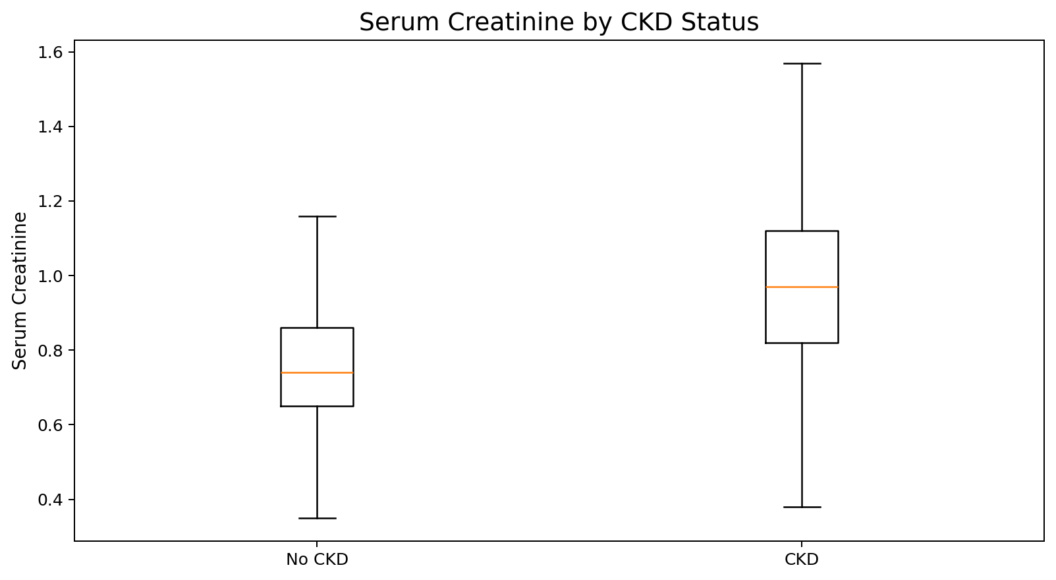
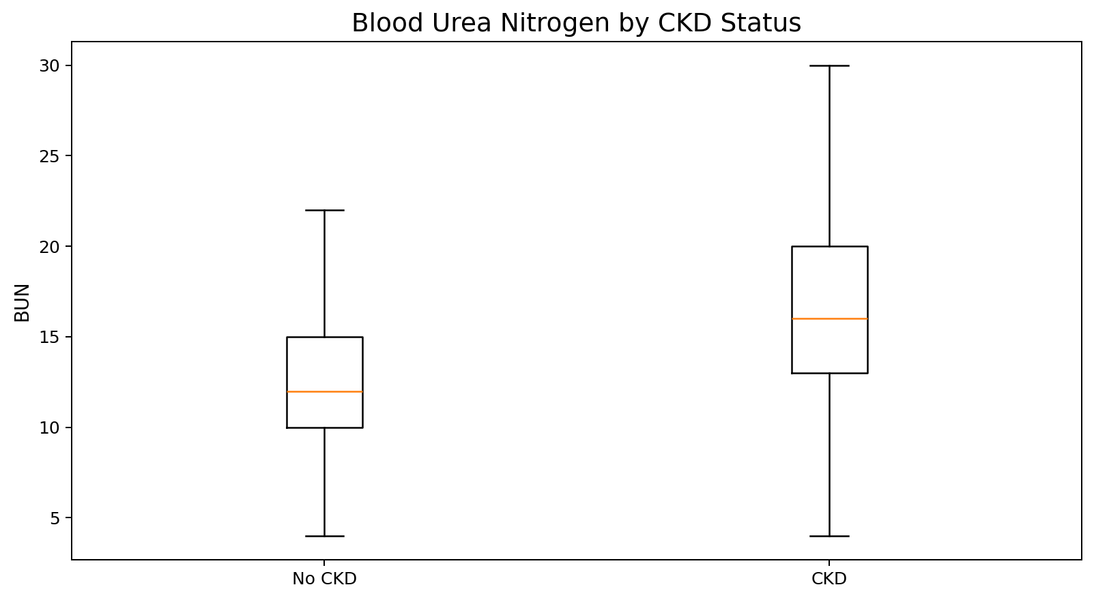
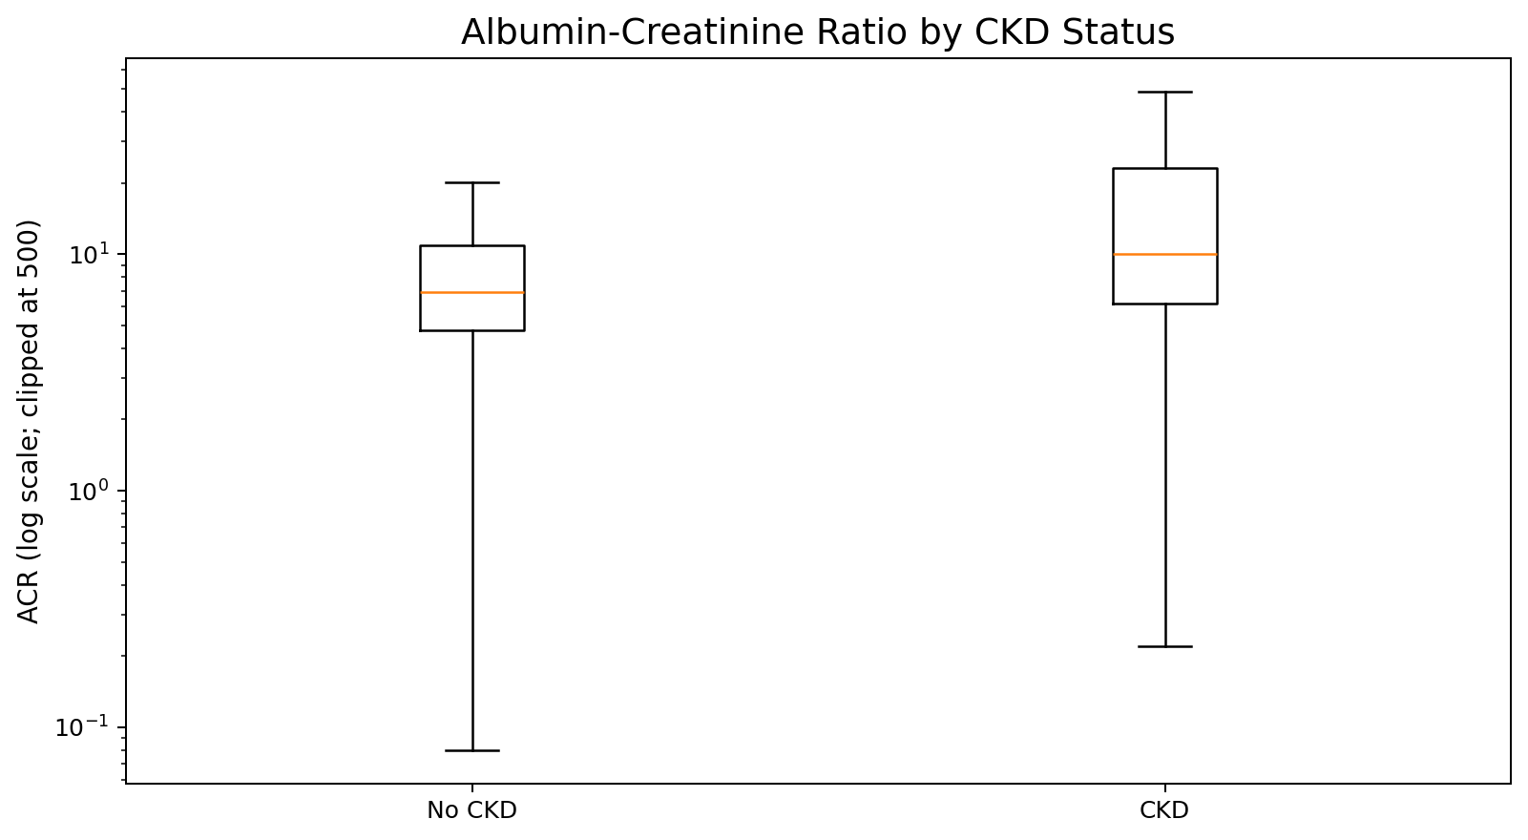
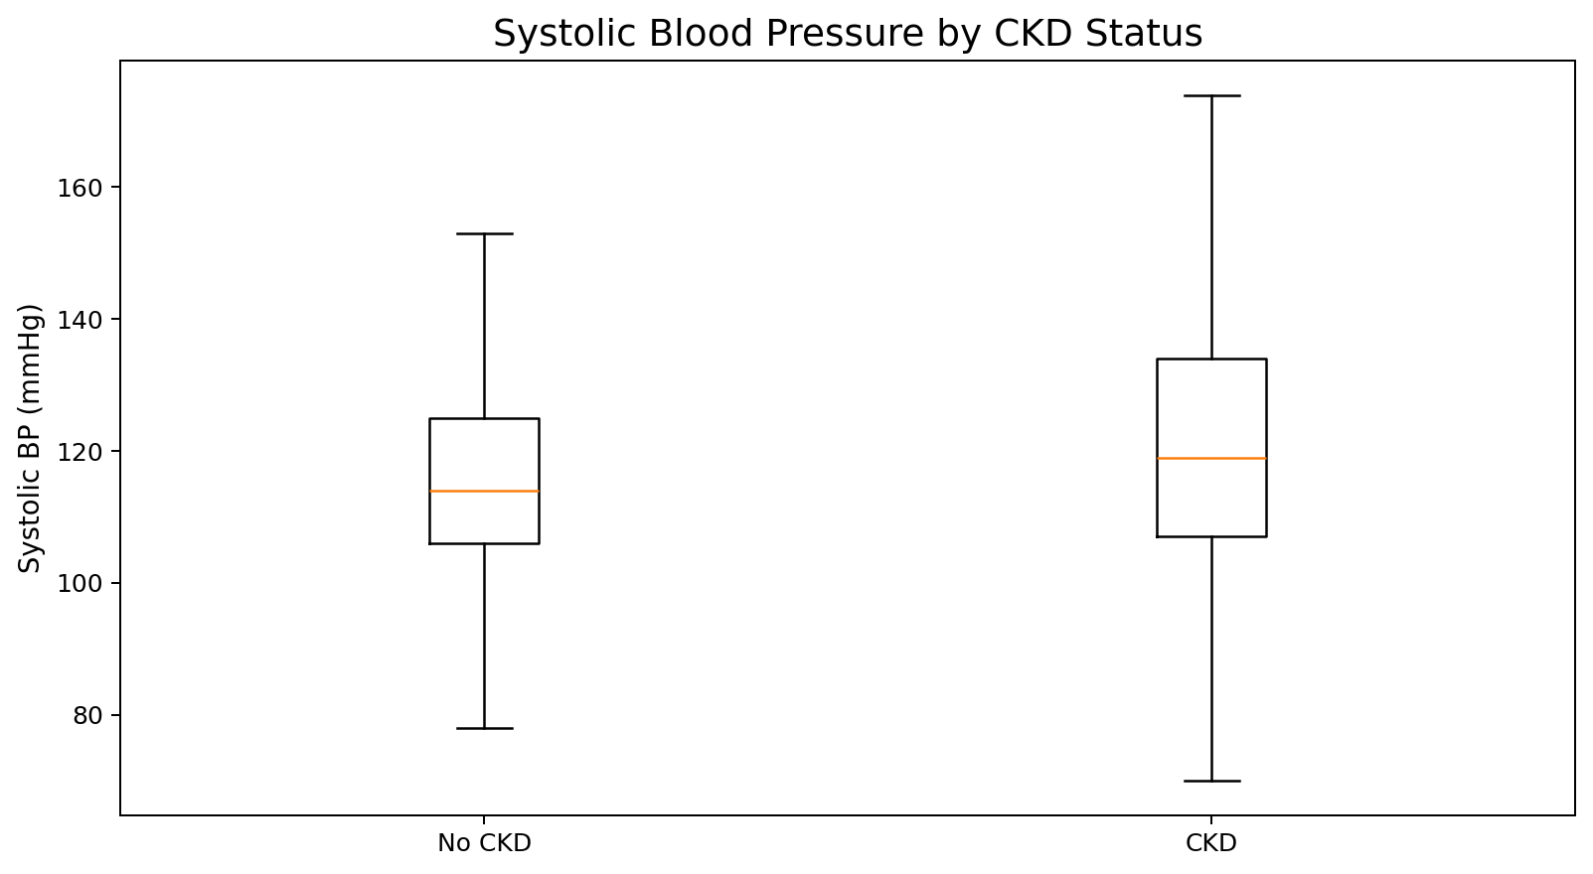
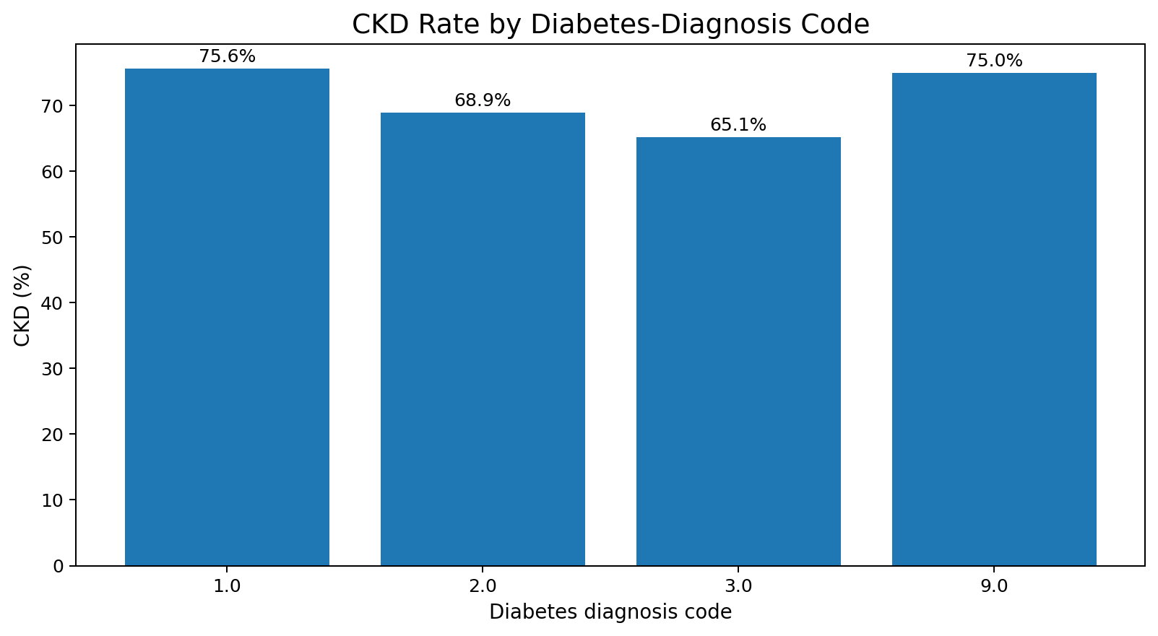
6. EDA — Clinical Signals
Renal and metabolic variables show stronger separation
Mini Hackathon 1 • CKD Prediction • 2026
7

Slide 8
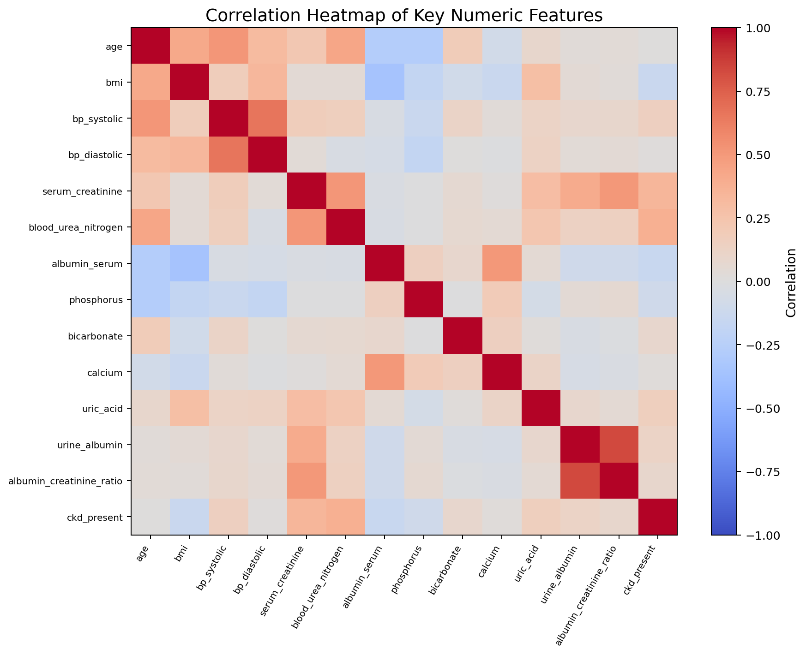
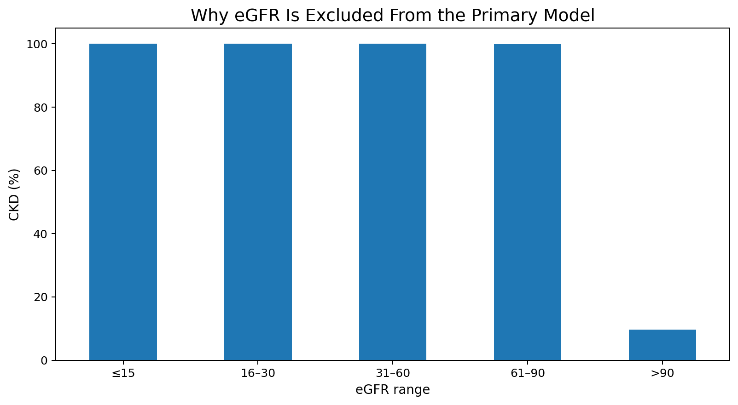
7. EDA — Correlation & Leakage Check
The most important methodological decision in the project
LEAKAGE CONTROL
Remove participant_id, ckd_stage and eGFR from the primary model. eGFR is almost deterministic of the supplied CKD target in this file.
Mini Hackathon 1 • CKD Prediction • 2026
8

Slide 9
8. Proposed Methodology
Leakage-controlled, reproducible ML workflow
DATA
→
EDA
→
PREP
→
TRAIN
→
EVALUATE
Audit + clean
Patterns + gaps
Impute + encode
XGBoost / LightGBM
ROC-AUC + F1
Hyperparameter tuning
3-fold stratified CV on the training portion • ROC-AUC scoring • fixed random seed • held-out test set for final comparison
Mini Hackathon 1 • CKD Prediction • 2026
9

Slide 10
9. Algorithms
Why compare XGBoost and LightGBM?
XGBoost
LightGBM
Regularized gradient-boosted decision trees.
Strong tabular performance and mature ecosystem.
Sparsity-aware learning and scalable tree construction.
Gradient-boosted trees with histogram-based learning.
Uses Gradient-based One-Side Sampling (GOSS) and Exclusive Feature Bundling (EFB).
Designed for efficient training on large/high-dimensional tabular data.
Chen & Guestrin, KDD 2016
Ke et al., NeurIPS 2017
Mini Hackathon 1 • CKD Prediction • 2026
10

Slide 11
10. Experimental Results
Measured on the held-out 20% test set
Metric
XGBoost
LightGBM
Accuracy
99.50%
99.58%
Precision
99.82%
99.76%
Recall
99.46%
99.64%
F1-score
99.64%
99.70%
ROC-AUC
99.9917%
99.9917%
Single-fit time
0.19 s
0.91 s
Interpretation
LightGBM edges XGBoost slightly on accuracy, recall and F1 in this run; ROC-AUC is effectively tied. The measured single-fit time was faster for XGBoost on this environment, so training speed should be reported as an empirical result rather than assumed from algorithm branding.
Mini Hackathon 1 • CKD Prediction • 2026
11

Slide 12
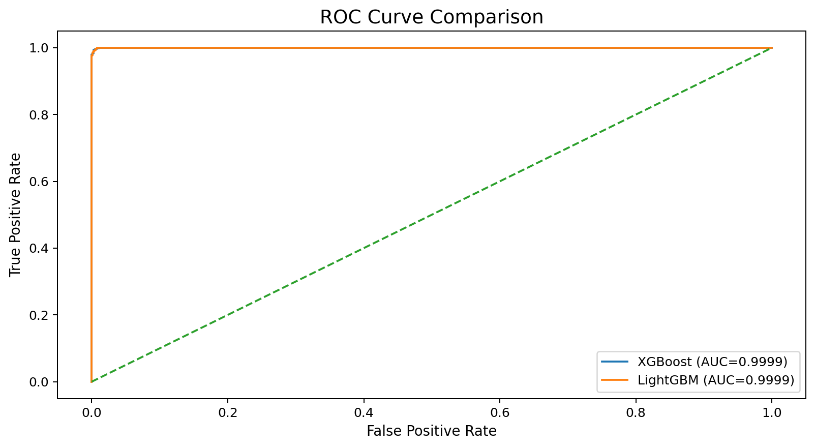
11. Model Discrimination
ROC curves are virtually overlapping on the supplied data
Takeaway
Both models separate the two classes extremely well.
At this level, interpretability, validation and data quality become as important as tiny metric differences.
External validation is still required before clinical use.
Mini Hackathon 1 • CKD Prediction • 2026
12

Slide 13
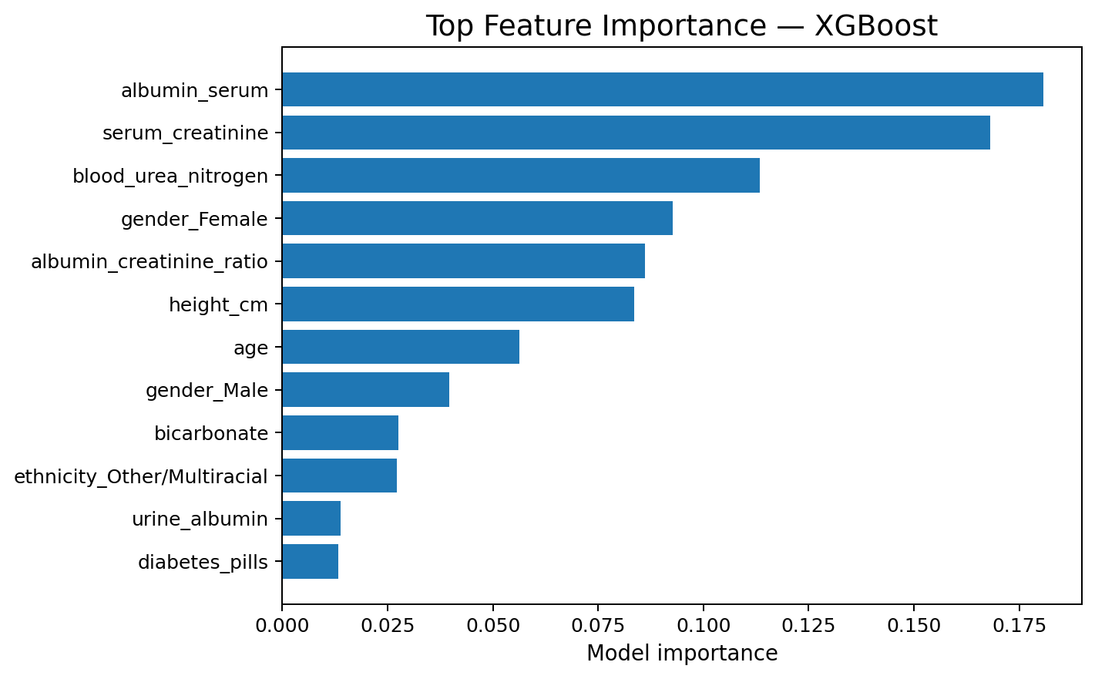
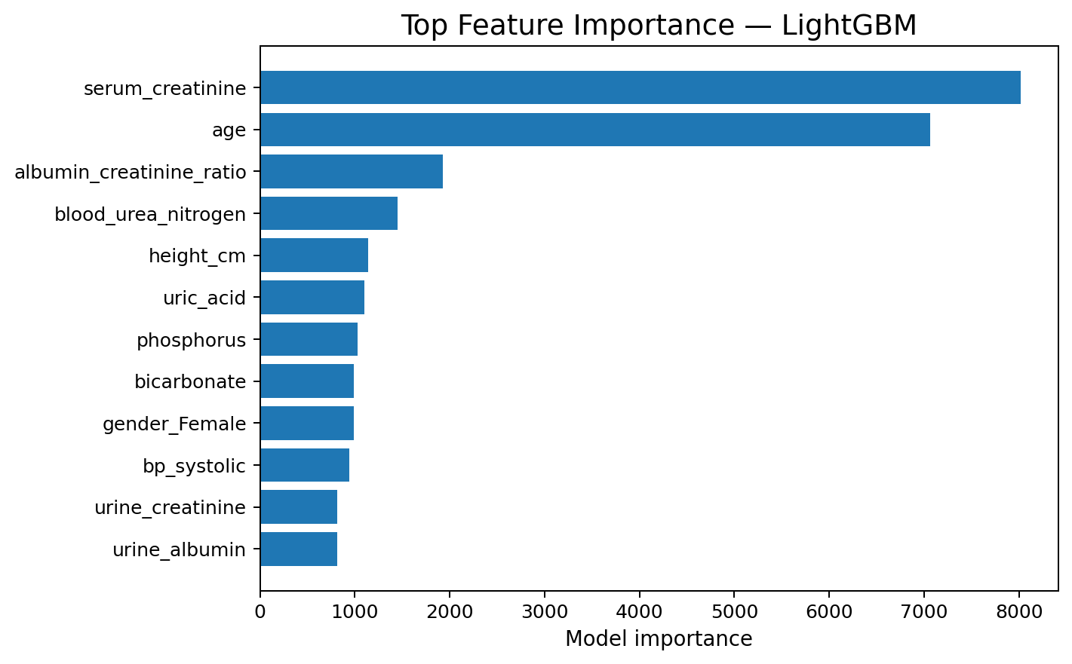
12. Feature Importance
What the models relied on most
Common high-signal variables include serum creatinine, albumin-creatinine ratio, BUN, age and other renal/clinical measures.
Mini Hackathon 1 • CKD Prediction • 2026
13

Slide 14
13. Research Literature
Papers supporting the algorithm choice and clinical ML context
Chen & Guestrin (2016)
XGBoost: A Scalable Tree Boosting System
1
KDD 2016 • arXiv:1603.02754
Ke et al. (2017)
LightGBM: A Highly Efficient Gradient Boosting Decision Tree
2
NeurIPS 2017
Capodici et al. (2023)
Predict, diagnose, and treat CKD with machine learning: systematic review
3
J Nephrol • PMID 36786976
AI to Predict CKD Progression (2025)
Narrative review of AI for progression to kidney failure
4
Asian Pacific Society of Nephrology
Mini Hackathon 1 • CKD Prediction • 2026
14

Slide 15
14. Prototype — CKD Screening Demo
A lightweight Streamlit interface for academic demonstration
CKD Early-Screening Prototype
Prototype flow
Select model
LightGBM ▾
Load trained pipeline
Enter clinical inputs
Run probability prediction
Compare XGBoost vs LightGBM
Show educational warning
Age
50
Serum creatinine
0.9
BUN
14
Serum albumin
4.1
ACR
10
Important: not a medical diagnosis; intended only for academic demonstration.
PREDICT CKD RISK
Mini Hackathon 1 • CKD Prediction • 2026
15

Slide 16
15. Limitations & Future Work
What a responsible next version should improve
Current limitations
Next version
Supplied target construction may closely reflect renal-function thresholds.
Cross-sectional dataset; no longitudinal progression modeling.
High missingness in several clinical variables.
Very high test scores require independent external validation before clinical claims.
Dataset provenance/collection details were not supplied with the CSV.
External validation on an independent cohort.
Calibrated risk estimates and threshold analysis for screening sensitivity.
SHAP-based explanations and fairness/subgroup analysis.
Prospective / longitudinal CKD progression prediction.
Secure deployment with clinical governance and audit logging.
Mini Hackathon 1 • CKD Prediction • 2026
16

