Slide 1

FULL-STACK ENTERPRISE WEB APPLICATION
TaskFlow
Modern Employee Task Management & Workload Balancing Platform
"Work, Clearly Assigned."
Team Members
Roll No
V. PRANAV
P. SAMRAT REDDY
2520030207
2520030131
Section: Sec-7
Notes:
TaskFlow delivers clear enterprise task delegation and real-time workload balancing across modern distributed engineering teams.

Slide 2
THE OPERATIONAL GAP
Opaque delegation puts delivery at risk
CHALLENGE
DELIVERY RISKS
CORE VISION
Workplace Friction
Compounding Failure
Unified Alignment
Fragmented communication tools create siloed task requests.
Opaque task delegation obscures current project ownership.
No real-time visibility into individual employee bandwidth.
Missed sprint deadlines due to unaligned priorities.
Unmonitored bottlenecks stalling critical deployment paths.
Team burnout and uneven distribution across contributors.
A centralized, secure full-stack enterprise web platform.
Direct operational bridge between manager planning and employee execution.
Transparent accountability backed by live workload metrics.
Notes:
Unmonitored delegation causes hidden bottlenecks and contributor burnout, creating a direct operational need for TaskFlow's unified platform.

Slide 3
SYSTEM ARCHITECTURE
A decoupled SPA on a secure REST backend
End-to-end data flow: client single-page application → enterprise REST API → relational storage.
TIER 1
TIER 2
TIER 3
Frontend Client SPA
Enterprise REST API
Relational Persistence
React 18 & Vite tooling; React Router 6 client navigation
Axios interceptors & Lucide icons; custom CSS micro-animations
Java 21 LTS with Spring Boot 3.4; Spring Security RBAC filter chains
Spring Data JPA & Hibernate ORM; strict DTO validation boundaries
MySQL 8.0 enterprise engine; strict foreign-key referential integrity
ACID transaction management; optimized query indexes & schema
→
→
Notes:
TaskFlow isolates presentation logic in React 18 while Spring Boot 3.4 and MySQL 8.0 enforce strict transactional business boundaries.

Slide 4
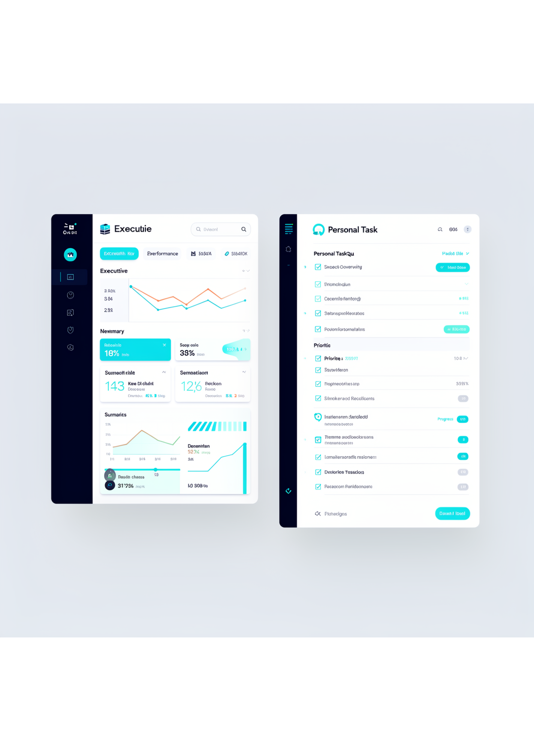
ROLE-BASED ACCESS CONTROL
Two workspaces, one source of truth
MANAGER WORKSPACE
Strategic Oversight & Team Distribution
Comprehensive organization overview with real-time KPI progress widgets.
Dynamic task allocation engine, full team directory, and capacity reports.
EMPLOYEE WORKSPACE
Focused Individual Execution
Distraction-free "My Tasks" queue scoped strictly to assigned responsibilities.
Direct status workflow transitions with inline milestone checklists.
SERVER-ENFORCED RBAC
Hardened Boundary Security
Spring Security context intercepts every API endpoint to block unauthorized horizontal and vertical data access.
Notes:
Strict server-enforced role separation gives managers total project clarity while keeping individual contributors entirely focused on assigned tasks.

Slide 5
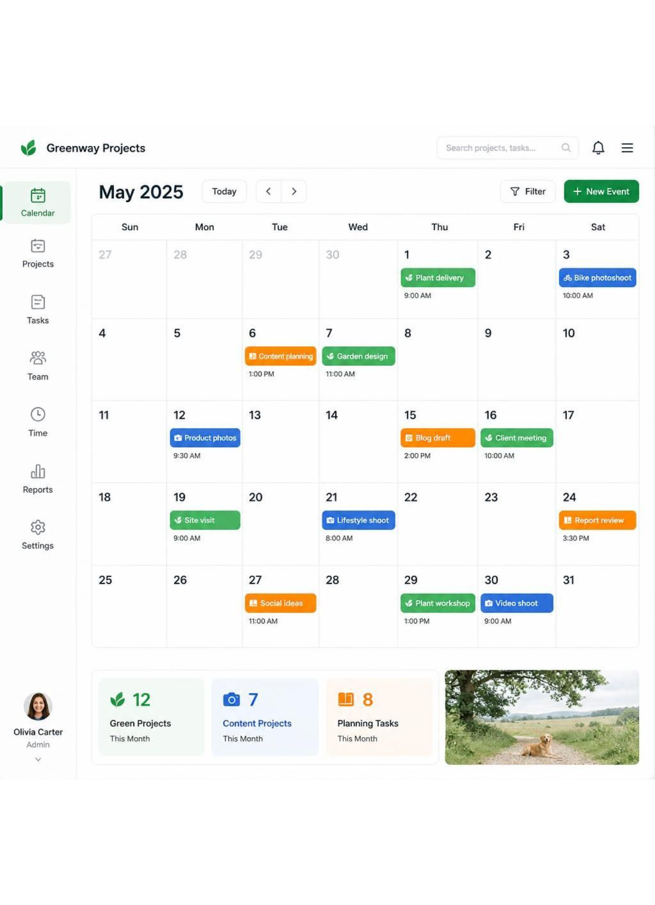
SCHEDULE CLARITY
The calendar makes every deadline visible
INTERACTIVE MONTHLY GRID
Live Timeline Matrix
Real-time dynamic visual matrix displaying current sprints and upcoming project milestones across teams.
STATUS DIFFERENTIATION
Instant Color-Coded Categorization
Immediate differentiation across Upcoming, Completed, and Overdue delivery items.
SEARCH & FILTER ENGINE
Targeted Milestone Discovery
Instant multi-parameter filters by assignee, priority, and completion status.
Notes:
The calendar view transforms abstract deadlines into actionable milestones, instantly surfacing overdue items before deliverables slip.

Slide 6
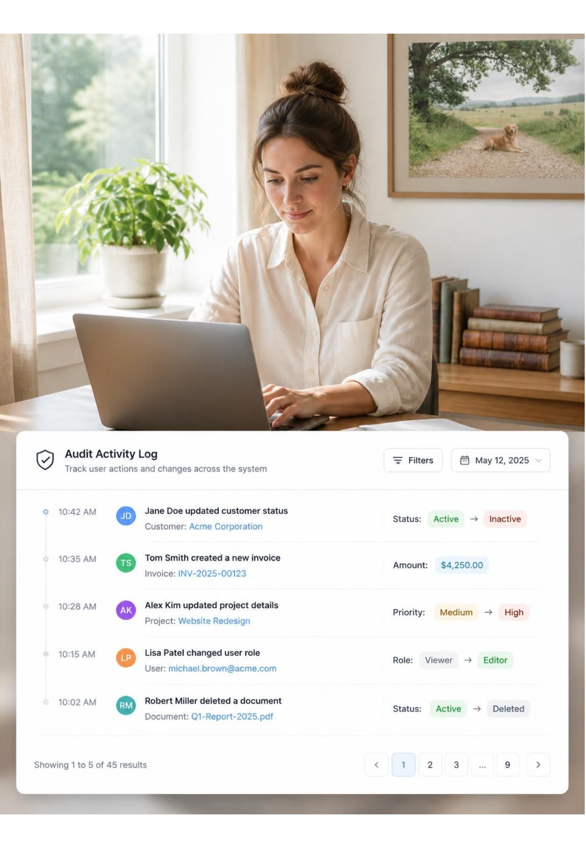
IMMUTABLE COMPLIANCE
Every change leaves an audit trail
Automated tracking eliminates ambiguity across the lifecycle.
01
02
03
TASKACTIVITY
LIFECYCLE
DIFF BADGES
Entity Persistence
Monitored Events
Visual History
Dedicated JPA audit entity automatically captures every mutation with actor, timestamp, and IP origin.
Records task creation, reassignment, priority changes, and status transitions across all states.
UI timeline displays granular historical diffs highlighting transitions from old → new.
Notes:
Every action generates an immutable TaskActivity record, giving teams complete visibility into historical handoffs and requirement edits.

Slide 7
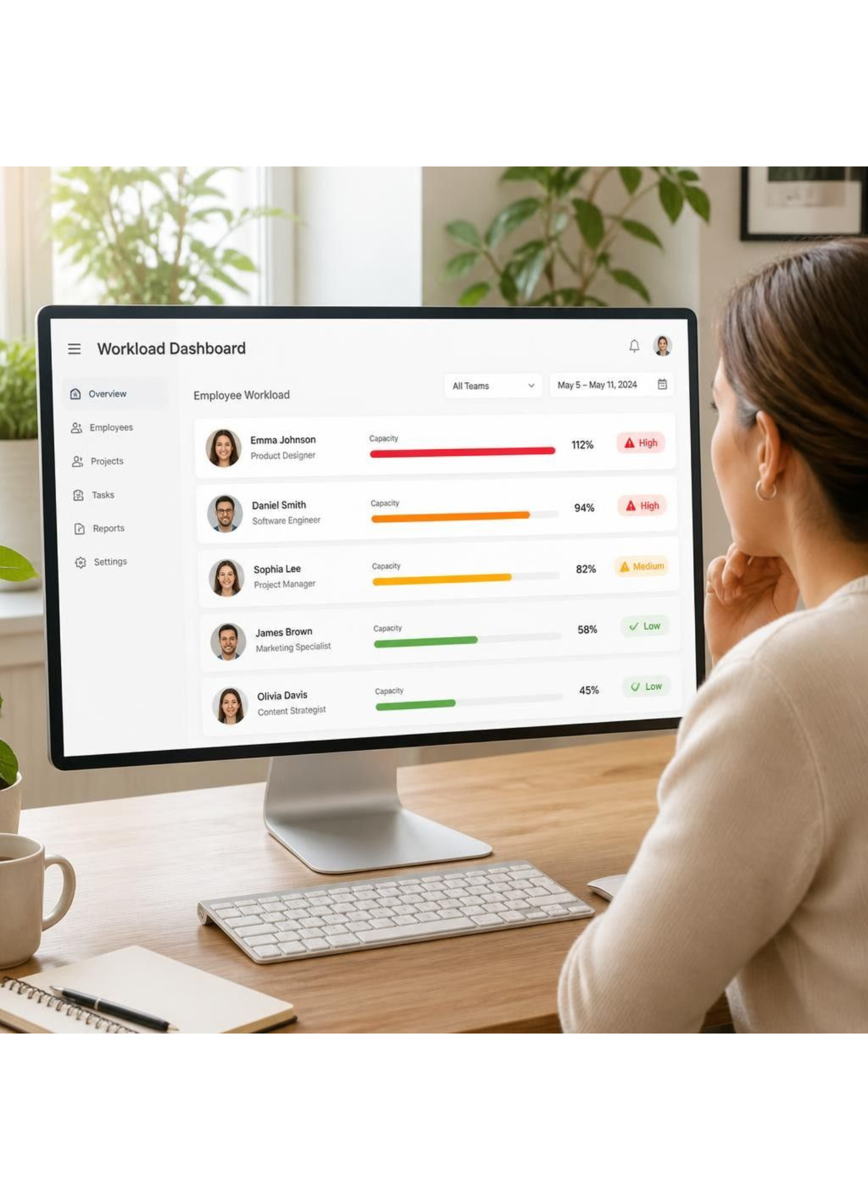
PROACTIVE RESOURCE MANAGEMENT
Workload severity flags burnout before it happens
CAPACITY BALANCING
Granular Volume Distribution
Tracks pending, in-progress, completed, and overdue volumes for every team member in real time.
BURNOUT PREVENTION
Automated Severity Thresholds
Dynamic system tags classify member load into HIGH, MODERATE, and LOW severity tiers.
QUICK FILTER
One-Click Risk Mitigation
Instant managerial view of overloaded employees and delivery risks for immediate task rebalancing.
Notes:
Automated workload severity algorithms proactively alert managers to team fatigue, enabling balanced redistribution before bottlenecks emerge.

Slide 8



ENTERPRISE VISIBILITY
One-click reporting for executives
Exportable operational transparency designed for leadership reporting.
Standardized Export
Export data
Executive Insights
RFC 4180 CSV
8 Standard Fields
Real-Time Metrics
Full UTF-8 BOM encoding ensuring instant compatibility across Microsoft Excel and Google Sheets without parsing anomalies.
Task ID, title, assignee, department, priority tier, lifecycle status, start date, and target deadline.
Real-time performance metrics and aggregated progress statistics, completion velocity, and cross-departmental delivery benchmarks.
SCHEMA
EXPORT
INSIGHTS
Notes:
Leadership obtains instant reporting with standardized RFC 4180 CSV exports compatible with Excel alongside live aggregate velocity metrics.

Slide 9
ZERO-TRUST FOUNDATION
Security built into every layer
AUTH
COOKIES
HEADERS
RELIABILITY
Authentication
Cookie Protection
Request Guard
Code Integrity
BCrypt adaptive password hashing with secure salt rounds.
Opaque server-side session tokens persisted in MySQL storage.
Hardened session cookies configured with HttpOnly flags.
Strict SameSite=Lax policies to eliminate CSRF exposure.
Mandatory custom X-TaskFlow-Request: 1 header validation.
Rejects forged cross-origin requests on all state-mutating routes.
Strict DTO schema validation with Hibernate validator constraints.
Transactional boundaries via @Transactional and full unit and integration tests.
Zero External Vulnerability Surface · Spring Security 6.x Compliant
Notes:
Multi-tier defense combines BCrypt hashing, HttpOnly sessions, mandatory custom request headers, and transactional DTO validation.

Slide 10

Clear ownership, balanced teams, full accountability
DELIVERABLE
Production-ready, secure, and responsive web application engineered with zero external UI bloat.
OUTCOMES
Eliminated delegation ambiguity, well-balanced employee workloads, and end-to-end audit accountability.
ROADMAP
Automated email notifications, recurring task cadence scheduling, and native team webhook integrations.
TaskFlow Platform · Section 7 Engineering Project
Notes:
TaskFlow delivers production-ready workload governance today, setting an extensible foundation for automated webhooks and notification pipelines.

