Slide 1
Sales Dashboard Summary
Name: Narsingoju Pranav
Elevate Labs Data Analyst Internship

Slide 2
Objective
• Design an interactive dashboard for business stakeholders
• Use Power BI to visualize sales performance
• Summarize findings in a PPT format

Slide 3
KPIs Used
Total Sales
Sales by Category
Sales by State
Sales Trends Over Time
Average Sale Value
Total Orders

Slide 4
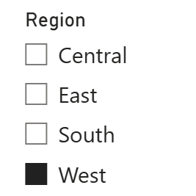
Interactive Dashboard Features
Empowering User-Driven Analysis: This slicer allows users to filter the entire dashboard by a specific region.
How It Works: Clicking on a region (e.g., "West") instantly updates all charts and KPIs to show data only for that selected area.
Enables Deep-Dive Analysis: Stakeholders can easily answer questions like:
"How are sales trending in the East vs. the South?"
"What is our top-selling product category in the West?"
Personalized Views: A regional manager can use this filter to create a view tailored specifically to their area of responsibility, making the dashboard relevant for everyone.

Slide 5
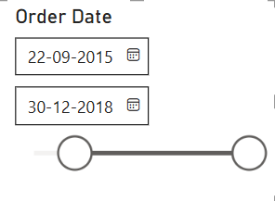
Interactive Time-Based Analysis
Select Custom Date Range
Analyze Specific Time Periods
Focus on Trends & Campaign Results
Interactive Time Control

Slide 6
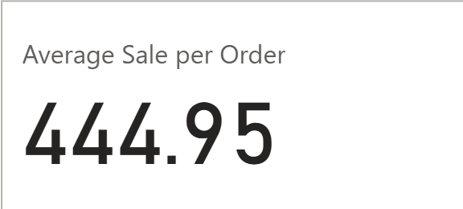
Average Sale per Order: $444.95This metric shows that, on average, each transaction a customer makes is worth nearly $445.What This Tells Us : High Customer Value: This is a very strong number. It indicates that customers are making significant, high-value purchases . Quality over Quantity: The business model likely relies on selling higher-priced items rather than a high volume of low-cost items. Strategic Importance: Profitability: A high average order value is excellent for profitability, as it helps cover the fixed costs of processing and shipping each order more efficiently . Marketing Insight: This data can be used to target customers with promotions on premium products or to create "bundle" deals that encourage even larger purchases . Actionable Recommendation: Focus sales and marketing efforts on upselling (offering a more premium version of a product) and cross-selling (suggesting related items) to increase this already high average.

Slide 7
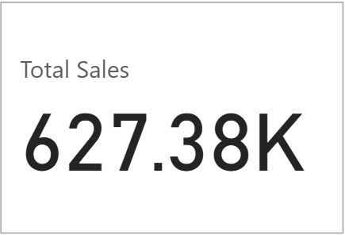
Overall Business Performance
Total Sales: $627.38KThis is our top-line revenue, representing the total value of all customer purchases . Primary Health Indicator: This is the most important metric for understanding the overall size and market performance of the business . Foundation for Analysis: All other metrics, like profit and growth, are derived from this core number . Strategic Goal: The fundamental goal of our sales and marketing efforts is to consistently grow this number.

Slide 8
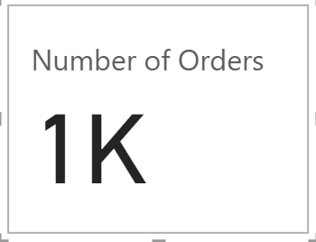
Measuring Business Activity
Total Orders Processed: 1,000This metric represents the total number of individual transactions completed. Indicator of Customer Engagement: It shows how many times customers have chosen to make a purchase, reflecting market reach and customer activity . Combined with Average Sale: When viewed alongside the "Average Sale per Order," it helps build a complete picture of our sales performance (e.g., many small orders vs. fewer large orders).Operational Insight: This number is critical for logistics and operations, helping to forecast workload for order fulfillment and customer service

Slide 9
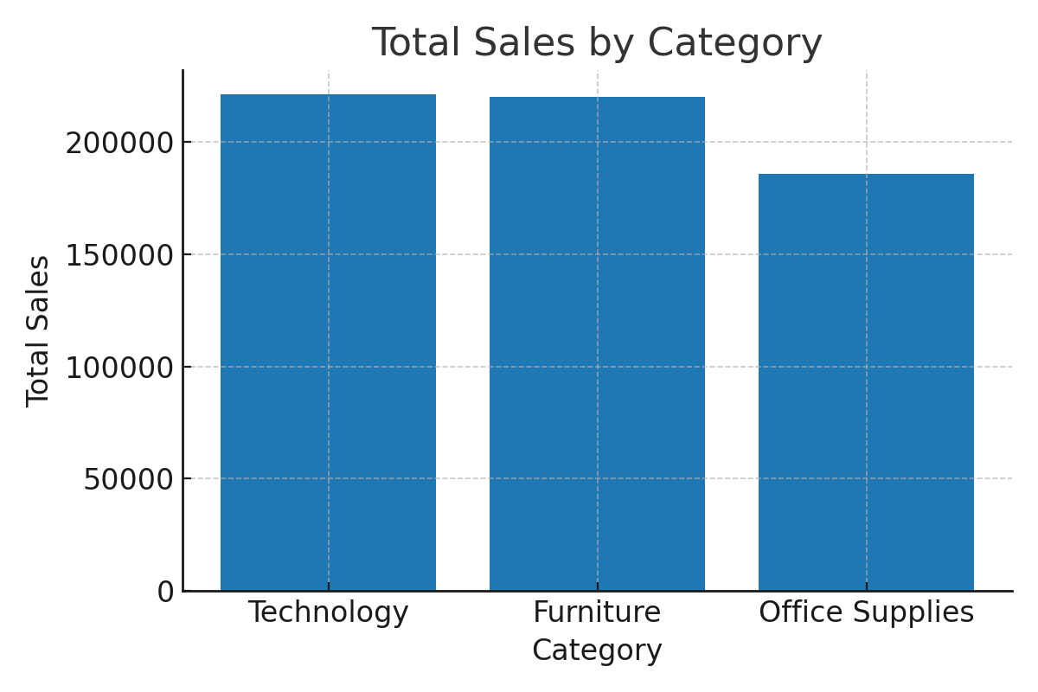
Total Sales by Category
Balanced Performance: Sales are strong and well-distributed across all three categories. Technology Leads: The Technology category is the top revenue generator. Furniture is a Close Second: Furniture sales are nearly identical to Technology, showing its critical importance . Strategic Strength: This balance proves the company has a diversified product portfolio and is not overly reliant on a single category.

Slide 10
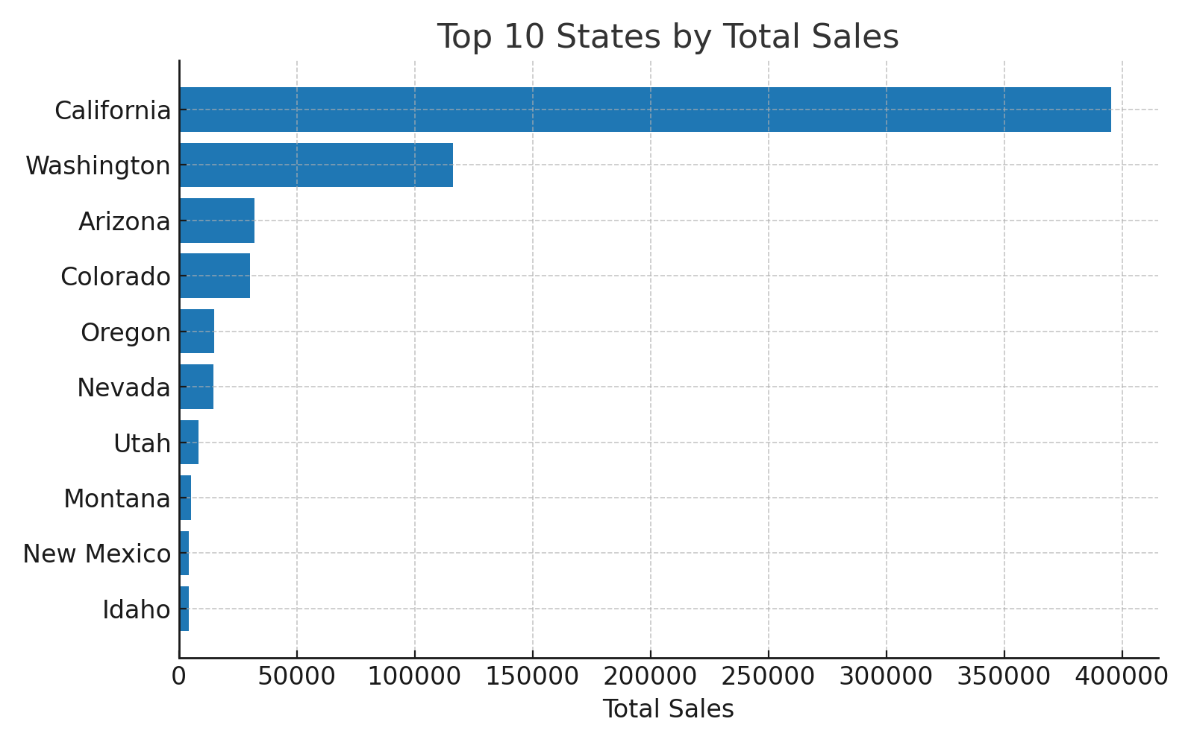
Top 10 States by Total Sales
California is the Dominant Market: It generates significantly more sales than any other state.Top Two States Drive Revenue: California and Washington together account for the vast majority of sales in this group . Clear Market Tiers: There is a distinct drop in sales volume after the top two states, identifying clear tiers of market importance . Strategic Focus: This chart pinpoints our most critical markets, guiding where to focus marketing and inventory efforts

Slide 11
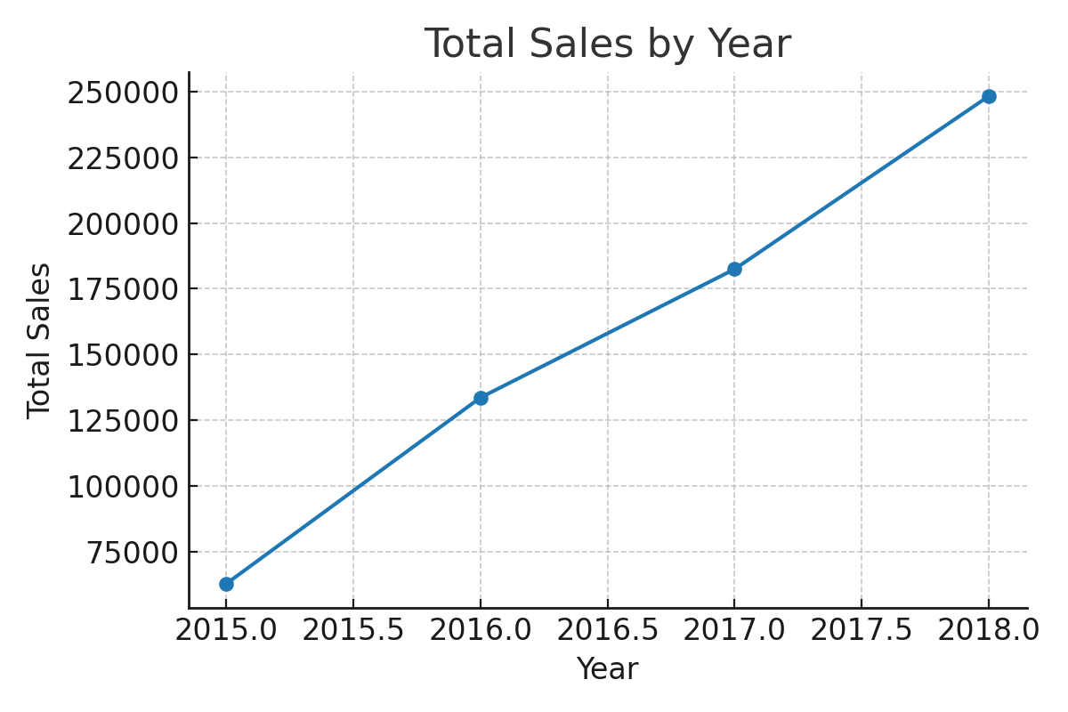
Sales Trend Over Years
Consistent Year-Over-Year Growth: The chart shows a strong and steady increase in sales from 2015 to 2018.Positive Upward Trend: This demonstrates a healthy and successful business trajectory over the four-year period . Peak Performance in 2018: The most recent year shows the highest sales, indicating accelerating momentum . Key Takeaway: This trend is a key indicator of successful market strategy and growing customer demand.

Slide 12
Key Insights & Recommendations
• Technology and Furniture categories lead in total sales
• California dominates in state-wise sales
• Sales have shown upward trends over years
• Focus marketing and inventory in top-performing regions and categories

Slide 13


