Slide 1
UNIT 2: COMPREHENSIVE THEORETICAL ANALYSIS
Data Centre Electrical
Infrastructure Engineering
Utility Power Systems • Backup Power Systems • Power Distribution
Earthing & Grounding • Lightning Protection • Capacity Sizing & PUE
Curriculum: M.Tech Computer Science & Engineering (Data Centre Systems)
Institutional Collaboration: MIT World Peace University (MIT-WPU) × NIRVAA Solution

Slide 2
THEORETICAL FOUNDATION
Mission-Critical Power Engineering Paradigms
• The Availability Mandate: Data centres demand 99.982% (Tier III) to 99.995% (Tier IV) availability, representing maximum allowable annual downtime of 1.6 hours and 26 minutes respectively.
• Micro-Interruption Vulnerability: High-density server power supplies (SMPS) tolerate voltage sags only up to 15 to 20 milliseconds (CBEMA / ITIC curve) before processors crash and memory registers reset.
• Tri-Level Power Architecture: System design integrates three decoupled tiers: Public Utility Grid (economic power), Battery Energy Storage (0 ms bridging), and Diesel Generation (sustained prime power).
• Zero Single Points of Failure: Mandates concurrent maintainability and fault tolerance through independent, dual-path physical and electrical redundancy.
Unit 2: Data Centre Electrical Infrastructure Engineering | Theoretical Reference
Slide 2 of 25

Slide 3
UTILITY POWER SYSTEMS
Utility Grid Interconnection & Substation Architecture
• High-Voltage Grid Intake: Megawatt-scale facilities (5 MW to 100+ MW) interconnect at 132 kV, 66 kV, 33 kV, or 11 kV to drastically minimize I²R transmission losses.
• On-Site Primary Substation: Steps incoming transmission voltage down to 11 kV or 33 kV, housing outdoor surge arresters, high-voltage isolators, and metering instrument transformers.
• Tariffs & Power Factor Mandates: Commercial tariffs impose peak kVA demand penalties; Automatic Power Factor Correction (APFC) keeps power factor strictly between 0.95 and 0.99 lag.
• Point of Common Coupling (PCC): The contractual boundary between utility provider and data centre where strict IEEE 519 voltage and current harmonic limits are enforced.
Unit 2: Data Centre Electrical Infrastructure Engineering | Theoretical Reference
Slide 3 of 25

Slide 4
UTILITY POWER SYSTEMS
Dual Utility Intake & Physical Routing Diversity
• Substation Independence: Tier III/IV facilities require two independent utility feeds supplied by two separate transmission substations fed by distinct power generation grids.
• Physical Conduit Separation: Underground utility feeder cables must enter the property boundary from opposite directions with at least 20 meters of physical separation.
• Civil Risk Protection: Prevents accidental excavation cuts, municipal roadworks, or localized water-main ruptures from severing both electrical intake conduits simultaneously.
• Automated MV Failover: Motorized medium-voltage switchgear automatically isolates a faulted utility feeder and transfers facility intake to the secondary healthy grid source.
Unit 2: Data Centre Electrical Infrastructure Engineering | Theoretical Reference
Slide 4 of 25

Slide 5
UTILITY POWER SYSTEMS
Primary Switchgear: RMU, VCB, and GIS Technologies
• Ring Main Unit (RMU): Metal-enclosed switchgear configured in a closed ring loop, enabling fault isolation without interrupting continuous power delivery to downstream systems.
• Vacuum Circuit Breakers (VCB): Contacts separate inside a sealed high-vacuum bottle (< 10⁻⁷ mbar). The absence of air extinguishes electrical arcs at zero-crossing; standard for 11 kV / 33 kV.
• Gas Insulated Switchgear (GIS): Conductors and busbars are enclosed inside tanks pressurized with Sulfur Hexafluoride (SF6) gas, providing 3x the dielectric strength of air.
• Urban Footprint Optimization: GIS reduces switchroom floor space by up to 70% compared to Air Insulated Switchgear (AIS), making it ideal for dense urban multi-story facilities.
Unit 2: Data Centre Electrical Infrastructure Engineering | Theoretical Reference
Slide 5 of 25

Slide 6
UTILITY POWER SYSTEMS
Substation Transformers: Cast Resin Dry-Type vs. Oil-Immersed
• Cast Resin Dry-Type (CRT): Coils are cast under vacuum in non-flammable epoxy resin with quartz filler, delivering F1 fire safety (self-extinguishing, zero toxic gas emissions).
• Indoor Whitespace Proximity: CRT units can be safely placed directly inside the building adjacent to Low Voltage Main Switchboards, drastically shortening high-current busduct runs.
• Oil-Immersed Hazards: Mineral oil poses severe fire and explosion risks, requiring outdoor blast barriers, automatic water deluge fire suppression, and oil-spill containment pits.
• Dyn11 Vector Group: Standard specification (Delta primary, Wye secondary with neutral brought out); stabilizes 230V phase-to-neutral voltage and traps 3rd harmonics in primary delta.
Unit 2: Data Centre Electrical Infrastructure Engineering | Theoretical Reference
Slide 6 of 25

Slide 7
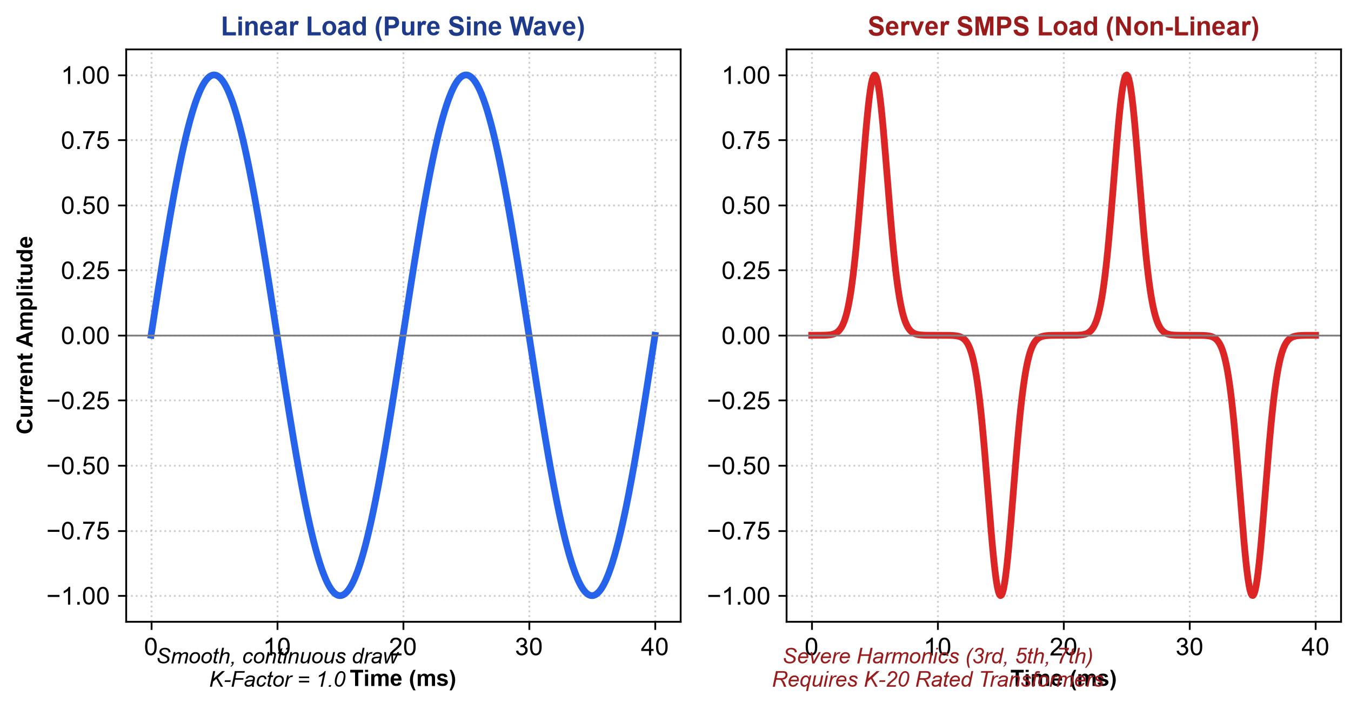
UTILITY POWER SYSTEMS
Harmonic Distortion & K-Factor Rated Transformers
• Non-Linear Server SMPS: Switch-Mode Power Supplies draw current in short, sharp pulses, injecting severe 3rd, 5th, and 7th harmonic frequencies into the power system.
• Eddy Current Overheating: Transformer core Eddy current losses increase with the square of frequency (P ∝ f² × I²), rapidly destroying ordinary transformer winding insulation.
• K-Factor Rating Definition: A weighting index (K = ∑ [I_h² × h²]) measuring a transformer's ability to safely dissipate harmonic heating without exceeding temperature limits.
• Data Centre Standard: K-20 rated transformers are mandatory for IT whitespace, featuring thicker copper windings, electrostatic shielding, and 200% neutral conductors.
Figure 1: Pure 50 Hz linear sine wave vs. high-harmonic non-linear SMPS current pulses.
Unit 2: Data Centre Electrical Infrastructure Engineering | Theoretical Reference
Slide 7 of 25

Slide 8
UTILITY POWER SYSTEMS
Triplen Harmonics & 200% Neutral Sizing Dynamics
• Zero-Sequence Alignment: Triplen harmonics (odd multiples of 3: 3rd, 9th, 15th) are in phase and do not cancel out in a balanced 3-phase 4-wire system.
• Neutral Current Addition: Triplen harmonic currents add up directly in the return neutral wire, causing neutral current to reach I_neutral ≈ 1.73 × I_phase.
• Thermal Runaway Risk: Standard neutral conductors overheat and suffer insulation breakdown, causing hazardous ground-to-neutral voltages in IT racks.
• Engineering Solution: Install 200% double-sized copper neutral conductors and Active Harmonic Filters (AHF) to maintain THDi < 5% under IEEE 519 standards.
Unit 2: Data Centre Electrical Infrastructure Engineering | Theoretical Reference
Slide 8 of 25

Slide 9
BACKUP POWER SYSTEMS
Backup Power: Diesel Generator (DG) Plant Architecture
• Sustained Prime Source: The on-site diesel plant serves as the ultimate sustained power source, providing complete autonomy during prolonged utility grid failures.
• 10-Second Black Start: Digital Engine Control Units (ECUs) crank, accelerate to 1500 RPM / 50 Hz, and stabilize output voltage within 10 to 15 seconds of grid collapse.
• On-Site Fuel Autonomy: Tier III/IV standards require 48 to 72 hours of dedicated continuous-run diesel storage housed in underground double-walled tanks with leak sensors.
• Automated Fuel Polishing: Continuous multi-stage filtration removes water, particulates, and microbial sludge from stored fuel to prevent injector failure during emergency starts.
Unit 2: Data Centre Electrical Infrastructure Engineering | Theoretical Reference
Slide 9 of 25

Slide 10
BACKUP POWER SYSTEMS
Generator Classifications: ISO 8528 Standards & DCC Rating
• Emergency Standby Power (ESP): Rated for maximum 200 hours/year and 70% average load factor. Strictly rejected by Uptime Institute for Tier III/IV data centres.
• Prime Power (PRP): Permits unlimited annual run hours but restricts long-term average load factor to 70% over any 24-hour operational cycle.
• Continuous Power (COP): Allows 100% continuous base-load operation indefinitely, but possesses limited transient step-load handling capability.
• Data Centre Continuous (DCC): Industry gold standard (Cummins, Caterpillar, Kohler). Allows continuous 100% full-load operation for unlimited hours without derating.
Unit 2: Data Centre Electrical Infrastructure Engineering | Theoretical Reference
Slide 10 of 25

Slide 11
BACKUP POWER SYSTEMS
Uninterruptible Power Supply (UPS): Topology Classifications
• Standby / Offline UPS: Feeds loads directly from raw utility power; mechanical relay switches to battery in 8 to 12 ms upon failure. Unacceptable for data centre IT.
• Line-Interactive UPS: Features an autotransformer compensating for sags with a 4 to 6 ms transfer gap. Suitable only for peripheral office networking racks.
• Online Double Conversion (VFI): Voltage and Frequency Independent. Continuously converts AC to DC, then back to pure 50 Hz AC. Delivers absolute zero (0.00 ms) transfer time.
• Total Electrical Isolation: Completely regenerates clean sinusoidal power, eliminating utility voltage sags, spikes, frequency fluctuations, and harmonics.
Unit 2: Data Centre Electrical Infrastructure Engineering | Theoretical Reference
Slide 11 of 25

Slide 12
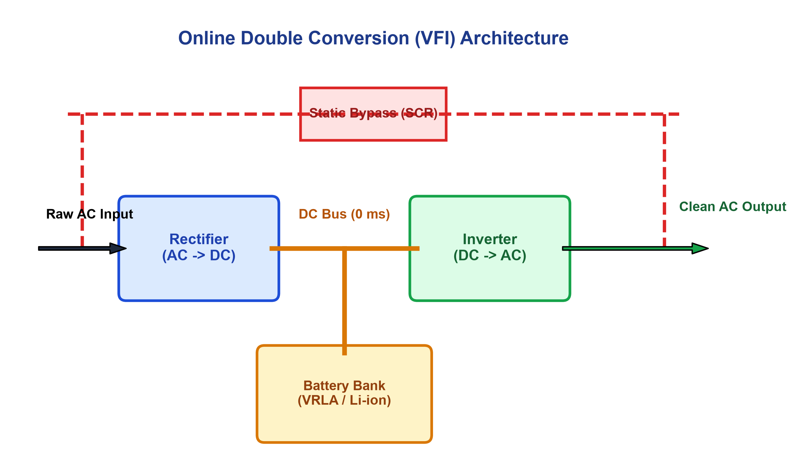
BACKUP POWER SYSTEMS
Online Double Conversion (VFI) & Static Bypass
• IGBT Rectifier Stage: Converts incoming 415V AC into a controlled DC link voltage while maintaining input Power Factor > 0.99 and THDi < 3% via PWM control.
• Permanent DC Bus Battery Link: The battery bank floats directly across the internal DC bus. On utility failure, battery power feeds the inverter instantly with 0 ms interruption.
• IGBT Inverter Stage: Re-synthesizes pristine 3-phase 415V AC power with tight voltage regulation (± 1%) regardless of load steps or input grid disturbances.
• Static Bypass Switch: Solid-state silicon controlled rectifiers (SCRs) provide a < 2 ms failsafe bypass to utility power during inverter overloads or internal faults.
Figure 2: Architecture of an Online Double Conversion (VFI) UPS with Static Bypass.
Unit 2: Data Centre Electrical Infrastructure Engineering | Theoretical Reference
Slide 12 of 25

Slide 13
BACKUP POWER SYSTEMS
Battery Energy Storage: VRLA vs. Lithium-Ion Chemistries
• Valve Regulated Lead-Acid (VRLA): Mature legacy technology with high weight requiring floor structural reinforcement; service life limited to 3 to 5 years.
• Thermal Sensitivity of VRLA: Must be kept strictly at 20°C to 25°C; operational lifespan degrades by 50% for every 10°C temperature elevation above nominal.
• Lithium-Ion (LiFePO4 / NMC): Modern high-density chemistry offering 60% weight reduction, 50% smaller footprint, and 12 to 15 years operational calendar life.
• Operating Envelope & Fast Recharge: Operates reliably up to 35°C (reducing cooling energy), recharges in 1 to 2 hours, and includes integrated Battery Management Systems (BMS).
Unit 2: Data Centre Electrical Infrastructure Engineering | Theoretical Reference
Slide 13 of 25

Slide 14
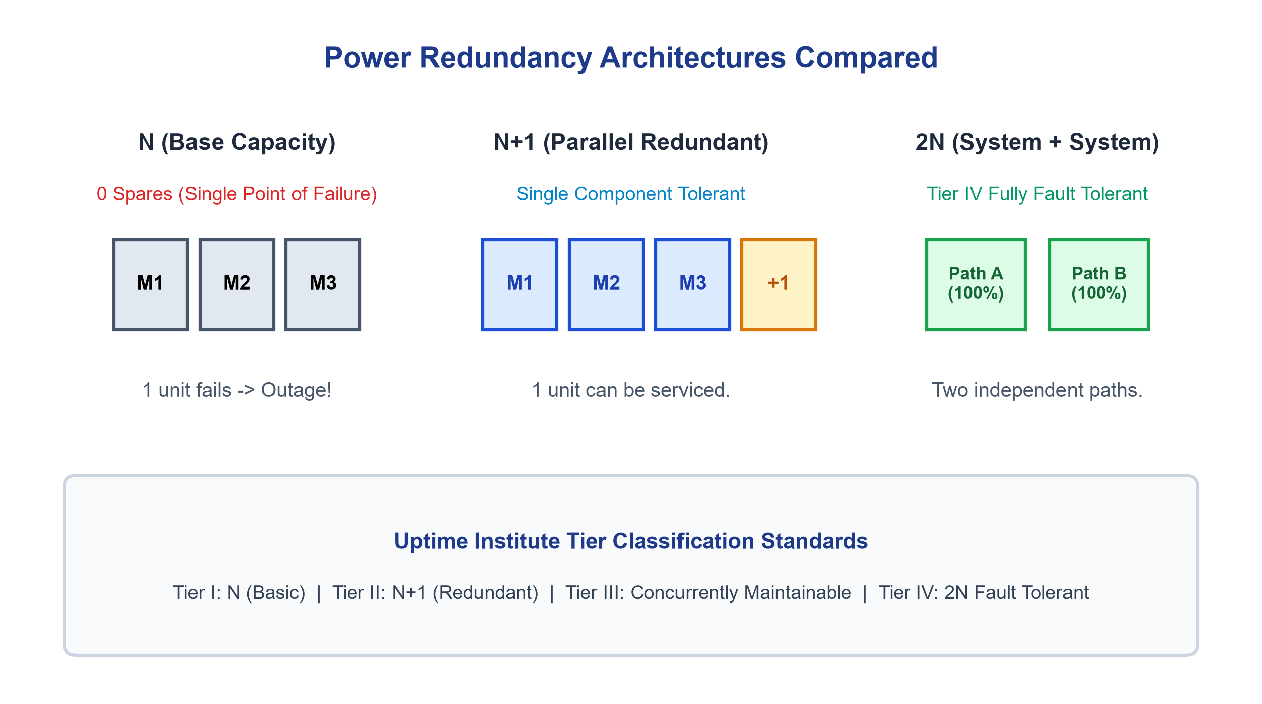
ELECTRICAL DESIGN & REDUNDANCY
Power System Redundancy: N, N+1, and 2N Topologies
• N Configuration (Base Capacity): Provides baseline capacity required to support active IT load with zero spares. Any single component failure causes an outage.
• N+1 Configuration (Parallel Redundant): Includes one extra module beyond baseline (N). Allows scheduled maintenance or failure of one unit without disrupting IT load.
• 2N Configuration (System + System): Two complete, independent electrical delivery systems (Path A & Path B) running from substation down to dual-corded servers. Tier IV standard.
• 2(N+1) Configuration: The pinnacle of resilience: two independent parallel distribution paths, each possessing internal N+1 module-level redundancy.
Figure 3: Redundancy topologies across Uptime Institute Tier classification levels.
Unit 2: Data Centre Electrical Infrastructure Engineering | Theoretical Reference
Slide 14 of 25

Slide 15
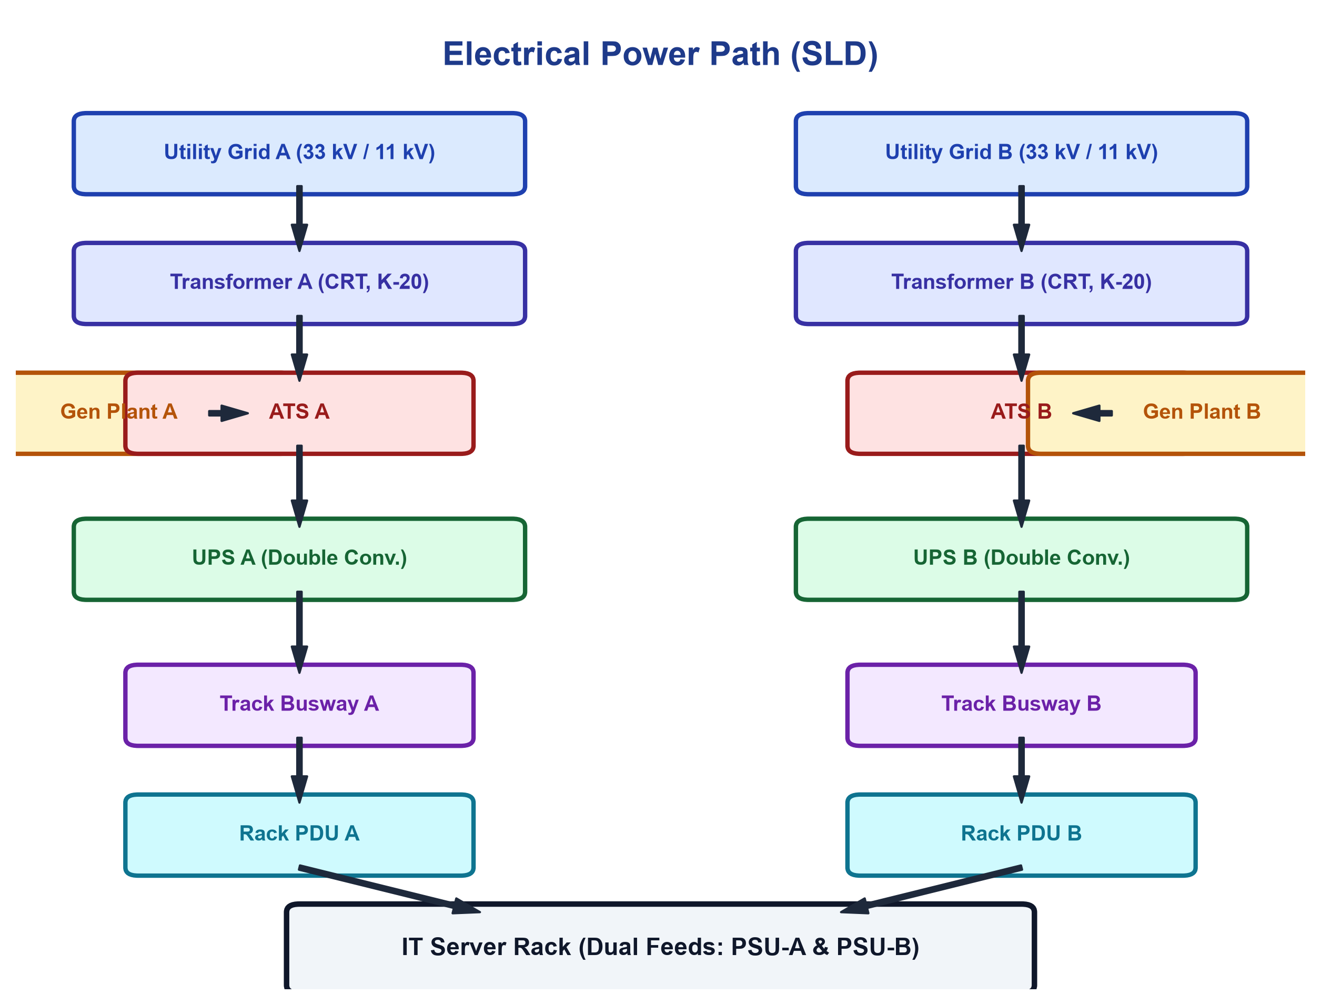
POWER DISTRIBUTION
End-to-End Single Line Diagram (SLD) Power Journey
• High-Voltage Intake: Dual 33 kV utility lines feed Medium Voltage Vacuum Circuit Breaker (VCB) switchgear equipped with Ring Main Units.
• Voltage Transformation: Cast Resin Dry-Type step-down transformers convert 33 kV to 415 V utilization voltage (Dyn11 vector group, K-20 rated).
• Main Switchboard & ATS: Low-voltage switchboard integrates utility feeds with backup diesel generators via high-speed Automatic Transfer Switches.
• Dual-Path Delivery: Conditioned power flows through parallel Online Double Conversion UPS systems into overhead track busways feeding dual rack ePDUs.
Figure 4: Complete Single Line Diagram (SLD) from utility substation to server rack.
Unit 2: Data Centre Electrical Infrastructure Engineering | Theoretical Reference
Slide 15 of 25

Slide 16
POWER DISTRIBUTION
Transfer Switching Technologies: ATS vs. STS Principles
• Automatic Transfer Switch (ATS): Electromechanical motorized switch operating upstream between Grid and Diesel Generators with switching speeds of 50 to 100 ms.
• Static Transfer Switch (STS): Solid-state silicon SCR switch performing phase-synchronized power transfers in 2 to 4 ms (< 1/4 cycle), imperceptible to servers.
• Single-Corded IT Protection: STS units are deployed immediately upstream of legacy single-corded network switches to prevent reboot upon an upstream power feed loss.
• Interlocking & Anti-Paralleling: Strict mechanical and microprocessor interlocks prevent accidental paralleling of unsynchronized electrical sources.
Unit 2: Data Centre Electrical Infrastructure Engineering | Theoretical Reference
Slide 16 of 25

Slide 17
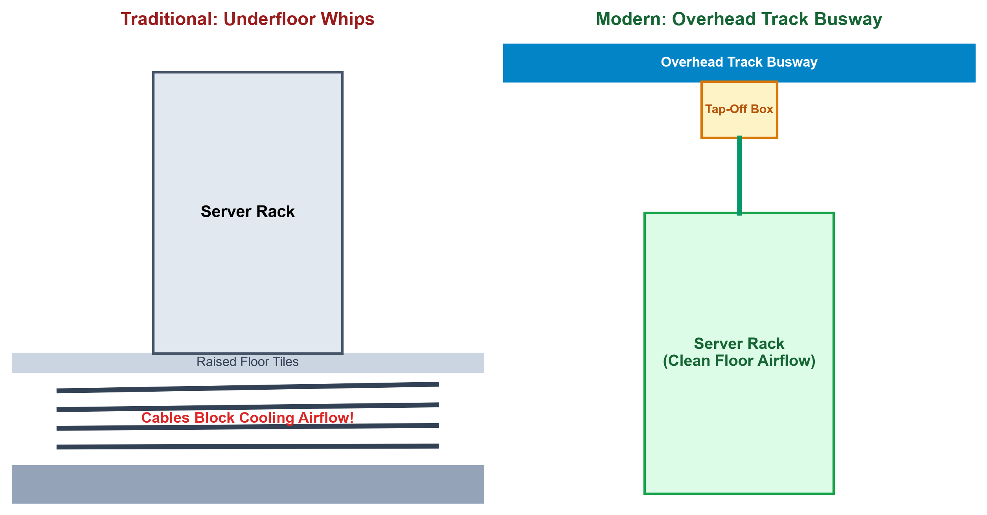
POWER DISTRIBUTION
Whitespace Distribution: Floor PDU vs. Overhead Busway
• Legacy Floor-Mounted PDU: Steel cabinets housing isolation transformers; distributes power via hundreds of flexible underfloor conduit cables ('whips').
• Underfloor Airflow Choking: Dense accumulation of underfloor cable whips severely blocks chilled air circulation, causing hotspot risks in high-density server racks.
• Overhead Track Busway: Modular open-channel aluminum/copper track suspended directly above aisles, completely eliminating underfloor airflow obstructions.
• Plug-and-Play Tap-Off Boxes: Allows electricians to insert and lock modular branch circuit tap-off boxes in real time without de-energizing the main overhead busbar.
Figure 5: Underfloor cable whip congestion vs. modern modular overhead track busway.
Unit 2: Data Centre Electrical Infrastructure Engineering | Theoretical Reference
Slide 17 of 25

Slide 18
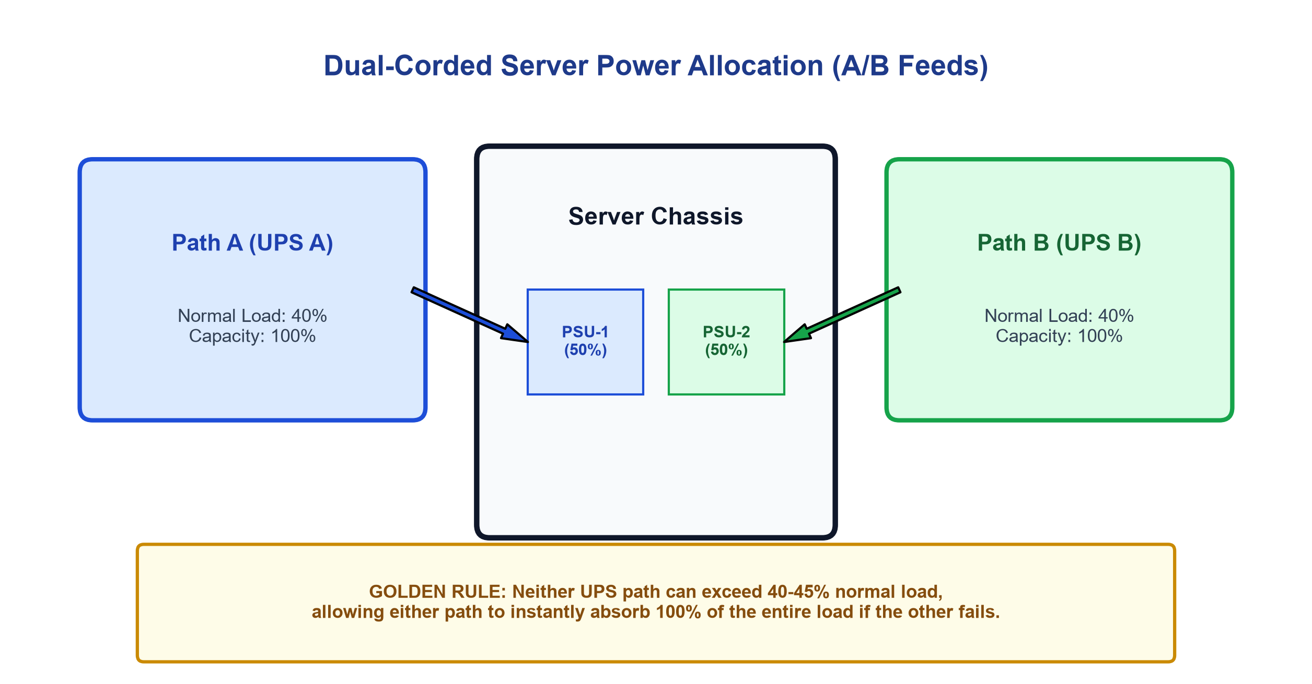
POWER DISTRIBUTION
Dual-Corded Server Power Allocation & The 45% Rule
• Internal Redundant PSUs: Enterprise servers incorporate dual internal Power Supply Units (PSU-1 & PSU-2) sharing the active processing load in a 50/50 ratio.
• A/B Source Separation: PSU-1 connects to Rack PDU A (UPS A); PSU-2 connects to Rack PDU B (UPS B), providing complete circuit independence.
• The 40–45% Operational Rule: Neither UPS path must exceed 45% rated load during normal dual-feed operation to guarantee safety headroom.
• Instantaneous Load Step: If UPS A fails, 100% of the entire data centre load immediately transfers to UPS B. Operating below 45% prevents cascading overload trips.
Figure 6: Dual-corded server power allocation and the critical 45% maximum operational threshold.
Unit 2: Data Centre Electrical Infrastructure Engineering | Theoretical Reference
Slide 18 of 25

Slide 19
EARTHING & LIGHTNING PROTECTION
Earthing Philosophy: Life Safety vs. Digital Signal Integrity
• Dual-Role Grounding Mandate: Data centre grounding simultaneously fulfills two objectives: Low-Frequency Fault Clearing and High-Frequency Signal Integrity.
• Personnel Safety (IEEE 142): Provides a permanent low-impedance metallic fault return path to trip upstream circuit breakers within 20 ms during insulation failure.
• Signal Grounding (IEEE 1100): High-speed processors operating at gigahertz frequencies require a stable equipotential reference plane to eliminate common-mode noise and ESD.
• Earth Resistance Standard: Engineering standards mandate a total earth electrode system resistance of less than 1.0 Ohm (R_earth < 1.0 Ω) for mission-critical IT facilities.
Unit 2: Data Centre Electrical Infrastructure Engineering | Theoretical Reference
Slide 19 of 25

Slide 20
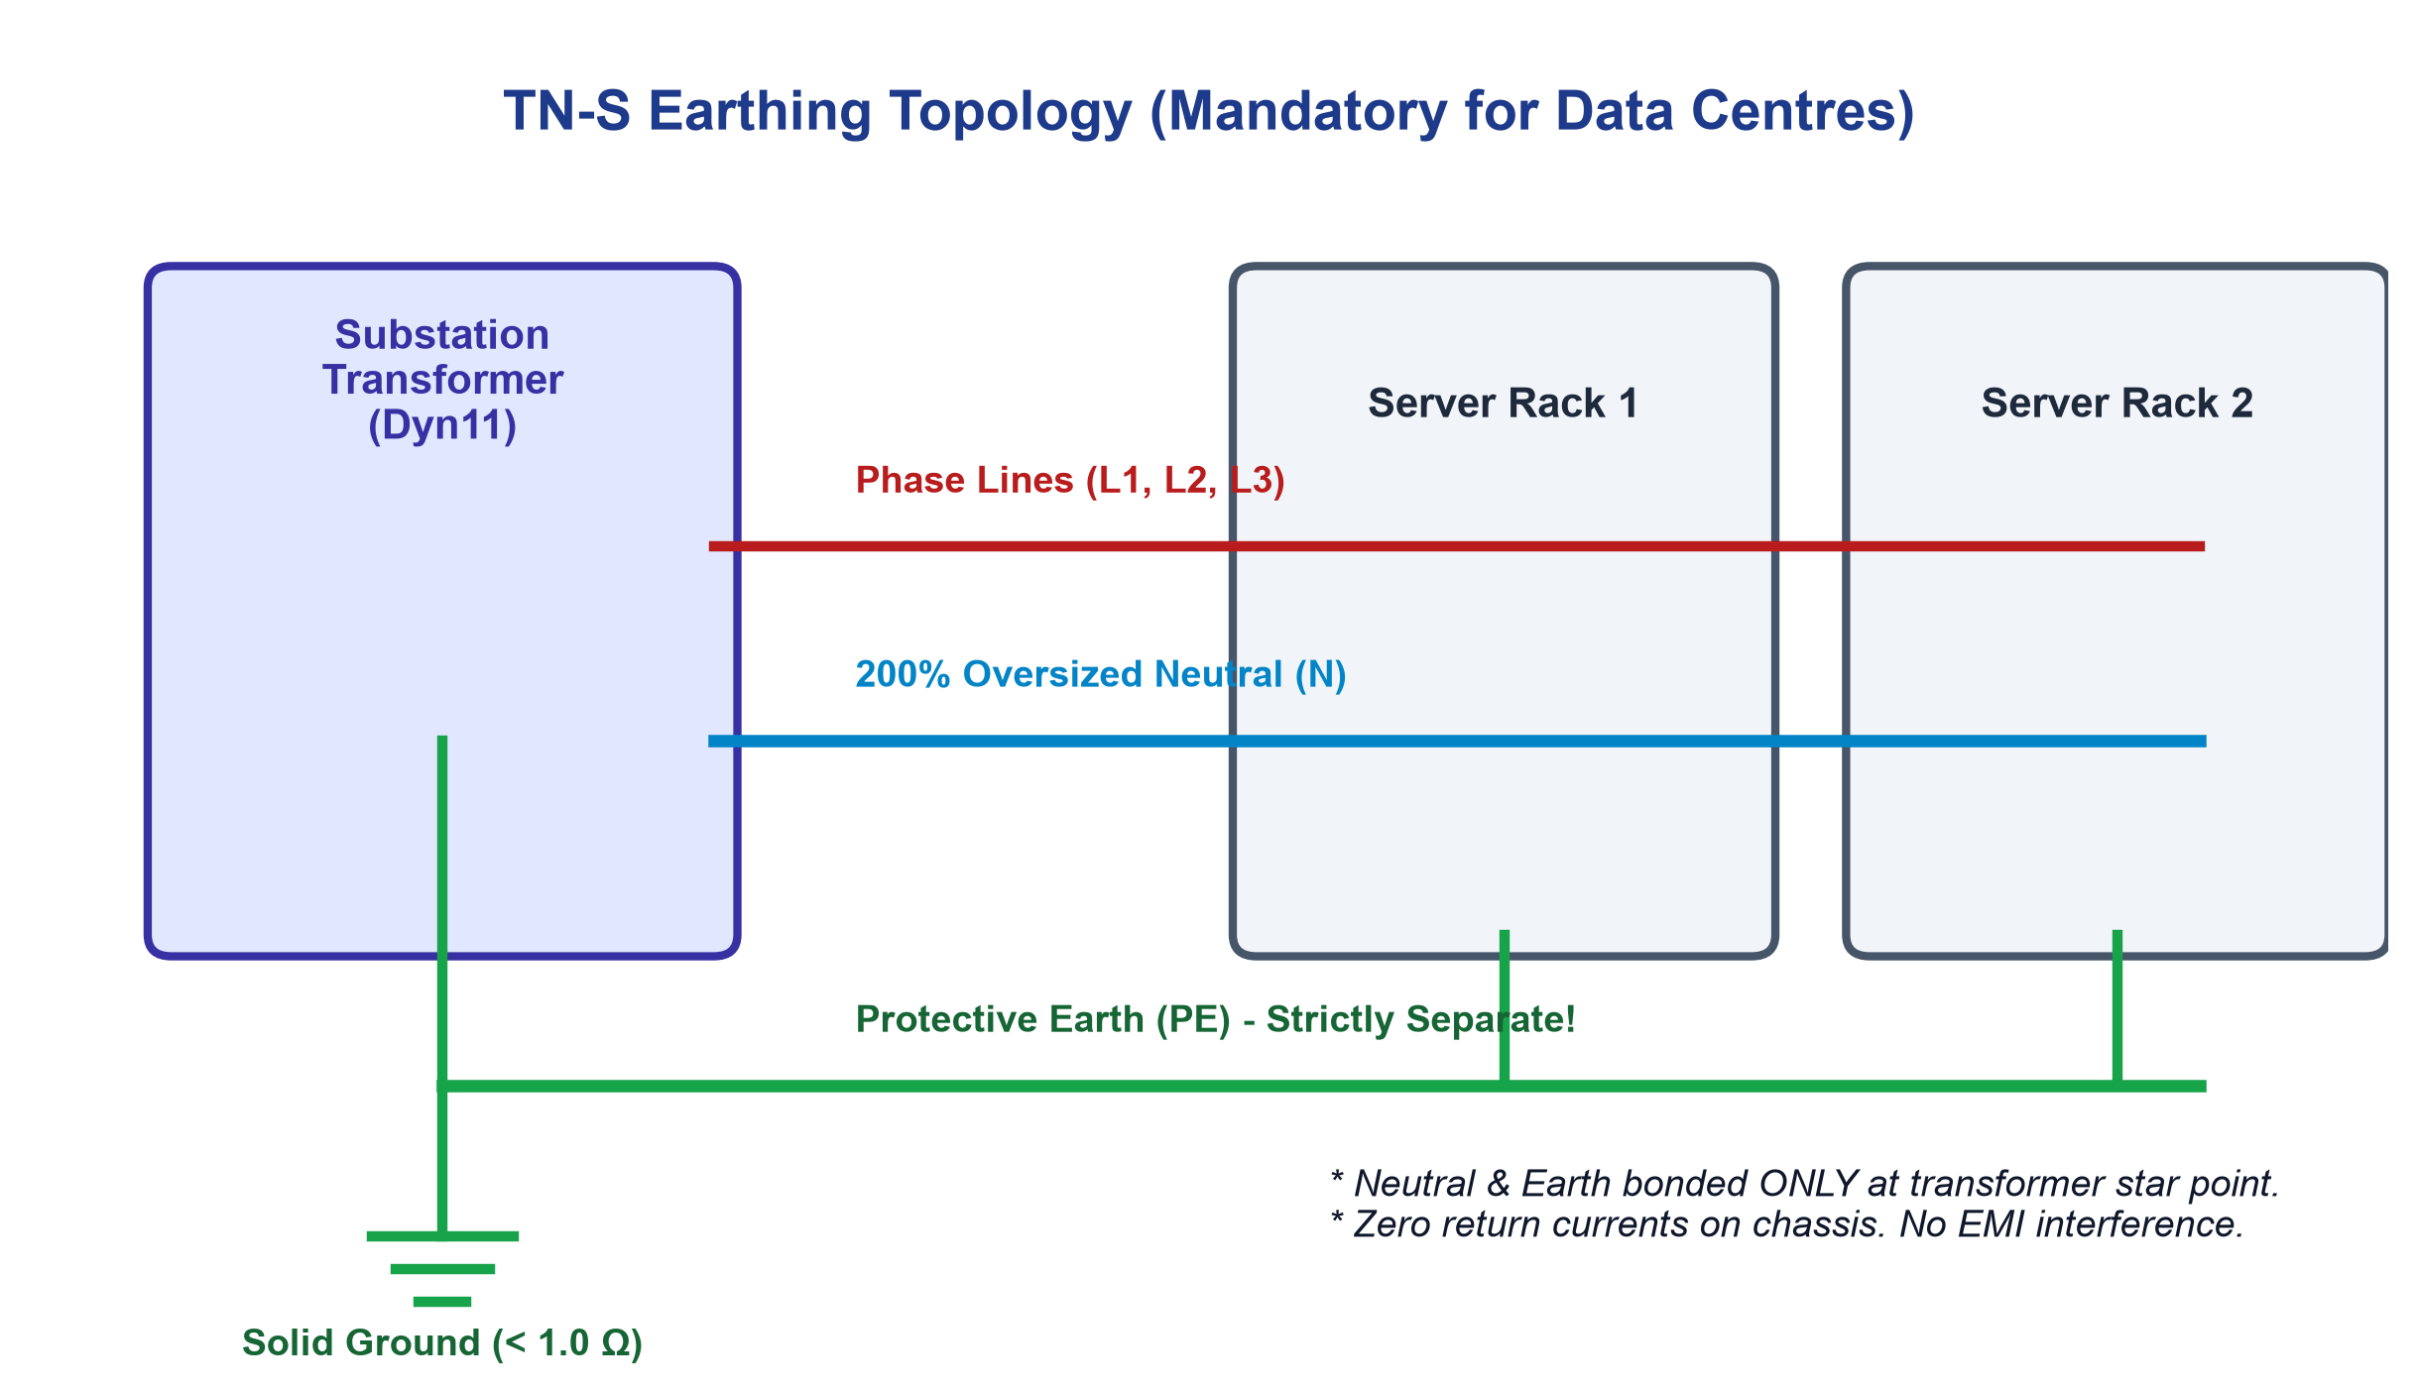
EARTHING & LIGHTNING PROTECTION
The TN-S Grounding Architecture: Standards & Separation
• TN-S Definition: T (Solidly grounded transformer neutral), N (Chassis bonded to earth), S (Neutral and Protective Earth run as strictly separate conductors).
• Single-Point Neutral Bonding: Neutral (N) and Protective Earth (PE) are bonded together at ONLY ONE point in the facility: the main transformer secondary star point.
• Strict Prohibition of TN-C: In TN-C systems, Neutral and Earth share one wire (PEN). Harmonic return currents flow across server chassis, causing shock risks and data corruption.
• Electromagnetic Isolation: Guarantees zero operational return currents circulate through building steel, cable trays, or server rack cabinets.
Figure 7: Schematic wiring of the TN-S earthing scheme showing total separation of Neutral and PE.
Unit 2: Data Centre Electrical Infrastructure Engineering | Theoretical Reference
Slide 20 of 25

Slide 21
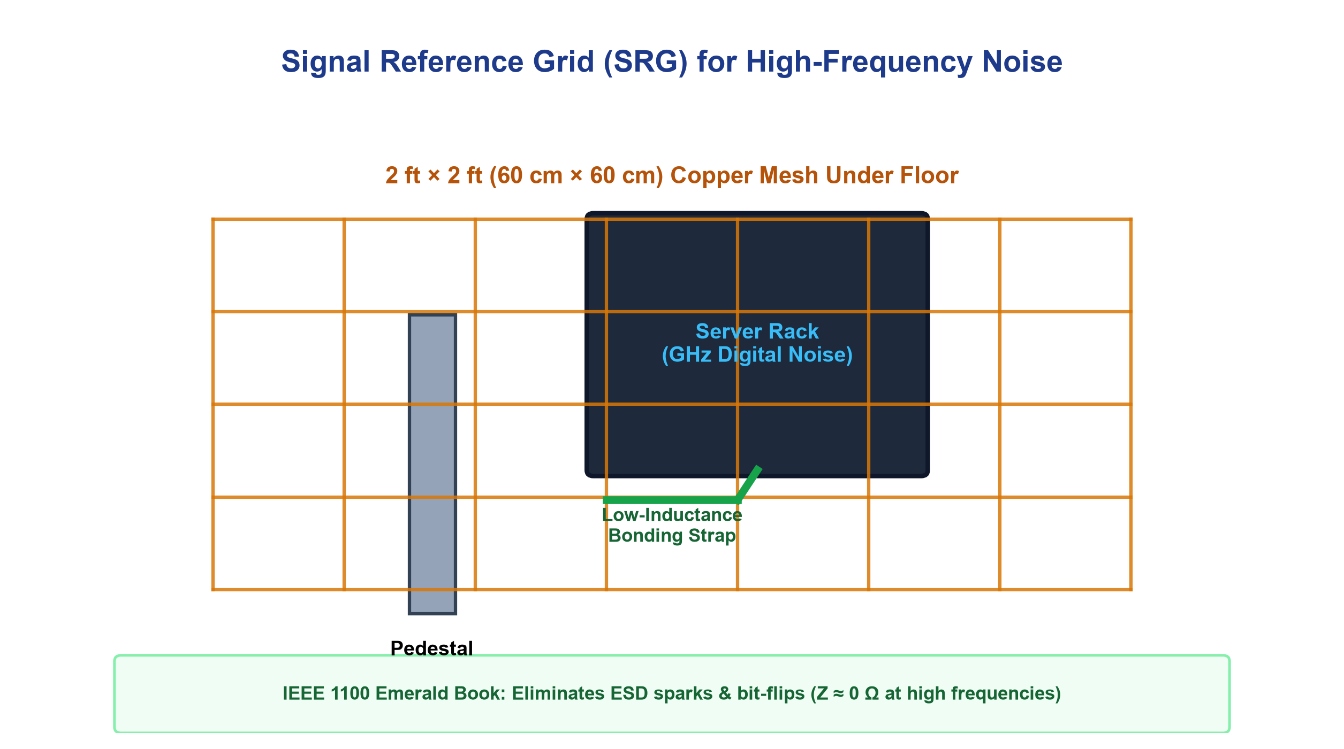
EARTHING & LIGHTNING PROTECTION
High-Frequency Grounding: Signal Reference Grid (SRG)
• High-Frequency Inductance: At gigahertz frequencies, conductor inductive reactance dominates (Z = R + j2πfL). A conventional single ground wire acts as an open antenna.
• Welded 2ft × 2ft Copper Mesh: A prefabricated planar grid of flat copper strips or bare wire forming a 2-foot by 2-foot mesh installed directly beneath raised floor pedestals.
• Multi-Path Low Impedance (Z ≈ 0 Ω): The mesh provides hundreds of parallel interconnected ground paths, reducing high-frequency impedance to near zero across the entire whitespace.
• Equipotential Bonding: All server racks, stanchions, cable trays, and air handlers are bonded to the SRG using short, wide, low-inductance braided copper straps.
Figure 8: Signal Reference Grid (SRG) welded 2ft × 2ft copper mesh beneath raised floor pedestals.
Unit 2: Data Centre Electrical Infrastructure Engineering | Theoretical Reference
Slide 21 of 25

Slide 22
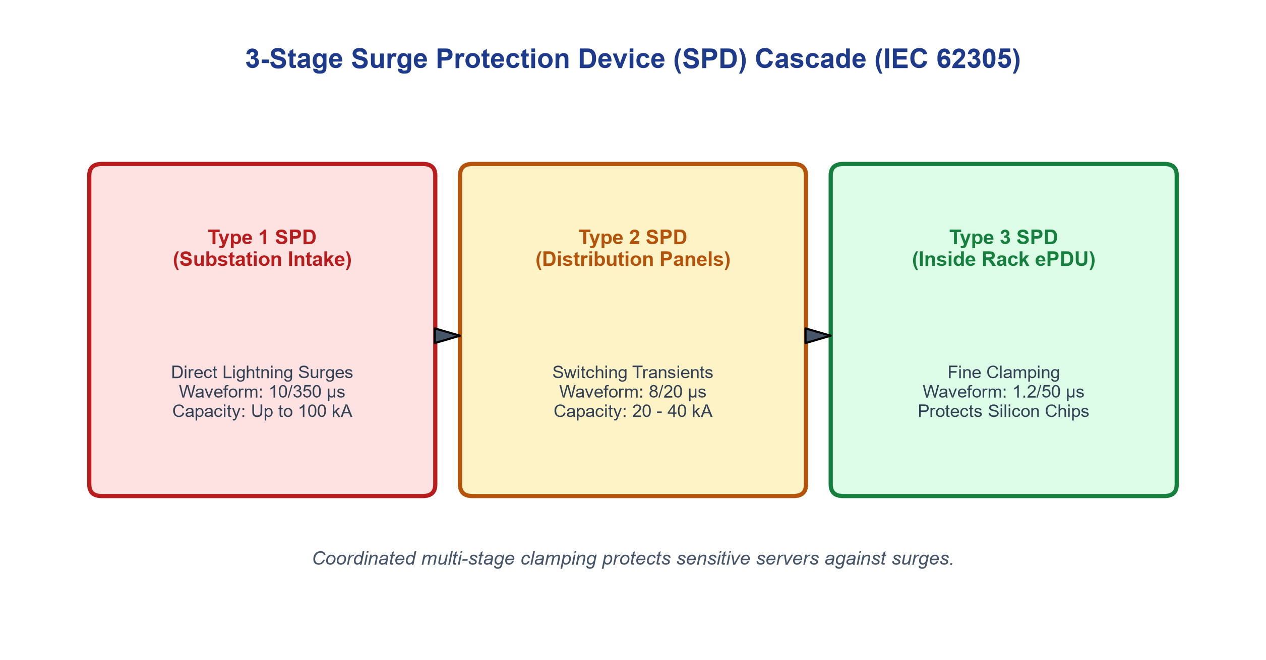
EARTHING & LIGHTNING PROTECTION
Lightning & Surge Protection: IEC 62305 & SPD Cascading
• External Protection (Faraday Cage): Engineered under IEC 62305 using the Rolling Sphere Method (radius = 20m). Rooftop air terminals safely channel 200 kA strikes to ground.
• Coordinated 3-Stage SPD Cascade: Protects sensitive server silicon against lightning electromagnetic pulses (LEMP) and switching surges across three coordinated defense layers.
• Type 1 SPD (Substation Intake): Heavy-duty spark gaps or MOVs absorbing high-energy direct lightning current waveforms (10/350 µs) at the facility service entrance.
• Type 2 & Type 3 SPDs: Type 2 devices clamp distribution switching surges (8/20 µs); Type 3 devices in rack ePDUs provide precision sub-microsecond voltage clamping.
Figure 9: Coordinated 3-stage Surge Protection Device (SPD) cascade under IEC 62305.
Unit 2: Data Centre Electrical Infrastructure Engineering | Theoretical Reference
Slide 22 of 25

Slide 23
ELECTRICAL DESIGN
Electrical Capacity Planning & Load Sizing Methodology
• Step 1: IT Whitespace Load: Total IT Load (kW) = ∑ [Rack Count × Power per Rack]. Incorporates blade servers, high-density AI accelerators, storage, and networking.
• Step 2: Mechanical Cooling Overhead: Chillers, cooling towers, pumps, and Computer Room Air Handlers (CRAH) draw 25% to 40% of active IT load depending on ambient climate.
• Step 3: Auxiliary Infrastructure: Substation battery chargers, whitespace lighting, fire suppression, security, and UPS conversion losses represent an additional 5% to 8% load.
• Step 4: Diversity & Growth Margins: Apply operational diversity factors (0.80–0.90) and include 20% to 30% electrical headroom across switchgear and transformers for future expansion.
Unit 2: Data Centre Electrical Infrastructure Engineering | Theoretical Reference
Slide 23 of 25

Slide 24
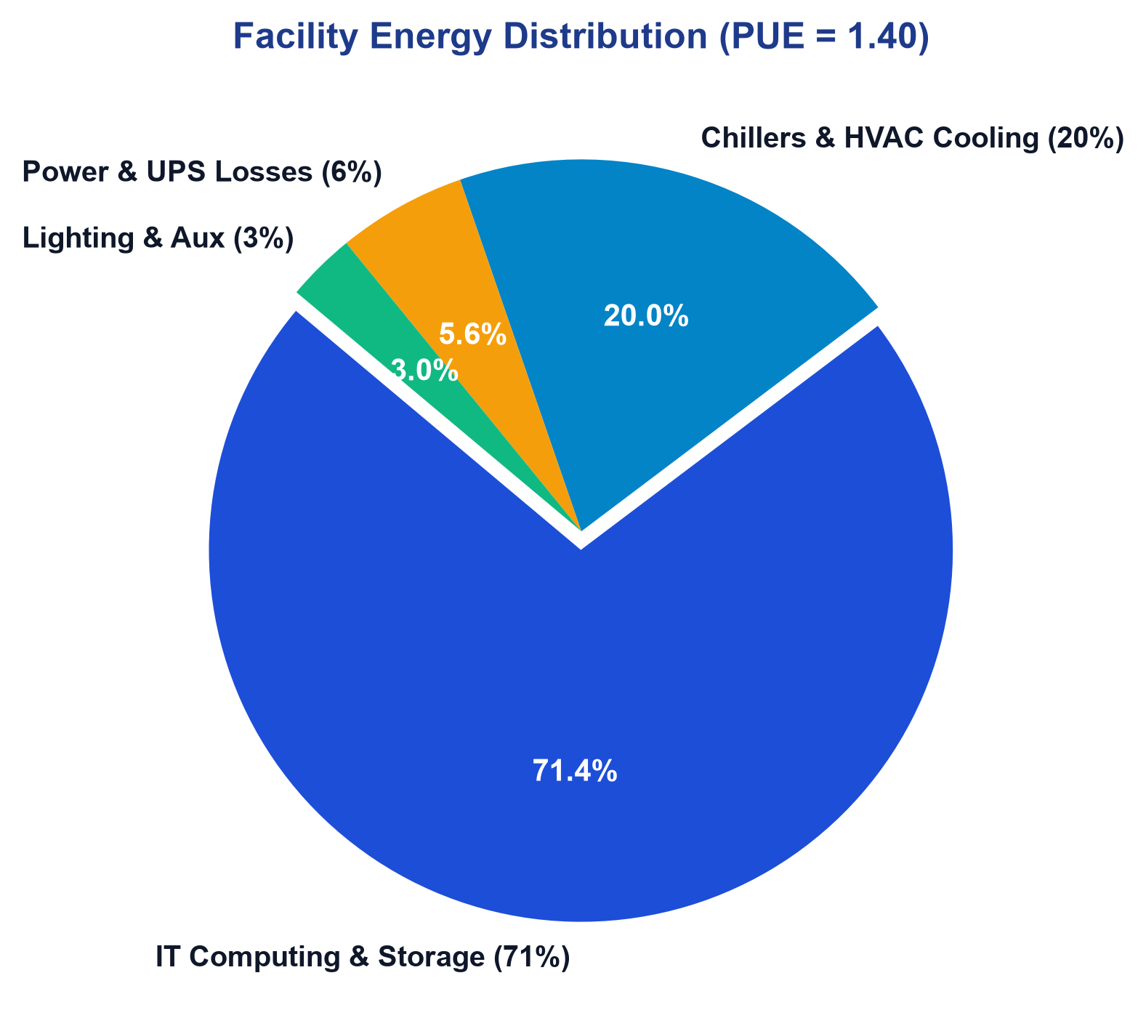
ENERGY EFFICIENCY & METRICS
Data Centre Energy Efficiency: PUE & DCiE Metrics
• Power Usage Effectiveness (PUE): The global benchmark by The Green Grid: PUE = Total Facility Energy / IT Equipment Energy. Ideal theoretical PUE is 1.0 (zero non-IT waste).
• Industry Benchmarks: Legacy facilities operate at PUE 1.8–2.0. Modern enterprise facilities achieve PUE 1.3–1.4. Hyperscale liquid-cooled facilities achieve PUE 1.10–1.15.
• Data Centre Infrastructure Efficiency (DCiE): The reciprocal of PUE expressed as a percentage: DCiE = (1 / PUE) × 100%. Quantifies the percentage of incoming energy delivered to computing silicon.
• Efficiency Levers: Hot/cold aisle containment, variable frequency drives (VFDs) on pumps/fans, elevated chilled water setpoints, and transformer loss minimization.
Figure 10: Total facility energy consumption breakdown for a modern data centre (PUE = 1.40).
Unit 2: Data Centre Electrical Infrastructure Engineering | Theoretical Reference
Slide 24 of 25

Slide 25
ENGINEERING SUMMARY
Summary of Core Electrical Engineering Principles
• Continuous Availability: Total elimination of single points of failure via dual utility interconnections, DCC-rated generator plants, and Online Double Conversion UPS systems.
• Power Quality Management: Harmonic mitigation via K-20 rated CRT transformers, active harmonic filters, and 200% double-sized neutral conductors designed for SMPS loads.
• High-Frequency Grounding: Implementation of strict TN-S earthing topology combined with an equipotential 2ft × 2ft Signal Reference Grid (SRG) ensuring earth resistance < 1.0 Ω.
• Holistic Lifecycle Sizing: Rigorous capacity modeling factoring in IT density, mechanical cooling overhead, Uptime Tier redundancy targets, and aggressive PUE efficiency metrics.
Unit 2: Data Centre Electrical Infrastructure Engineering | Theoretical Reference
Slide 25 of 25

