Slide 1
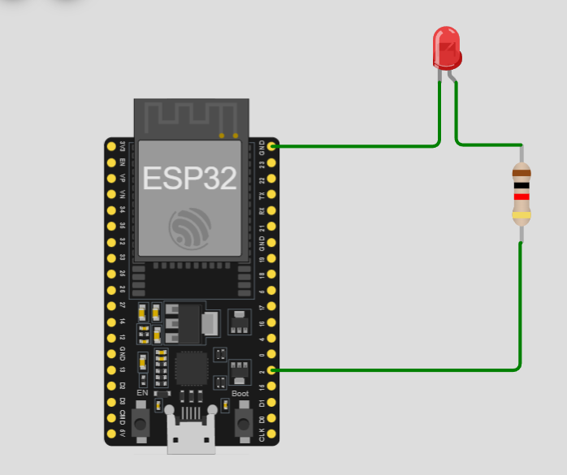
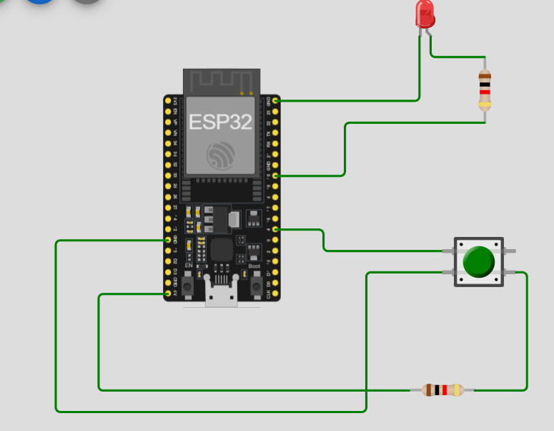
1.LED BLINKING
void setup() {
pinMode(2, OUTPUT);
}
void loop() {
digitalWrite(2, HIGH);
delay(1000);
digitalWrite(2, LOW);
delay(1000);
}
2. LED PUSH BUTTON
int button =0;
void setup() {
pinMode(19, OUTPUT);
pinMode(4, INPUT_PULLUP);
Serial.begin(9600);
}
void loop() {
button=digitalRead(4);
if(button==LOW)
{
digitalWrite(19, HIGH);
Serial.println("LED IS ON");
}
else
{
digitalWrite(19, LOW);
Serial.println("LED IS OFF");
}
}

Slide 2
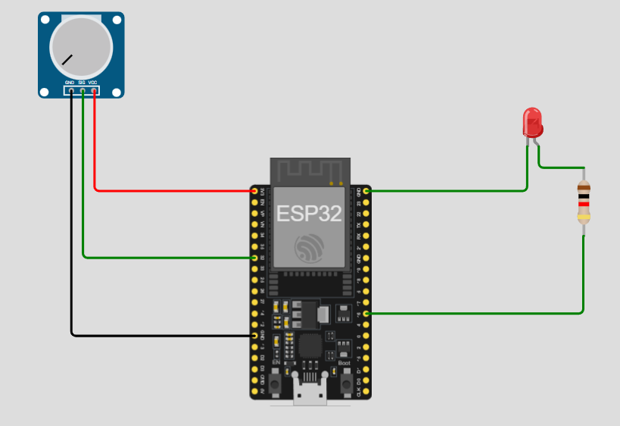
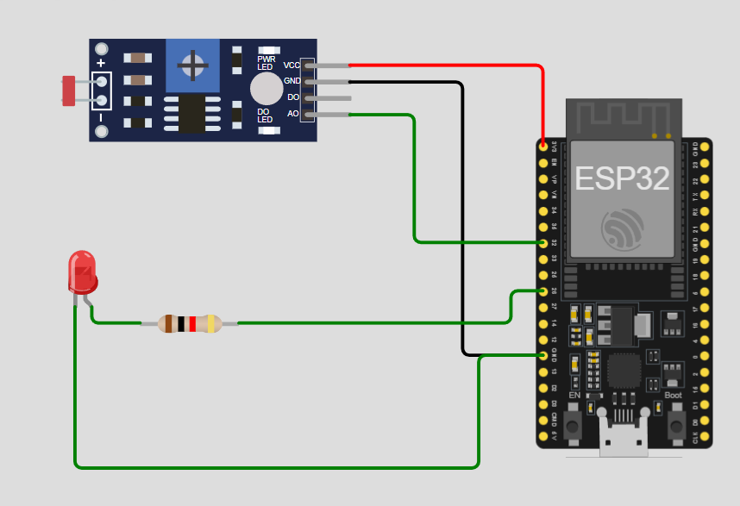
3. POTENTIOMETER
void setup(){
Serial.begin(115200);
pinMode(16, OUTPUT);
}
void loop(){
int value =analogRead(32);
int intensity = map(value, 0, 4095, 0, 255);
analogWrite(16, intensity);
Serial. println(intensity);
delay(10);
}
4. LDR SENSOR
void setup()
{
Serial.begin(9600);
pinMode(26, OUTPUT);
pinMode(32, INPUT);
}
void loop()
{
int LDRStatus = analogRead(32);
if (LDRStatus <=1000)
{
digitalWrite(26, HIGH);
Serial.print("Current light intensity value is ");
Serial.println(LDRStatus);
}
else
{
digitalWrite(26, LOW);
Serial.print("Current light intensity value is - ");
Serial.println(LDRStatus);
}
}

Slide 3
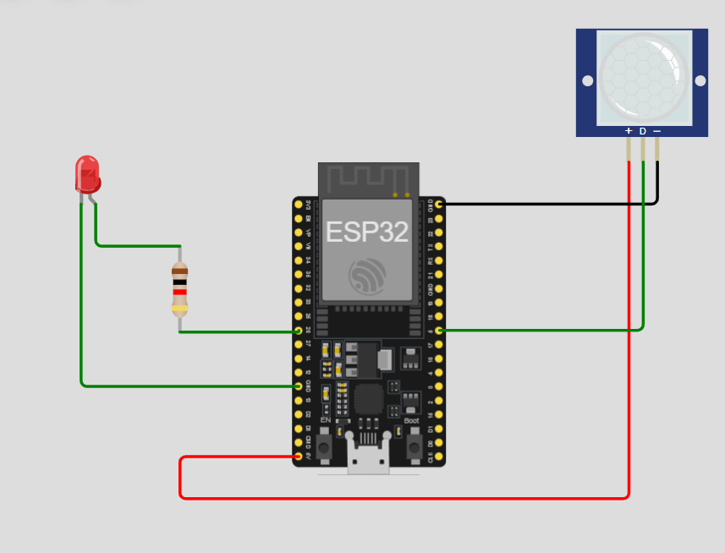
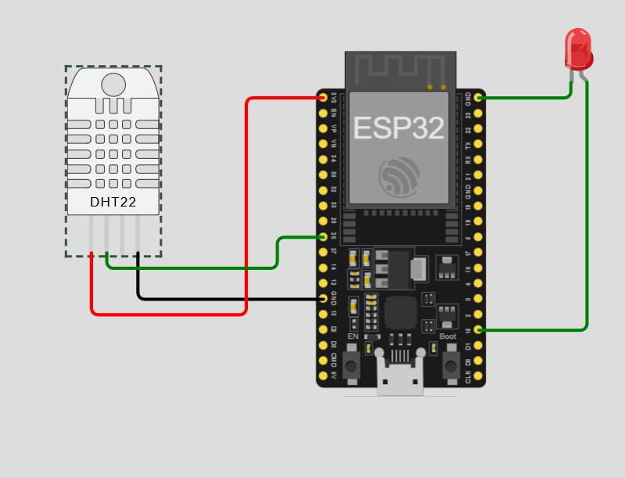
5. PIR MOTION SENSOR
void setup()
{
pinMode(5, INPUT);
pinMode(26, OUTPUT);
Serial.begin(9600);
}
void loop()
{
int motion = 0;
motion = digitalRead(5);
if (motion == HIGH)
{
digitalWrite(26, HIGH);
Serial.println("Motion Detected");
}
else
{
digitalWrite(26, LOW);
Serial.println("Motion Not Detected");
}
delay(100);
}
6. Temperature Measurement
#include "DHT.h"
#define DHT22PIN 26
DHT dht(DHT22PIN, DHT22);
void setup() {
pinMode(15, OUTPUT);
Serial.println("Hello, ESP32!");
Serial.begin(115200);
dht.begin();
}
void loop() {
delay(1000);
float humi = dht.readHumidity();
float temp = dht.readTemperature();
Serial.print("Temperature: ");
Serial.print(temp);
Serial.print("°C ");
Serial.print("Humidity: ");
Serial.println(humi);
if (temp > 30) {
digitalWrite(15, HIGH);
} else if (temp < 25) {
digitalWrite(15, LOW);
}
delay(1000);
}

Slide 4
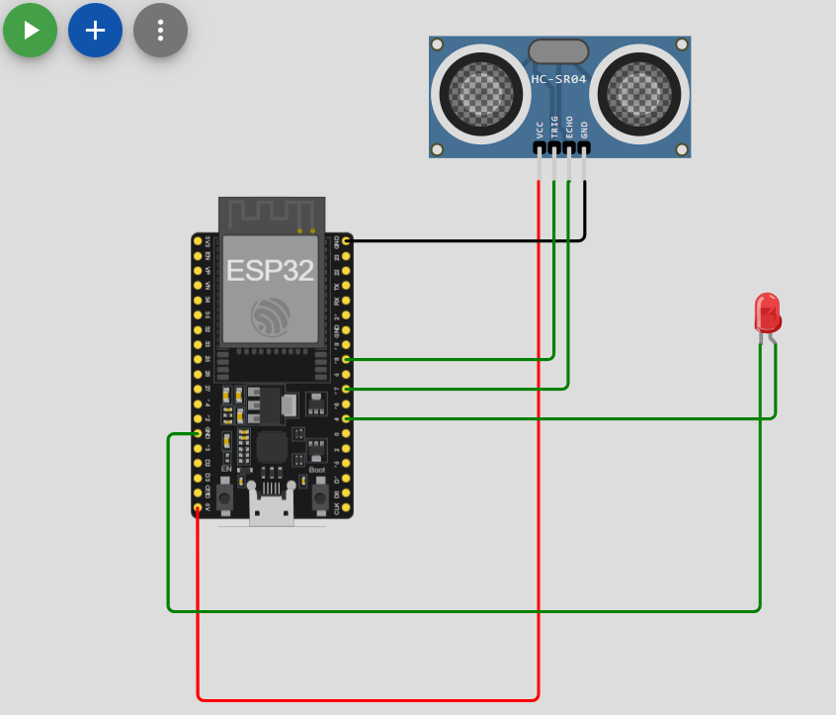
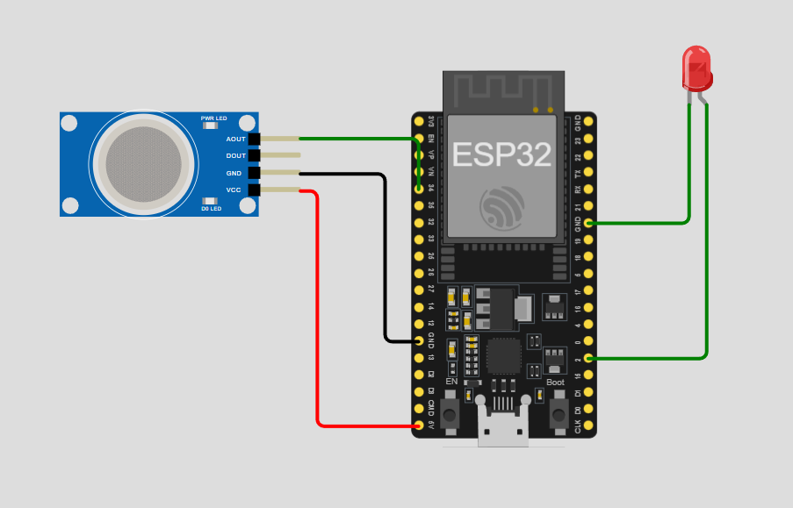
7. Distance MEASUREMENT
float distance;
float duration;
void setup() {
Serial.begin(9600);
pinMode(18, OUTPUT);
pinMode(17, INPUT);
pinMode(4, OUTPUT);
}
void loop() {
digitalWrite(18, HIGH);
delayMicroseconds(10);
digitalWrite(18, LOW);
duration = pulseIn(17, HIGH);
distance = duration * 0.017;
if (distance < 50) {
digitalWrite(4, HIGH);
} else {
digitalWrite(4, LOW);
}
Serial.print("distance: ");
Serial.print(distance);
Serial.println(" cm");
}
8.GAS DETECTION
void setup() {
Serial.begin(115200);
pinMode(2, OUTPUT);
}
void loop() {
int gasValue = analogRead(34);
Serial.print("Gas Sensor Value: ");
Serial.println(gasValue);
if (gasValue >= 700) {
digitalWrite(2, HIGH);
Serial.println("Danger! Gas leak Detected!");
} else {
digitalWrite(2, LOW);
Serial.println("Environment safe");
}
delay(2000);
}

Slide 5
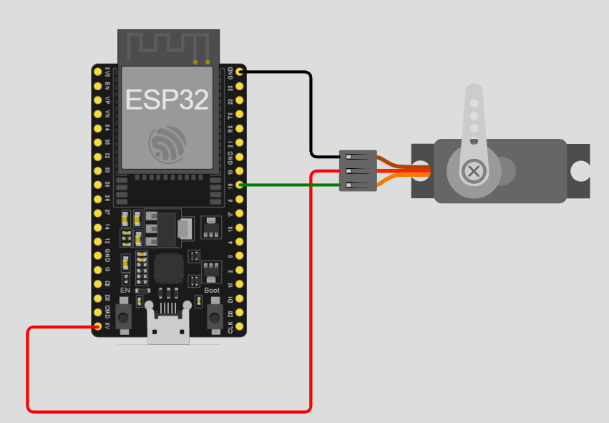
9. SERVOMOTOR
#include <ESP32Servo.h>
const int servoPin = 18;
Servo servo;
void setup() {
servo.attach(servoPin, 500, 2400);
}
int pos = 0;
void loop() {
for (pos = 0; pos <= 180; pos += 1) {
servo.write(pos);
delay(15);
}
for (pos = 180; pos >= 0; pos -= 1) {
servo.write(pos);
delay(15);
}
}

