Slide 1

FootGen AI : Conversational Agent for Football Insights Using Generative AI
By Pranav Yada and Pratyush Rokade

Slide 2

Problem Statement
This project aims to develop an AI-powered chatbot that leverages generative AI models to deliver accurate, real-time football-related information in a user-friendly, conversational format, making it easier for users to engage with football data.
We aim to :
Provides conversational insights specifically designed for football analysts and fans seeking detailed, real-time information.
Customizes a GPT-based model to answer real-time football-related queries within the app, offering accurate and dynamic responses.
Transforms the way users access football data, simplifying information retrieval and providing an intuitive, engaging experience.

Slide 3

Data Sources
Football-Data.co.uk: Offers comprehensive match details, including home and away teams, goals, corners, yellow/red cards, fouls, free kicks, Bet365 odds, and historical game data, which help in predicting underdog and favorite teams.
FBref: Provides detailed player statistics per season, including metrics like goals, assists, passes made, and distance passed, essential for analyzing player performance.
WhoScored.com: Supplies raw player performance data, such as shots, passes, and ratings, which are analyzed to derive insights into player and team dynamics during matches.

Slide 4
Example EPL Case Study: Brentford VS Arsenal – Jan 1, 2025

Slide 5
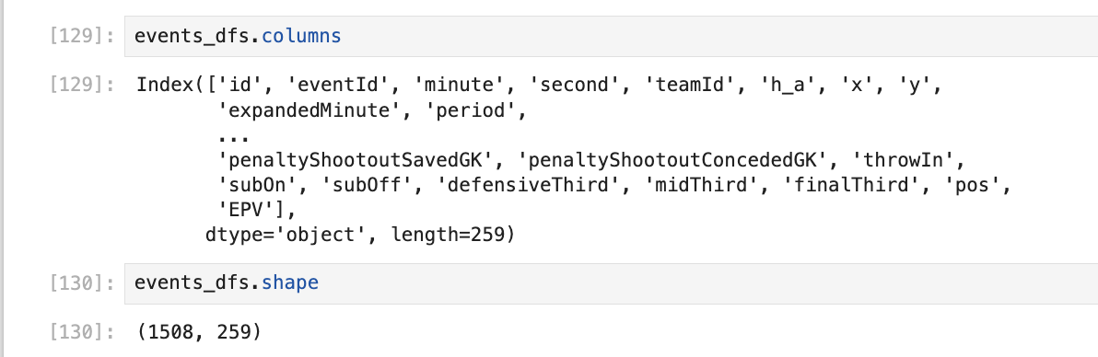

Slide 6
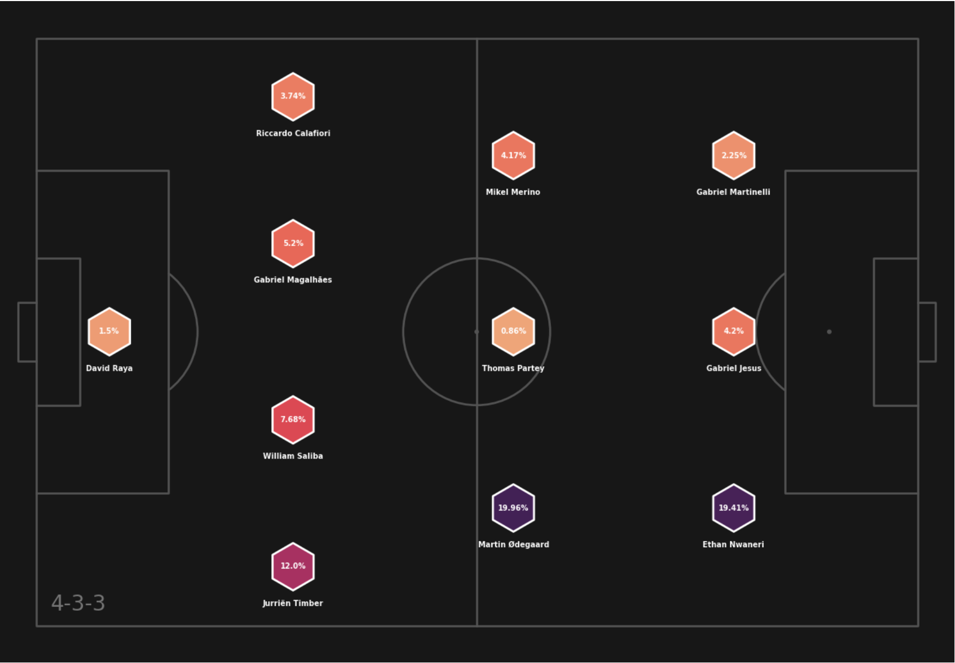
Arsenal’s Formation

Slide 7
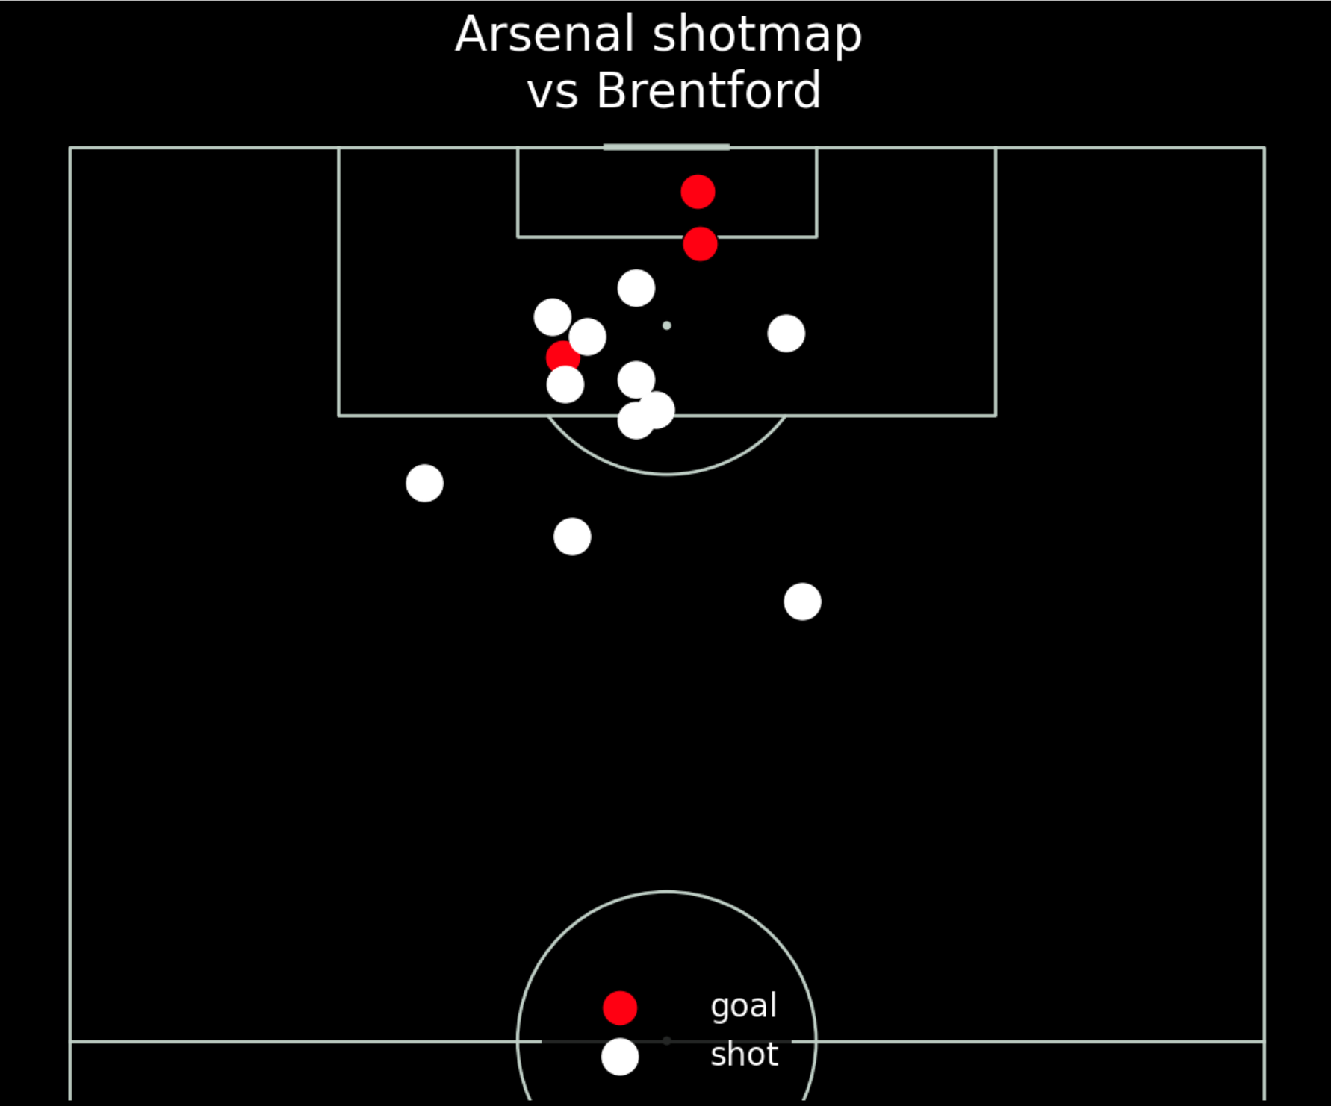
Shots taken by Arsenal

Slide 8
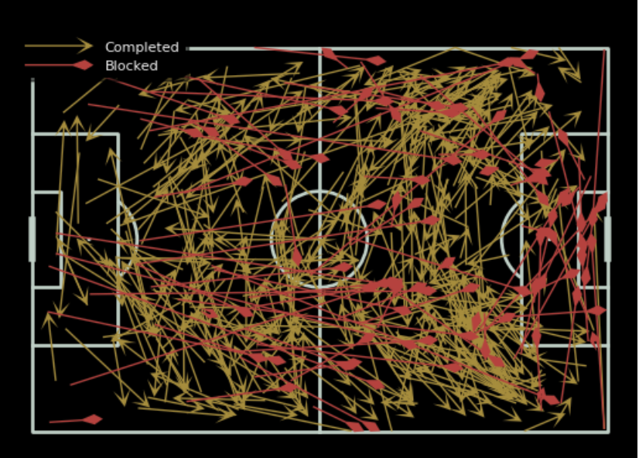
Passes made by Arsenal in the Game

Slide 9
Next Steps
ETL Pipeline Development: Design and implement an ETL pipeline to clean, preprocess, and store football data in a unified format within a PostgreSQL database for efficient querying and analysis.
Generative AI Agent with Langchain: Build a conversational agent using Langchain to manage and maintain seamless conversational flow for retrieving football-related data and insights from the database.
Frontend Integration: Integrate the AI model with a user-friendly frontend interface, providing an intuitive experience for users to interact with the football data and receive insights.

Slide 10
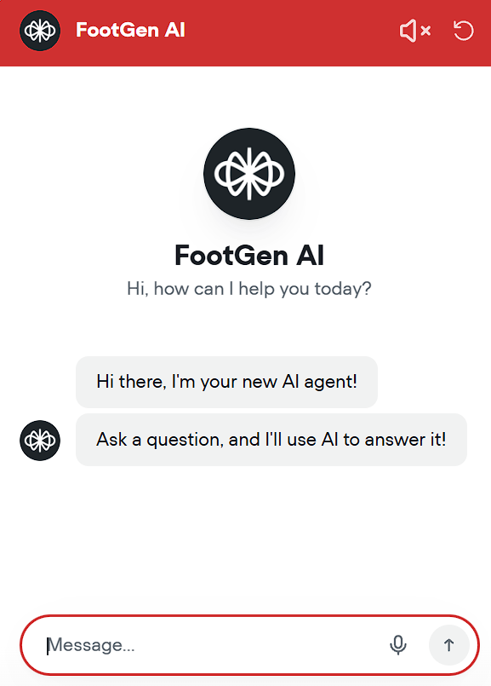
Expected Voiceflow Agent

