Slide 1


Slide 2

PRESENTED BY
ATHARVA KONDI
ATHARVA ASABE
MAYANK UGADE
PRATHAMESH PATIL
SAIRAJ KEKADE

Slide 3
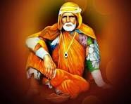
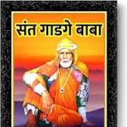
SANT GADGE BABA

Slide 4
WHO WAS SANT GADGE BABA ?
SANT GADGE BABA WERE ALSO KNOWN AS SANT GADGE MAHARAJ.
HE WAS A INDIAN MENDICINENTSAINT AND A SOCIAL PERFORMER FROM INDIA .
HE WANDERED TO DIFFERENT VILLAGES PROMOTING SOCIAL JUSTICE .
FULL NAME OF SANT GADGE BABA WAS DEBUJI ZHINGRAJI JANORKAR .

Slide 5
LIFE OF SANT GADGE MAHARAJ
SANT GADGE BABA BORN IN 23 FEBRUARY .
SANT GADGE BABA GOT MONEY FROM VILLAGERS .
FROM THE OBTAINED MONEY HE BUILT EDUCATIONAL INSTITUTIONS, DHARMASHALAS, HOSPITALS AND ANIMAL SHELTERS

Slide 6
AS SOON AS HE ENTERED AN VILLAGE HE CLEANED THE ROADS AND GUTTERS .
THAT’S WHY HE IS CALLED AS SANT GADGE BABA .
SANT GADGE MAHARAJ MARRIED WITH KUNTABI AND HAD FOUR CHILDREN .
HE DIED IN 20 DECEMBER 1956 .

