Slide 1

Movie Recommendation System

Slide 2
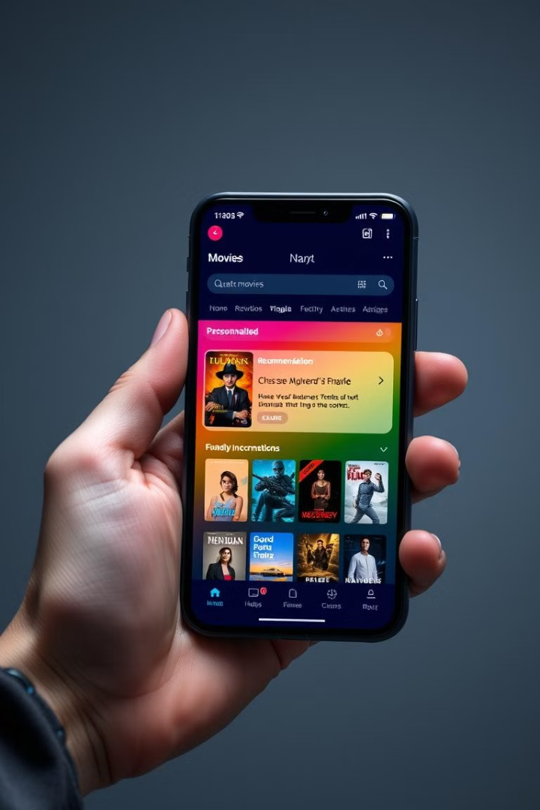
Introduction
1
Objective
2
Vital Feature
Build a movie recommendation system.
Key for streaming platforms like Netflix.
Personalized Recommendations
Improve user experience.

Slide 3
Dataset Overview
Data Source
Data Size
movie details: title, overview, genres, keywords, cast, crew.
5000 movies, key features: genres, keywords, cast, crew.

Slide 4
Workflow
1
Data Loading
Reading movie data from a CSV file.
2
Data Preprocessing
Cleaning and transforming text (stemming, stopword removal).
3
Feature Engineering
Creating tags from overview, genres, keywords, etc.
4
Vectorization
Converting tags to numeric form (Bag-of-Words).
5
Similarity Calculation
Calculating cosine similarity between movies.
6
Recommendation
Suggesting top 5 similar movies based on user input.

Slide 5
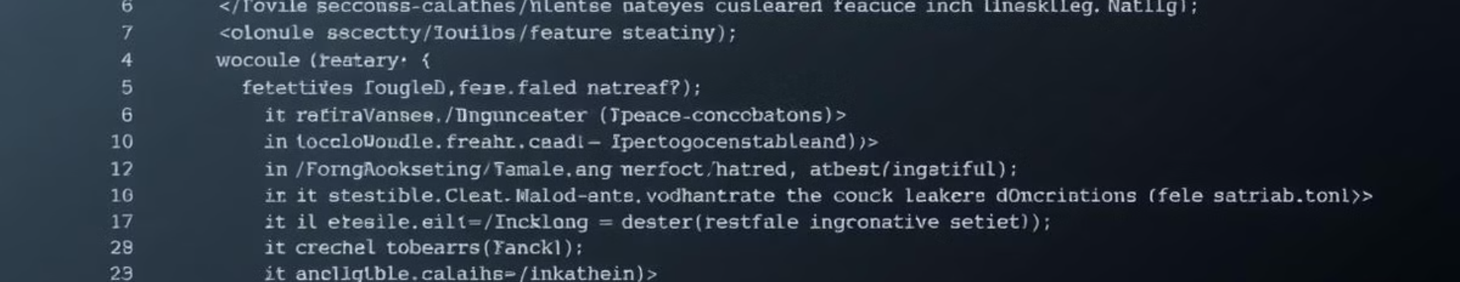
Feature Engineering
Key Transformations
Unified Tags
Stemming
Convert JSON-like structures into clean lists.
Combine all relevant fields into "tags" column.
Normalize words (e.g., "love" and "loving" → "love").

Slide 6
Methodology
Vectorization
Similarity Calculation
Recommendation Logic
Used CountVectorizer to represent tags as numerical vectors.
Cosine Similarity to measure similarity between movies.
Based on similarity score, recommend top 5 movies.

Slide 7
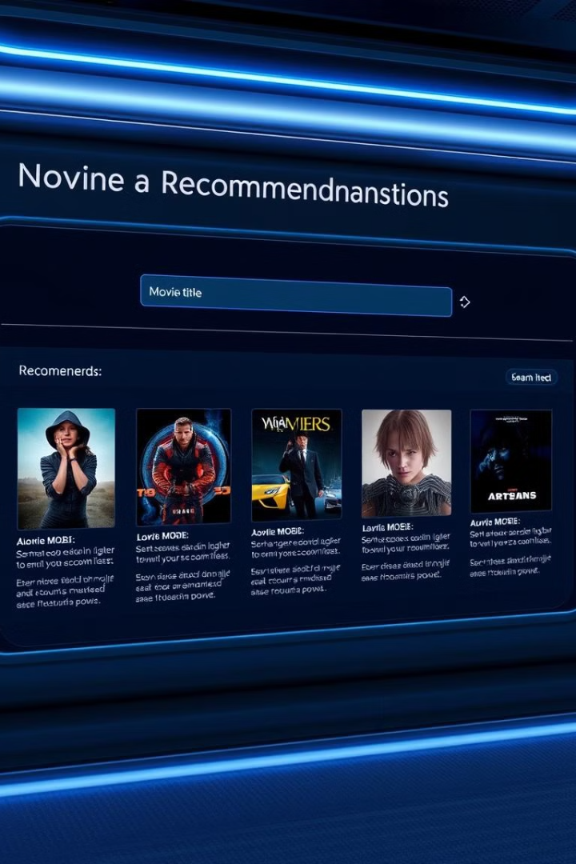

Results
Example Recommendations
Input Movie: Inception.
The Matrix
Interstellar
Avatar
The Dark Knight
Shutter Island

Slide 8
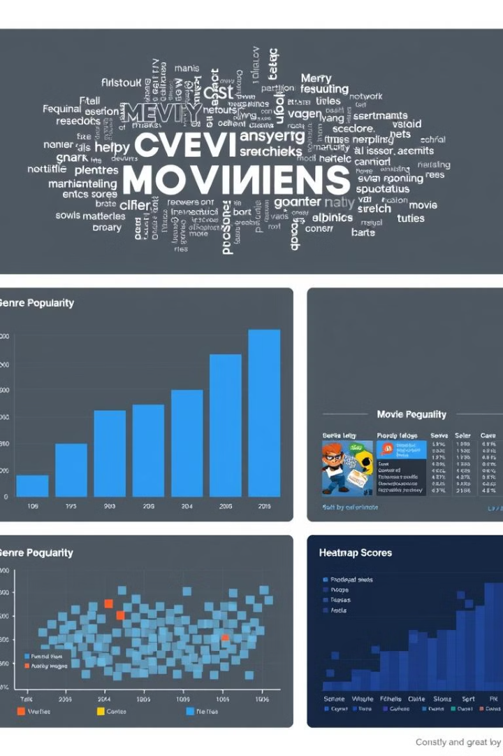
Visualizations
1
2
Word Cloud
Genre Popularity
Frequent keywords from the dataset.
Bar chart of the number of movies by genre.

Slide 9
Challenges
Data Quality
1
Inconsistent or missing values in some features.
Scalability
2
Approach works well for small datasets but may require optimization for larger datasets.
Cold Start Problem
3
Unable to recommend for movies with no metadata.

Slide 10
Reference

Slide 11

Thank You!
This presentation explored the design and implementation of a movie recommendation system.
The system utilizes various techniques to provide personalized recommendations based on user preferences.

