Slide 1




RewardWise
Stop Wasting Days
Start Saving Money
AI-Powered Travel “Wallet” Optimizer

Slide 2
Agenda
01
02
03
04
Customer
Persona
Competitive
Analysis
Voice of Customer Results
Overview
05
06
07
08
AI Hypothesis
Validation Results
Skills &
Expectations
Roadmap
Mockup

Slide 3
Problem
Solution
"I spent 8 hours researching how to book Paris with my points. I still don't know if I did it right."
- Marcus, 34 (used 487K Chase points)
Reality
$5.4 Billion capital market
💰 10.8M Americans lose $500/year on bad point redemptions
⏰ Average 8 hours researching EACH trip
😰 57% feel "overwhelmed" by points options
🤯 Existing tools show 47 choices but NO answer
"RewardWise tells you EXACTLY what to book
Not 47 options
THE answer
INPUT: "Business class to Paris from NY, June, 2 people"
OUTPUT :
✅ Transfer 140K Chase → Air France
Save $8,160 vs cash
Value: 5.8¢/point
Fauget Inc.

Slide 4


Customer Persona
Marcus Miller
Maria Gavras
💼 Creative Services
Manager at Disney
📍 LA, CA
✈️ 8-12 work trips/year +
personal travel
PAIN POINTS:
Time drain
Analysis paralysis
Decision anxiety
Wasted value
Constant second-guessing
💼 Associate Professor at NYU
📍New York City
✈️ 2 Greece trips/year with family of 4
PAIN POINTS:
Analysis paralysis
Feels overwhelmed
No time to research
Afraid to waste points
Second-guesses choices
GOALS:
Visit family
Stretch budget
Simple solution
Affordable travel
GOALS:
Clear verdict
Quick answer
Booking confidence
Expert validation

Slide 5
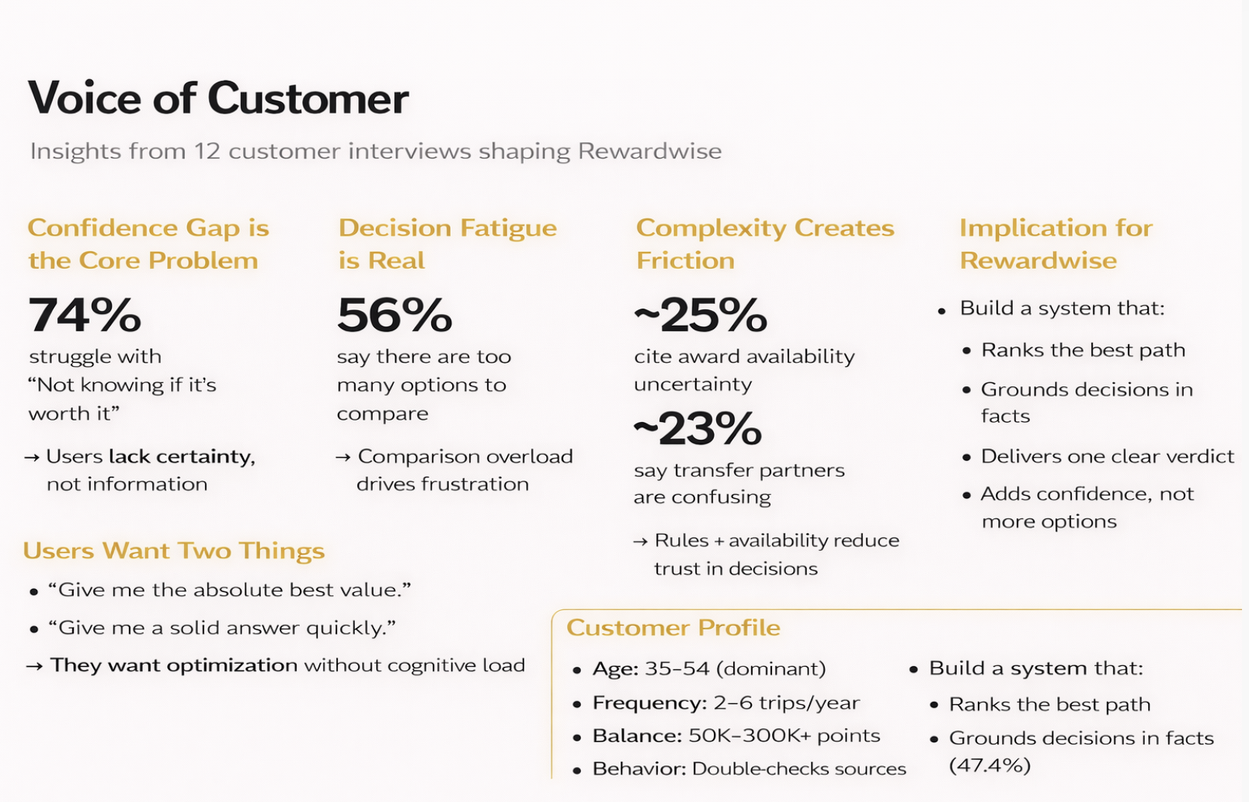
01
02

Slide 6
Competitive Advantage
What exists today
Hopper | Price prediction for booking through cash only | Uses AI to user choose between ‘buy now or wait’ Valued at $5 BILLION 120M+ downloads
Point.me | Search flights with multiple results for user to decide | NO AI decision engine Raised $38.5M
PointYeah | Similar search engine with user left to decide | NO clear recommendation Shows 20+ options
All competitors leave final decision to overwhelmed user
What we’re building
AI native decision engine
Validated market of $5Billion and clear technical gaps

Slide 7
Roadmap
Week 1-2
Week 3-4
Week 5
Week 6
  Search interface (origin, destination, dates)
  Points portfolio input Award chart database (United, Chase, Amex)
  Basic recommendation algorithm
Deliverable: Working search → Get recommendation
  AI recommendation engine
  Value calculation (¢/point, cash equivalent)
  Result display with explanation
  Deep-links to airline websites
Deliverable: recommend → guide" flow
  User authentication (Google OAuth)
  Portfolio dashboard
  Booking tracking (user confirms completion)
  Success metrics
Deliverable: Polished user experience
  Bug fixes & testing Landing page
  Deploy to production
  ProductHunt launch
Deliverable: Live product with real users

Slide 8

Mockups
01
Describe how you envision to solve the problems you previously shared.

Slide 9
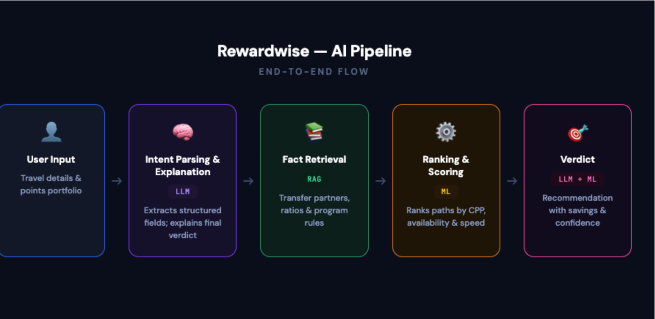
AI Hypothesis
If we deliver high confidence(>90% correctness)cash vs points recommendations instantly(<5) by combining ML based ranking, RAG grounded program rules, and LLM powered verdict explanation.
then time poor travellers will make booking decisions faster and more confidently (>50% reduction in decision time, >75% positive verdict feedback), driving higher trust, repeat usage, premium subscription conversion.

Slide 10
Why you should Join Rewardwise
This isn't another AI wrapper. This is a real decision engine.
What You'll Build:
A ranking engine that makes real financial decisions
ML + RAG + LLM orchestration systems
Greenfield architecture from scratch
Optimization under real-world constraints
What You'll Gain:
Real AI systems experience — beyond simple API integrations
Early influence on model design and decision logic
High-impact ownership in a greenfield product
Fast iteration cycles with measurable user outcomes

Slide 11
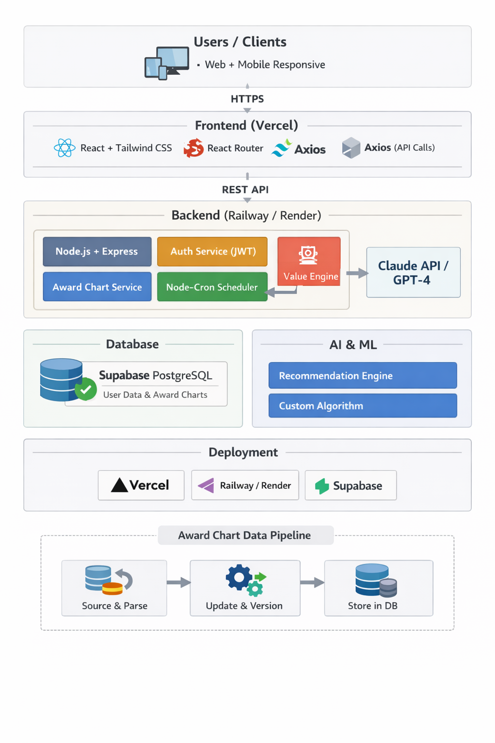
TEAM NEEDS & EXPECTATIONS
FRONTEND (React)
  Build user interface
  Implement designs/mockups
  Mobile-responsive (IOS)
BACKEND (Node.js)
  API & database integration
  Implement recommendation algorithm
  Integrate AI (Claude/GPT)
FULL-STACK DEVELOPER
  Help both frontend & backend
  Handle integrations

Slide 12
Thank You
FOR YOUR TIME

