Slide 1
Cloud task scheduling
Random Forest runtime estimates, residual uncertainty, and deadlines
Research implementation report
Synthetic simulation • 1,008 paired scheduler runs • no improvement claim
Notes:
This presentation describes an implementation and the full-grid evaluation. Results are synthetic simulation evidence only.

Slide 2
System path: prediction to dispatch
Task features
CPU • RAM • type
RF runtime
prediction
Residual
calibration
Queue wait
+ deadline slack
Task dispatch
into SimPy workers
Train split
Calibration split
Held-out test split
The existing ingress buffer, FIFO queue storage, SimPy worker pool, and autoscalers remain in place. Dispatch policy is a separate choice.
Notes:
Architecture reflects the current implementation in simulation/runner.py, simulation/scheduling.py, ml/rf_service_time.py, system/processing_queue.py, and workload/generator.py.

Slide 3
Runtime estimate and residual calibration
60%
Train RF
15%
Calibrate residual
10%
Validation
15%
Held-out test
→
→
→
r = actual runtime − predicted runtime
upper runtime = max(0, prediction) + max(0, 95th-percentile calibration residual)
One global additive margin; empirical test coverage is descriptive, not a guarantee.
Notes:
The split residual quantile is not claimed as formal conformal coverage. Related background: Romano, Patterson, and Candes (2019), Conformalized Quantile Regression, https://papers.nips.cc/paper/2019/hash/5103c3584b063c431bd1268e9b5e76fb-Abstract.html

Slide 4
Dispatch policies and tie rules
Baselines
Deadline and uncertainty variants
FCFS: arrival time → request ID
SJF predicted: RF runtime → arrival → ID
SJF actual: actual runtime oracle → arrival → ID
EDF: absolute deadline → arrival → ID
Deadline-aware: feasible tasks by least slack; infeasible tasks afterward by deadline
Uncertainty-aware: shortest upper runtime first
Proposed: conservative slack, then deadline/runtime/arrival/ID
No deadline: follows deadline-bearing work under slack policies
Non-preemptive priority heuristic. Running tasks continue; no policy guarantees that all deadlines can be met.

Slide 5
Benchmark design and measures
Workload factors
Recorded measures
Load: low / medium / high
Task duration: short / medium / long
Deadlines: tight / relaxed
Arrivals: steady / bursty
Synthetic RF target noise: low / high
Deadline miss rate and response latency
P95 / P99, waiting time, throughput
Time-weighted processing queue length
Busy service time / active VM time
Simulated VM-hours, RF MAE / RMSE, test coverage
Paired seeds across seven dispatchers; fixed capacity for policy comparisons. Full grid: 72 workload cases, or 504 runs per repeat.

Slide 6
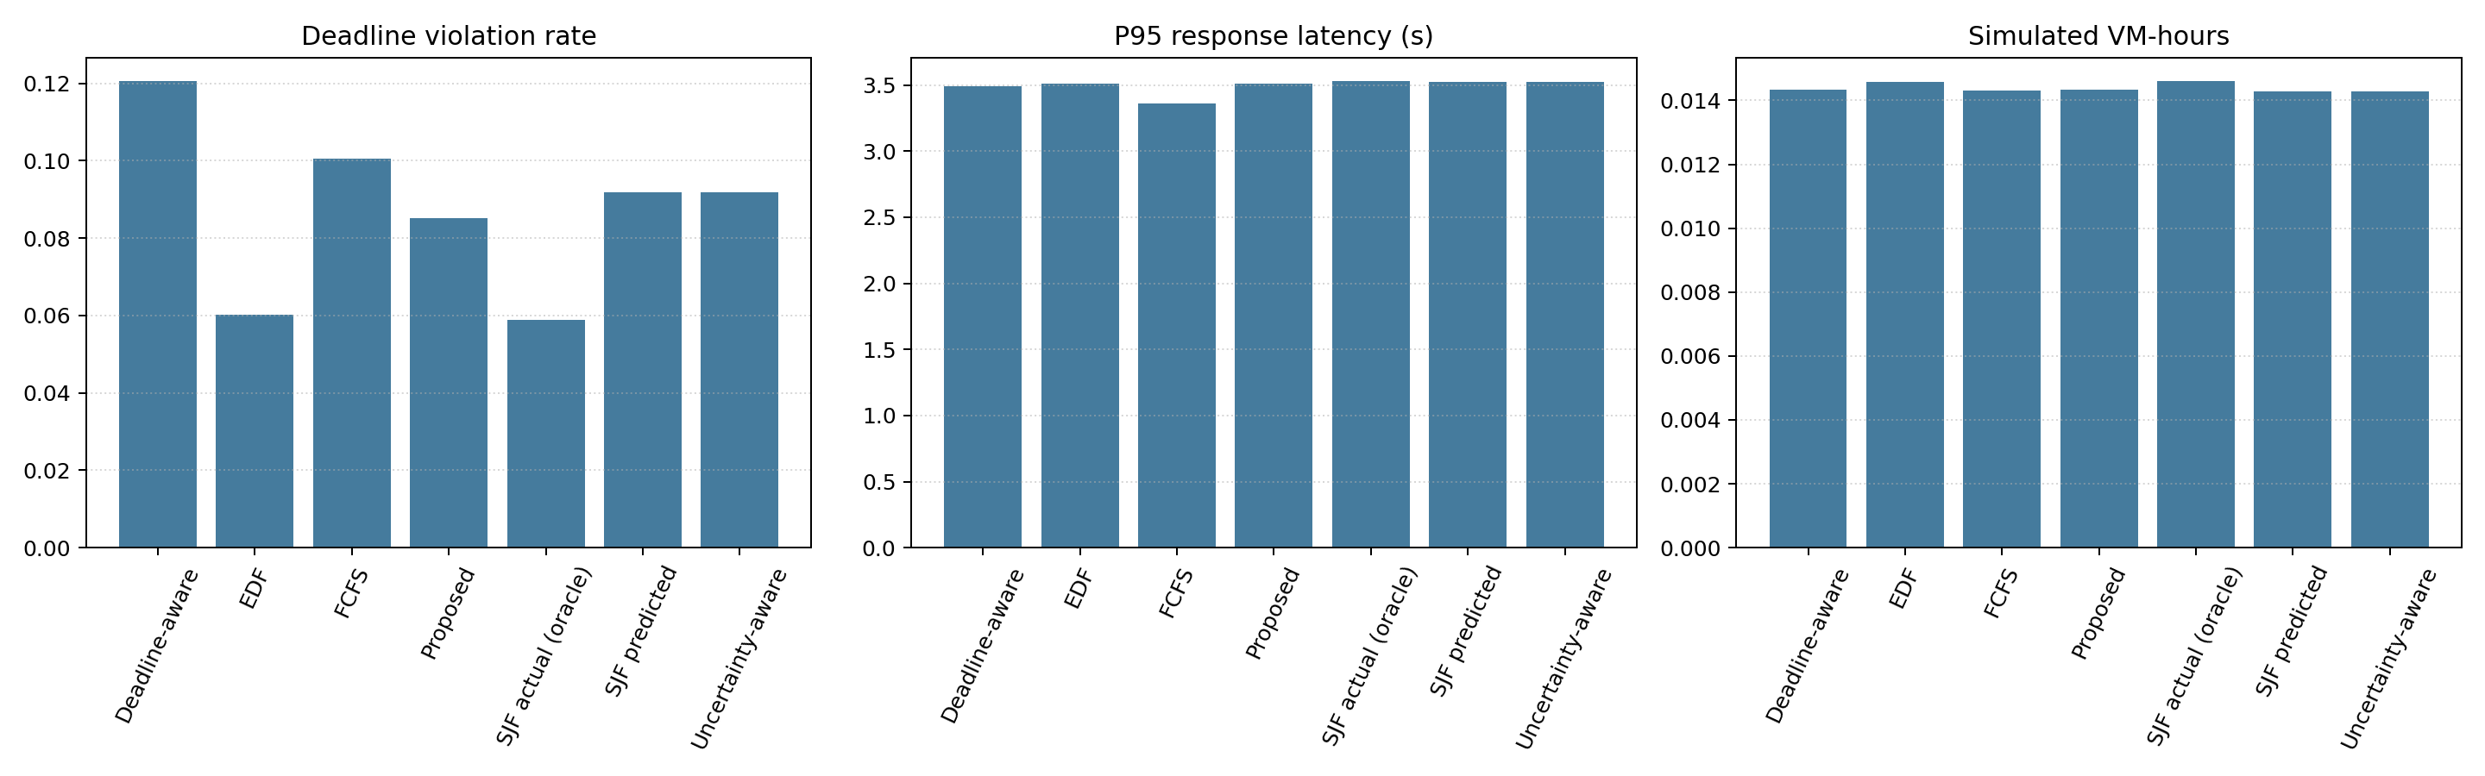
Full-grid results: measured means
1,008 runs • 25 tasks per run • 72 cases • 2 seeds per case • means are descriptive
Notes:
Source: research_results/full_grid/benchmark_results.csv and benchmark_overall_summary.json. Each policy has 144 paired simulations. Results are from synthetic traces only.

Slide 7
Measured findings and limits
Measured across the full grid
Interpretation limits
Per policy: 144 runs × 25 tasks
RF test MAE: 0.907 s
RF test RMSE: 1.383 s
Upper-runtime coverage: 95.9%
Proposed late rate: 8.5%
FCFS late rate: 10.1%
25 tasks per simulation; two seeds per case
Global residual offset is not task-specific
All workloads remain synthetic
Queue wait omits remaining work in service
VM-hours are not a provider bill
These measurements do not establish improvement or novelty.
Notes:
All source data are in research_results/full_grid/benchmark_results.csv. The workflow aligns the synthetic runtime profile across model and task traces, but this does not establish real-world generalization.

Slide 8
Reproduction and research next steps
Run the full benchmark grid
Before stronger claims
python simulation/research_benchmark.py
--requests 300 --repeats 2
--output-dir research_results
Align task generation with RF calibration
Run full repeated-seed grid
Study feature-conditional uncertainty
Review the scheduling literature systematically
Compare under shared capacity and queue assumptions
Outputs: paired raw CSV and JSON, condition summary, overall summary, and plot.
Key references: Breiman (2001); Romano et al. (2019); Liu & Layland (1973). See report bibliography.
Notes:
References: Breiman, Random Forests, Machine Learning 45 (2001), https://doi.org/10.1023/A:1010933404324; Romano, Patterson, and Candes, Conformalized Quantile Regression, NeurIPS 2019, https://papers.nips.cc/paper/2019/hash/5103c3584b063c431bd1268e9b5e76fb-Abstract.html; Liu and Layland, Scheduling Algorithms for Multiprogramming in a Hard-Real-Time Environment, JACM 20(1) (1973), https://doi.org/10.1145/321738.321743.

Slide 9
References and scope
L. Breiman (2001). Random Forests. Machine Learning 45, 5–32. doi:10.1023/A:1010933404324
Y. Romano, E. Patterson, and E. Candes (2019). Conformalized Quantile Regression. NeurIPS 32.
C. L. Liu and J. W. Layland (1973). Scheduling Algorithms for Multiprogramming in a Hard-Real-Time Environment. JACM 20(1), 46–61.
These references provide background only. They do not establish novelty or formal guarantees for this implementation.
Notes:
Primary references: https://doi.org/10.1023/A:1010933404324 ; https://papers.nips.cc/paper/2019/hash/5103c3584b063c431bd1268e9b5e76fb-Abstract.html ; https://doi.org/10.1145/321738.321743 .

