Slide 1




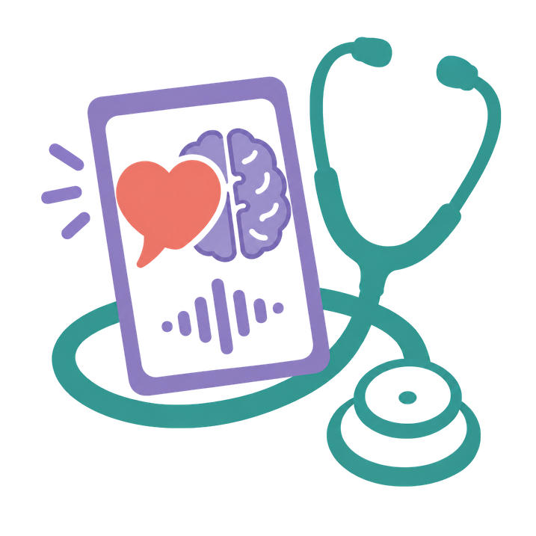

Saykind
Find your words. At your pace.
DubHacks 2026 · Community Kitchen track
Piyush · Devvrat · Pranay

Slide 2

































Every year, almost 12 million people have
a stroke.
Sources: World Stroke Organization, Global Stroke Fact Sheet 2025; RELEASE Collaborators, Stroke, 2021

Slide 3










1 in 3 lose access to their words.
This is called aphasia.
Sources: World Stroke Organization, Global Stroke Fact Sheet 2025; RELEASE Collaborators, Stroke, 2021

Slide 4










61% still have communication problems one year later.
Sources: World Stroke Organization, Global Stroke Fact Sheet 2025; RELEASE Collaborators, Stroke, 2021

Slide 5





Recovery doesn’t stop.
Practice shouldn’t either.
Within 1 month:
After 6 months:
+19.1 points
+8.2 points
(still a meaningful gain)
Therapy happens in a clinic.
Life happens at the café counter.
Source: RELEASE Collaborators, Stroke, 2021

Slide 6





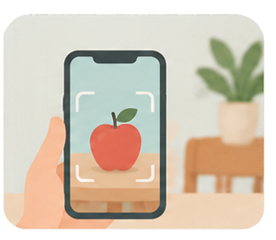
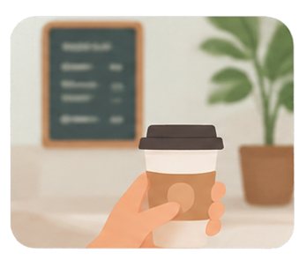

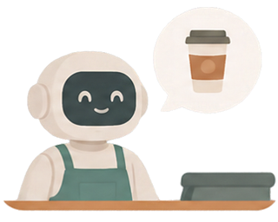






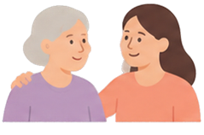

From seeing a word to saying it in real life
apple
1. Learn
2. Discover
3. Practice
4. Real life
picture, word, slow audio
camera finds objects at home
order from an AI barista
phrase help at a real café
Caregiver support and help, always available

Slide 7
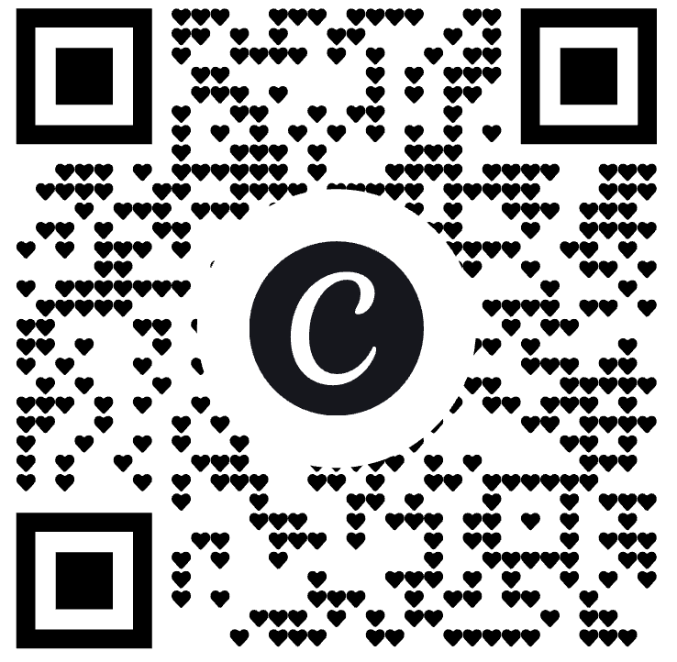
Demo

Slide 8







Designed for aphasia
No timers. Practice at
your own pace.
No scores. Speech
recognition is never
the judge.
Pictures and audio
with every word.
Private by default.
Practice data stays on
your device.

Slide 9

From prototype to product
Validate
Build
Launch
Pilot with speech-language pathologists
Secure accounts and a therapist portal
Privacy and health-data compliance
Test with people with aphasia and caregivers
More scenarios, more languages
Partner with clinics and stroke rehab programs

Slide 10




Aphasia takes away words, not intelligence.
Saykind helps people find them again.

