Slide 1
Introduction to typescript.
TypeScript is a syntactic superset of JavaScript which adds static typing..
JavaScript is a loosely typed language. It can be difficult to understand what types of data are being passed around in JavaScript.
TypeScript uses compile time type checking. Which means it checks if the specified types match before running the code, not while running the code.
npm install typescript
npx tsc
npx tsc –init

Slide 2
Problem in JavaScript:
JavaScript is dynamically typed, which means:
let name = "KLH";
name = 42; // This won’t throw an error immediately
TypeScript Solves It
let name: string = "KLH";
name = 42; //Compile-time error: Type 'number' is not assignable to type 'string’
Now you catch the mistake before running the code!
Errors like this only show up at runtime, which can lead to bugs that are hard to track.

Slide 3
Core Key features
1. Static Typing
Add types to variables, function parameters, and return values.
function add(x: number, y: number): number { return x + y; }
2. Type Inference
Even if you don’t write types, TS tries to guess them.
let message = "Hello"; // TS infers message: string
3. Interfaces and Types
Define the shape of objects:
interface Student { id: number; name: string; course: string; } let s1: Student = { id: 1, name: "Ravi", course: "AI" };
4. Classes and OOP
TS supports full object-oriented programming.
class Car { constructor(public brand: string, private speed: number) {} drive() { console.log(`${this.brand} is going at ${this.speed} km/h`); } }
5. Generics
Write flexible and reusable functions:
function identity<T>(value: T): T { return value; } identity<string>("KLH"); identity<number>(42);
6. Modules
Split your code into multiple files and reuse:
// greet.ts export function greet(name: string): string { return `Hello, ${name}`; } // app.ts import { greet } from './greet'; console.log(greet("KLH"));

Slide 4
How it Works
You write code in .ts files (TypeScript files).
TypeScript is compiled to JavaScript using the tsc command.
tsc index.ts
The output is plain JavaScript that browsers understand.
File extensions
.ts – regular TypeScript files
.tsx – TypeScript with JSX (for React apps)

Slide 5
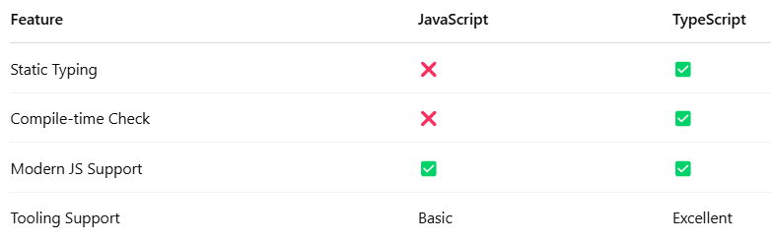

Slide 6
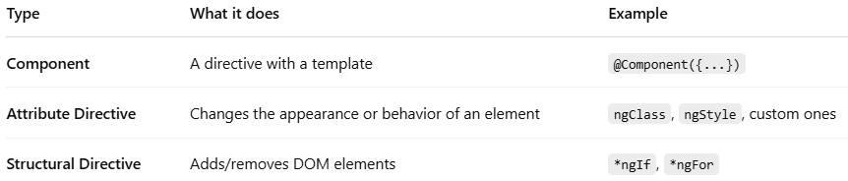
Directives
Directives are classes in Angular that let you add custom behavior to elements in your templates.
They fall into 3 categories:

Slide 7
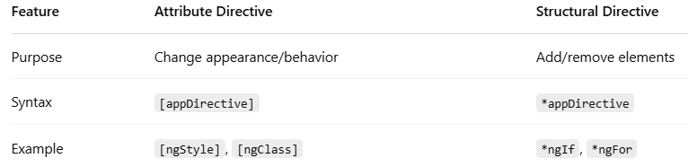
An Attribute Directive changes the appearance, behavior, or style of a DOM element.Think of it like "adding behavior via attributes".✅ Built-in Examples:ngClass: Adds/removes classes dynamically.ngStyle: Sets inline styles based on data.
Structural directives change the structure of the DOM — they can add, remove, or modify elements dynamically.TL;DR: They control what gets rendered in the DOM.

Slide 8
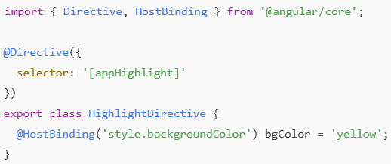
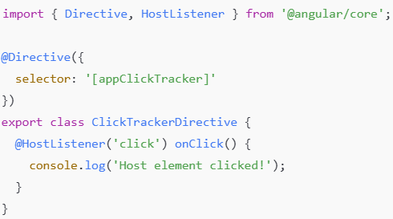
Host Listener, Host Binding
In Angular, @HostListener and @HostBinding are decorators provided by the framework to interact with the host element of a component or directive. These are powerful tools when you're building custom directives or when you need more control over how your component interacts with the DOM.
What happens here?
This directive sets the background color of the host element to yellow.
What happens here?
Every time the host element is clicked, a message is logged to the console.

Slide 9
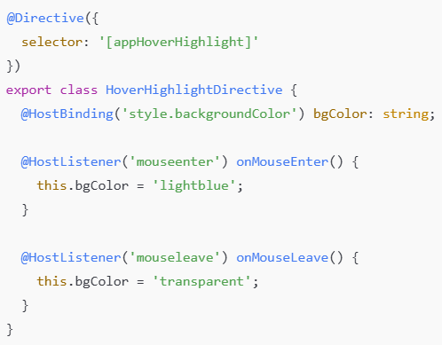
@HostListener listens for mouse events.
@HostBinding updates the background color of the host element accordingly.
npm install -g @angular/cli
ng new directive-demo
cd directive-demo

Slide 10
Angular Component Lifecycle
The Angular Component Lifecycle is all about how a component is created, updated, and destroyed. Angular gives us a series of lifecycle hooks that allow us to tap into different moments in a component's life — like initialization, change detection, and cleanup.
Here’s a timeline of how Angular interacts with a component:
Constructor → ngOnChanges → ngOnInit → ngDoCheck → ngAfterContentInit→ ngAfterContentChecked → ngAfterViewInit → ngAfterViewChecked → ngOnDestroy

Slide 11
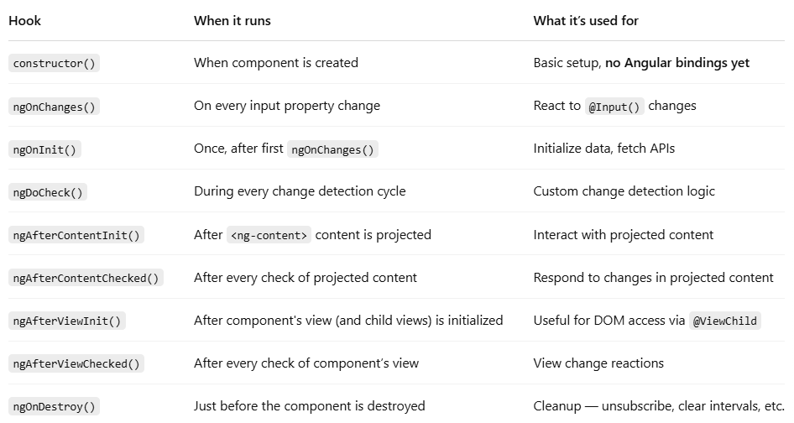
Lifecycle Hooks

