Slide 1

BloodBridge
Blood donor registry, inventory and hospital request fulfilment — shipped through a full DevSecOps pipeline to Amazon EKS
Pranay Reddy N
DevOps Final Capstone · October 2026
github.com/pranay-reddy2/BloodBridge
Notes:
Introduce BloodBridge: a blood-bank operations app used as the payload for an end-to-end DevSecOps pipeline — from git push to a monitored, autoscaling, GitOps-managed EKS cluster.

Slide 2
Why a blood bank needs better software
Platelets expire in 5 days — units are lost when nobody issues the oldest stock first
O-negative is the universal donor and only ~1% of donors — it gets used when another group would do
Critical hospital requests compete with routine ones in spreadsheets and phone calls
8
5 days
blood groups matched by ABO/Rh rules
platelet shelf life tracked per unit
18
40
BloodBridge matches every request by ABO/Rh compatibility, keeps O- for last, and issues first-expiring units first.
REST API endpoints
automated tests · 96% coverage
Notes:
Set up the domain problem in 30 seconds, then the numbers on the right.

Slide 3





What the application does
Donor registry
Donations → units
Inventory control
Search by group and city; 90-day donation eligibility computed per donor
Each donation becomes a unit with a component shelf life (5–365 days)
Quarantine, release, discard; a daily CronJob expires stale stock
Hospital requests
Smart fulfilment
Ops endpoints
Queue ordered by urgency (critical → routine), then by age
Compatible group first, O- last, first-expiry-first-out, partial issue
/health, /ready (DB check), /metrics and build SHA via /api/meta
Notes:
Demo these live later: register donor, record donation, create a critical AB- request and fulfil it.

Slide 4
















Tech stack
Application
Delivery
Platform
Observability
React 19 + Vite
Docker multi-stage
Terraform
Prometheus
FastAPI · Python 3.13
GitHub Actions
AWS VPC + EKS
Grafana
PostgreSQL 17 + Alembic
GHCR registry
Helm 3
Alertmanager rules
pytest + ruff
Trivy + SBOM
Argo CD · Traefik
Dependabot
Notes:
Four layers: what the app is built with, how it is delivered, where it runs, how we see it.

Slide 5
Runtime architecture on Amazon EKS
EKS cluster · namespace bloodbridge
Users
browser
Frontend ×2
React + Nginx
Argo CD
syncs Helm chart
/
AWS LB
public subnets
Traefik
Ingress
Backend · HPA 2→6
FastAPI
PostgreSQL
StatefulSet · EBS gp3
/api
/metrics
CronJob
daily expiry sweep
Prometheus
ServiceMonitor · alerts
Grafana
dashboard + alerts
Notes:
Trace a request: user -> AWS load balancer -> Traefik -> / goes to the frontend, /api goes to the backend -> PostgreSQL. Prometheus scrapes /metrics; Argo CD keeps everything in sync with Git.

Slide 6





CI/CD pipeline: every push to main
Test
Source scan
Build
Image scan
GitOps deploy
ruff · 40 pytest tests · migrations on real Postgres
Trivy: secrets, dependency CVEs, IaC config
Buildx images tagged with the commit SHA
Trivy blocks HIGH/CRITICAL · SBOM
Push to GHCR, commit tag, Argo CD syncs
Gate before push
SHA, never latest
Pull, not push
No image reaches GHCR unless every test and scan passes
commit → image → pod is always traceable (shown in the UI footer)
CI never holds cluster credentials; Argo CD pulls from Git
Notes:
Walk the five stages left to right, then the three rules underneath. Live: push a commit and show the run.

Slide 7
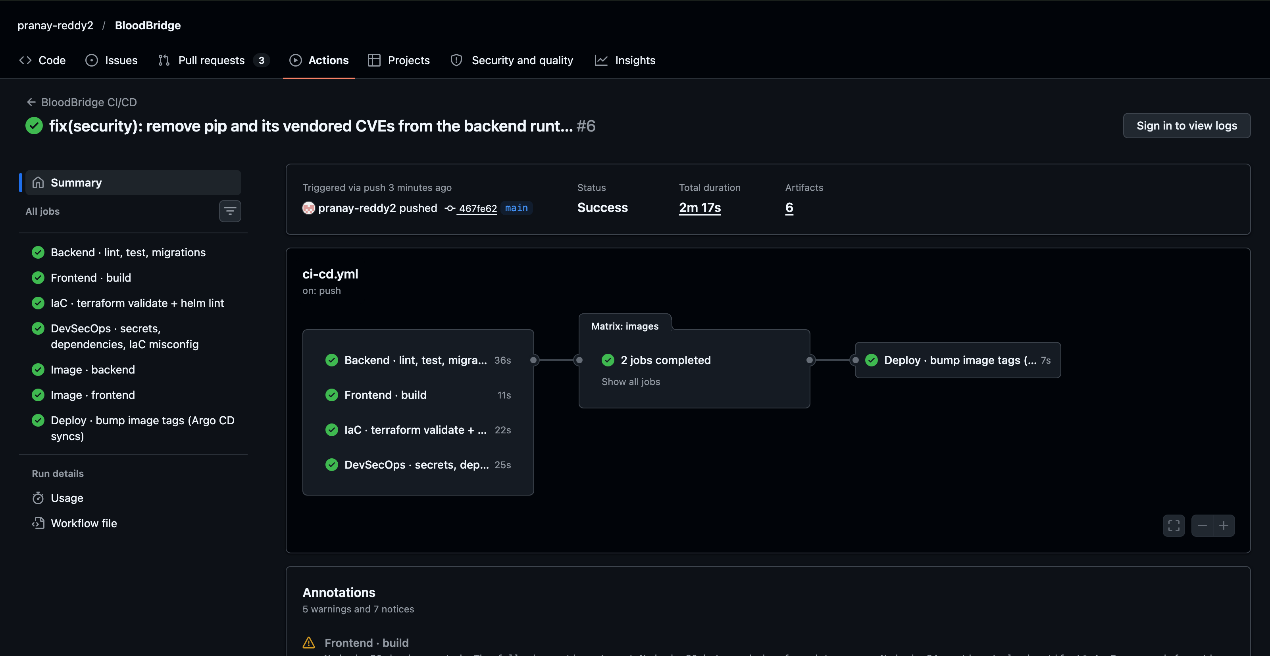
Pipeline run on GitHub Actions
Live run: https://github.com/pranay-reddy2/BloodBridge/actions/runs/38284457781
Notes:
Screenshot of the GitHub Actions run for this repository. In the video, open the run itself and show the Trivy log and the SBOM artifact.

Slide 8





Security at every layer
Code
Dependencies
ruff security rules, Pydantic validation, ORM-parameterised SQL
Trivy dependency scan + weekly Dependabot PRs
Secrets
Images
Trivy secret scan; DB password created out-of-band, never in Git
Non-root, multi-stage; HIGH/CRITICAL gate; CycloneDX SBOM
Runtime
Network & cloud
Read-only root FS, drop ALL caps, seccomp, Pod Security labels
NetworkPolicy to Postgres, IRSA for EBS CSI, audit logs
Notes:
Real Trivy finding from the first pipeline run: the backend image failed on 4 HIGH CVEs (urllib3 CVE-2026-97687/97689, msgpack GHSA-6v7p-g79w-8964, setuptools CVE-2025-47273). All were libraries vendored inside pip, not app dependencies. Fix: uninstall pip from the runtime image instead of suppressing the CVEs — the gate stopped the vulnerable image from ever reaching GHCR.

Slide 9
Infrastructure as Code with Terraform
VPC 10.42.0.0/16 · ap-south-1
Modules
AZ a
AZ b
terraform-aws-modules VPC 5.21 · EKS 20.37 · IAM (IRSA)
Public subnet
10.42.0.0/24 · load balancer
Public subnet
10.42.1.0/24 · load balancer
Add-ons
vpc-cni (NetworkPolicy on), coredns, kube-proxy, EBS CSI
Private subnet
10.42.16.0/20 · t3.medium node
Private subnet
10.42.32.0/20 · t3.medium node
Safety
No credentials in code · tfvars git-ignored · lock file committed
EKS 1.34 control plane
managed node group 2–4 · AL2023 · access entries
Cost
≈ $6–8 per day → terraform destroy after the demo
Notes:
Show terraform plan output and the AWS console: VPC with 2 public + 2 private subnets, EKS cluster with its node group.

Slide 10



Kubernetes, Helm and GitOps with Argo CD
git push to main
Deployments
StatefulSet
frontend ×2, backend (startup/ready/live probes)
PostgreSQL on encrypted gp3 EBS
CI writes the new SHA into values-prod.yaml
HPA
PDB
backend 2 → 6 pods at 60% CPU
minAvailable 1 during node drains
Argo CD detects the commit (≈60 s) and syncs
Ingress
NetworkPolicy
Traefik: / → UI, /api → API
only backend pods reach Postgres
Helm chart rolls out with zero downtime
CronJob
helm test
Self-heal reverts manual kubectl drift · prune removes deleted resources · rollback = git revert
daily blood-unit expiry sweep
in-cluster smoke test of /ready and the UI
Notes:
Show the Argo CD app tree, kubectl get pods/svc/ingress/hpa, helm list, and helm test.

Slide 11


Observability: Prometheus and Grafana
Metrics from /metrics
Alerts and dashboard
http_requests_total · request rate, errors
http_request_duration_seconds · p50/p95/p99
bloodbridge_inventory_available_units · stock
bloodbridge_requests_open · queue depth
donations, units issued and shortfall counters
Backend down · 5xx above 5% · p95 above 1 s
Low stock per blood group (< 5 units)
CRITICAL request open more than 15 min
Grafana dashboard auto-loaded from the chart: stock, golden signals, HPA replicas, CPU, memory, restarts
15 s
5
16
0
scrape interval via ServiceMonitor
PrometheusRule alerts
Grafana dashboard panels
manual dashboard setup steps
Notes:
Show the Prometheus Targets page with bloodbridge-backend UP, then the Grafana dashboard while running scripts/load-test.sh to make the HPA scale.

Slide 12

Troubleshooting lab: five failure drills
Scenario | Root cause | How it is diagnosed
ImagePullBackOff | Tag never pushed | kubectl describe pod → Events
Service without endpoints | Selector label typo | get endpointslices · --show-labels
Running, never Ready | Readiness probe on the wrong port | describe → probe failures, 0 restarts
OOMKilled | Memory limit below working set | Last State: exit code 137
Wrong DB password | Bad credentials in a rollout | Old pods keep serving; Argo CD self-heals
Same loop every time: kubectl get pods → describe pod → logs --previous → get events --sort-by=.lastTimestamp
Notes:
Run scenario 2 live: apply the manifest, diagnose with the runbook, patch the selector.

Slide 13

Key learnings
What I would keep, and what comes next
Readiness ≠ liveness
Gates before artifacts
Checking the DB only in /ready stops a DB blip from becoming a restart storm
Tests and scans run before any image is pushed to the registry
Git is the deploy API
Next steps
Argo CD + SHA tags make every rollout auditable and reversible
Amazon RDS, TLS with cert-manager, OIDC sign-in, per-AZ NAT gateways
Notes:
Close with the three lessons and the production roadmap. Thank the audience and open for questions.

