Slide 1


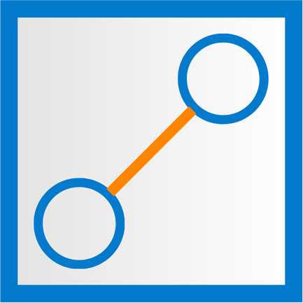
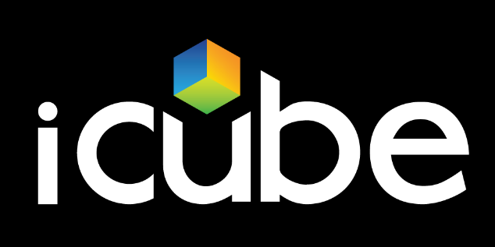

Project FMD
October 5th, 2026
From Data Rich
to Insight Rich

Slide 2
Project Plan
Phase | Timeline | Status | Description
Business Understanding | Weeks 1–2 | ✓ | Define the foreign-matter criteria, reject rules, 647 µm threshold, lens-material exclusion, false-reject target, and annotation ownership.
Data Understanding | Weeks 3–4 |  | Characterize defect frequency, size, image quality, 647 µm detectability, and annotation ambiguities through EDA and image reviews.
Data Preparation | Weeks 5–6 |  | Pre-process images, remove excess black background, assess class-wise data sufficiency, and create stratified model-ready datasets.
Modelling | Weeks 7–13 |  | Select the architecture, build Edge and Back-Office baselines, run challenger cycles, optimise for latency and false-reject targets, and test model generalisation on unseen data.
Evaluation | Weeks 14–15 |  | Review code, model performance, and failure modes; finalize acceptance.
Deployment Planning | Week 16 |  | Define deployment requirements, including hardware, environment, interfaces, line prerequisites, and monitoring; no deployment is executed.
Project KickOff – 17th August 2026
Currently at Week 7

Slide 3
Agenda – Augmentation, Multi Label Model
Photometric & Geometric Techniques
Defect Relocation Technique
Results
Multi label Model
Notes:
Is there a better name for Cut-Paste technique?

Slide 4
Photometric & Geometric Used for Augmentation:
Overview:
9 pixel-level techniques applied to real image that includes flips, brightness, contrast, gamma, noise, blur, zoom, vignette.
One random parameter drawn per image within the range, seeded for reproducibility
Applied to all 22 classes
Notes:
Make the text normal. Not italics. De

Slide 5
Defect Relocation Technique:
Overview:
Select the Image
  Take an image containing the defect.
Mark the Defect Region
  Draw an outline that follows exact defect shape
Remove the Defect
  Remove the identified defect region from the image.
Inpaint the Defect Region
  Fill the removed defect region with textured lens pixels to reconstruct the lens.
Reinsert the Defect
  Add the defect back into the lens at new region, to create the augmented image.
  Defect is added at random but always within a safe range of the lens

Slide 6
RESULTS

Slide 7
Dataset Augmentation Summary by Defect Class
Label | Original | Augmented | Added | Augmentation
Bubble | 90 | 100 | 10 | Defect Relocation + Photometric and Geometric
Bubble Cluster | 28 | 100 | 72 | Defect Relocation + Photometric and Geometric
Bubble Irregular | 35 | 100 | 65 | Defect Relocation + Photometric and Geometric
Bubble On 123 | 11 | 100 | 89 | Defect Relocation + Photometric and Geometric
Bubble On Edge | 12 | 100 | 88 | Defect Relocation + Photometric and Geometric
Bubble Scatter | 5 | 100 | 95 | Photometric and Geometric
Cavity Off Center | 147 | 147 | 0 | None
Dirty Camera | 20 | 100 | 80 | Photometric and Geometric
Dirty Strobe | 34 | 100 | 66 | Photometric and Geometric
Extraneous Polymer | 215 | 215 | 0 | None
Fiber | 290 | 290 | 0 | None
Foreign Matter | 1,026 | 1,026 | 0 | None
HEMA Fragment | 16 | 100 | 84 | Defect Relocation + Photometric and Geometric
HEMA Obstruction | 140 | 140 | 0 | None
Lens Off Center | 206 | 206 | 0 | None
Low Dose ROI | 1,564 | 1,564 | 0 | None
Missing Lens | 260 | 260 | 0 | None
Missing Primary Package | 1,142 | 1,142 | 0 | None
Multiple Lenses | 1,151 | 1,151 | 0 | None
Package Misalignment | 234 | 234 | 0 | None
View Obstructed | 94 | 100 | 6 | Photometric and Geometric
Wet Package | 54 | 100 | 46 | Defect Relocation + Photometric and Geometric
Total | 6,774 | 7,475 | 701

Slide 8
Augmentation Improves Overall Accuracy
Model results Original vs Augmented
Original:
Augmented:
For the original, we used 6,774 images for training.
For the augmented, we used 6,774 original + 601 augmented images for training.
The same 1693 images were used as the test set for both models.
Notes:
What is v0.1 and v0.3

Slide 9
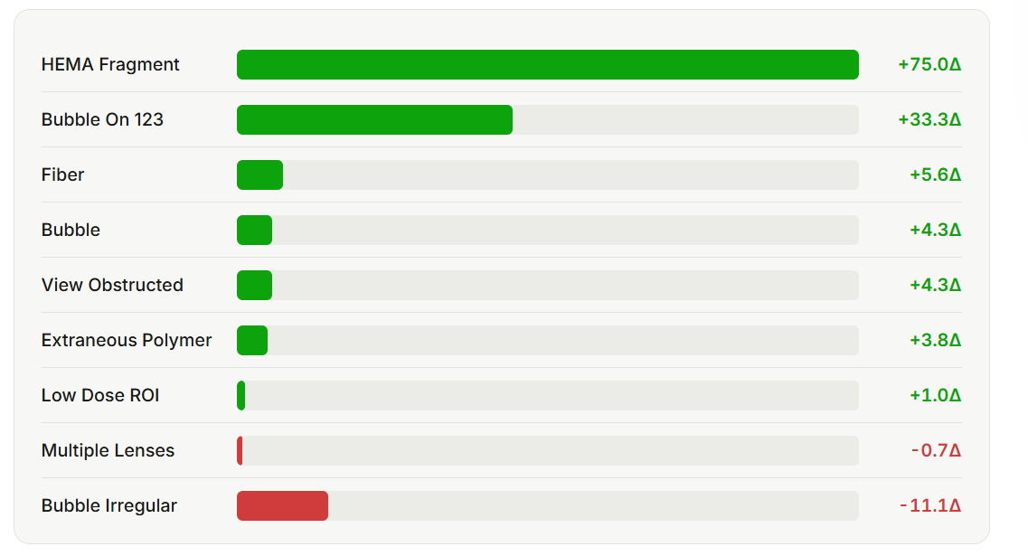
Average recall changes improves for most defect types

Slide 10
Multi Label Model

Slide 11
Why we built a multi-label model ?
Real images can carry more than one defect tag at once: of 3,377 lens images, 178 carry two tags together.
A standard model gives exactly one answer per image, so on those pictures it must drop a real label.
Our model answers all 5 tags independently: it can say “Multiple Lenses: yes” and “Folded Lens: yes” in the same picture.
First full run: 93.9% of test images came back fully correct (636 of 677).
4 of the 5 tags are learned almost perfectly; only one tag, Folded Lens, stays weak - and that is the story of the next slides.

Slide 12
Data
All 3,377 lens-presentation images used, and how the tags overlap
Label distribution | Images | Share of the 3,377
Single-tag images | 3,199 | 94.7%
Two-tag images (Folded Lens + Multiple Lenses) | 178 | 5.3%
Three or more tags | 0 | 0%
Total images used | 3,377 | 100%
Tag | Images carrying the tag | With another tag
Multiple Lenses | 1,442 | 178 (Folded Lens)
Missing Primary Package | 1,427 | 0
Missing Lens | 325 | 0
Cavity Off Center | 183 | 0
Folded Lens | 178 | 178 (always with Multiple Lenses)

Slide 13
How we read the results
Accuracy is misleading here.
  Most answers are 'not present', so a model that says 'no' to everything still scores better accuracy while detecting nothing.
We use AUPRC as the primary measurement:
  It scores each tag separately and averages them, so rare tags count as much as common ones.
ACCURACY
AUPRC
79%
0.90
Scores every tag separately: the weak tag is visible, not hidden
A model that answers "No" to every tag reaches 79% accuracy while detecting nothing.
Multiple Lenses
1.00
Missing Primary Package
1.00
Missing Lens
1.00
High score, zero value
Cavity Off Center
1.00
Folded Lens
0.52

Slide 14
How the model works
A high-level overview: one picture in, five independent answers out
1 Image
2 ResNet 50 model
3 Five tag scores
4 Answer per tag
one photo from the line
a pre-trained network that reads the picture
one 0-1 score per tag, cut at 0.5 (red line)
one yes / no for each tag
Multiple Lenses
0.5 cut
Multiple Lenses: Yes
feeds
scores
0.99
Folded Lens
0.93
Folded Lens: Yes
Missing Lens
0.14
Missing Lens: No
Cavity Off Center
0.10
Cavity Off Center: No
Missing Primary Package
0.12
Missing Primary Package: No
Old way: one answer per picture
New way: five independent answers
The model picks the single most likely label. On the 178 pictures that carry two tags, one real label has to be dropped.
Each tag is decided on its own, so a picture can answer Yes to both Multiple Lenses and Folded Lens at the same time.

Slide 15
Results: Baseline vs MultiScale, and the Folded Lens issue
We compared two models on identical data:
  ResNet 50 and the larger Multi Scale ResNet 50 model.
The larger model does not win:
  ResNet 50 AUPRC 0.905 vs MultiScale 0.862 - more capacity did not add accuracy.
Measure | ResNet 50 | MultiScale
Overall score (AUPRC) | 0.905 | 0.862
Balance across tags (macro F1) | 0.808 | 0.774
Pictures fully correct | 93.9% | 92.5%
Multiple Lenses found | 289 of 289 | 289 of 289
Folded Lens found | 2 of 36 | 0 of 36

Slide 16
Contd..
Both models failed on same tag
  Folded Lens is found at most 2 times out of 36, while Multiple Lenses is found 289 of 289.
The reason
  Every Folded Lens image in our data also carries Multiple Lenses, so the model learns 'Multiple Lenses implies everything' and never learns what a folded lens looks like.
Adding capacity made it worse, not better
  The bigger model is simply more confident in the wrong answer.
Conclusion:
  This is not a model gap. We need more diverse Folded Lens examples to break the pattern.

Slide 17
What's next
Data
Collect more Folded Lens images, ideally some that are not also Multiple Lenses
  The one change that lets the model learn the difference.
Modelling
Keep testing other architectures: the best variant leads on overall F1, and we will confirm it with repeat runs.
Weigh the tags differently during training so rare tags like Folded Lens count more.
Tune the decision level for Folded Lens from saved scores

Slide 18
THANK YOU

