Slide 1




FlashCart
YOUR BAG
5 items · 3 stores
₹4,414
Fashion Zone
₹2,006
Smart mall billing & unified checkout
Tech Store
₹2,240
One bag. Every store. Zero queues.
Food Court
₹168
Pay ₹4,414
Pranay Nagpal · Suryansh Jain · Srijan Tanwar
UCS503 Software Engineering · Submitted to Jhonsy Bansal
Thapar Institute of Engineering & Technology, Patiala
UPI · Card · Cash at desk
Notes:
FlashCart is a smart mall billing system. Shoppers scan products in any showroom with their phone, everything goes into one bag, and they pay once and get a single GST invoice. This deck covers the problem, what we built, how it is built, how we designed and delivered it, and our results and next steps.

Slide 2




Three queues become one bag
With FlashCart
Today: a counter per showroom
1
Sign in with a mobile number
No password and no OTP needed
A queue at every showroom
Buy three things, stand in three queues
2
Scan barcodes in any showroom
The phone camera reads EAN-13 tags
Scattered GST bills
Three separate invoices to reconcile
3
Review one bag and one GST bill
5%, 12% and 18% slabs, CGST + SGST
Error-prone cash counters
Wrong change, no day-end total
4
Pay once: UPI, card or cash
Get one digital tax invoice
Notes:
Today a shopper who buys a shirt, earbuds and a coffee stands in three queues, pays three times and leaves with three GST bills. Cash counters also make change mistakes and struggle to reconcile the drawer. FlashCart replaces all of that with four steps: sign in with a phone number, scan barcodes anywhere in the mall, review one bag with the GST split by slab, and pay once.

Slide 3





Two apps, one checkout
Customer app
on the shopper's phone
Cash desk
on the cashier's laptop or tablet
Scans EAN-13, UPC and Code 128 barcodes
Cashier signs in with email + password
One bag across five showrooms
Finds a bill by barcode or phone number
UPI and card via Razorpay, or cash
Shows the change to return, note by note
GST invoice and receipt history
Tracks the drawer and the day-end total
Tested on real tags: Puma polo ₹2,999 · Mufti shirt ₹2,399 · JPG parfum, billed at exact MRP
Notes:
FlashCart has two web apps. The customer app scans product barcodes with the phone camera, keeps one bag across five showrooms, and takes payment by UPI or card through Razorpay, or issues a cash bill. The cash desk is deliberately simple: find the bill, enter the cash received, and it shows exactly how much change to return, then reconciles the drawer at the end of the day. We tested it on real product tags, and the bill matches the printed MRP to the rupee.

Slide 4
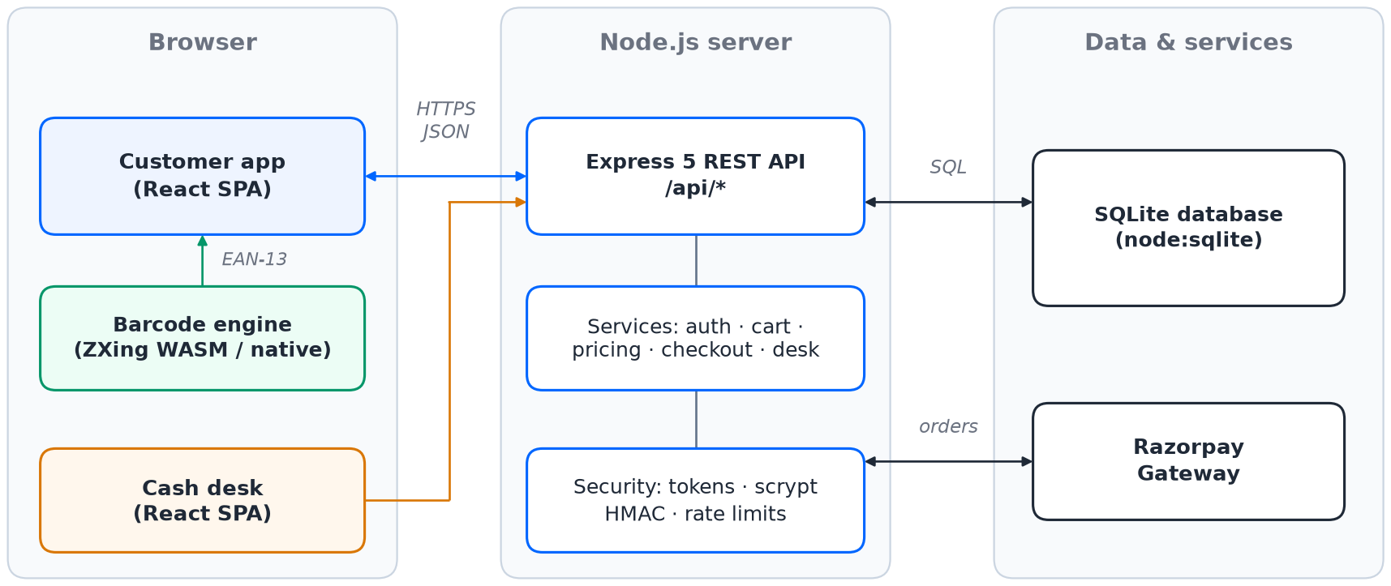






How FlashCart is built
Tech stack
Frontend
React 19 · Vite 8 · Tailwind 4
Backend
Node.js · Express 5
Database
SQLite (node:sqlite)
Payments
Razorpay UPI and cards
Three tiers: browser apps → Express REST API → SQLite database and Razorpay
Scanning
ZXing-C++ WebAssembly
Paise-exact GST
Per-slab CGST + SGST with round-off
Server pricing
HMAC check on every payment
Secure sign-in
Signed tokens, scrypt passwords
Testing
node:test · 17 API tests
Notes:
Architecturally it is three tiers. Two React single-page apps run in the browser and talk JSON over HTTPS to one Express API, which owns every business rule. Data lives in SQLite, and online payments go through Razorpay. Three engineering choices matter most: all money math is done in integer paise, the server prices the bag itself and verifies Razorpay's HMAC signature before issuing an invoice, and sign-in uses signed tokens with scrypt-hashed cashier passwords.

Slide 5
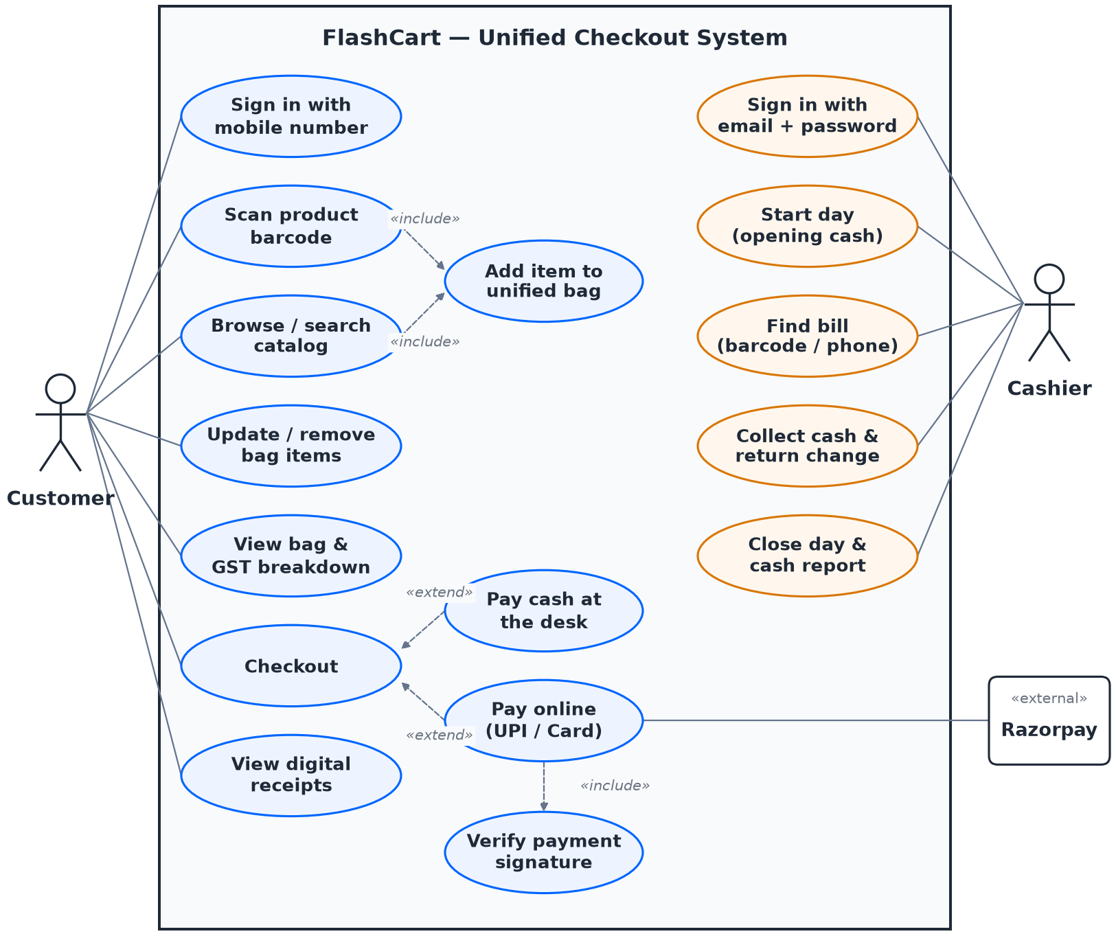
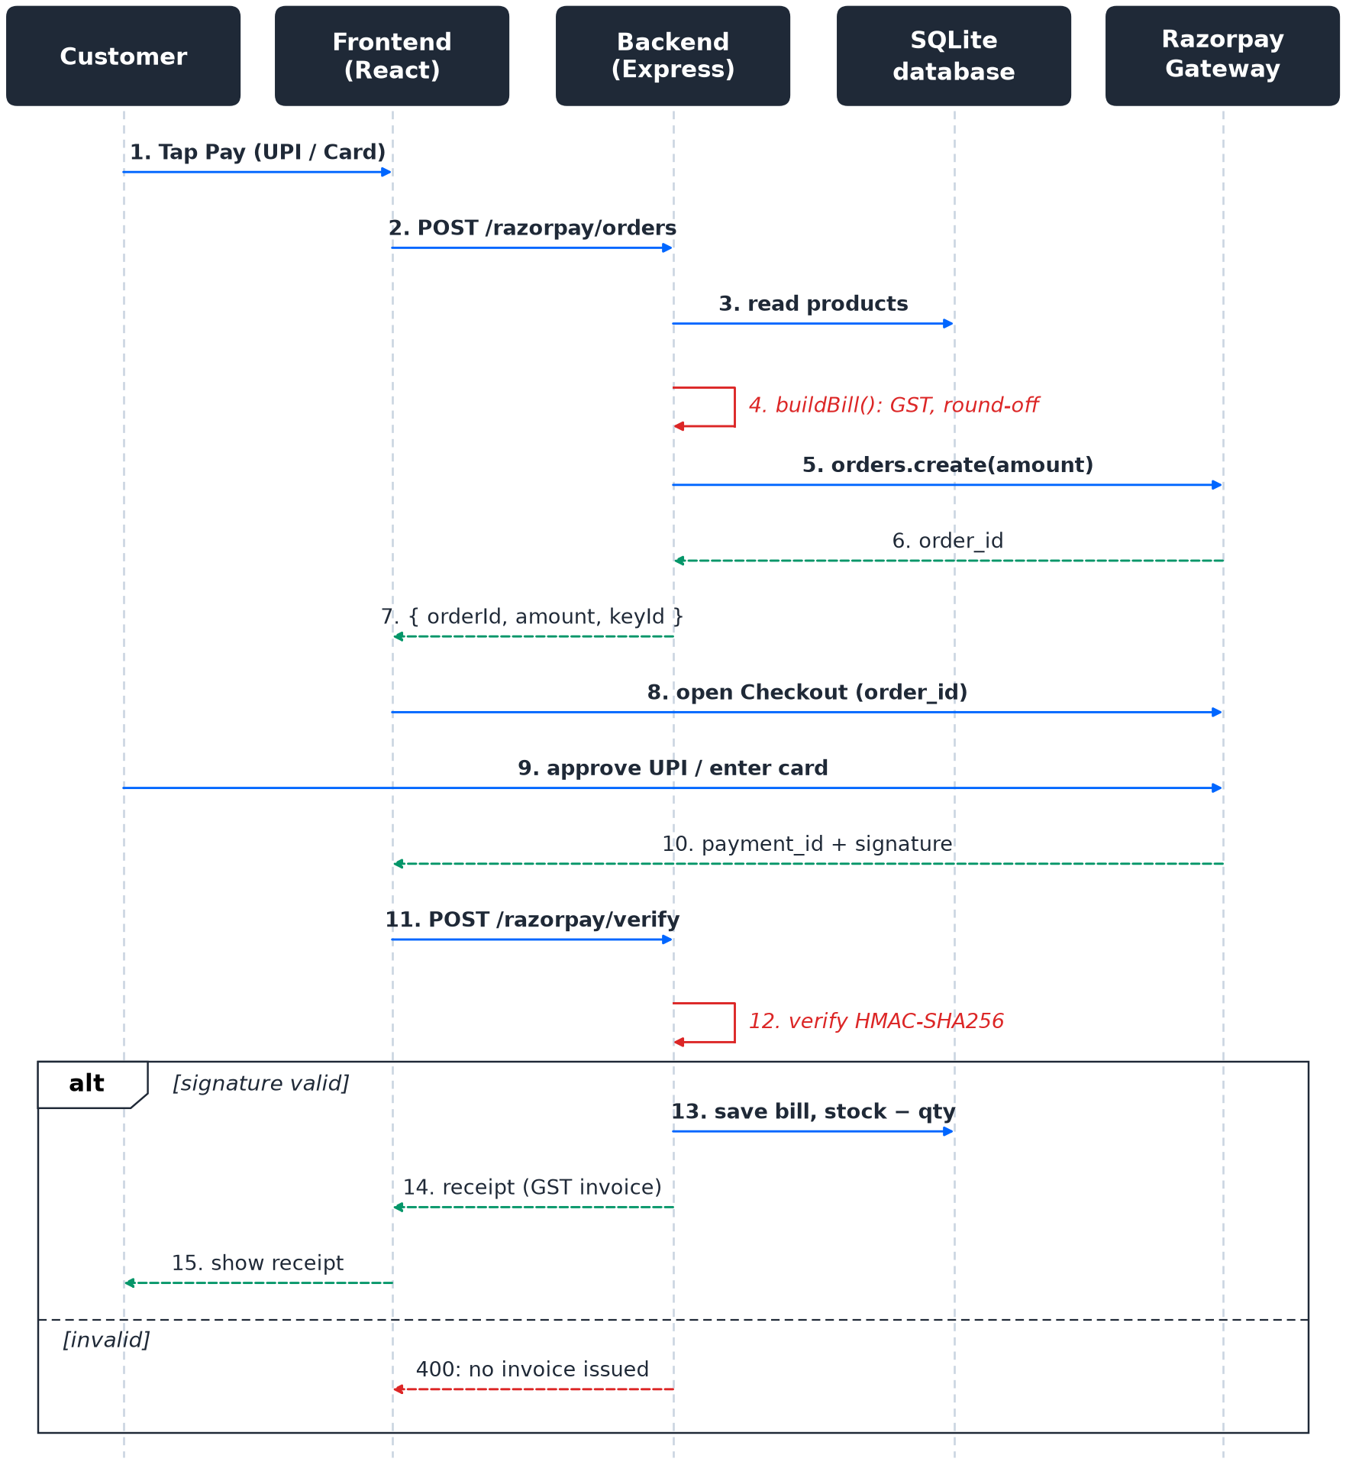
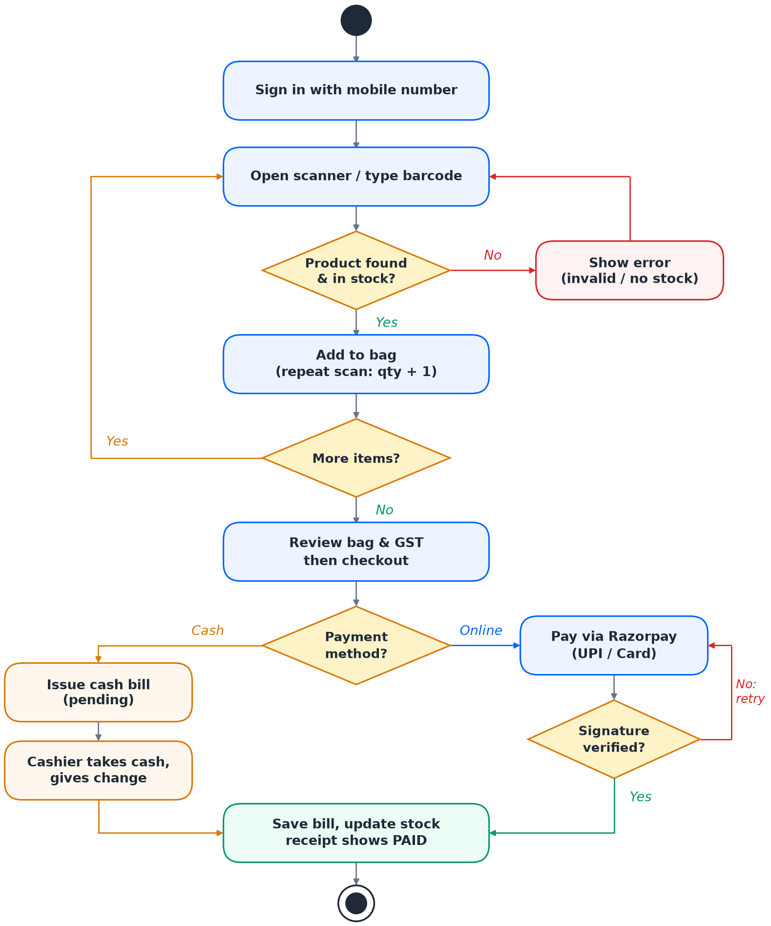
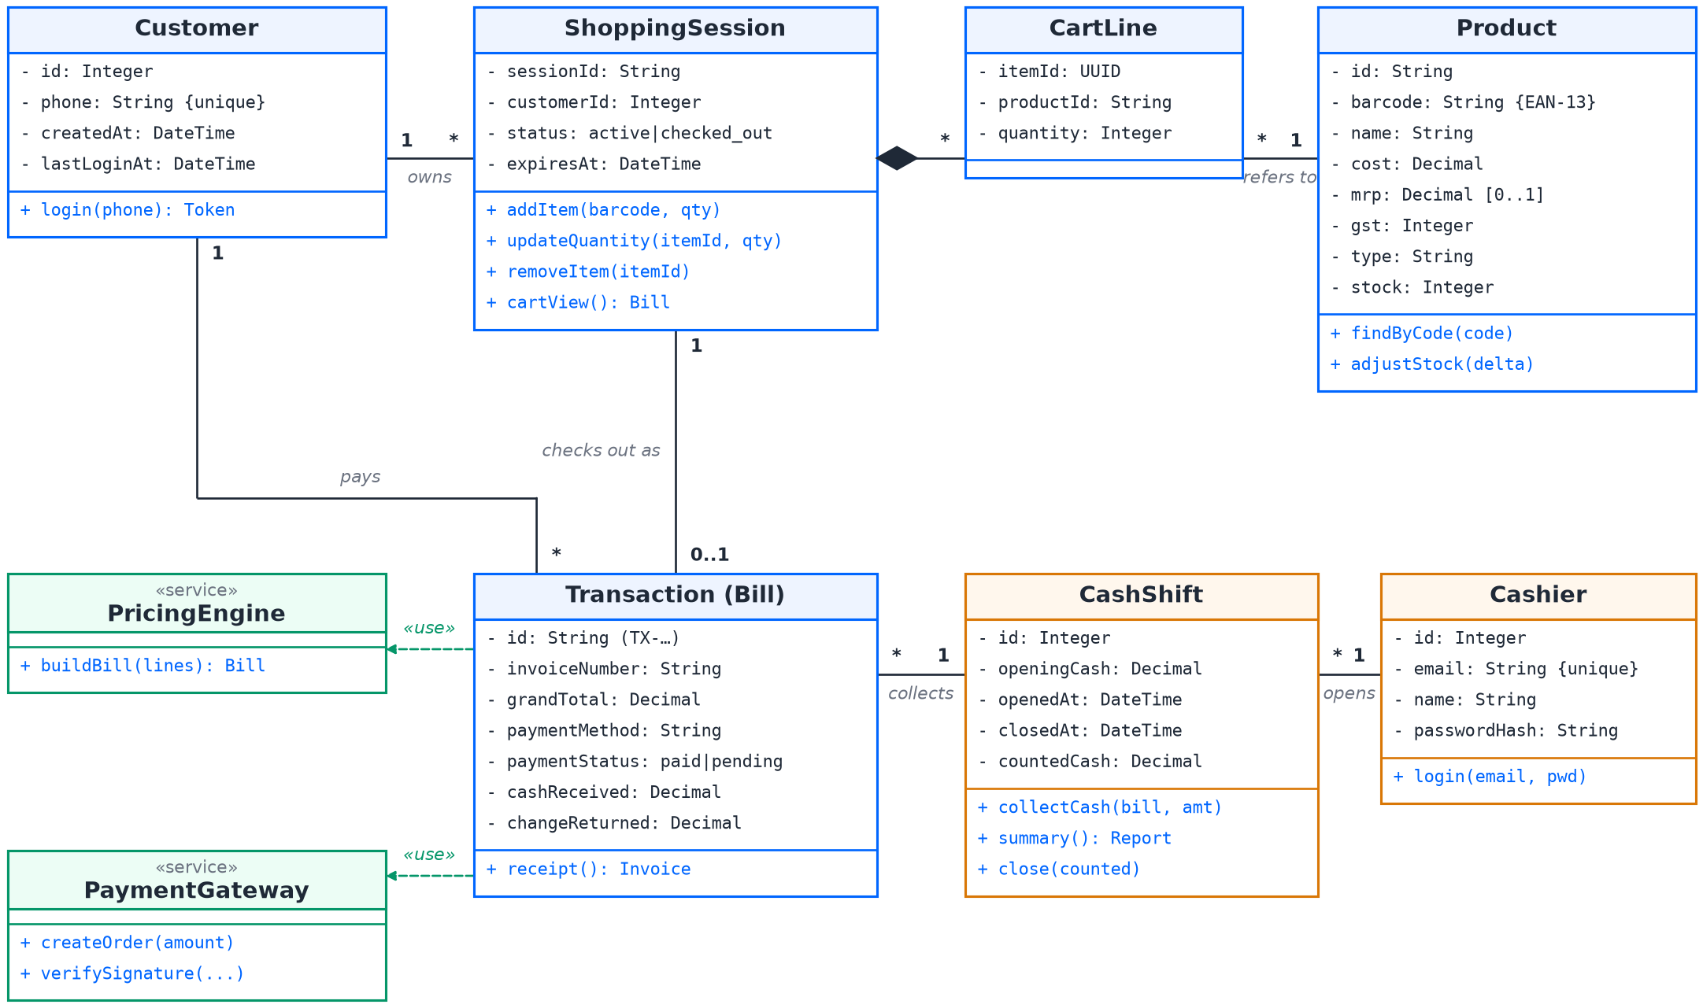
Design and delivery
Iterative & incremental SDLC
Plan, design, build, test, demo, review
1
Weeks 1–6 · MVP
Unified bag, GST, Razorpay
Use case
Sequence (Razorpay)
2
Weeks 7–8 · Accounts & data
Sign-in, SQLite, cash desk
3
Weeks 9–10 · Real retail
Barcode engine, real tags, MRP
Activity (checkout)
Class (domain model)
Notes:
We modelled the system with four UML views: a use case diagram for the customer, cashier and Razorpay; a sequence diagram for the online payment and signature check; an activity diagram for the checkout flow; and a class diagram for the domain model. We delivered in three iterations: the MVP first, then accounts, the SQLite database and the cash desk, and finally real barcode scanning with MRP-accurate pricing. Each demo's feedback shaped the next iteration.

Slide 6




Results and what's next
What's next
17/17
API tests passing
~1 ms
API response (p95)
Inventory management
Stock in and out, low-stock alerts, admin panel
Hardware smart cart
Mounted scanner, Raspberry Pi, weight check
~30 ms
per barcode frame
3/3
real tags scanned
Safer sign-in and payments
SMS OTP, Razorpay webhooks, refunds
Scale up
PostgreSQL, cloud hosting, a mall-wing pilot
Shop more. Wait less. Pay once.
Notes:
All 17 automated API tests pass, server operations finish in about a millisecond, a barcode frame decodes in about 30 milliseconds, and all three real product tags we tried scanned correctly with bills matching their MRP. Next, we want to add inventory management for each showroom, then build a hardware smart cart with a mounted scanner and a load cell that checks the cart's weight against the scanned items. We also plan SMS OTP sign-in, Razorpay webhooks and refunds, and a move to PostgreSQL in the cloud for a pilot.

