Slide 1
MACHINE LEARNING • 2nd REVIEW
Bayesian Deep Learning-Based
SIC Failure Prediction and
Reliability-Aware User Scheduling
for Imperfect-SIC NOMA Networks
Project Team
P. Kethan — 2520040033
P. Kireeti — 2520040034
B. Shanmukh Pranay — 2520040070
Course: 25SC2107E | Department of ECE
A.Y. 2026–27 | Guide: Mr. N. Lava Prasad

Slide 2
Problem Statement
02
Why the problem matters
What our project tries to predict
NOMA allows multiple users to share the same time/frequency resources. At the receiver, SIC is required to separate superimposed signals.
Wireless conditions
SNR • channel • power • interference
SIC risk
Problem in imperfect SIC
Probability of cancellation failure
Noise, interference, channel variation, channel-estimation error and decoding errors can make SIC unreliable. A failure can increase BER, outage and reduce useful throughput.
Uncertainty
How confident is the prediction?
Scheduling
Choose lower-risk user pairs
Machine Learning • 2nd Review

Slide 3
Proposed Methodology / Algorithm
03
Core idea: predict SIC failure probability first, then use risk + uncertainty for pairing.
1. Generate / collect
NOMA conditions
2. Preprocess
+ standardize
3. Train neural classifier
neural classifier
4. Repeated inference:
mean + uncertainty
5. Reliability-aware
user pairing
Bayesian prediction
Reliability-aware cost
Baseline
• One hidden layer: 32 ReLU units
• Dropout = 0.25 during training/inference
• 40 repeated predictions for uncertainty estimation
• Mean probability = predicted SIC risk
• Standard deviation = uncertainty
For each strong/weak candidate pair:
pair cost = predicted failure probability
+ 0.50 × prediction uncertainty
Minimum-cost matching is then selected.
Conventional NOMA pairing:
• Sort users by SNR
• Pair strongest with weakest
• Continue inward
Both methods use the same near/far candidate pools.
Source: project implementation (prediction + scheduling modules)

Slide 4
Dataset, Features and ML Model
04
Synthetic dataset generated from a physically motivated imperfect-SIC simulation.
60,000
8
80/20
55
40
32
synthetic SIC attempts
input features
train / test split
training epochs
Repeated predictions
hidden units
Input features
ML formulation
SNR • channel gain • received power • interference
channel-estimation error • power gap • mobility • user distance
Binary supervised classification:
target = SIC failure (0/1)
StandardScaler → Dense(32, ReLU) → Dropout(0.25) → Sigmoid
Training uses mini-batch gradient descent + binary cross-entropy.
Course alignment: supervised learning, preprocessing and classification evaluation

Slide 5
Project Workflow / Implementation
05
End-to-end execution in main.py
Data generation
Preprocessing
Model training
60,000 samples
synthetic NOMA/SIC
stratified split
standardization
55 epochs
BCE loss
Evaluation
Scheduling
Repeated prediction
BER • outage
throughput • reliability
80 users
40 pairs
40 repeated predictions
mean + std
Code modules
data_generation.py • preprocessing.py • bayesian_model.py • scheduling.py • performance.py • visualization.py
Source: project README + main.py

Slide 6
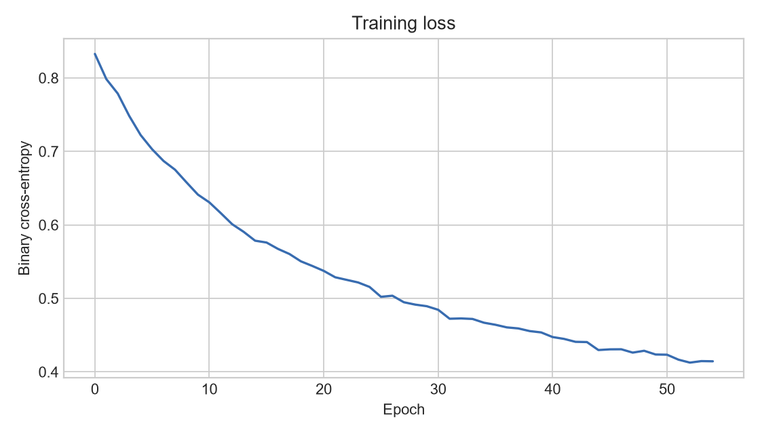
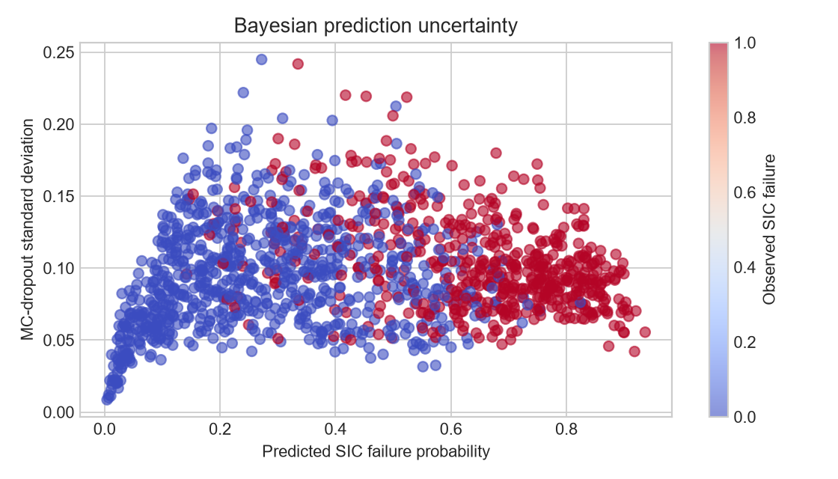
Simulation / Experimental Setup
06
Channel / link simulation
Training setup
Evaluation
Distance: 40–500 m
Tx power: 18–32 dBm
Noise: −100 dBm
Interference sampled around −112 to −78 dBm
Imperfect-SIC effects include estimation error, power gap and mobility.
Seed = 42
Batch size = 128
Epochs = 55
Learning rate = 0.001
Standardized inputs
Binary cross-entropy loss
Prediction: accuracy, ROC-AUC, Brier score, mean uncertainty
Scheduling: SIC failure rate, BER, outage, throughput and reliability
80 users → 40 scheduled pairs
Training loss decreases across 55 epochs.
Prediction standard deviation is used as prediction uncertainty.
Actual plots generated by the submitted project code

Slide 7
Experimental Results: SIC Failure Predictor
07
Test-set results from the current implementation
0.846
0.928
0.122
0.097
test accuracy
ROC-AUC
Brier score
mean prediction std.
What the results show
Important limitation at this stage
• The model separates failure / non-failure cases with ROC-AUC ≈ 0.93.
• Accuracy is ≈ 84.6% on the held-out test set.
• Brier score is included because the system uses probabilities, not only class labels.
• Repeated predictions provide an uncertainty estimate for downstream scheduling.
The dataset is synthetic and generated by the project simulation model. Therefore, these numbers demonstrate the implemented pipeline rather than validated performance on a real wireless-network dataset.
Actual test metrics: outputs/metrics/model_metrics.json

Slide 8
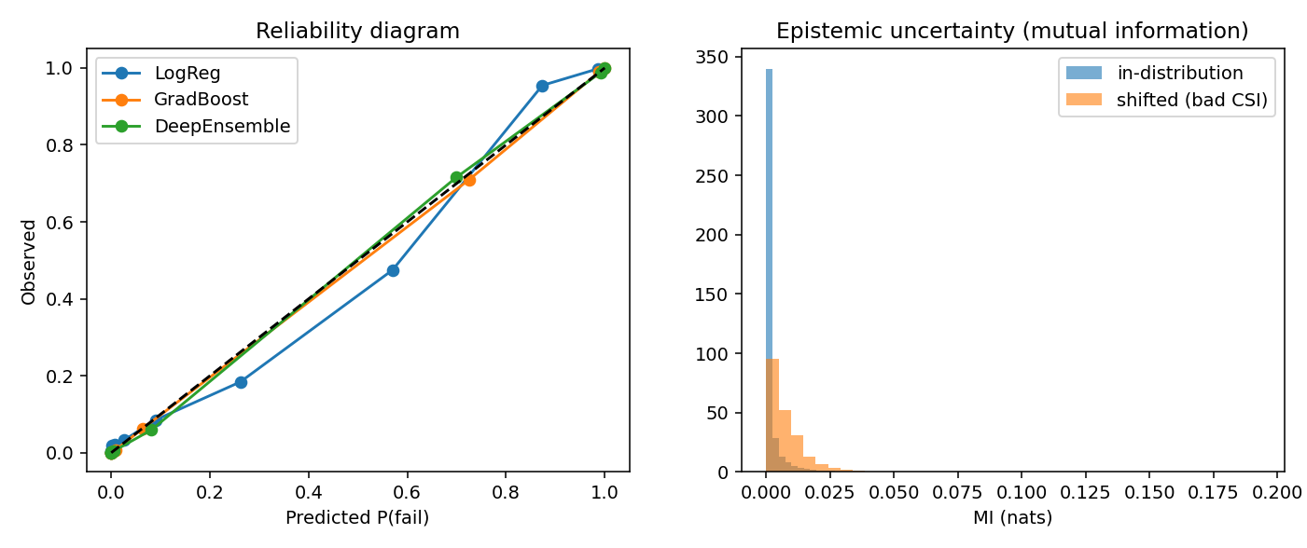
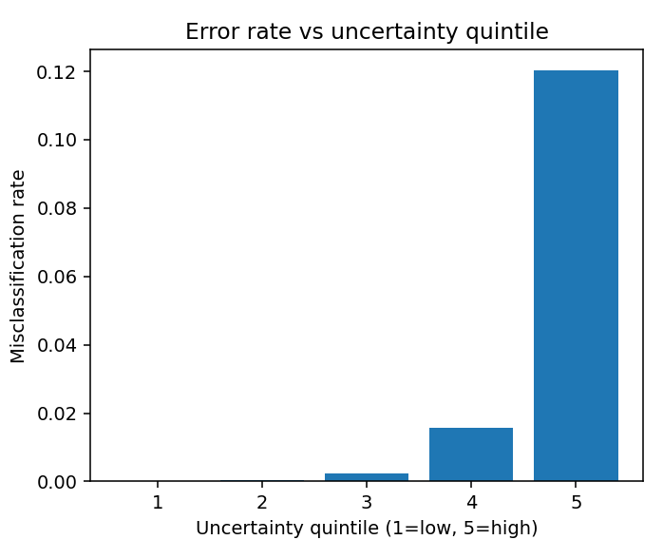
Experimental Results: User Scheduling
08
Current run — 40 scheduled pairs
Metric
Conventional
Reliability-aware
Pred. SIC failure
0.190
0.108
Observed SIC failure
0.075
0.000
BER
0.069
0.039
Outage
0.150
0.075
Throughput (Mbps)
36.06
37.39
Reliability
0.850
0.925
Observation from this run
Reliability-aware pairing reduced predicted risk and improved the measured reliability/throughput metrics.
Actual comparison: outputs/metrics/final_comparison.csv

Slide 9
Current Progress and Remaining Work
09
Completed / working
Remaining / next stage
Synthetic imperfect-SIC dataset generation
Feature preprocessing and standardization
SIC failure predictor with uncertainty estimation
Uncertainty estimation using repeated stochastic inference
Conventional and reliability-aware NOMA pairing
BER / outage / throughput / reliability evaluation
Training, uncertainty and scheduling plots generated
Test with a larger / real-world wireless dataset or validated simulator
Run repeated trials and report mean ± standard deviation
Add stratified k-fold cross-validation and hyperparameter search
Calibrate predicted probabilities and include a reliability diagram
Study scheduler sensitivity to the uncertainty weight (0.50)
Improve documentation, visualisation and final demonstration
2nd Review status: End-to-end prototype + initial experimental results completed; validation and refinement remain.
Aligned with course topics: evaluation, calibration, CV and ML engineering

