Slide 1
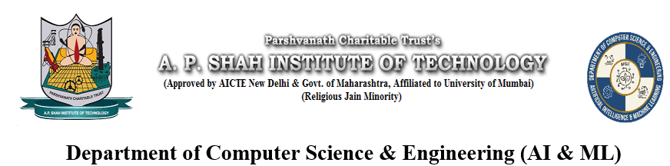
AI CHATBOT: Chatter Box
Pratik Patil-23106013
Ritesh Pandey-23106058
Tarun Pandey-23106046
Pranay Bhere-23106004
Project Guide
Mr. Viki Patil

Slide 2
Outline
Introduction
Literature Survey of the Existing Systems
Limitations of the Existing Systems
Problem Statement
System Design
Technologies and Methodologies
Implementation Screenshots
Conclusion
References

Slide 3
Introduction
AI chatbots are AI-driven programs that engage in human-like conversations.
They leverage NLP like techniques to understand user queries,
process them, and generate meaningful responses.

Slide 4
Literature Survey of the Existing System
Rule-Based Chatbots: These use predefined rules and pattern matching (e.g., ELIZA).
Retrieval-Based Chatbots: These use a database of predefined responses and select the most appropriate one based on user input (e.g., A.L.I.C.E.).
Generative Chatbots: These employ deep learning models like RNNs, LSTMs, or Transformer-based models (e.g., OpenAI's ChatGPT, Google's BERT-based chatbots).
Hybrid Chatbots: A combination of retrieval-based and generative models for more accurate responses.

Slide 5
Limitations of Existing System
Limited Context Understanding: Most chatbots struggle with maintaining long-term context in conversations, leading to disjointed or irrelevant responses during extended interactions.
Dependency on Internet Connectivity: Existing systems often require a stable internet connection for real-time communication with servers or APIs, limiting usability in areas with poor connectivity.
High Development Costs: Advanced AI chatbots with capabilities like NLP often involve significant development and maintenance costs, which can be a barrier for small-scale applications.
Storage : Most chatbots keeps temporary storage leading to lack of recommendation and references
Some advanced models : Chatbots usually lack in model training leading to long term static responses

Slide 6
Problem statement
To develop an intelligent AI-based chatbot that overcomes the existing limitations by leveraging some data models, contextual understanding, and adaptive learning mechanisms for improved user interaction and response accuracy.

Slide 7
Technologies and Methodologies
Frontend:
HTML, CSS, JavaScript – For structuring, styling, and interactivity
of the chatbot UI.
Material Design Icons & Google Fonts – Enhancing visual aesthetics.
Backend:.
RESTful API (JSON) – Exchanging data between frontend and backend.
Python(FLASK) - Web Application Development & API Development (RESTful APIs)
Database:
MYSQL : Contains chat history which is useful to view

Slide 8
Technologies and Methodologies
AI & NLP Models:
Sentence Transformers (BERT-based Model) – For semantic similarity matching.
Hugging Face Transformers (RoBERTa-QA Model) – Answering user queries using a Q&A model.
GEMINI API – Providing fallback responses when predefined models fail.
Speech Recognition API – Converting speech to text for voice input.
Speech Synthesis (Text-to-Speech) – Converting bot responses to speech output.

Slide 9
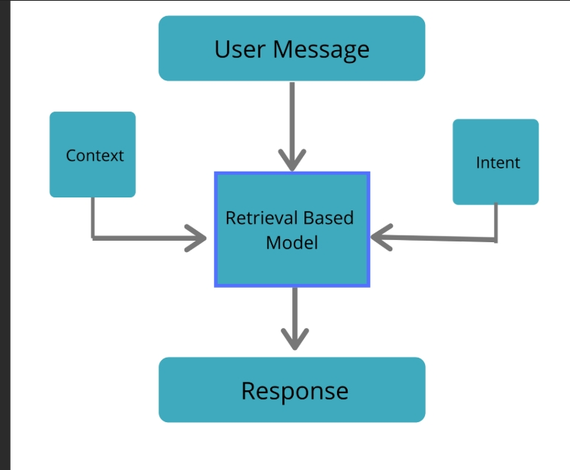
System Design

Slide 10
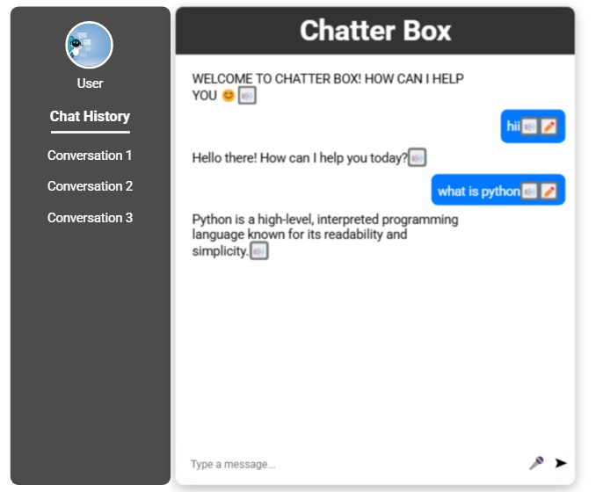
Implementation

Slide 11
Conclusion
Our chatbot project integrates multiple technologies, combining small language models, and speech interaction to create a dynamic conversational AI system. By leveraging Flask, BERT embeddings and GEMINI API, the chatbot can provide intelligent, context-aware responses, ensuring a seamless user experience.
Additionally, the project enhances usability with a responsive UI, voice recognition, and text-to-speech features, making it accessible across different devices. The combination of rule-based responses, AI-powered answers, and database storage ensures adaptability and scalability.

Slide 12
References
Gemini API Documentation., Gemini API. (n.d.). Official Documentation retrieved from [Gemini API Documentation Link]
Chatbot Design and Development., Huang, K., & Rust , R.T.(2021). “Artificial Intelligence in Service.” Journal of Service Research, 24(1), 3-7.
Trends in AI-Powered Chatbots Deloitte Insights. (2022). “AI-Fueled Chatbots: Current Trends and Future Opportunities.” Mckinsey & Company. (2023). “Transforming Customer Experience with AI Chatbots.”.
Urls: https://ai.google.dev/gemini-api/docs
https://web.stanford.edu/~jurafsky/slp3/

Slide 13
Thank You...!!

