Slide 1


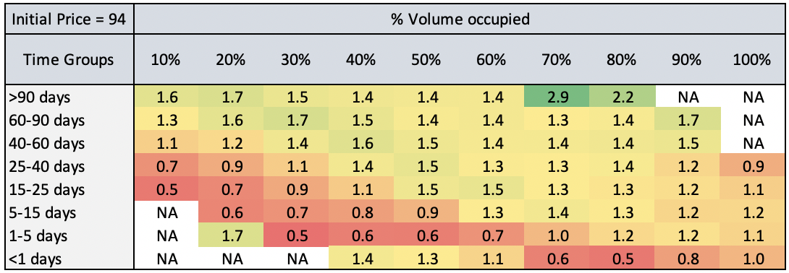
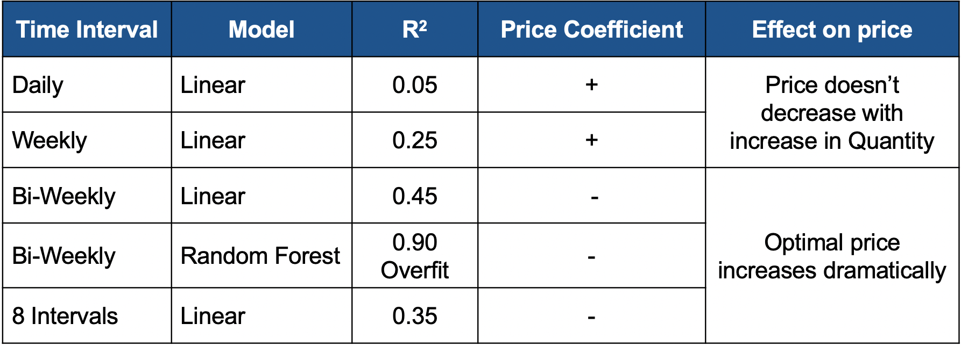
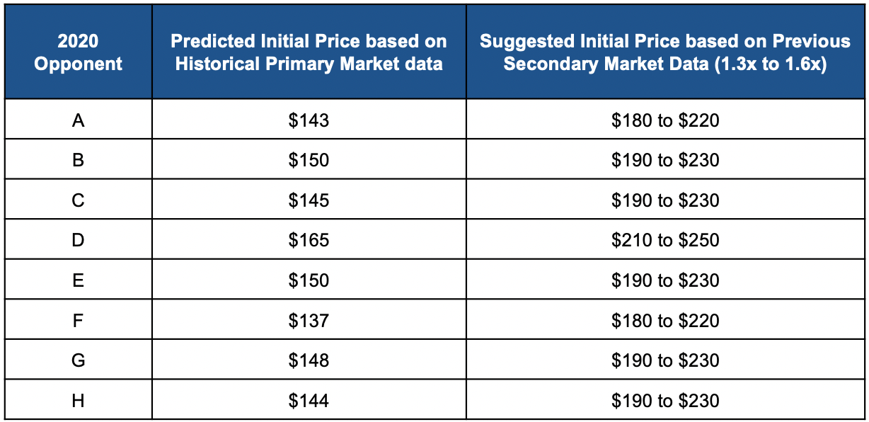
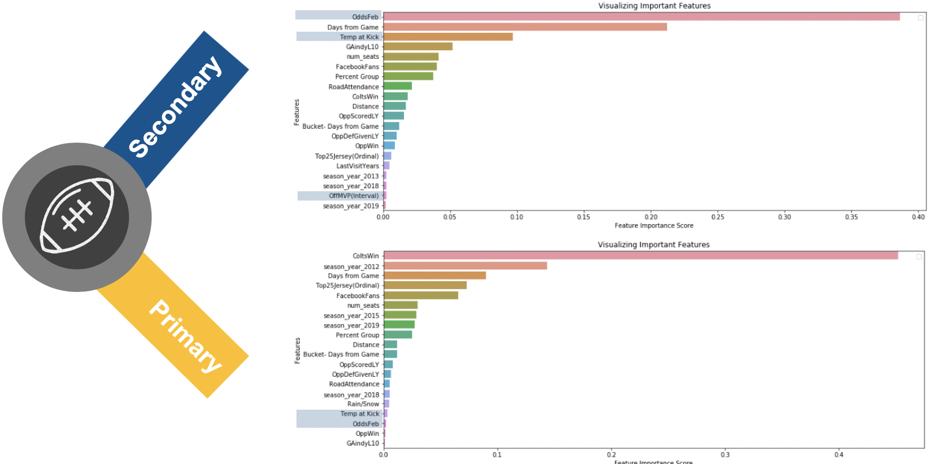




A Dynamic Ticket Pricing Solution for an NFL Team
Pranay Khandelwal, Lindsay Neufer, Ashwini Rao, Matthew A. Lanham
Purdue University Krannert School of Management
pkhande@purdue.edu; lneufer@purdue.edu; rao120@purdue.edu; lanhamm@purdue.edu
Abstract
Methodology
Results
We are developing a dynamic ticket pricing model with a National Football League (NFL) team. Our model was developed using real-time inventory data from internal and third party (e.g. Stubhub.com) ticket sales transactions, and opponent demographics. Since ticket sales are one of the key revenue generators for sports teams, maximizing this revenue using data-driven models that are operational in real-time is key. We discuss what we found to be state-of-the-art in this area, our model proto-typing journey, and what worked best for us that lead to valuable pricing recommendations.
Data
The dataset consists of primary market sales, secondary market sales, unsold inventory, and opponent attributes for the 2012-2019 seasons. Some ticket attributes include selling price, seat location, and time of sale. Some opponent attributes include their previous winning percentage and number of Facebook fans.
Solution 1: Demand Model for Revenue Maximization
Revenue = Price X Quality
Quality = f(Price, team & other factors)
Differentiate for optimal Price value
Use Optimal Price value to obtain maximum revenue
Demand Model: f (Price, team, & opponent factors)
Price Drivers:
Solution 2: Pricing that Mimics Secondary Market
Capture the demand using the secondary market fluctuations
Calculate initial pricing for the primary market using Regression
Use the grid below to multiply the initial price for dynamic pricing
The grid below gives the ratio of ticket price of secondary market to that of the primary market across time and volume occupied buckets. Multiplying this ratio with the primary market price, will give us the price that the secondary market is most likely to set.
We went ahead and predicted the primary market price 3 months from the game. Using the table above, we are able to estimate the range in which the secondary market will price the same tickets.
Introduction
A major reason so few teams were practicing dynamic pricing was because consumers don’t like it when the fact that different consumers have paid different amounts is made visible in some way. Since team are limited geographically in terms of who will buy tickets to their events, they rely heavily on loyal customers and are weary of making them angry. This practice can however dramatically increase revenues for the team, sometimes by multiple millions of dollars, which is why more teams are moving towards the practice now and potentially sacrificing the number of attendees for more revenue.
Research Questions:
How sensitive are the team's fans to price on average?
Which factors from the dataset affect quantity demanded and price?
How do factors differ between the primary and secondary markets?
How can we optimize revenue over the course of the entire ticket selling period?
Low R² suggesting data doesn’t have enough variable or fans are price insensitive
Results from Demand model
Conclusion and Recommendations
Our study explores two solutions to optimize revenue with dynamic pricing for an NFL team. While one approach focusses on revenue maximization, the other explores bridging the revenue gap between the primary and secondary markets and suggesting primary prices based on historical secondary market data.
On implementing solution two on the primary data for 2019, we realized a potential revenue increase of 10% ($125,000) by setting solution two's suggested price.
Adding consideration of customers buying patterns and other characteristics might enhance the reliability of the revenue optimization model. Additionally, considering cannibalization and week of game effects within sections will improve performance.
Literature Review
Kemper and Breuer (2016) developed 8 demand functions for the Bayern Munich Stadium – the team with the highest attendance but lowest prices.
Arslan et al (2019) compared all NFL teams who were dynamically pricing to those who were not. Teams who do sell 3% more tickets on average.
Arslan, Easley et al (2019) built models for two customer segments of a college football team, then modeled customer utility to predict purchase.
Xu et al (2016) built a three- stage regression model to optimize one MLB team's revenue from single-game ticket sales. Found frequency of prices changes unimportant.
Acknowledgements
We thank Professor Matthew Lanham for constant guidance on this project.

