Slide 1
SIH26034 · WORKING PROTOTYPE
Naap-Tol
We said we would measure it. Here is the code that does.
60
14
0.002 mm
Rs 0
tests passing
rules encoded
height error
licence cost
Python · OpenCV · Tesseract · Streamlit · SQLite — all open source, runs offline on a laptop
streamlit run app.py
Ministry of Consumer Affairs, Food & Public Distribution · Smart India Hackathon 2026
Notes:
This deck is the demo deck. Lead with: the idea slide said we would measure letter heights in millimetres. This is the working system that does it.

Slide 2
What is built
A working pipeline, not a mock-up
scale.py
Finds the printed marker, rectifies the photograph, derives mm per pixel
THE APPLICATION
geometry.py
Rule 7 panel area and the Table-I letter-height bands
Scan a package
capture, measure, adjudicate
Enforcement dashboard
ocr.py
Swappable engines: Tesseract, EasyOCR, PaddleOCR
breaches, repeat offenders, states
Rule pack viewer
quality.py
Decides whether a photograph can support a conclusion at all
every encoded rule, readable
extract.py
Pattern-matches the nine declarations out of OCR output
ALSO IN THE REPOSITORY
rules.py
The rule engine. Rules are JSON data, not code
Synthetic label generator with exactly known millimetre heights
Accuracy benchmark and a degraded-capture robustness harness
60 tests covering geometry, rules and the offence ladder
Printable 50 mm ArUco reference card
report.py
The evidence PDF an officer attaches to a case file
store.py
Scan history and the Section 36 repeat-offender ledger
Notes:
Point out that the rule engine reads JSON. An officer edits a file, not the program.

Slide 3
The measurement chain, verified
From a photograph to a millimetre, with a stated error bound
0.056 %
Scale recovery error
ArUco card is exactly 50 mm
detected in the frame
Image rectified on its four corners
removes camera tilt
0.002 mm
Letter-height mean absolute error
1 px = 0.0833 mm
exact, by construction
5 / 5
End-to-end verdicts correct
Glyph box measured at half-maximum
37 px tall
Letter height = 3.08 mm
vs 2.5 mm required -> PASS
0
False accusations on degraded photos
READ THIS BEFORE QUOTING THOSE NUMBERS
These measure the measurement chain on clean synthetic renders, where the true height of every letter is known exactly. They do not measure real-world capture. The next step is 20 real packets measured with a vernier caliper — that is the number a judge is actually asking for.
Notes:
Volunteer the limitation before a judge finds it. Saying which number is which is what makes both numbers believable.

Slide 4
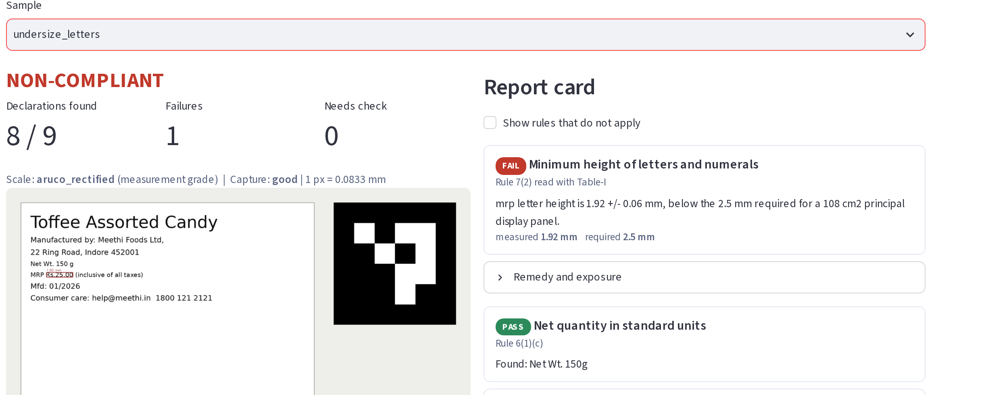
It catches what text extraction cannot
Every declaration is printed correctly. The text is simply too small — and that is the offence.
Rule 7(2), Table-I — measured 1.92 +/- 0.06 mm against 2.5 mm required for a 108 cm2 panel. An OCR-only system reads this label perfectly and reports no problem.
Notes:
This is the slide to slow down on. The label is legible, complete and correctly worded. It is still illegal.

Slide 5

Three bugs our own tests caught
Written down because how a team finds its own mistakes says more than a clean demo
A defocused photo of a COMPLIANT label reported NON-COMPLIANT
Cause Otsu thresholding is not blur-invariant. Soft edges get eroded, the measured box shrinks, and an honest label fails.
Fix Locate the glyph edge at the half-maximum between ink and background. Symmetric blur spreads an edge evenly about its true position, so the reading holds.
A 5 degree camera tilt inflated heights by about 7 %
Cause Larger than the margin most Rule 7 decisions turn on, so a compliant pack could read as a violation or the reverse.
Fix Rectify the whole frame on the marker's homography before measuring. Worst-case error fell from 0.22 mm to 0.05 mm.
The dashboard crashed on its second page view
Cause Streamlit runs each rerun on a new thread; the cached SQLite connection tripped the same-thread guard.
Fix Open the connection with check_same_thread=False and WAL journaling. Covered by a regression test that reads from another thread.
Notes:
The first bug is the important one: it is exactly the false accusation the whole design claims to prevent, and it was found by our own robustness harness, not by a judge.

Slide 6

The system never guesses a violation
Five verdicts, not two. Poor input produces an inspection lead, never a case.
Complies, with the measurement and its tolerance shown
PASS
WHAT BLOCKS A FAIL
No reference marker in the frame
Panel area not supplied
Scale only indicative, not measurement grade
Reading within its own uncertainty of the threshold
Photograph too soft, too dark or unreadable
Breaches the rule. Only ever issued on measurement-grade evidence
FAIL
The reading straddles the threshold. 2.45 +/- 0.07 mm against 2.5 mm is not a violation
BORDERLINE
The image cannot support a conclusion. Re-shoot, or check physically
INDETERMINATE
Exempt under Rule 26, wrong package type, or another regime prevails
NOT APPLICABLE
A false accusation against an honest shopkeeper is a worse outcome than a missed case. The system is built to prefer the miss.
Notes:
Ministry judges respond to this. Say it plainly: we would rather miss a case than create a false one.

Slide 7
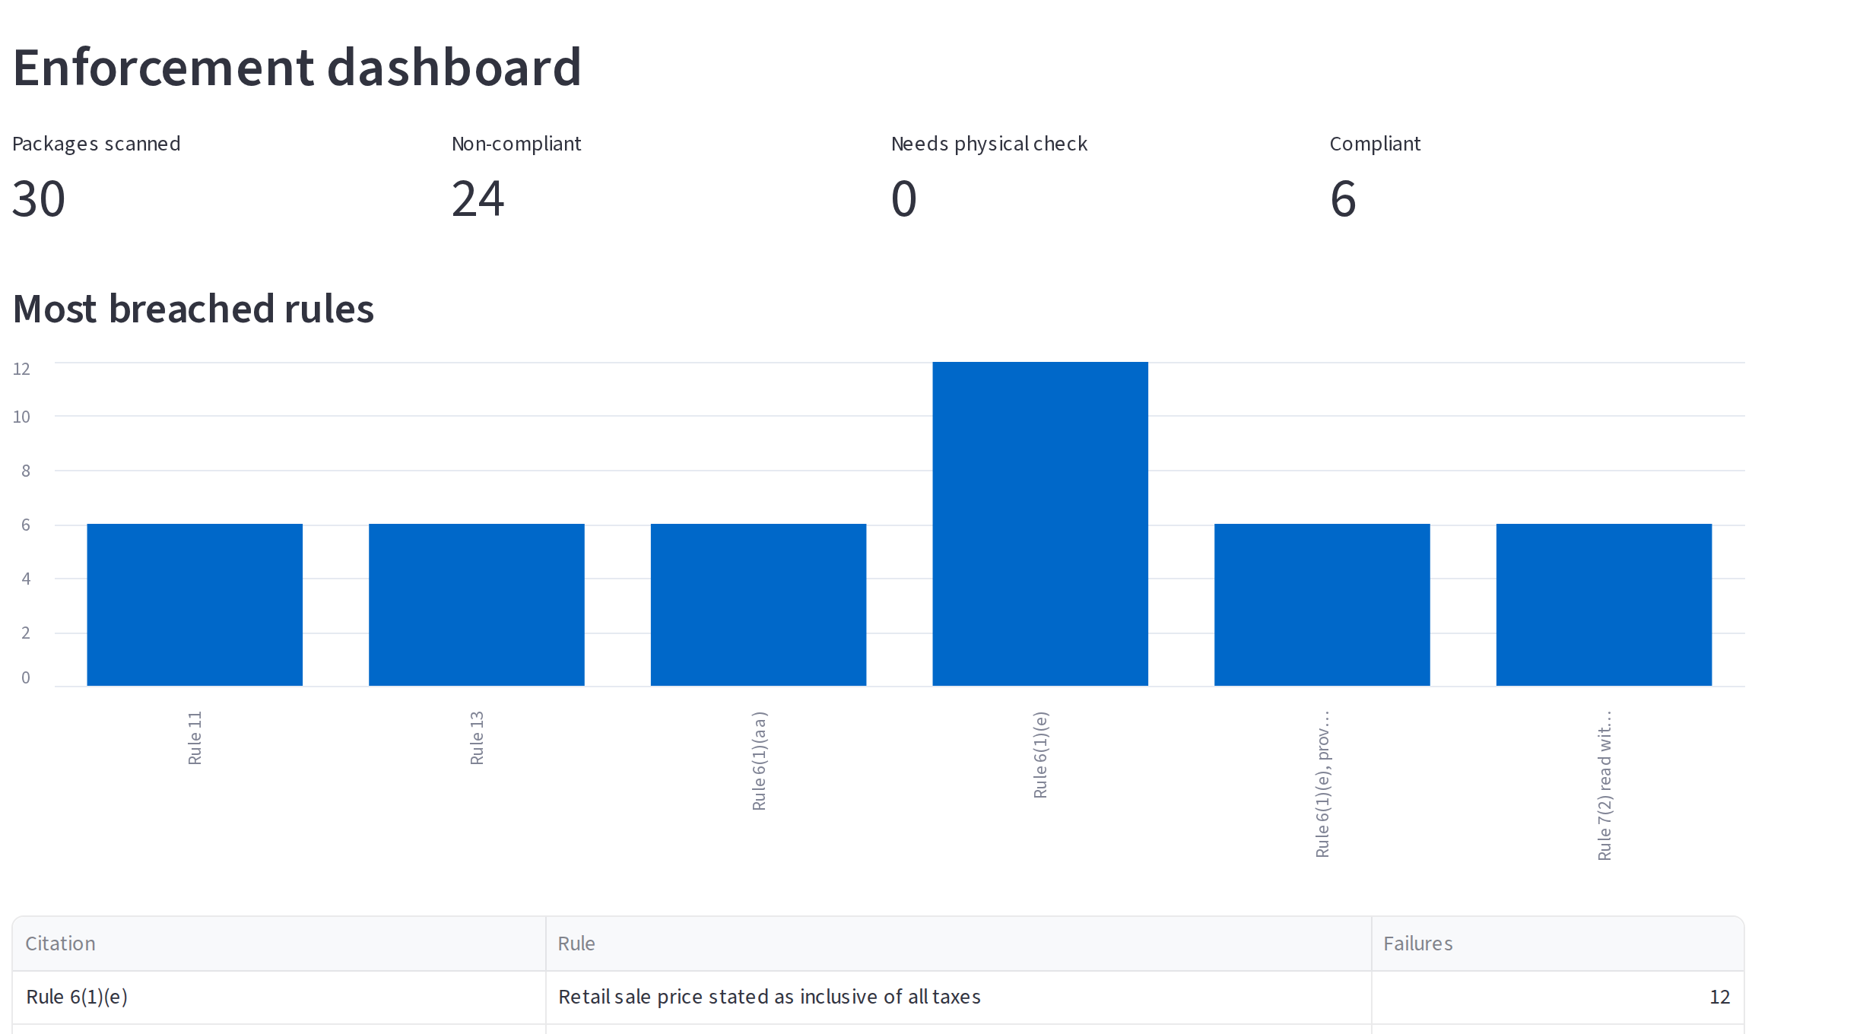
From one packet to an enforcement picture
Every saved scan feeds the targeting view a Controller would actually use
Most breached rules
Shows where to concentrate a drive. Missing tax wording leads by a distance.
Repeat offenders
Section 36 escalates: Rs 25,000, then Rs 50,000, then Rs 1,00,000 with imprisonment. The ladder is unusable without a queryable history, so we keep one.
Risk-based targeting
Brand, category, state and district, so scarce inspectors go where violations cluster.
Evidence PDF
Rule-pack version, image SHA-256, scale method and measurement uncertainty on every report.
30 scans in this view were produced by the real pipeline, not typed into a table.

Slide 8
Zero licence cost, and that is a design decision
A public system that pays per scan pays forever, in every district
WHAT WE USE
WHAT WE DELIBERATELY DO NOT USE
Python, OpenCV, NumPy, Pillow
PSF, Apache 2.0, BSD, MIT
Free
Cloud vision APIs
about $1.50 per 1000 images, forever
Tesseract / EasyOCR / PaddleOCR
Apache 2.0
Free
An LLM API for reading labels
Streamlit, pandas, Plotly
Apache 2.0, BSD, MIT
Free
per-token billing, and less explainable to an officer
A GPU
SQLite
Public domain
Free
Tesseract is CPU-only
fpdf2 (the only copyleft component)
LGPL-3.0
Free
Maps platform, cloud hosting, app store
not needed for a laptop demo
fpdf2 is LGPL. Fine as a library, imposes nothing on our code, and ReportLab (BSD) is a one-file swap if a permissive-only stack is ever required.
TOTAL SPEND
About Rs 5 to print the reference card, plus a Rs 300 vernier caliper to prove our accuracy claims. Nothing else.
Notes:
If asked why not Google Vision: cost across lakhs of shops, no connectivity in the markets inspectors work in, and an officer has to defend a finding in a way a model output cannot support.

Slide 9


What works, and what does not yet
Stated plainly, because judges probe
WORKING TODAY
NOT DONE YET
Marker rectification and millimetre measurement
14 rules with citations, exemptions and precedence
Rule-version selection by date of packing
Capture-quality gate that blocks false failures
Evidence PDF and enforcement dashboard
60 tests, all passing
Real photographs
Tested on synthetic labels only. Twenty real packets, measured with a caliper, is the next task and the number judges will ask for.
Threshold calibration
The capture-quality thresholds were tuned on synthetic renders and must be re-derived on real photos.
Curved packs
Cylindrical unwrapping is designed but not implemented.
Hindi in the field
Devanagari works in EasyOCR; not yet tested on real Indian packaging.
Advisory only. Decision support for a Legal Metrology officer, not an adjudication.
SIH26034 · github.com/pranay9th/SIHP2026
Notes:
Closing line: we would rather tell you what is not finished than be caught not knowing. The next number we produce is the caliper number.

