Slide 1
HCAI · WEEKS 1–3
MindMap V2
A chat-first agent that drafts a mind map, challenges it with research, and only finalizes after you answer.

Slide 2
WHO IT’S FOR
Someone starting a messy plan, not a polished report.
Need: turn a vague topic into a map they can argue with — trip, launch, or research plan.
Success: they can say what the challenge step changed, and whether they’d use the result.
Studio stays hidden until a draft exists. Conversation first, artifact second.

Slide 3
THE LOOP
Chat drives every step.
Topic → goal → constraints → draft → research + questions → your answers → validate → rate.
You can skip goal/constraints, answer any probing question, attach a source, or start over.
Validation must return OK or the app asks a clarifying question instead of showing a broken map.

Slide 4
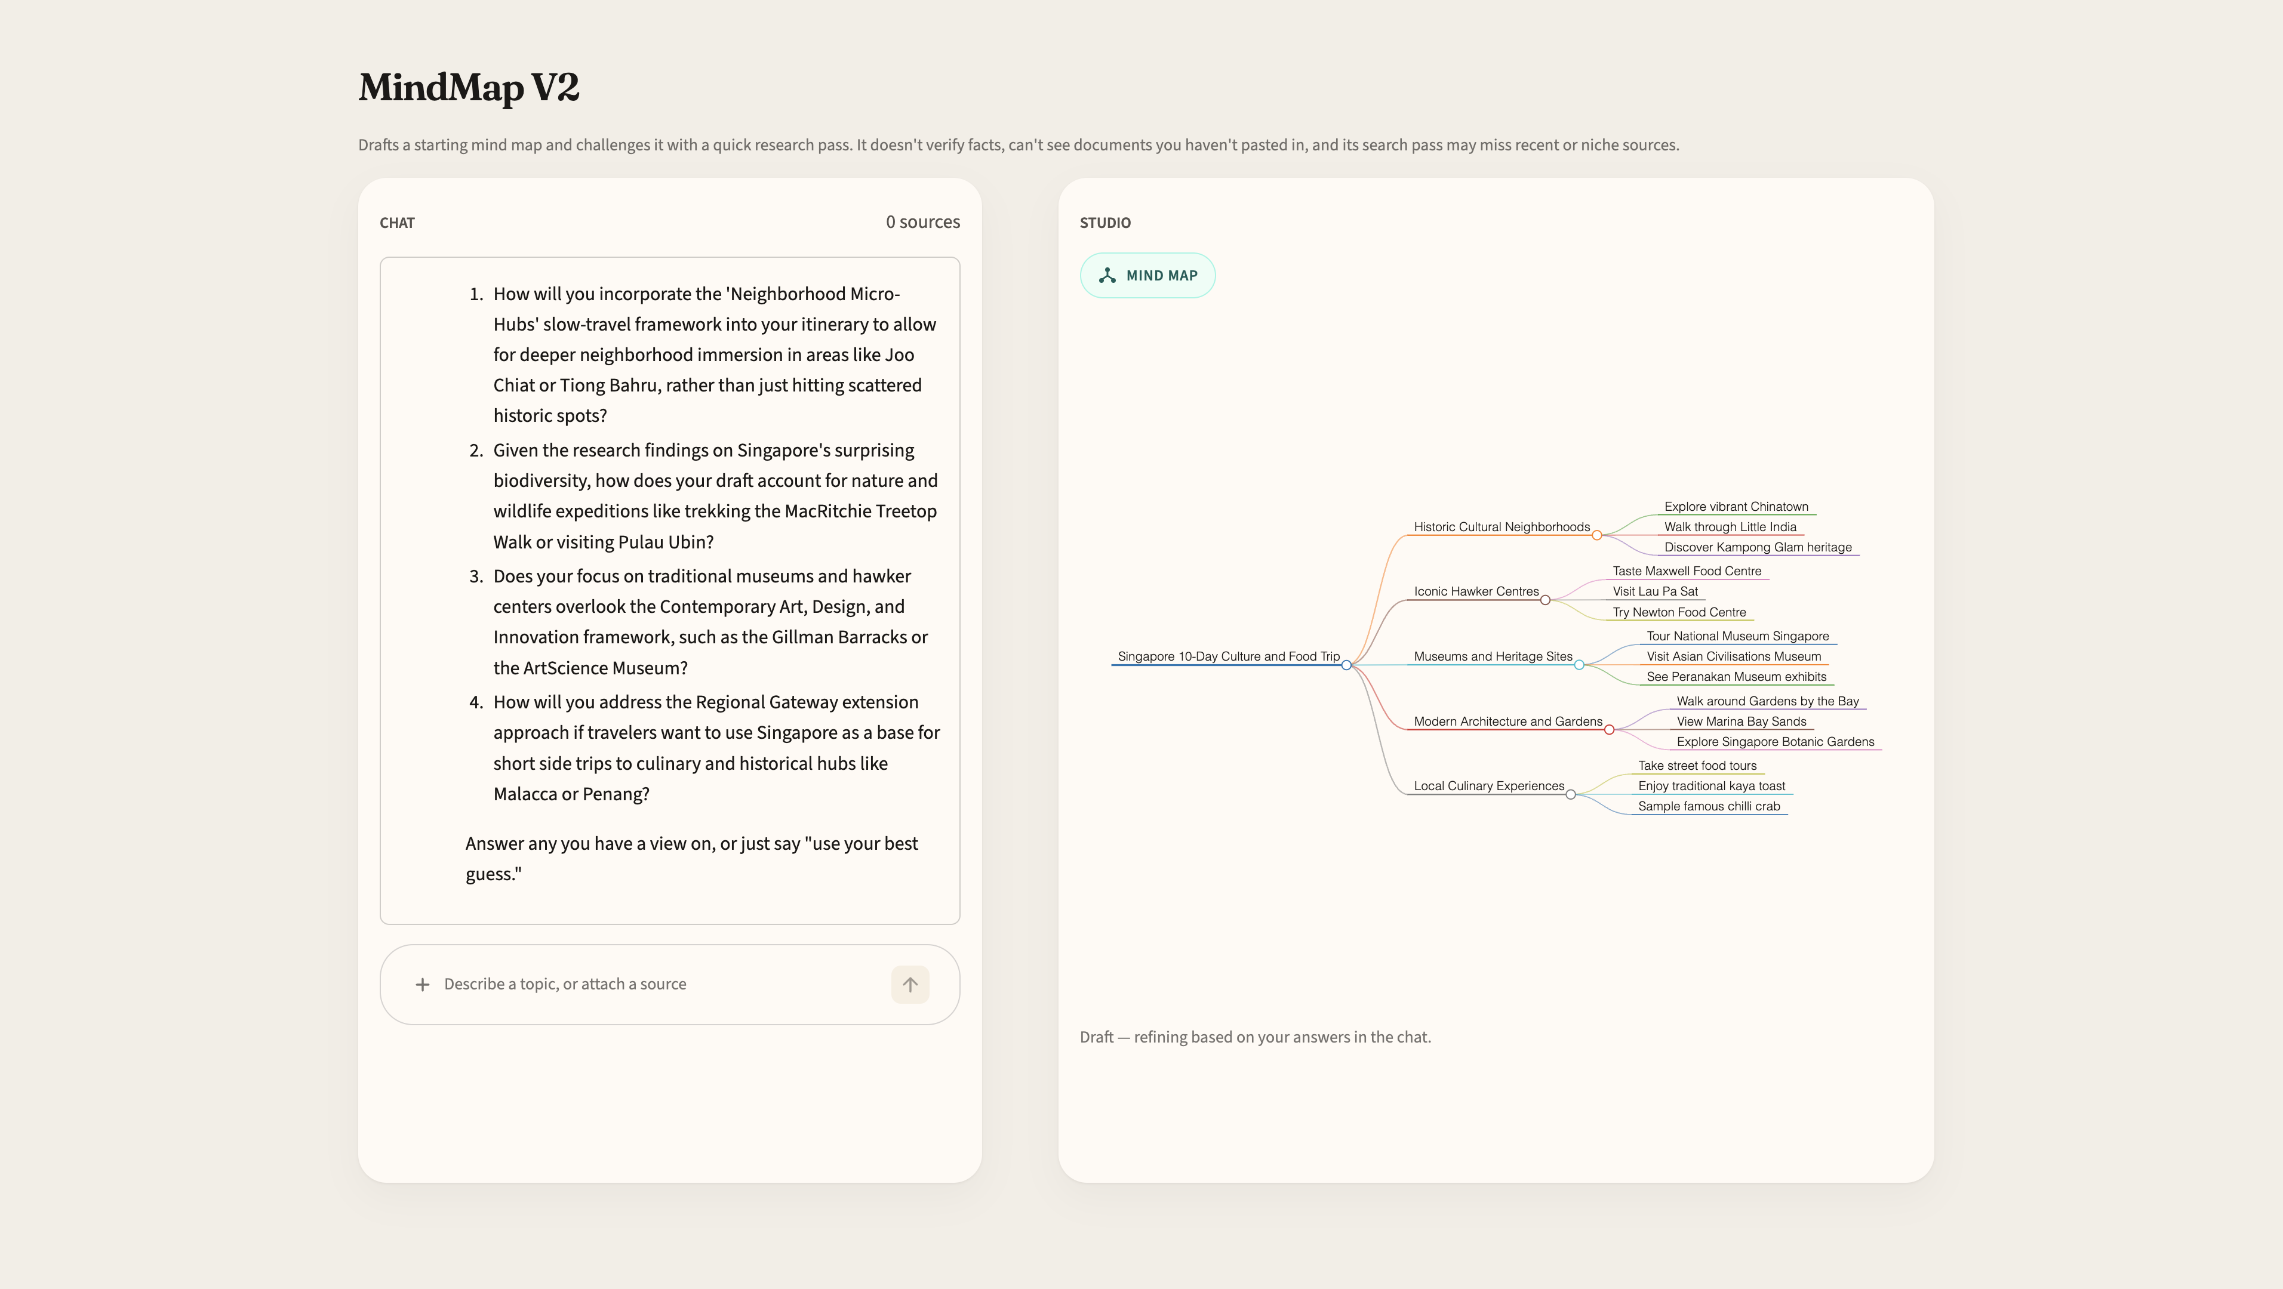
PRODUCT
Chat on the left. Studio on the right.

Slide 5
HCAI MAPPING
Where the brief shows up in the product
Trust: disclaimer on every screen — drafts and challenges, does not verify facts.
Control: skip, answer, attach files, start over. The map is not a one-shot dump.
Feedback: rate + comment after a final map. Logged to eval/feedback_log.csv.

Slide 6
WHAT TO TRY
A 12-minute evaluation path
Happy path: “10-day trip to Singapore.” Skip goal if you want. Answer two questions. Watch the map change.
Source: attach a short .txt or .pdf mid-chat. Check that the map absorbs it.
Close the loop: rate the result. If something felt off, say so in the comment.

Slide 7
EVIDENCE IN THE REPO
What graders can open without a demo
eval/run_eval.py — draft → research → challenge on 3 topics.
agent/prompts.py — draft, research, challenge, refine, validate.
agent/file_ingest.py — .txt / .md / .csv / .pdf; image-only PDFs say so.
https://github.com/pranayamanikonda/mindmap-v2

Slide 8
HONEST GAPS
Known, not hidden
Validate checks structure, not unsafe / out-of-scope content.
File + answer in the same send can skip the answer.
Google Search 429s fall back to ungrounded research.
Free-tier Gemini quota is shared by everyone on the live app.

Slide 9
LINKS
Code is public. Live app needs Streamlit Cloud.
Repo: github.com/pranayamanikonda/mindmap-v2
Deploy: share.streamlit.io — this repo, main, app.py
Secret (Cloud only, never in Git): GEMINI_API_KEY
After deploy, send evaluators the *.streamlit.app URL.

Slide 10
Try it, then tell me what you’d change.
The useful critique is: did the challenge step earn the map, or would you have been better with a blank page?

