Slide 1
Intelligent API Testing Framework with AI-powered test generation
Project Name: API AI Tester
Intelligent, AI-Powered API Testing for the Enterprise
Automatic generation, execution, and reporting—100% offline.

Slide 2
The Problem & Solution
The Problem: Manual API testing is slow, cloud-based AI testing risks data privacy and hits quota limits.
The Solution: A modular framework that combines deterministic rules & local LLMs to generate realistic test cases from OpenAPI/Swagger specs.
Key Value: Fully secure, and enterprise-ready

Slide 3
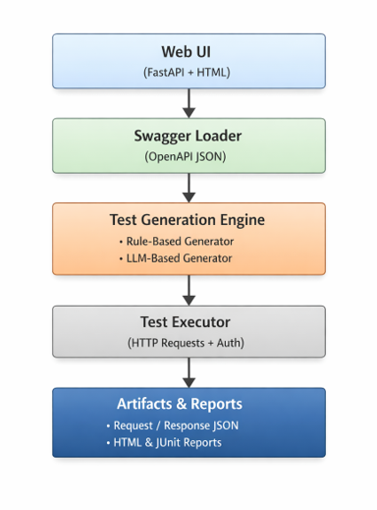
High-Level Architecture
Presentation: FastAPI-based interactive web interface.
Intelligence: Local AI runtime (Ollama) supporting 6+ models (Llama 3, Phi-3, etc.).
Execution: Parallel processing using ThreadPoolExecutor for high-speed results.

Slide 4
AI Intelligence Layer
Local LLM Runtime: Uses Ollama to run models locally—no API keys or cloud data leakage.
Model Flexibility: Supports various models based on need:
Fast: Qwen 2.5 (0.5B) for quick creation.
Powerful: Llama 3 (8B) for production-grade deep reasoning.
Smart Fallback: If the LLM is unavailable, the system reverts to reliable rule-based generation.

Slide 5
Tech Stack
FastAPI, Uvicorn
Ollama, Requests
Jinja2, JUnit XML
Python 3

Slide 6
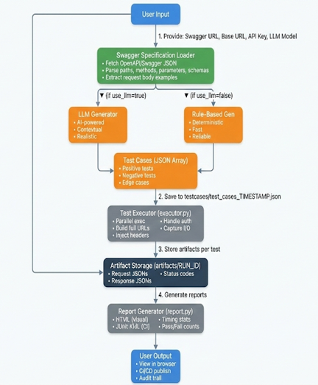
End-to-End Workflow
Ingest: Provide Swagger/OpenAPI URL.
Generate: AI enriches tests with semantic understanding and realistic payloads.
Execute: Parallel execution of GET, POST, PUT, and DELETE calls.
Report: Automatic generation of HTML dashboards and JUnit XML for CI/CD (Jenkins).

Slide 7

Demo

Slide 8
Future Enhancements
Improved test coverage: Expanding beyond ~60% to include complex edge cases and boundary validations
Data-Driven & Parameterized Testing: Executing tests against multiple AI-generated or file-based datasets.
Deep Validation: Moving beyond status codes to full Response Body & Schema validation.
Chain of Thought Testing: Supporting "ID Chaining" where output from one API (e.g., POST /user) feeds the next (e.g., GET /user/{id}).
Advanced Auth: Expanding to OAuth 2.0, JWT, and multi-step token refresh flows.
Smarter Optimization: Using AI to prioritize high-risk endpoints and detect breaking changes across API versions.

Slide 9

Thank you

