Slide 1
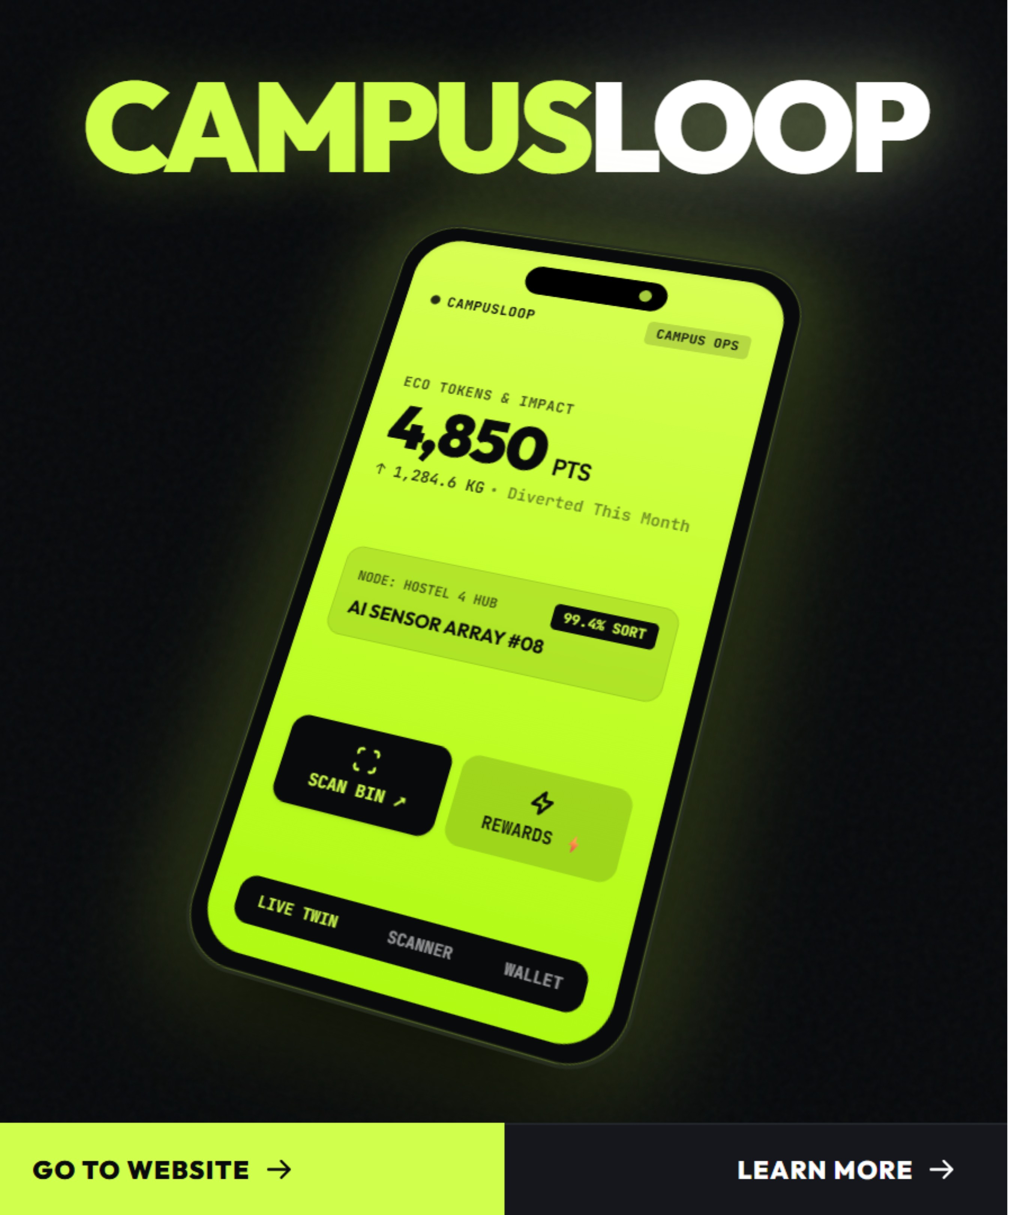
SOCIOTHON 2026 · PROJECT SHOWCASE
CAMPUSLOOP —
CAMPUS WASTE
INTELLIGENCE
"Every bin is an intelligent sensor, every scrap a valuable asset."
Autonomous multi-class bin classification, real-time campus digital twin, and circular proof-of-sort student tokenomics.
Notes:
Introduce CampusLoop: transforming institutional waste infrastructure from an unmonitored cost center into an intelligent, sensor-driven circular network.

Slide 2



02
THE STATUS QUO · SYSTEMIC INEFFICIENCY
CAMPUSES FLY BLIND ON WASTE
0
>70%
40%
INSTITUTIONAL BLINDSPOTS
CONTAMINATION DISASTER
STATIC COLLECTION DRAG
Metric tons generated daily with zero real-time weight or volume stream visibility across campus facilities.
Clean recyclables routed directly into general landfill waste due to improper manual sorting at disposal points.
Fixed truck routes empty half-empty bins while overflow hotspots fester, needlessly burning fleet fuel and budget.
Notes:
Three core pain points: complete telemetry blackout, massive contamination rates exceeding 70%, and rigid collection logistics that waste manpower and fuel.

Slide 3



03
SYSTEM ARCHITECTURE · CLOSED LOOP
A CLOSED-LOOP CIRCULAR ECOSYSTEM FOR CAMPUSES
Hardware classification, real-time spatial telemetry, and verified student incentive loops connect to eliminate disposal loss.
01
02
03
AI COMPUTER VISION SCANNER
IOT CAMPUS DIGITAL TWIN
PROOF-OF-SORT TOKENOMICS
Hardware-level edge inference sorts waste streams and flags contamination at the instant of disposal, for instant sorting guidance.
Telemetry mesh maps spatial fill pressure and dynamically dispatches custodial collection routes for dynamic routing and fill telemetry.
Rewarding students with redeemable campus credits. Verified disposal transactions reward student IDs with redeemable campus dining and store credits.
Notes:
Walk through the three interlocking pillars: vision at disposal, geospatial routing in the backend, and student tokenomics closing the engagement loop.

Slide 4

04
PILLAR 01 · POINT OF DISPOSAL
FEATURE 01: AI VISION SORTS AT THE BIN
EDGE CLASSIFICATION INTO 3 STREAMS
01
Organic (compostable), recyclable (dry recoverable), and reject streams separated autonomously in under 300ms.
CONTAMINATION GUARDRAILS
02
Flags mixed and dirty items such as unwashed containers via real-time multi-lingual voice and visual guidance.
LIVE PROOF-OF-SORT VERIFICATION
03
Validates item integrity and user ID confirmation before issuing tokens, systematically preventing gaming or fraud.
Notes:
Detail the smart receptacle edge capabilities: 3-stream multi-class sorting, active contamination prevention with audio prompts, and fraud-resistant verification.

Slide 5

05
PILLAR 02 · TELEMETRY & LOGISTICS
FEATURE 02: A LIVE DIGITAL TWIN DISPATCHES TRUCKS
3D CAMPUS HEATMAP
01
Fill level, temperature and tilt across hostel and academic zones.
PREDICTIVE AI ROUTING
02
Replaces fixed schedules, cutting route distance and fuel by 40%.
COMPOSITE HEALTH SCORE
03
Campus hygiene index from fill pressure and sensor uptime.
Notes:
Explain how IoT telemetry powers the operational dashboard, eliminating redundant truck rolls while improving overall campus hygiene metrics.

Slide 6

06
FEATURE 03: SORTING EARNS GREEN PTS
Scan university ID, dispose of sorted waste, earn verified Green PTS
Redeem for cafeteria meals, campus store discounts and EV shuttle credits
Circular marketplace for upcycled goods and peer-to-peer exchange

Slide 7
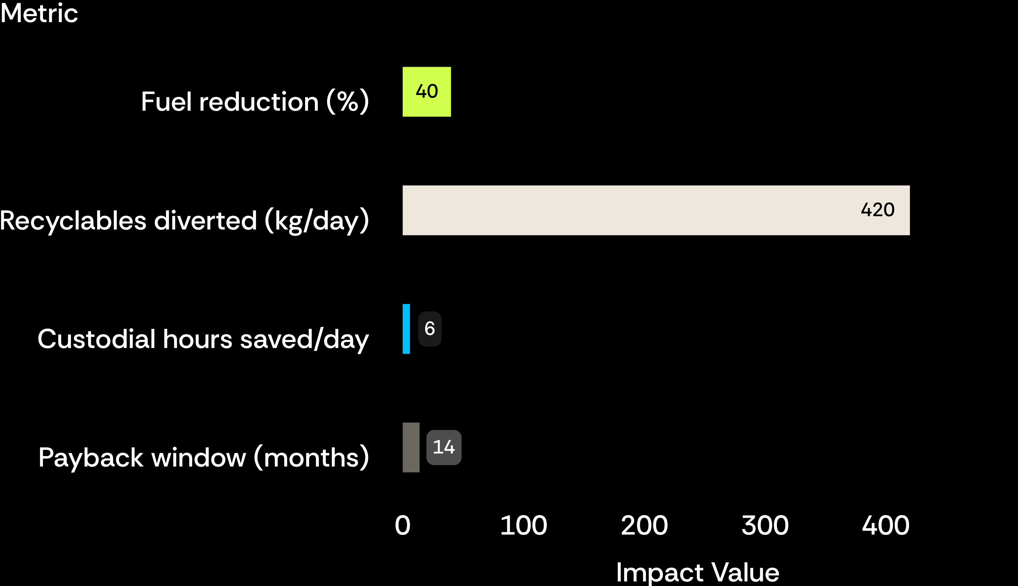
07
FINANCIAL VALIDATION · 63-BIN PILOT MODEL
PAYBACK IN UNDER 14 MONTHS
14 MO
maximum capital amortisation
420 kg/day of clean recyclables diverted from municipal landfill tipping fees to certified recycling off-takers generates recurring feedstock revenue, ensuring long-term net positive cash flow.
Modeled across a 63-bin pilot cluster serving university residential and dining zones
Notes:
Financial rationale: 40% fuel cut, 420 kg/day diverted to certified buyers, 6 labor hours recovered daily, fully paying off within 14 months.

Slide 8
08
ARCHITECTURE BUILT FOR THE EDGE
BACKEND
FRONTEND
EDGE AND SENSOR MESH
Python FastAPI engine, computer vision inference pipeline, automated ESG audit engine.
Responsive React SPA, Tailwind CSS, Recharts operational telemetry.
Micro-telemetry nodes, offline-first fallback.
Notes:
Technical deep dive: React SPA frontend, Python FastAPI backend handling vision inference, and fault-tolerant LoRaWAN edge sensor mesh.

Slide 9
09
GROWTH ROADMAP · PHASED SCALING
FROM 63 BINS TO CITY SCALE IN FOUR PHASES
01
02
03
04
PHASE 01
PHASE 02
PHASE 03
PHASE 04
HOSTEL PILOT
CAMPUS-WIDE
CONSORTIUM HUB
CIVIC SCALE
10 high-density zones with 63 connected smart bins validating student sort habits.
Comprehensive rollout across academic blocks, science research labs, and central dining halls.
Multi-university cluster pooling volume into a shared Material Recovery Facility.
Municipal ward infrastructure licensing and SaaS urban sanitation analytics dashboard.
Structured trajectory expanding from verified campus nodes to regional municipal waste intelligence.
Notes:
Outline expansion from the 63-bin pilot to campus-wide deployment, university consortium recovery, and municipal ward licensing.

Slide 10
DEPLOYMENT READY · LIVE DEMO
CLOSING THE LOOP ON CAMPUS WASTE
Interactive digital twin and edge scanner operational right now.
Experience the live web app and inspection console:
https://campus-loop-dg0.pages.dev/login
Sociothon 2026 Showcase · Autonomous Waste Intelligence
Notes:
Final call to action: invite judges to test the live web app and digital twin at campus-loop-dg0.pages.dev/login.

