Slide 1
BANK DATA ANALYSIS
ANALYZING THE BANK LOAN TRENDS USING EXCEL, POWER BI, TABLEAU AND MY SQL

Slide 2
GROUP 2 -TEAM MEMBERS
Vaishnavi Santosh Bairagi
Pranay Chandra Mohanty
Udit Rana
Ramji Shukla
Kripa K

Slide 3
OBJECTIVE OF THE ANALYSIS
Analyze client and loan data across branches
Understand loan disbursement and repayment patterns.
Recognize demographic trends in banking behavior
Evaluate loan performance and revenue indicators
Identify risk areas such as default and delinquency.
Derive insights for improving lending strategy and portfolio health.
Classify actionable insights for improving recovery and profitability

Slide 4
INTRODUCTION
This presentation provides a comprehensive analysis of a bank’s loan portfolio using internal lending data.
It explores how loans are disbursed, collected, and managed across various dimensions such as branch, state, product type, borrower demographics, and risk grade.
It highlights key metrics such as disbursements, collections, defaults, and demographic patterns
The goal is to assess portfolio performance, identify risk exposure (such as defaults and delinquencies), and offer strategic insights for improving lending decisions and portfolio health.

Slide 5
DATASET OVERVIEW
The dataset is from the bank’s records, and it's been cleaned to remove errors or missing values.
Working with a large dataset, which ensures a solid basis for insights.
Key Fields: Loan Amount, Status, Branch, State, Religion,Product Group, Client Age, Grade, Disbursement Date, etc.

Slide 6
EXECUTIVE SUMMARY
Total Loans: Around 65,500 loans have been issued — showing significant outreach and lending activity.
Amount Funded: The bank has disbursed nearly ₹778 million, reflecting the total capital invested in loans.
Total Collection: Collections have reached about ₹957.7 million, which includes both principal and interest repayments.
Default Loan Rate (0.01%): Extremely low — this means almost no loans have defaulted, which is a strong positive sign.
Delinquent Loan Rate (11%): However, 11% of loans are overdue, indicating some repayment issues that need monitoring.
Average Loan Amount: On average, each loan is about ₹9,615, pointing toward relatively small ticket sizes (possibly retail-focused).
Total Interest Earned: The bank has earned ₹179.5 million from interest — a major revenue driver.
Average Interest Rate: At 12.02%, this is a healthy return on lending for the bank.

Slide 7
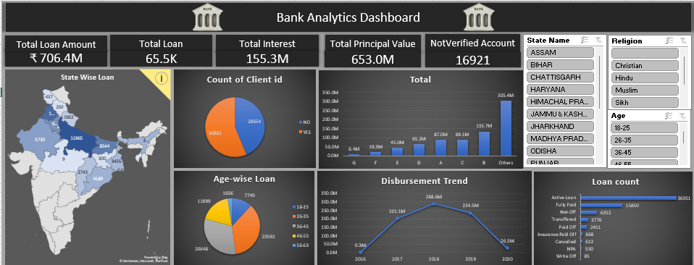
EXCEL DASHBOARD

Slide 8
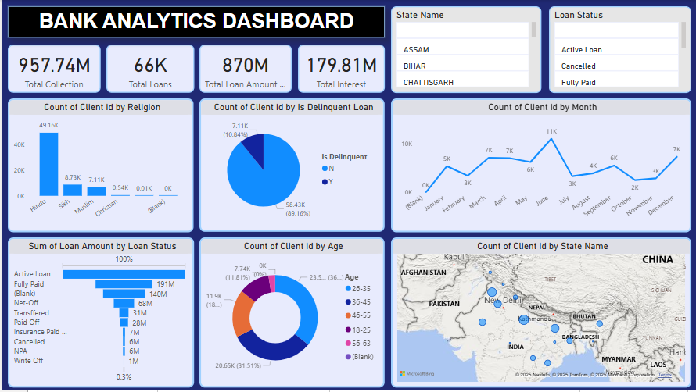
POWER BI DASHBOARD

Slide 9
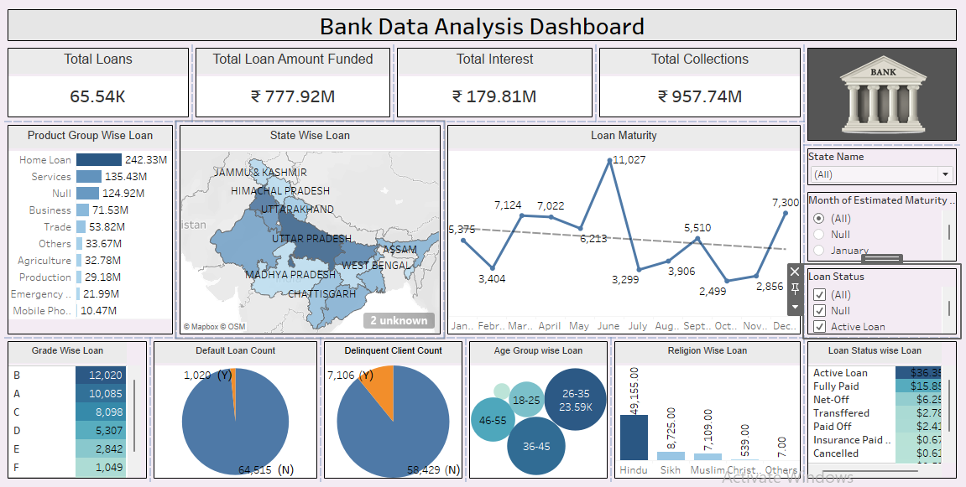
TABLEAU DASHBOARD

Slide 10
KEY INSIGHTS
Most clients are in the 36–45 age range
Some states and branches show higher default rates.
Credit grades are strong indicators of risk.
Delinquency clusters around certain age groups.
Loan disbursement trends show seasonal peaks.
High recovery from 36-month term loans
Certain branches outperform others in collections
Verified loans show significantly lower risk.
Recovery fees and late fees remain underutilized

Slide 11
CONCLUSION
The analysis reveals strong loan distribution across branches, with noticeable variations in repayment performance.
Certain borrower segments and regions show higher risks of default and delinquency, while others demonstrate consistent repayment behavior.
Interest rates are relatively high, possibly deterring some segments
Demographic and product segmentation reveal clear patterns.
Verification and monitoring practices influence outcomes.
Age and branch segmentation provide targeting opportunities
Credit grades, loan verification, and product types significantly influence performance.Understanding these patterns enables the bank to better target lending, mitigate risk, and improve overall portfolio quality.

Slide 12
RECOMMENDATIONS
Improve loan verification
Focus on high-risk branches
Expand lending to strong-performing sectors
Strengthen recovery strategies
Focus outreach on 26–45 age range
Standardize recovery practices across branches
Re-evaluate rates for high-risk segments
Increase automation for recovery fee collection

Slide 13
Thank You !

