Slide 1


“Employee Management System”
Submitted by: Pranay Gadhave
Submission type : Individual
Batch : HDFC API Developer Batch
Program :HDFC API Developer Program
Date: 02/05/2023

Slide 2

Table of contents
Introduction
Project Overview
Architecture Design
Back-end Development
Testing
Conclusion
Future Work
References

Slide 3
Introduction
An employee management system, sometimes known as an EMS, is a project that helps a business increase employee productivity and happiness in order to further its overall objectives.
The personal and professional information of employees is safely stored and managed by an EMS. An EMS offers security and data encryption measures that guarantee data security.
This project majorly aims to simplify the tasks of maintaining records of the employee records and other details.
It is designed using JAVA spring boot which is an opinionated framework that helps developers build stand alone and production grade spring based applications quickly and easily.

Slide 4
Project Overview
Database has a Employee table which consists of three columns named EmployeeID, name and Date of Birth with EmployeeID as the primary key.
If the user provides incorrect EmployeeID, an exception for Invalid EmployeeID is called.
Code is being pushed to the GIT repository. Jenkins is used to deploy the changes to the application server.
The response contains all three fields of that employee, i.e., EmployeeID, EmployeeName, and DateOfBirth. While the request only takes a single EmployeeID.
The code is exposed to the HTTP web service, where a logfile is generated every time it is called.
Also, log rotation is configured for the logfile when the size of the log file exceeds 1MB.
The web service has been tested with PostMan, and is exposed to HTTPS to maintain the security.
Since the DateOfBirth is a personal information, In order to maintain the privacy of Employee's data AES256 algorithm is used at client program for encryption and decryption.

Slide 5
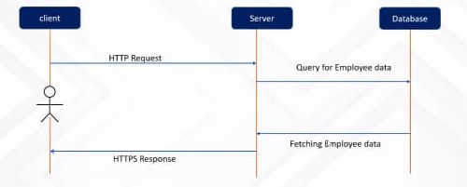
Architecture Design
Sequence Diagram

Slide 6
Back-end Development
Create the database schema
Create the Spring Boot project
Implement the Code
Create Employee entity
Create DTO layer
Create Controller layer
Add encryption and decryption functionality
Add logging functionality
Secure the web service
Run the web service
.

Slide 7
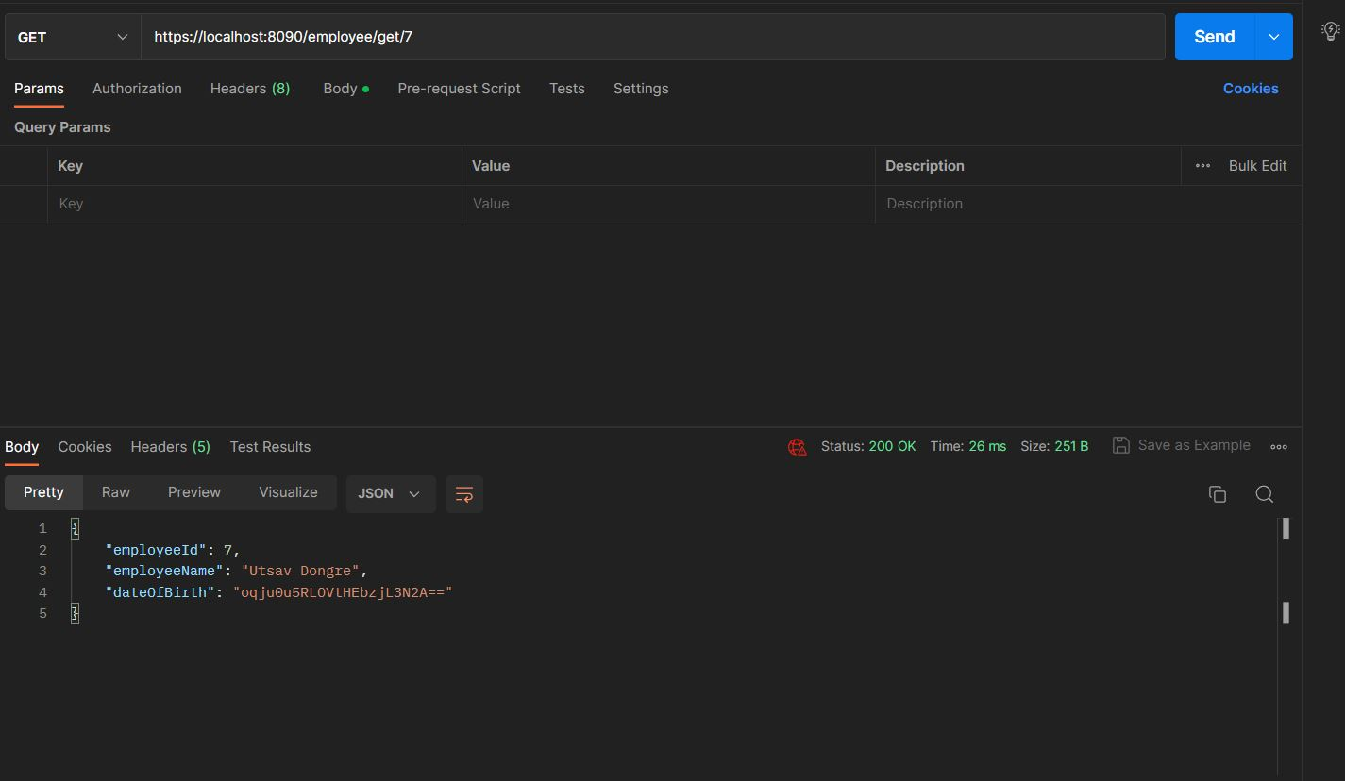
Integration and Testing
Testing for Employee-Management using Https using Encryption

Slide 8
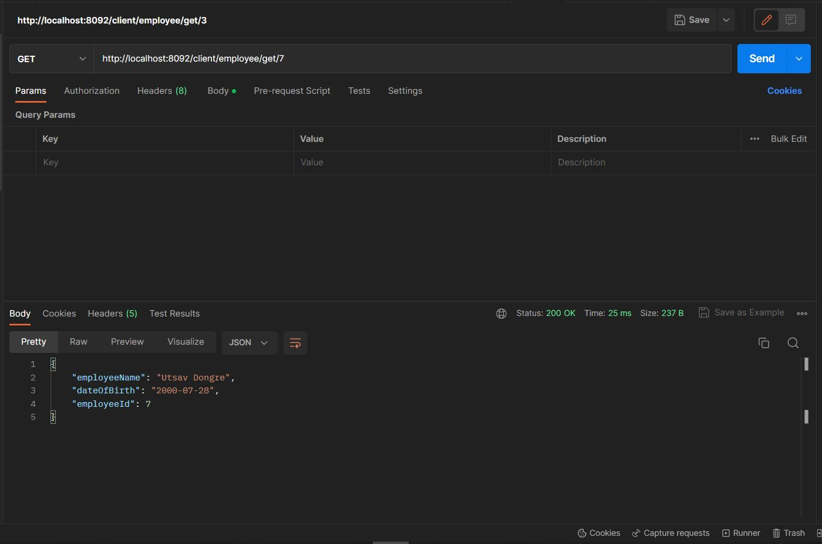
Integration and Testing
Testing for Client Employee-Management using Http using Decryption

Slide 9
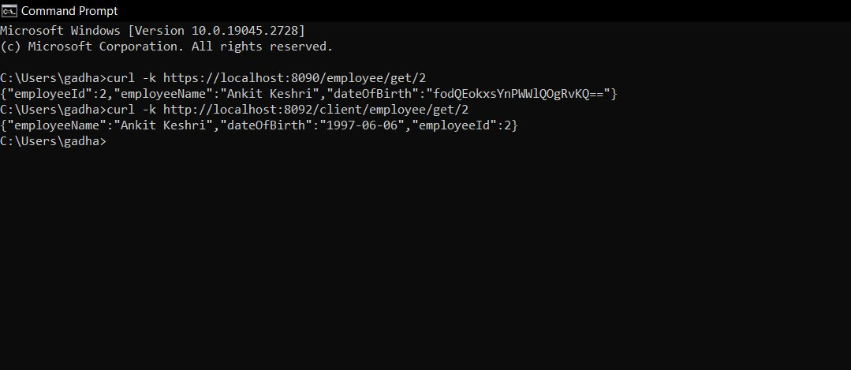
Integration and Testing
Executing using CURL Command

Slide 10
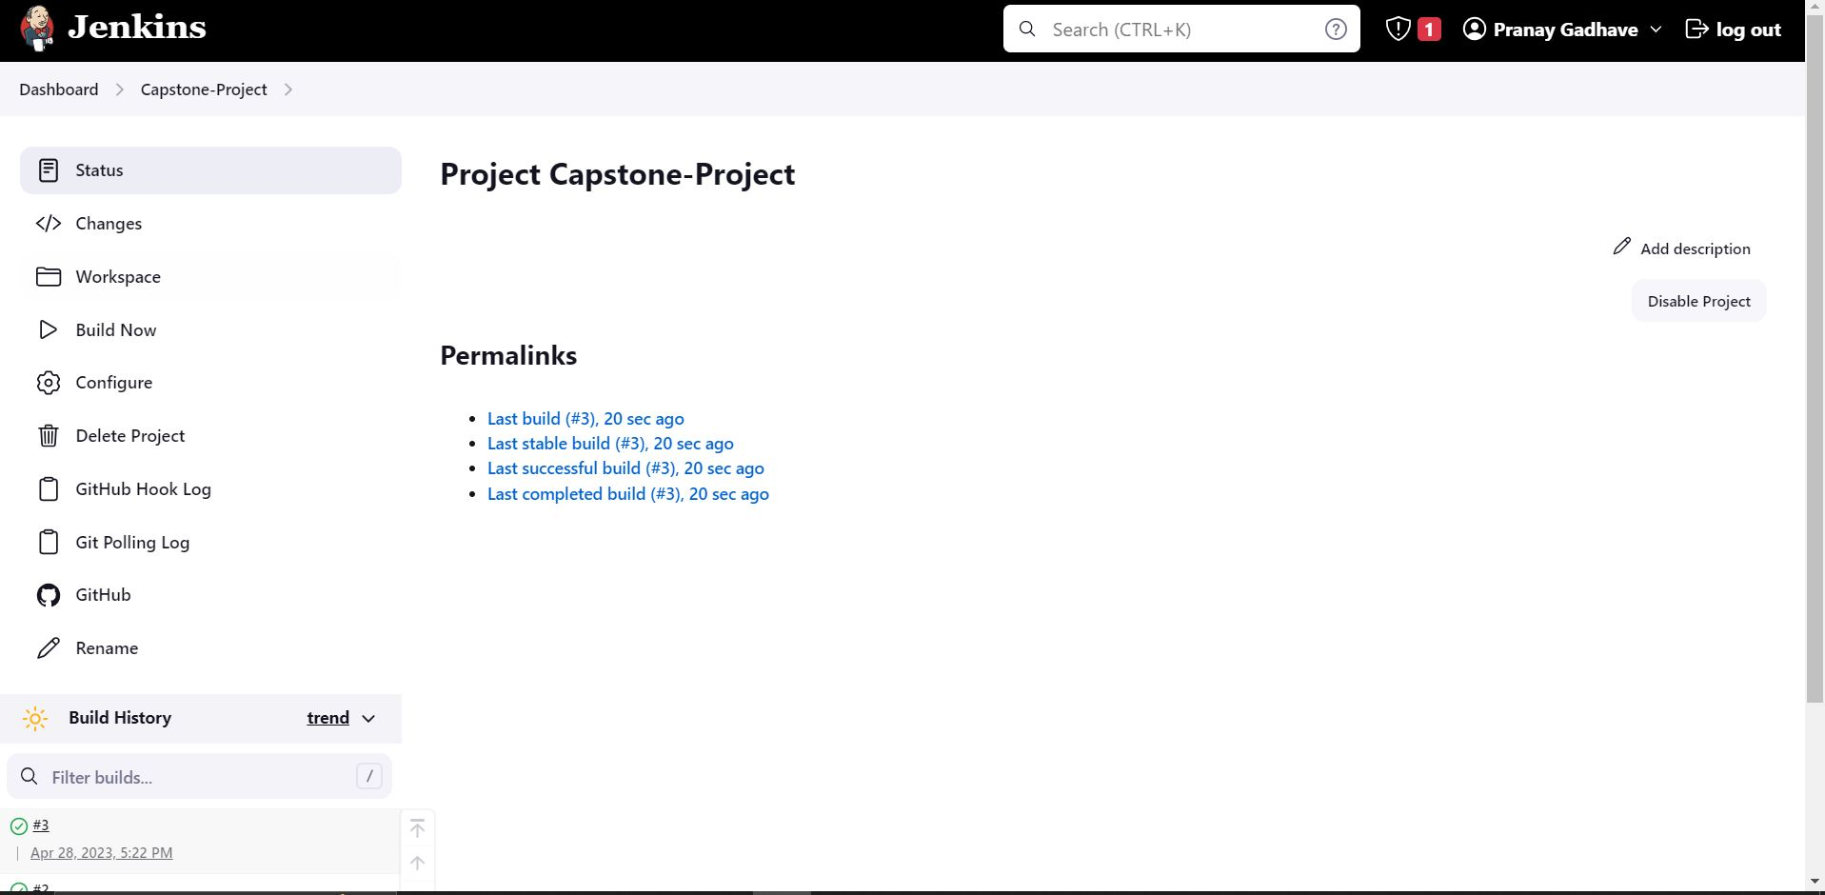
Deployment
Deploying Project on Jenkins

Slide 11
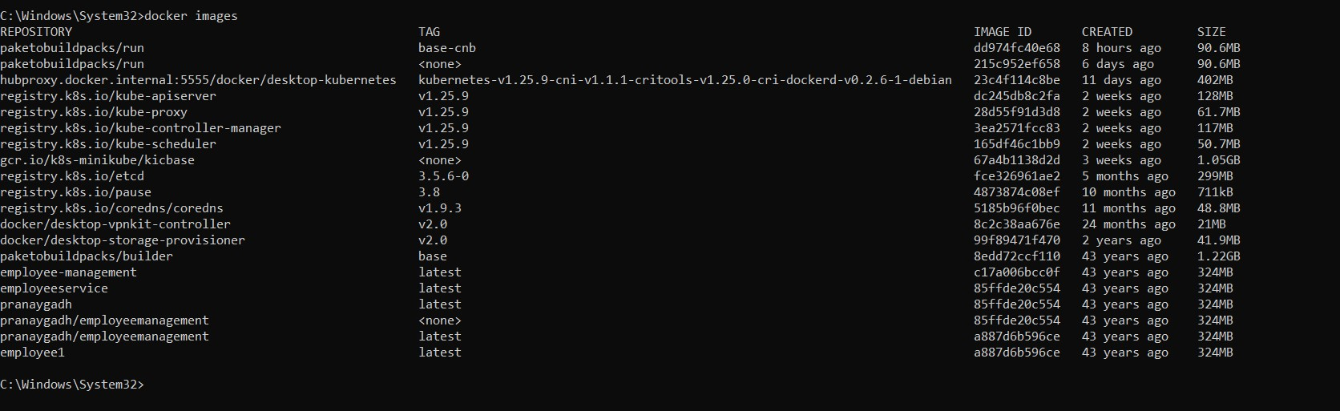
Deployment
Docker Images

Slide 12
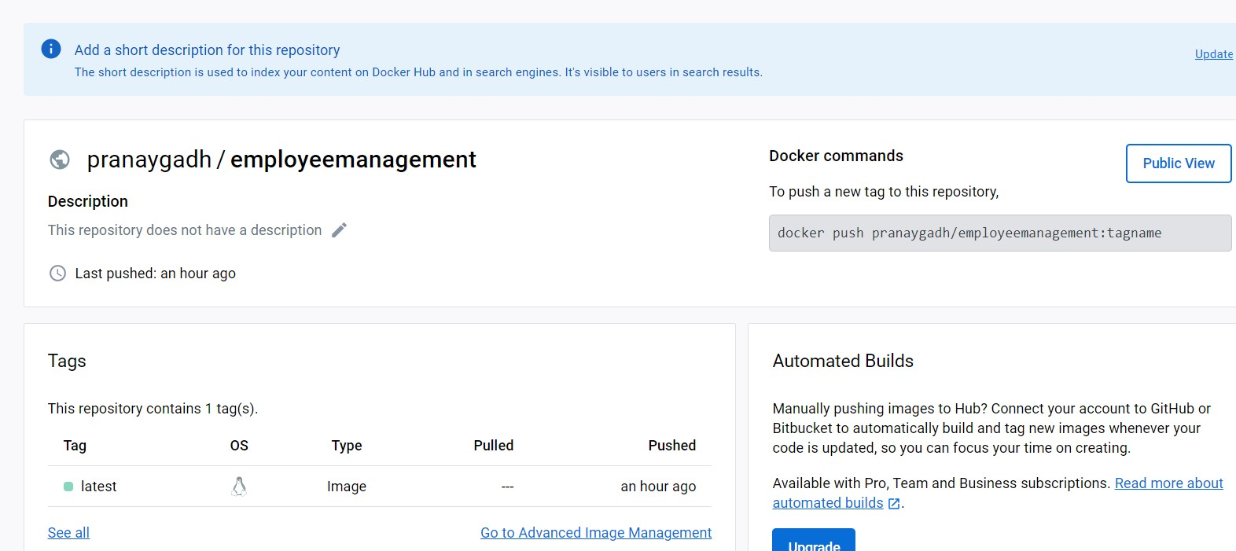
Deployment
Deploying Docker Image on Docker Hub

Slide 13
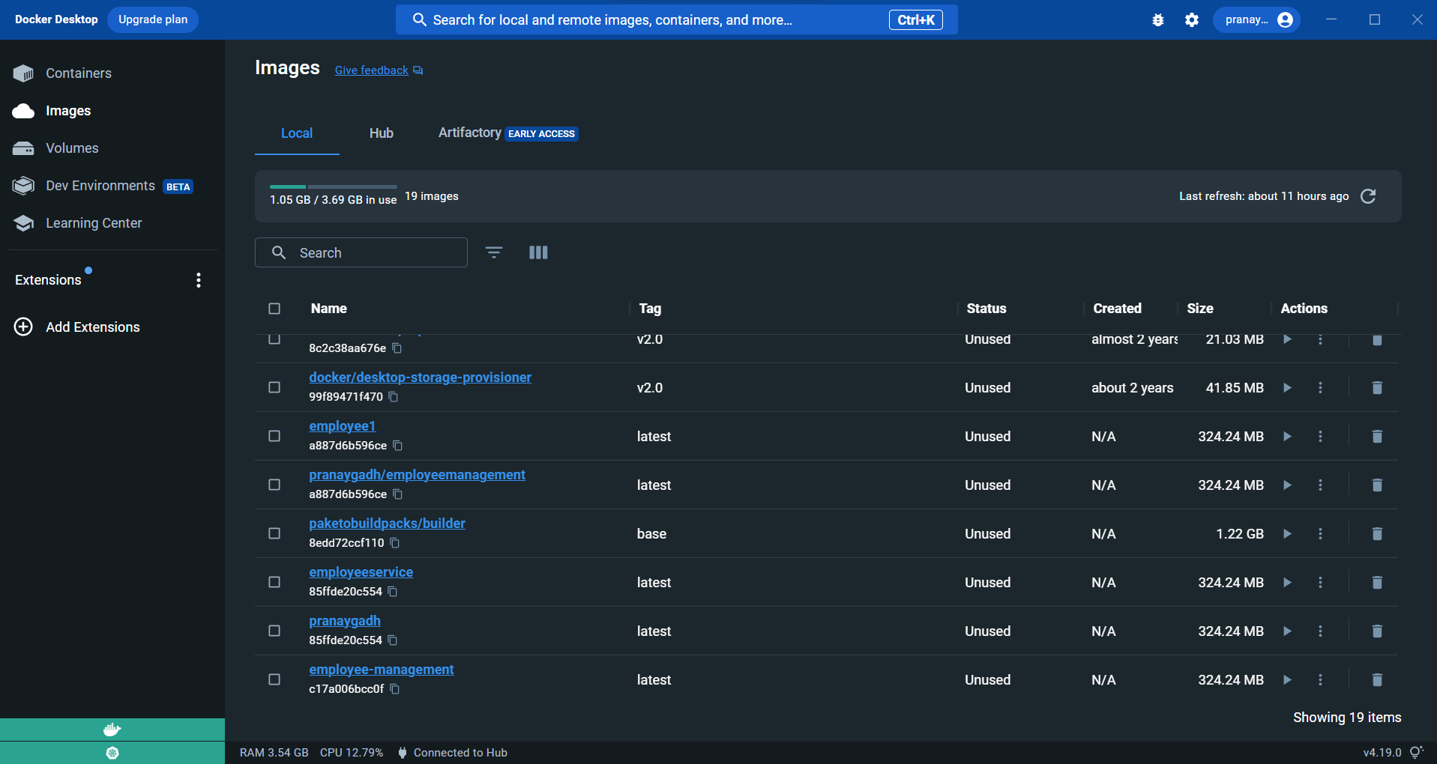
Deployment
Images on Docker Desktop

Slide 14
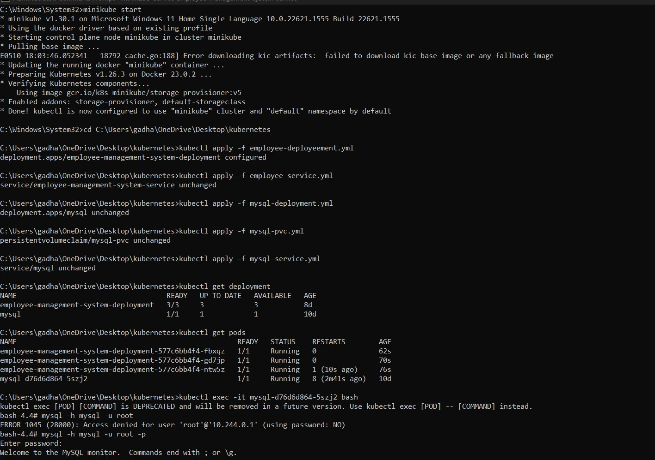
Deployment
Deploying Docker image on Kubernetes

Slide 15
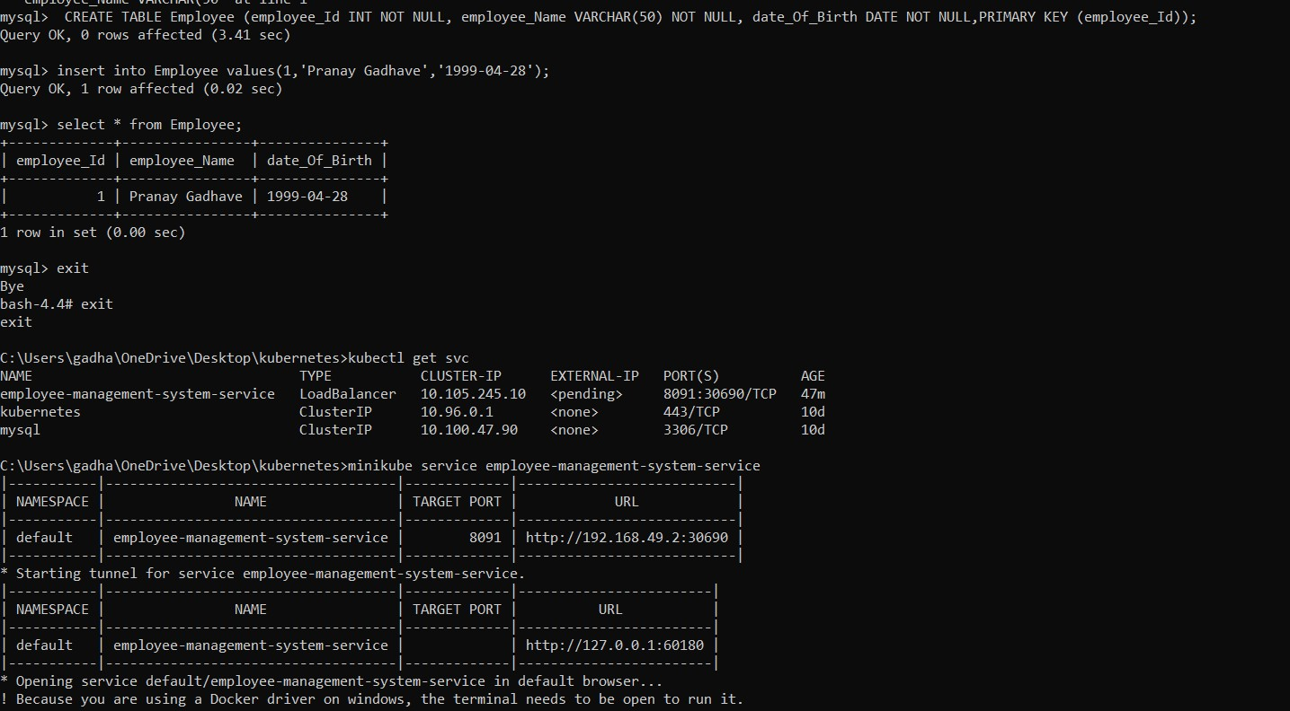
Deployment
Deploying Docker image on Kubernetes

Slide 16
Conclusion
Every business needs EMS because of its capacity to lower stress and pressure while fostering relationships between managers and employees. It produces a setting that might promote dialogue. This makes sure that management and staff cooperate to achieve the company's objectives.
This can help in reducing the paperwork. Using an EMS, the HR department can streamline processes and contribute to society.
This project can help in improving your data security methods. As an organization saves employee information like bank details, addresses, telephone numbers and personal identification details, providing better data security is essential. EMS offers security and data encryption measures that guarantee data security.

Slide 17
Future Work
We can involve additional features of managing the data related to the Payroll of the employee, the application can generate the Payroll of the Employee.
In future, we can also make the application to maintain the daily task details of the Employees so that it will become easier to maintain the daily tasks performed by the Employees which will eventually help in analysing the Performance of Employees.
By adding other modules like Payroll management, Employee Onboarding, Attendance tracker and Daily tasks tracker, this project can be enhanced and will ensure the business productivity.

Slide 18
References
Spring Boot Documentation: https://spring.io/projects/spring-boot
MySQL Documentation: https://dev.mysql.com/doc/
Git Documentation: https://git-scm.com/doc
OpenSSL Documentation: https://www.openssl.org/docs/
Postman Documentation: https://learning.postman.com/docs/getting-started/introduction/
Jenkins Documentation: https://www.jenkins.io/doc/
Docker Documentation: https://docs.docker.com/

Slide 19
THANK YOU

