Slide 1

Online Grocery Delivery
Submitted by: Pranay Gadhave
Program : HDFC API Developer Program

Slide 2
Table of Content
•Introduction
•Project Overview
•UML Diagrams :
1. Use Case Diagram
2. Class Diagram
3. Sequence Diagram
•Results

Slide 3
Technologies Used
JAVA
Spring Boot
MongoDB
Hibernate
Swagger
Spring Data JPA
Spring Framework

Slide 4
Modules
Customer Module
Order Module
Items Module
Cart Module
Payment Module

Slide 5
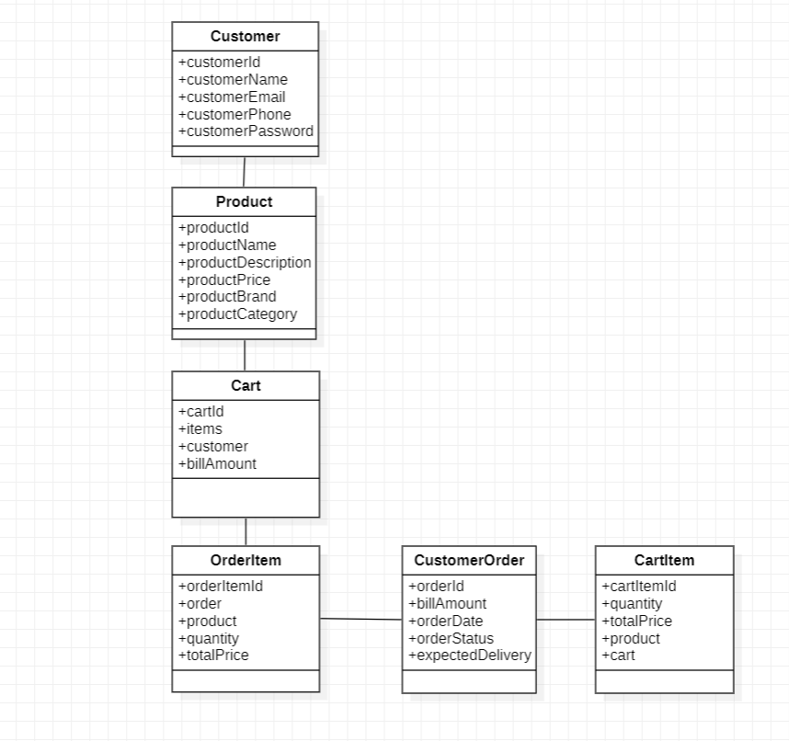
UML DIAGRAMS
CLASS DIAGRAM

Slide 6
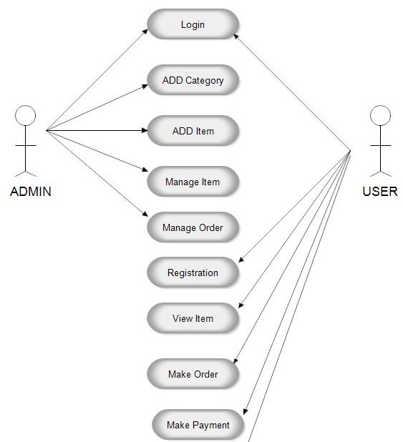
USE CASE DIAGRAM

Slide 7
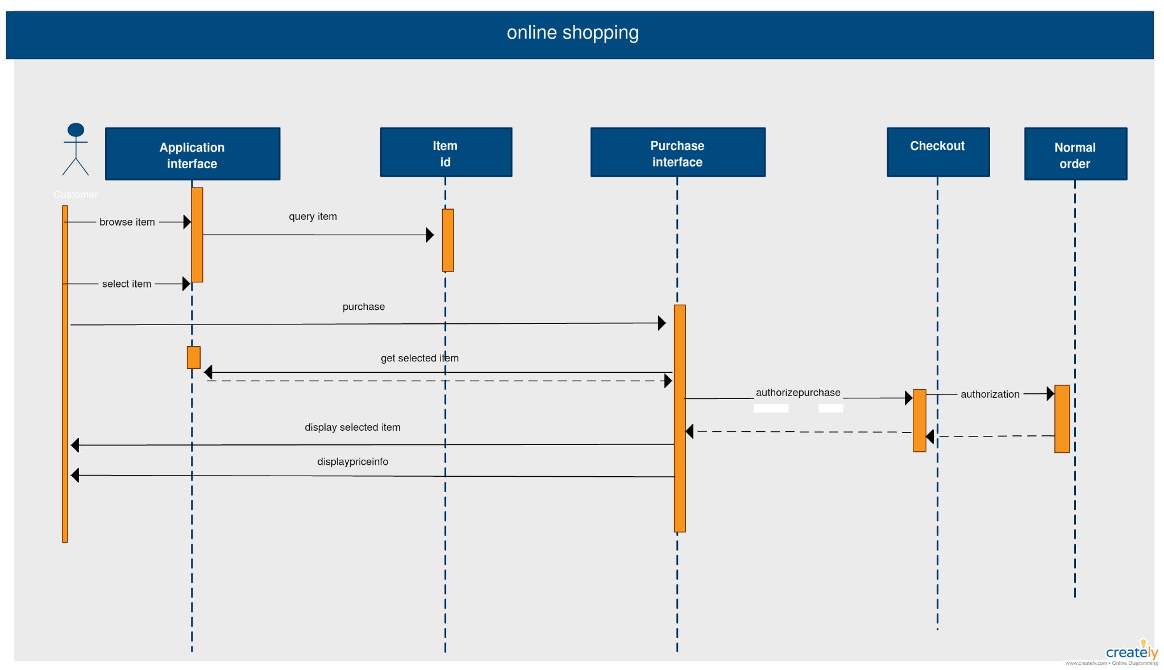
SEQUENCE DIAGRAM

Slide 8
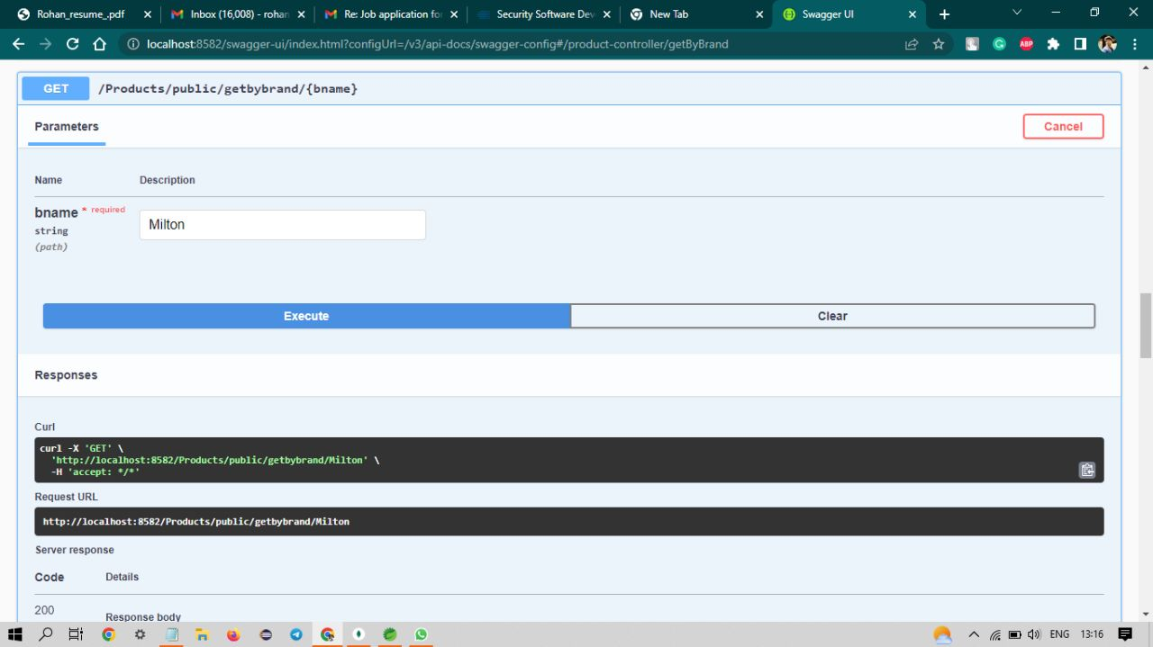
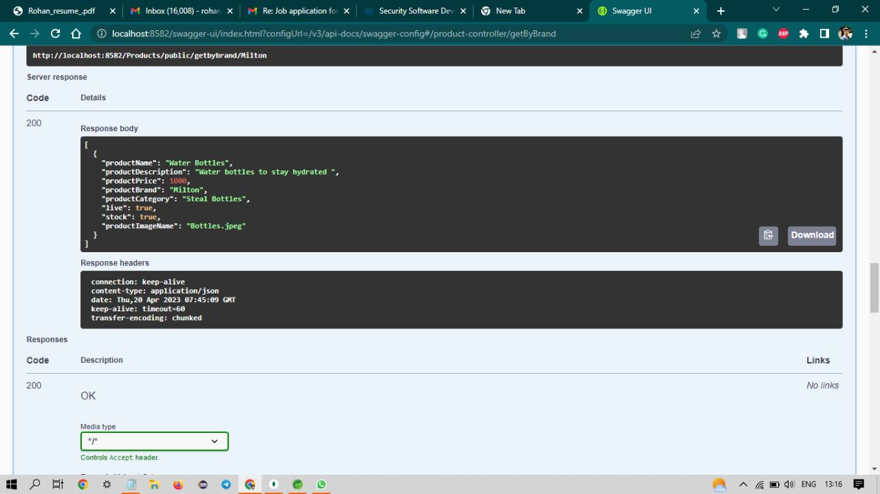
Results

Slide 9
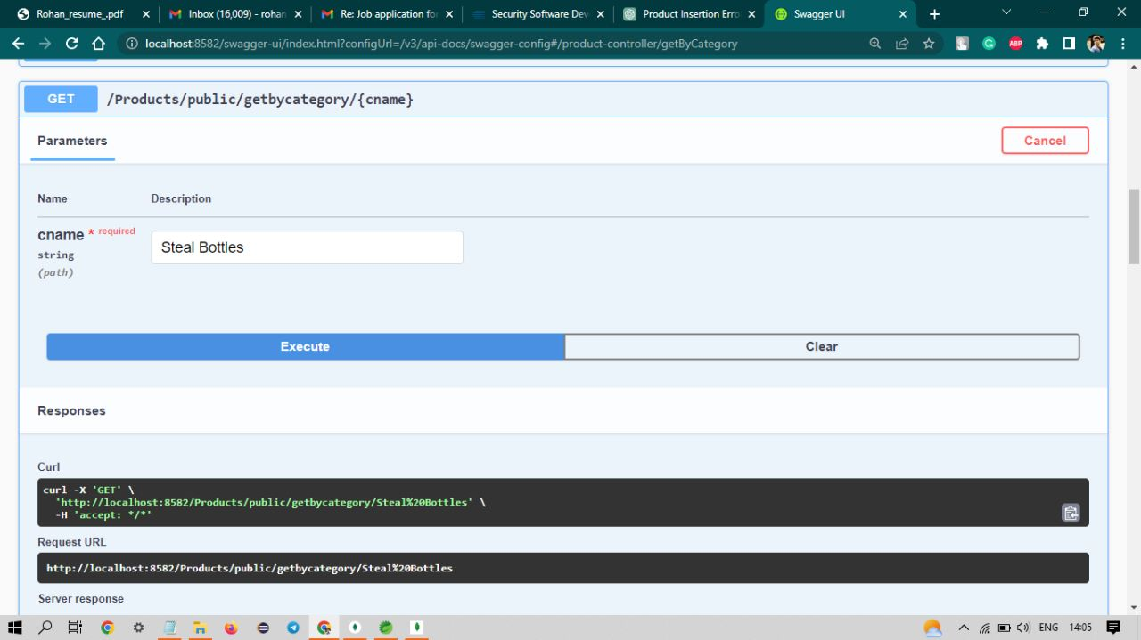
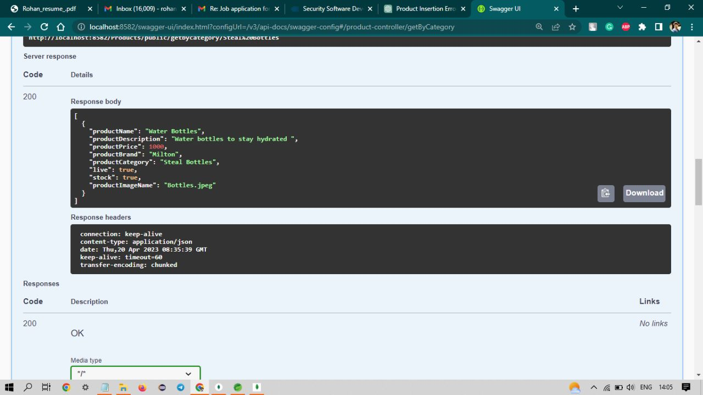

Slide 10
THANK YOU

