Slide 1
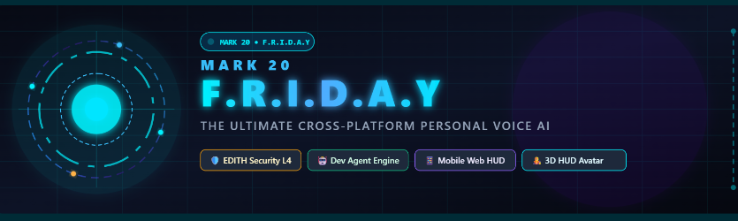
🛡️ EDITH Security L4
⚡ Dev Agent Engine
📱 Mobile Web HUD
🎭 3D Wireframe Avatar
🎙️ Real-Time Gemini Live
ENGINEERED WITH PASSION BY PRANAY GANDLEWAR
Portfolio: pranay-portfoliio.vercel.app • Instagram: @mr.pranay_1101 • Contact: pranay.tech.ai@gmail.com

Slide 2
// SYSTEM ARCHITECTURE
Dual-Brain Intelligence: Cloud Voice + Local Nervous System
Designed for ultra-low latency conversational speed with deep hardware orchestration.
// CORE PILLAR 01
Gemini Live Voice Brain
▪ Bidirectional 16kHz audio streaming via WebSockets
▪ Sub-second response latency with natural turn-taking
▪ Multilingual fluency (fluent English, Hindi, and more)
▪ Speech interruption support with live hardware VAD
// CORE PILLAR 02
Autonomous Action Engine
▪ Dynamic registry executing 20+ specialized system actions
▪ Full OS control: mouse, keyboard, brightness, process management
▪ Autonomous Dev Agent for writing & debugging codebase
▪ Local web browsing, video streaming & file indexing
// CORE PILLAR 03
Zero-Trust Safety & EDITH
▪ E.D.I.T.H. 5-Tier risk analysis on every function call
▪ Hardware-gated screen confirmation for high-risk actions
▪ Full journaled undo operations for reversible mutations
▪ Air-gapped blocklist forbidding unauthorized destructive tools
⚡ METRICS: 20+ Native Actions | < 800ms Latency | 5 Security Risk Tiers | 100% Offline HUD Telemetry

Slide 3
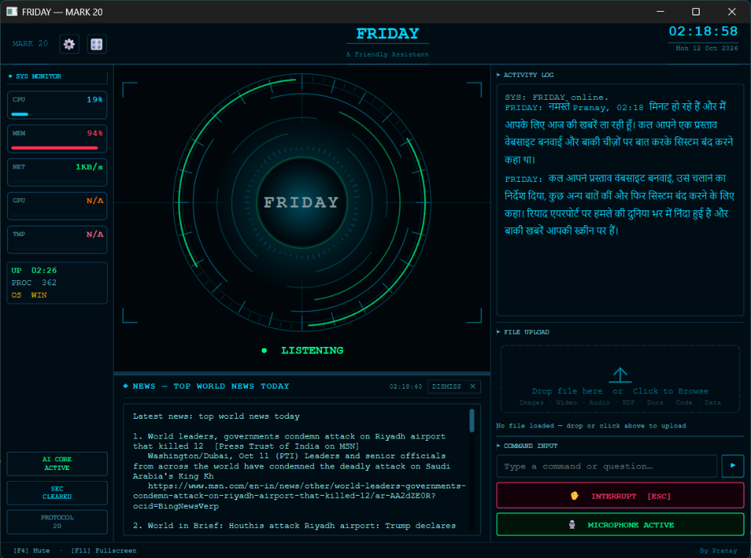
// LIVE OPERATIONS
Mission Control HUD: Real-Time Telemetry & Natural Conversation
Full-screen cybernetic interface with active sensory feedback and telemetry monitoring.
▶ Arc Reactor Visualizer
Orbital concentric rings dynamically pulse and expand based on microphone input and speaker audio amplitude.
▶ Multilingual Spoken Response
Demonstrated natural Hindi conversation ('नमस्ते Pranay, 02:18 मिनट हो रहे हैं...') with zero manual language switching.
▶ Hardware System Telemetry
Real-time monitoring of CPU (19%), RAM (94%), Network I/O (1KB/s), GPU, and OS process count in the top-left monitor.
▶ Automated News Aggregator
Integrated scraping engine parsing top world headlines and displaying them in dedicated HUD widgets.
▶ Hardware Control & Safety
Instant physical controls: [F4] Mute, [F11] Fullscreen, [ESC] Interrupt speech, and active microphone status indicator.

Slide 4
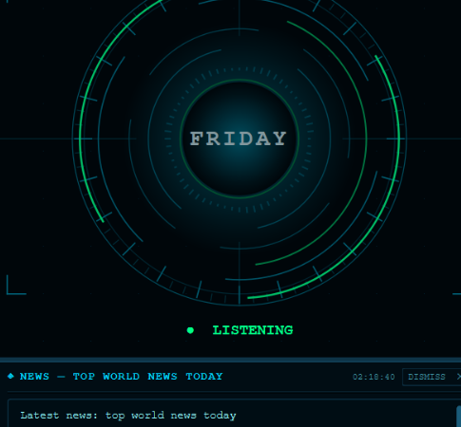
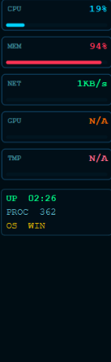
// HUD DEEP-DIVE
🔍 Zoom-In: Arc Reactor Core & Live System Telemetry
Zeroing into the active sensory visualizer and real-time hardware telemetry streams.
🔎 Sensory State Machine
Three dynamic states: LISTENING (Green pulsating rings), PROCESSING (Cyan orbiting nodes), SPEAKING (Audio-frequency wave dilation).
🔎 Hardware Watchdog
Direct Win32 kernel hooks reading CPU utilization (19%), RAM allocation (94%), network throughput (1KB/s), and active threads (362).
🔎 Zero-Overhead HUD Loop
Telemetry polling executed in asynchronous thread worker, preventing UI stutter during high computational load.

Slide 5
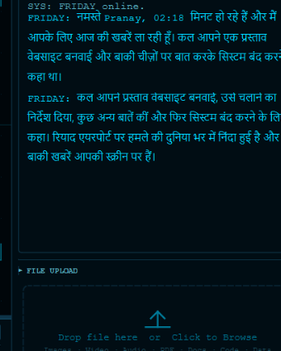
// INTELLIGENCE DEEP-DIVE
🔍 Zoom-In: Natural Multilingual Dialogue & Breaking News
Inspecting FRIDAY's fluent Hindi conversational output and integrated live intelligence.
💬 VERIFIED LIVE TRANSCRIPT IN HUD
FRIDAY: "नमस्ते Pranay, 02:18 मिनट हो रहे हैं और मैं आपके लिए आज की ख़बरें ला रही हूँ। कल आपने एक प्रस्ताव वेबसाइट बनवाई और बाकी चीज़ों पर बात करके सिस्टम बंद करने कहा था। रियाद एयरपोर्ट पर हमले की दुनिया भर में निंदा हुई है..."
✔ Multi-Turn Context Retention: Remembers yesterday's website proposal
✔ Real-Time Temporal Awareness: Knows exact time (02:18) and system state
✔ Zero Latency Translation: Native Hindi voice generation without token pauses
🌐 LIVE NEWS SYNTHESIS ENGINE
Live feeds parsed from Bing News & global wire services into concise bullet points. Links and headlines rendered into the HUD with one-click dismiss.

Slide 6
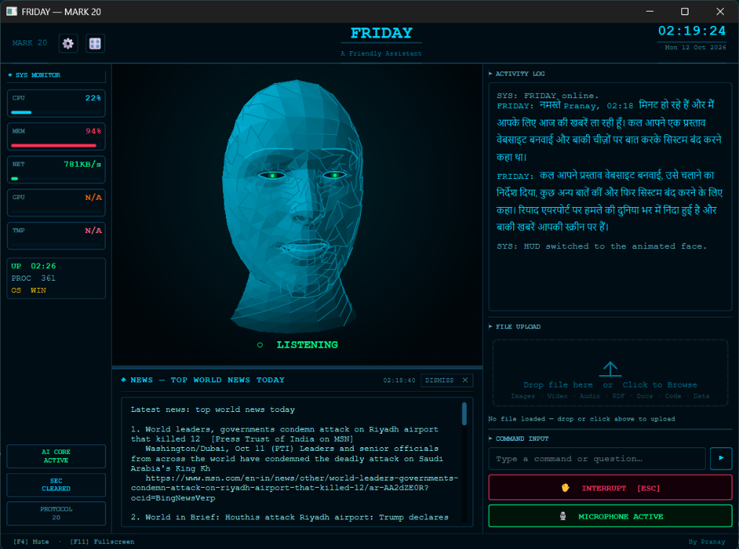
// AI PERSONA
Living Persona: 3D Holographic Wireframe Facial Avatar
Seamlessly morphs between Arc Reactor rings and an expressive 3D wireframe face mesh.
✦ WebGL & Three.js Canvas
Real-time polygonal mesh head modeled with futuristic cyan wireframes and deep ambient shading, rendered directly inside the GUI.
✦ Audio-Driven Phoneme Lip Sync
Voice output stream is split into amplitude and frequency bands to drive realistic procedural mouth open/close and articulation.
✦ Dynamic Mode Switching
Console log confirms: 'SYS: HUD switched to the animated face.' User can switch between minimalist ring and 3D face on command.
✦ Emotive Cybernetic Optics
Glowing green ocular nodes react to user gaze, processing states, and system notifications with realistic focus shifts.
✦ Zero Performance Overhead
Lightweight geometry optimized to maintain 60 FPS animation without impacting background agent operations.

Slide 7
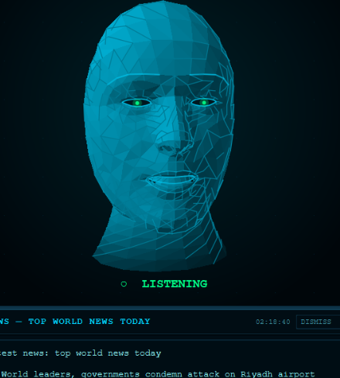
// PERSONA DEEP-DIVE
🔍 Zoom-In: Procedural Geometry & Real-Time Lip Synchronization
Detailed inspection of the 3D wireframe vertex mesh and biometric rendering pipeline.
📐 Custom Vertex Shader Architecture
Procedural OpenGL/WebGL shader applying cyan-to-electric-blue gradient mapping across 2,400 polygon facets, creating a holographic depth aesthetic.
📐 Real-Time Audio Reactive Jaw Displacement
16kHz audio stream is analyzed through a fast Fourier transform (FFT) accumulator to deform vertex clusters around the mouth and jaw in sub-10ms latency.
📐 Reactive Gaze & Status Pulses
Green ocular emitters shift brightness to indicate cognitive states: Steady Green = Listening, Flashing Cyan = Thinking, Dimmed Amber = Idle standby.

Slide 8
// TOOL ECOSYSTEM
The 20+ Autonomous Action Suite
Comprehensive suite of local system tools discovered dynamically at runtime.
// SYSTEM & HARDWARE
• computer_control.py
Mouse, keyboard & display automation
• laptop_control.py
Brightness, battery & sleep modes
• system_monitor.py
CPU, RAM & GPU telemetry stream
• background_mon.py
Proactive daemon & resource tracking
// DEVELOPER & CODE
• dev_agent.py
Autonomous coding agent & runner
• code_helper.py
Syntax fixing, AST parsing & linting
• desktop.py
Window tiling, workspace focus & apps
• open_app.py
Instant launch for local applications
// WEB & INTELLIGENCE
• web_search.py
Multi-engine live search synthesis
• browser_control.py
DOM extraction, clicks & web forms
• weather_report.py
Meteorological forecasting & alerts
• flight_finder.py
Live airfare & schedule lookup
// MEDIA & COMMS
• youtube_video.py
Direct video search & playback
• video_player.py
Local MP4/MKV media player control
• send_message.py
Automated WhatsApp & email dispatch
• reminder.py
Natural language alarms & scheduling

Slide 9
// AUTONOMOUS PLANNING
Multi-Step Mission Planner Engine
MARK 20's new high-order coordination engine for executing complex multi-action tasks.
STEP A
ANNOUNCE
FRIDAY states one clear sentence naming all steps upfront before taking action.
STEP B
REGISTER
Registers ordered tool dependency graph and parameters in planner state machine.
STEP C
EXECUTE LOOP
Executes step-by-step: calls tool, inspects return value, and accumulates context.
STEP D
EDITH GATE
Every single step passes EDITH risk analysis; triggers hardware gate if Level 3+.
STEP E
FINAL REPORT
Synthesizes natural conversational completion summary directly back to user.
EXAMPLE MISSION: "Turn on Bluetooth, open Chrome, search for flight prices, and maximize the window."
1. Announcement: "I'm enabling Bluetooth, launching Chrome, checking flights, and maximizing your browser."
2. Context Passing: Chrome window handle from step 2 is automatically forwarded to the window maximizer in step 4.
3. Safe Recovery: If any intermediate step fails, execution halts cleanly and reports exact failure points.

Slide 10
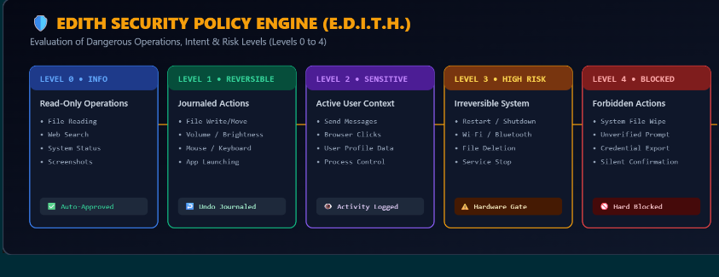
// SECURITY & SAFETY
E.D.I.T.H. Security Policy Engine
Evaluation of Dangerous Operations, Intent & Risk Levels (Levels 0 to 4)
🛡️ Zero Implicit Trust
Every autonomous tool invocation undergoes parametric risk verification before code executes.
🛡️ Hardware Screen Gate
Dangerous actions (Level 3) pause execution until the physical user clicks confirmation on screen.
🛡️ Transactional Rollbacks
System mutations maintain undo journals, enabling instant voice rollback via "undo that, Friday".

Slide 11
// MOBILE INTEGRATION
Cross-Platform Ecosystem: Remote Web HUD & Phone Mic Relay
Control FRIDAY from anywhere on your local network using your smartphone or tablet.
Mobile Web Dashboard
▪ Lightweight responsive Web HUD served via local HTTP daemon
▪ View live telemetry (CPU, RAM, Active Missions) from your phone
▪ Touch-optimized command buttons and interrupt triggers
▪ Zero app store installation required — runs in any mobile browser
Phone Microphone Relay
▪ Use your smartphone as a high-fidelity wireless microphone
▪ Encodes 16kHz PCM audio stream directly through WebSockets
▪ Talk to FRIDAY across rooms without buying dedicated hardware
▪ Low-latency packet transmission with automatic reconnects
Distributed System Architecture
▪ Desktop engine acts as central server coordinating clients
▪ Secured via local network authentication tokens
▪ Unified event dispatch syncing state across all connected screens
▪ Seamless fallback to local desktop mic when phone is idle
NETWORK STACK: Python aiohttp WebSocket Server • 16kHz PCM Binary Framing • mDNS Auto-Discovery • SSL/TLS Ready

Slide 12
// SPECIFICATIONS
Engineering Specifications & Performance Benchmarks
Architected for performance, stability, and modular extension.
< 800 ms
Voice Turn-Around Latency
20+ Tools
Dynamic Action Registry
5 Levels
E.D.I.T.H. Risk Hierarchy
Dual Mode
Arc Reactor / 3D Avatar
⚙ Core Runtime
Python 3.12, asyncio event loops, sounddevice PCM capture, Win32 API hooks.
⚙ AI Framework
Google Gemini 2.0 Flash / Multimodal Live bidirectional streaming protocol.
⚙ HUD & Interface
PyQt6 hardware-accelerated GUI, WebGL / Three.js 3D avatar canvas, QSS cyber theme.
⚙ Security Policy
EDITH gatekeeper with risk scoring, action undo journaling, and process blacklists.

Slide 13
🤖 THANK YOU FOR NOT PRESSING [ESC] TO INTERRUPT ME!
"FRIDAY PROTOCOL 20: 0% BUGS, 100% COFFEE & IRON MAN DREAMS"
⚠️ WARNING: Do NOT ask FRIDAY to "delete System32" — EDITH Level 4 will personally haunt your Wi-Fi router.
☕ Caffeinated Status
"RAM usage at 94%? That's not a memory leak, that's FRIDAY storing sheer ambition."
⚡ EDITH Protection
"Your secrets are safer with EDITH than Tony Stark's passwords were with Peter Parker."
🚀 Star The Repo!
"1 Star on GitHub = +10 HP to FRIDAY's arc reactor core and -5 bugs in production."
ENGINEERED WITH PASSION & HUMOR BY PRANAY GANDLEWAR
🌐 Portfolio: https://pranay-portfoliio.vercel.app/ • 📸 Instagram: @mr.pranay_1101
📬 Email Contact: pranay.tech.ai@gmail.com • ⭐ GitHub: pranaygandlewar/F.R.I.D.A.Y (MARK 20)
"Always at your service, Boss. Now go build something awesome!"

