Slide 1






Techno Ruhez Report 2023
YouTube Channel Report
By Pranay Jain
From November, 2022 to October 2023

Slide 2


Table of contents
01.
02.
03.
Recommendations
Descriptive Statistics
Inferential Statistics

Slide 3
01.
Descriptive Statistics
Mean, Standard Deviation, Views Distribution

Slide 4
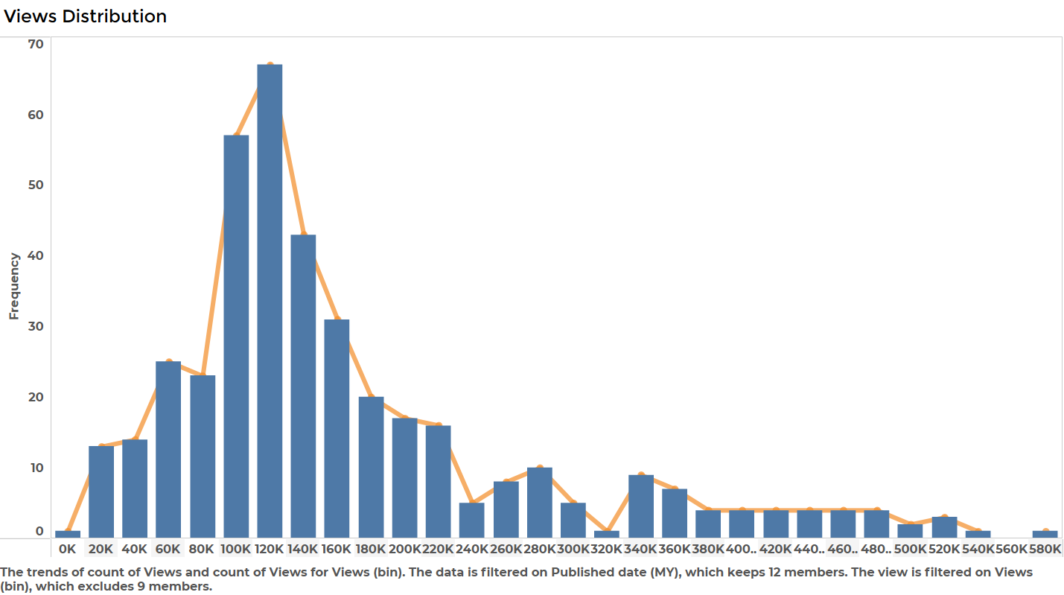
Views Distribution
The average views was around 192k.
Positive Skewness – a good sign.
Around 70% Probability of views falling into this range (70k,340k).
Note: This graph shows View Bins vs Frequency.

Slide 5
02.
Inferential Statistics
Views Based on Content, Duration, Day and Month

Slide 6
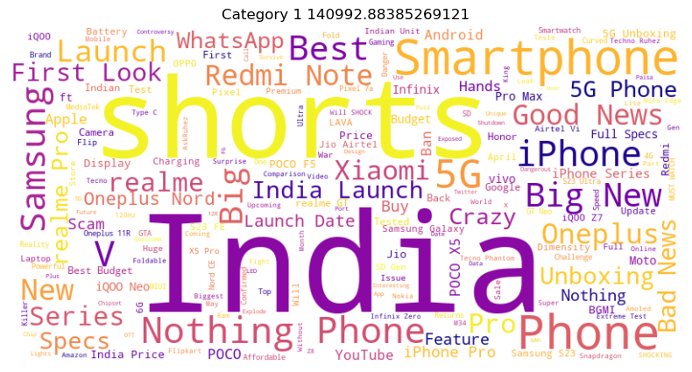
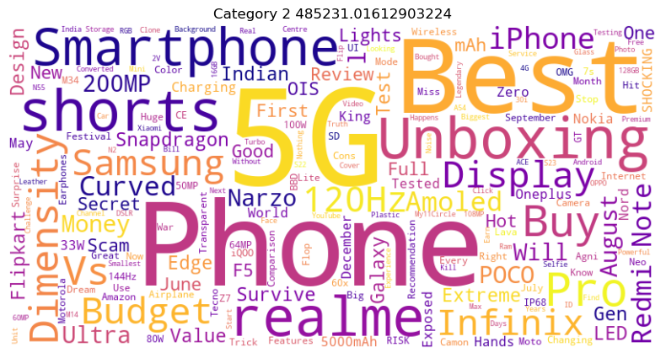
Views Based on Content

Slide 7
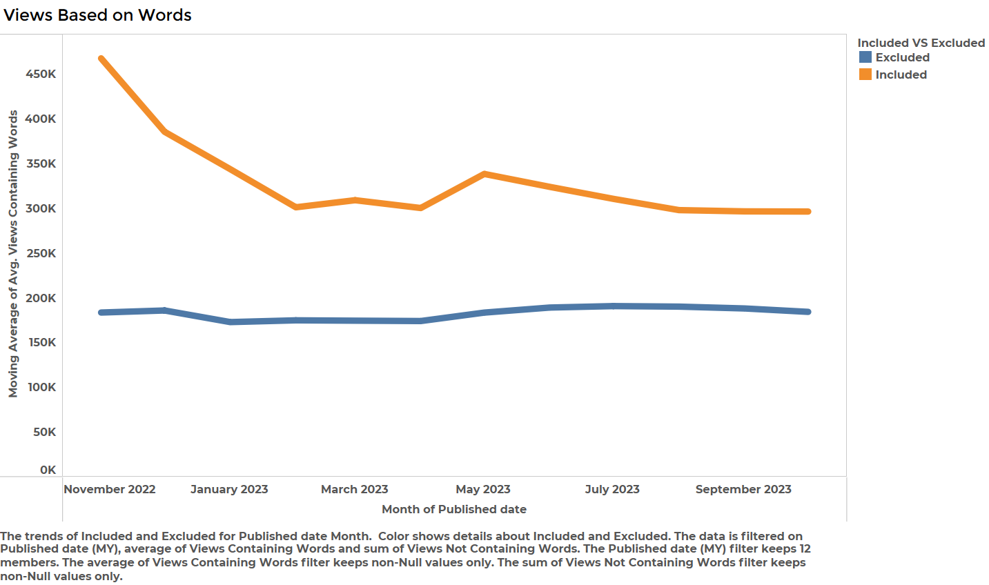
As can be seen, videos such as Unboxing, Best 5G Smartphone under __ , 120Hz Display, Dimensity, ___ MP Camera, etc get about 200% more views than Shorts and Tech News Combined (480k vs 140k).
Note: This graph shows Date vs Moving Average

Slide 8
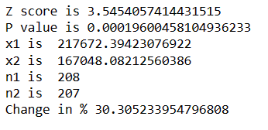
When words such as ‘Unboxing’,’Smartphone’,’5G’,’Best’ is included, the average goes up by 30% Vs When not included.

Slide 9
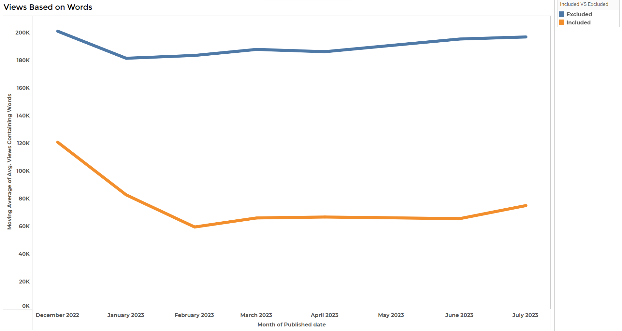
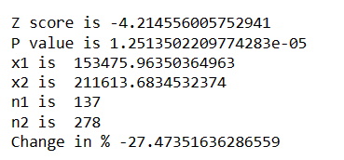
When words such as 'Ask’, ‘Ruhez', 'Shorts', 'Bad', 'News', 'Display', 'Nothing', 'Trick', 'Scam', 'Challenge' is included, the average goes down by 27% Vs When not included.
Note: This graph shows Date vs Moving Average

Slide 10
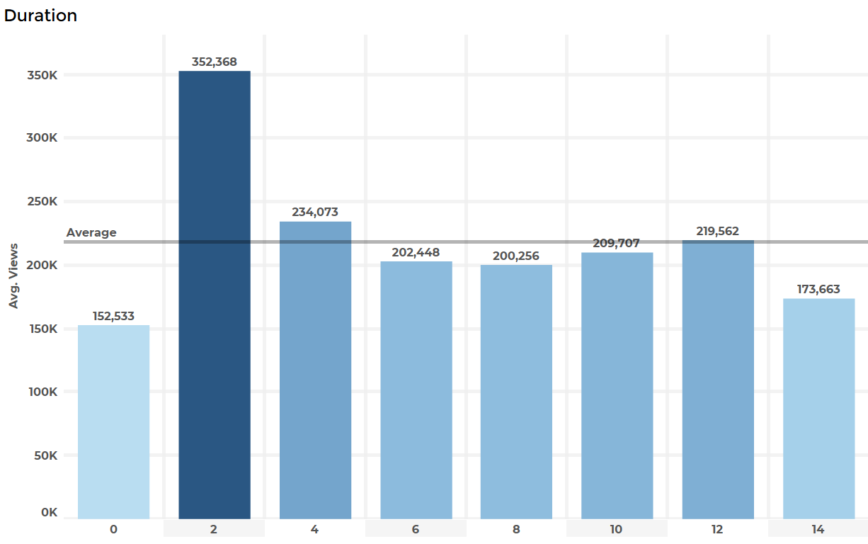
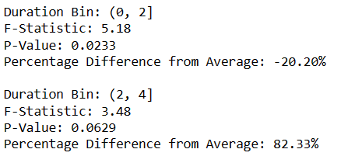
Views Based on Duration
Videos of duration 0 to 2 minutes performed 20% less than the average.
While, videos of duration 2 to 4 minutes performed 82% more than the average.
Note: This graph shows Duration vs Average Views

Slide 11
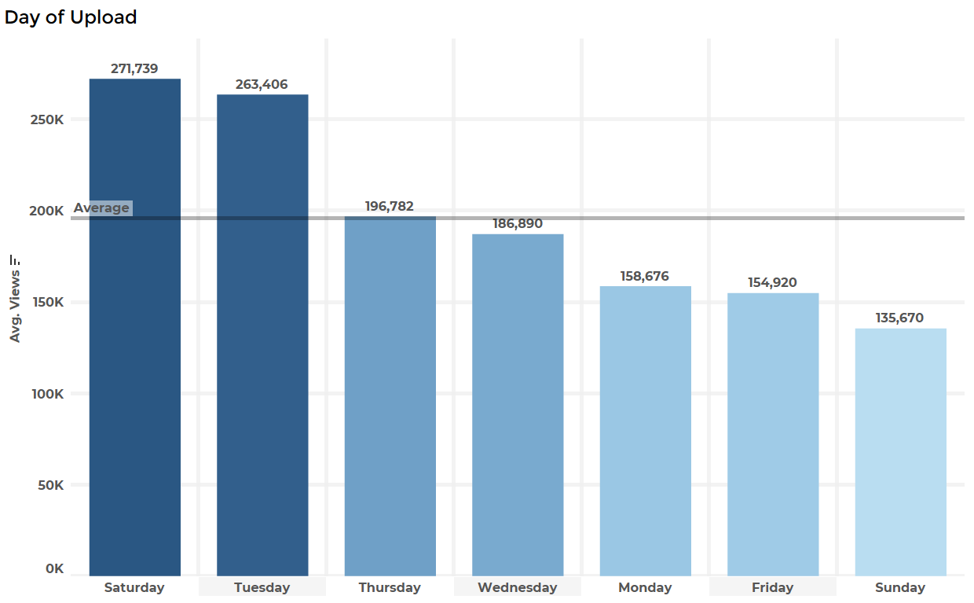
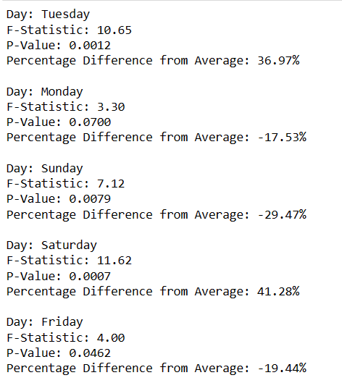
Views Based on Day
Videos uploaded on Saturday and Tuesday got 40% more views than the average.
While, videos uploaded on Monday, Friday and Sunday got 20% less views than the average.
Note: This graph shows Day vs Average Views

Slide 12
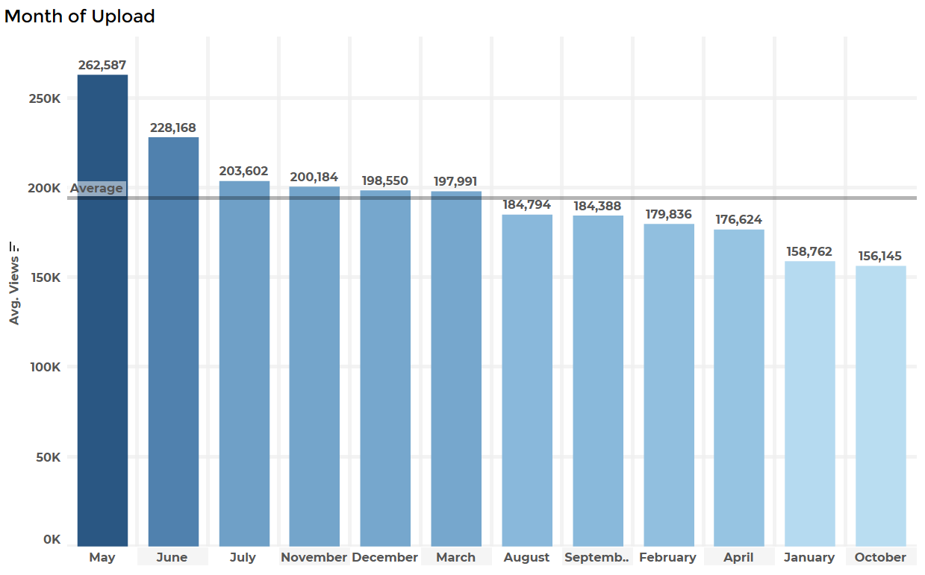
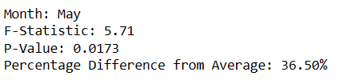
Views Based on Month
Videos uploaded in May got 36% more views than the average.
Note: This graph shows Month vs Average Views

Slide 13
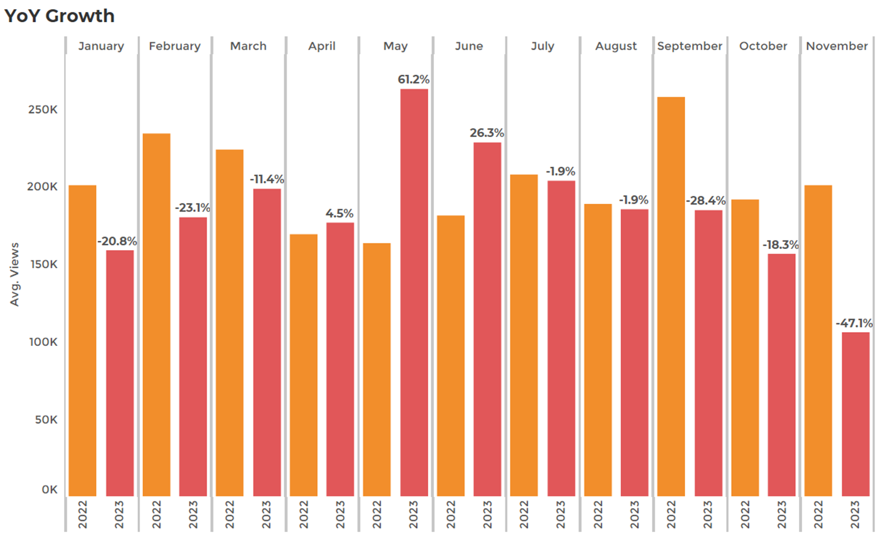
Performance vs Last Year
Average Views dropped by about 6% from last year (it has been decreasing from last 3 years).
Note: This graph shows YoY Growth for each Month.

Slide 14
03.
Recommendations
Where to Focus on

Slide 15
Recommendations
Reducing the frequency of Tech News was a wise decision made as videos like Unboxing, Best Smartphones to Buy, Full Reviews performed more than Tech News and Shorts in terms of Views.
Tricks and Tips in Shorts isn’t worth the effort, hence, try not to put much efforts there, instead, focusing on exclusive unboxings and reviews would give better results.
Videos of MWC (2 to 4 minutes) gave good results in terms of Views. Therefore, going to more such exhibitions and showcasing peculiar crazy tech would improve the number of views.
Videos uploaded on Saturday and Tuesday where of different kinds than the Tech News, and these videos performed better than those uploaded on Monday, Friday which consisted of Tech News. Hence, trying out different videos is really helping the channel a lot.
There were great unboxings and videos uploaded in May month. The ‘Don’t Buy POCO Phone’ really performed better. Continue making such real content and exposing the brand with honest content would definitely take the channel forward.
Factory tour videos in 2019 was booming on your channel. Try making such ground-level content.

Slide 16
Summary
1
2
3
4
Techno Ruhez should stand for Reality and Ground-work based content.
Unboxing and 2 to 4 minute videos on crazy tech would work.
Try out different content and see what works.
Underperformance of Tech News and Shorts.

Slide 17
Thank You
https://www.instagram.com/pranayjain._/
https://www.linkedin.com/in/pranay-jain-650ab0147/
forpranayjain@gmail.com
+91 9150924356

