Slide 1
Breast Cancer Prediction using Principle Component Analysis(PCA)
Pavan Gandhi : 202118009
Pranay Kothari : 202118010
Nidhi Sadhvani : 202118043

Slide 2
TABLE OF CONTENTS
PROJECT AIM
DATASET
DATA VISUALISATION
METHODOLOGY
PRINCIPLE COMPONENT ANALYSIS
MODELS
CONCLUSION

Slide 3
PROJECT AIM
According to studies over 9.5 million people died due to cancer, among different type of cancer Breast Cancer and Lung Cancer were the most common cancers in the world comprising 12.5% and 12.2% of the total cases which were registered in 2020 and causes has steadily increased over the last decade, which is a bad news for world population.
Nowadays many of the real world problems are being solved using artificial intelligence(AI) and data science techniques.
So in this project, taking one of the most common cancer into consideration we are using machine learning algorithm to diagnose breast cancer on the basis of their symptoms.

Slide 4
DATASET
•The breast cancer data includes 569 examples of cancer biopsies, each with 31 columns. Our target variable is cancer diagnosis and 30 are numeric-valued laboratory measurements. The diagnosis is coded as "Malignant" to indicate malignant or "Benign" to indicate benign.
•The other 30 numeric measurements comprise the mean, standard error and worst (i.e. largest) value for 10 different characteristics of the digitized cell nuclei, which are as follows:
-radius (mean of distances from center to points on the perimeter)
-texture (standard deviation of gray-scale values)
-perimeter
-area
-smoothness (local variation in radius lengths)
-compactness (perimeter^2 / area - 1.0)
-concavity (severity of concave portions of the contour)
-concave points (number of concave portions of the contour)
-symmetry
-fractal dimension ("coastline approximation" - 1)

Slide 5
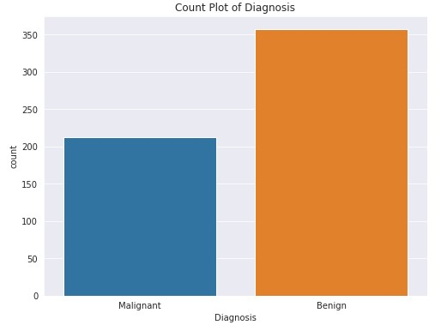
DATA VISUALISATION

Slide 6
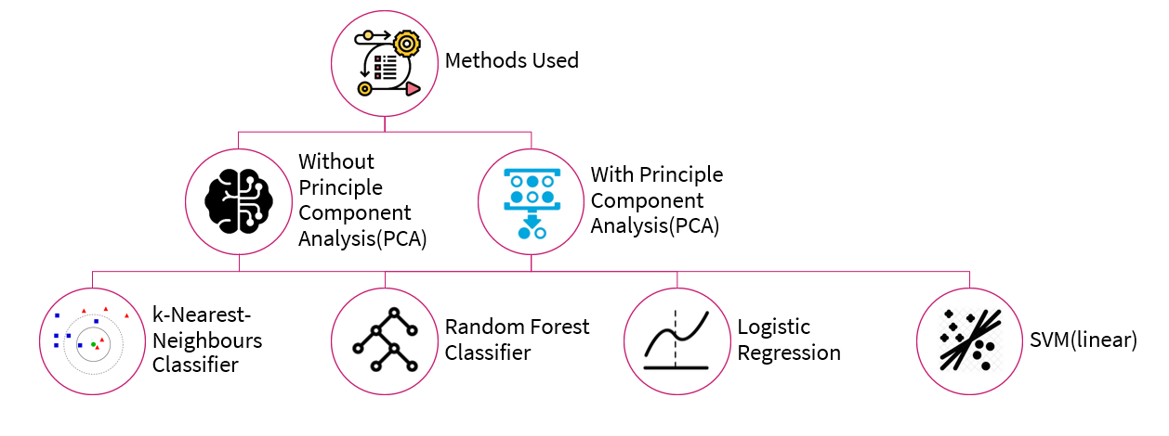
METHODOLOGY

Slide 7
PCA
PCA is a linear dimensionality reduction approach (algorithm) that converts a collection of correlated variables (p) into a smaller k number of uncorrelated variables called principal components while preserving as much variance as feasible in the original data. It is an unsupervised machine learning approach that finds relevant variables that may be used for subsequent regression, grouping, and classification tasks apropos of Machine Learning.
STEPS:
1. Standardize the dataset.
2. Calculate the covariance matrix for the features in the dataset
3. Calculate the eigenvalues and eigenvectors for the covariance matrix.
4. Sort eigenvalues and their corresponding eigenvectors.
5. Pick k eigenvalues( >1 ) and form a matrix of eigenvectors.
6. Transform the original matrix.

Slide 8
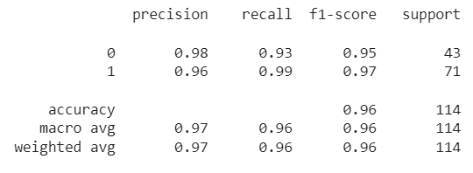
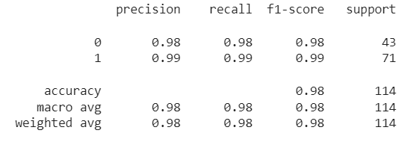
Classification Models
Logistic regression
Without PCA With PCA

Slide 9
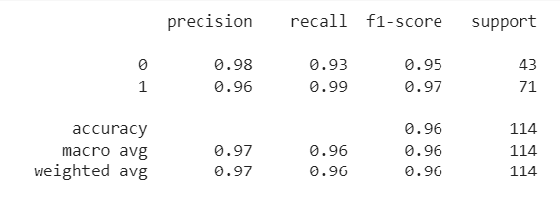
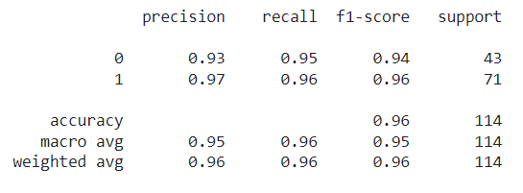
Random Forest Classifier
Without PCA With PCA

Slide 10
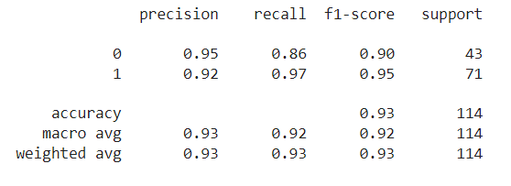
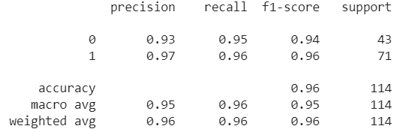
Knn Classifier
Without PCA With PCA

Slide 11
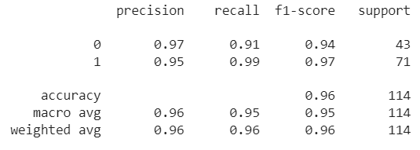
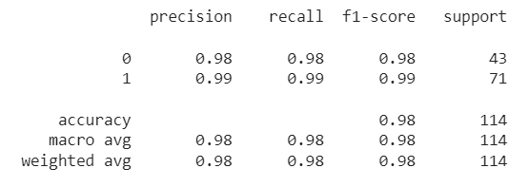
SVM Classifier
Without PCA With PCA

Slide 12
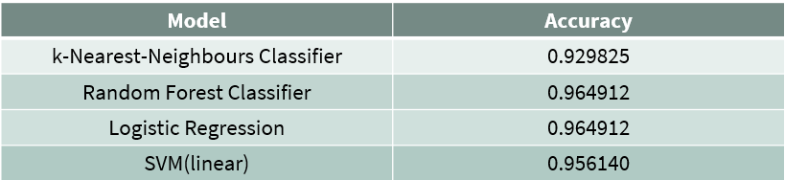
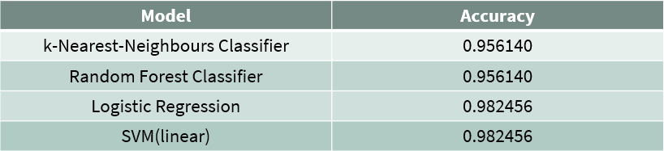
CONCLUSION
WITHOUT PCA
WITH PCA

Slide 13
Thank You!!!

