Slide 1


CREDIT CARD FRAUD DETECTION
202118002 KESHAV ATRI
202118010 PRANAY KOTHARI
202118014 JAINAM SHAH
202118021 PRACHI

Slide 2

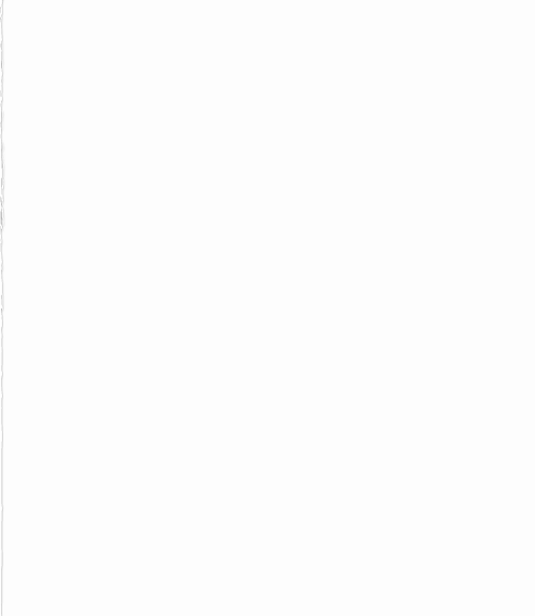
INDEX
INTRODUCTION
DATA SET
RELATED WORK
DATA PRE-PROCESSING
IMBALANCED DATA
EVALUATION STRATEGY
CLASSIFICATION MODELS
LOGISTIC REGRESSION
RANDOM FOREST CLASSIFIER
KNN CLASSIFIER
CONCLUSION

Slide 3
INTRODUCTION
We see frauds occurring around us here and there in any transaction, but debit or credit card transaction is a very common example. It is important for companies to identify fraudulent credit card transactions so that they don’t charge customers who did not purchase that item or goods. Since the day payment systems have emerged, group of people have been trying to illegally access other people’s money. According to the Nilson Report, by 2025 United States will suffer a loss of 1.2 billion dollars because of Credit Card fraud.
In this project we used various Machine Learning algorithms to detect Credit card fraud and find the best possible model that can detect fraud in best possible way. In this project we have used Logistic Regression, Random Forest Classifier and KNN Classifier as well. We drew the confusion matrix, classification report and ROC curve for all. The results of these models help us give a clear idea whether our transaction is normal or fraudulent transactions.

Slide 4
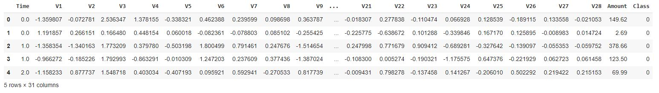
DATASET
The dataset used in this project is from Kaggle(creditcard.csv), which consists data of two day’s transactions in European Union by the cardholders on 09/2013. Total of 284,807 transactions were made out of which 492 were fraudulent. So, our dataset is highly imbalanced, with frauds less than 0.17% in total.

Slide 5
DATASET
The dataset consists of only numerical variables. As the details of the Credit card or cardholder cannot be disclosed, all the features in the dataset leaving Time, Amount and Class are converted by applying PCA. After applying PCA we get 28 features with labels V1,V2, ……,V28. These features include credit card history, early month’s bills, credit boundary, savings account,etc.
Features:
Time: Represents the elapsed time from the first transaction.
V1,V2,…..V28: PCA converted features
Amount: Total amount of transaction
Class: 0 if Non-fraudulent transaction, 1 if fraudulent transaction

Slide 6
RELATED WORK
J. O. Awoyemi, A. O. Adetunmbi and S. A. Oluwadare, "Credit card fraud detection using machine learning techniques: A comparative analysis", 2017 International Conference on Computing Networking and Informatics (ICCNI), pp. 1-9, 2017.
J. O. Awoyemi, A. O. Adetunmbi and S. A. Oluwadare performed a study using logistic regression, Naïve Bayes and KNN classifiers to classify fraudulent and non-fraudulent transactions with accuracies 54.86%, 97.69%, and 97.92% respectively.
W. Deng, Z. Huang, J. Zhang and J. Xu, "A Data Mining Based System for Transaction Fraud Detection", 2021 IEEE International Conference on Consumer Electronics and Computer Engineering ICCECE 2021, pp. 542-545, Jan. 2021.
Deng. Wenkai, Huang. Ziming et al. performed a research using random forest and manual detection for detecting fraudulent transaction. In this research their model outperforms logistic regression and support vector machines with the benchmark accuracy of 96.8% and ROC AUC score of 92.50%.
P. Tiwari, S. Mehta, N. Sakhuja, I. Gupta and A. K. Singh, "Hybrid method in identifying the fraud detection in the credit card" in Evolutionary Computing and Mobile Sustainable Networks, Singapore:Springer Singapore, pp. 27-35, 2021.
P. Tiwari, S. Mehta, N. Sakhuja, I. Gupta and A. K. Singh worked on models KNN, ANN and Decision Trees to detect fraudulent and non-fraudulent data with the average accuracy of 95.66%

Slide 7
DATA PREPROCESSING
In our dataset, we see that the values in Amount feature are varying. So we have standardized the Amount feature.
The Time feature is an external deciding factor, so we dropped it from our dataset.
As there were duplicate transactions in our dataset, so we dropped 1,081 duplicated transactions from our dataset.
Our dataset is highly imbalanced, so have balanced it using Under Sampling and Over Sampling using SMOTE.
We split the dataset into training and testing sets where 80% of the dataset is training set and remaining 20% is testing set.

Slide 8

IMBALANCED DATA
UNDER SAMPLING:
After standardizing the amount, dropping the time feature and deleting duplicate values, we have 473 fraudulent transactions and 283253 Non-fraudulent transactions. In Under sampling, we randomly select 473 Non-fraudulent transactions from 283253 transactions and then apply all the models on the new dataset.

Slide 9

IMBALANCED DATA
OVERSAMPLING:
After standardizing the amount, dropping the time feature and deleting duplicate values, we have 473 fraudulent transactions and 283253 Non-fraudulent transactions. In Over sampling, we generate copies of data in the minority class using SMOTE technique.

Slide 10
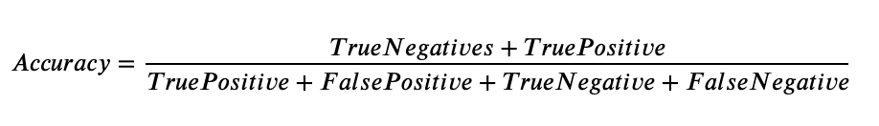
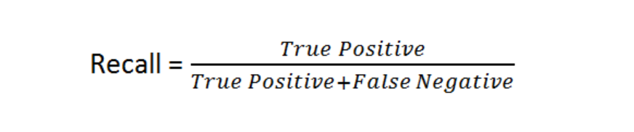

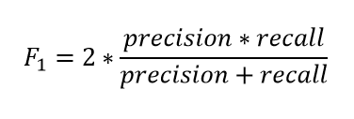
EVALUATION STRATEGY
We have used Accuracy, Precision, Recall, F1 score and ROC curve as our parameters to evaluate our model.

Slide 11
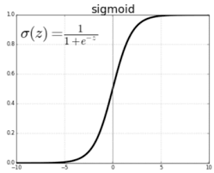
CLASSIFCATION MODELS
LOGISTIC REGRESSION

Slide 12
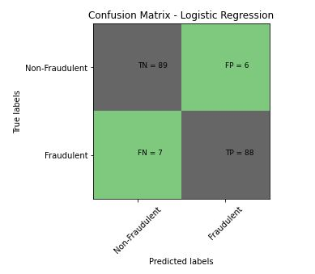
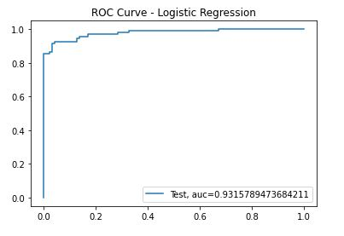

LOGISTIC REGRESSION (UNDER SAMPLING)

Slide 13
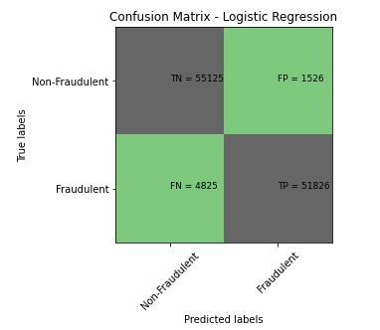
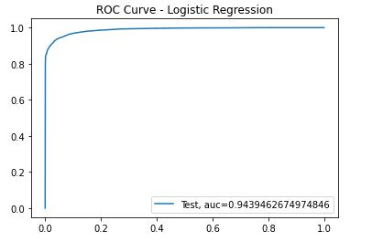

LOGISTIC REGRESSION (OVER SAMPLING)

Slide 14

Random Forest Classifier

Slide 15
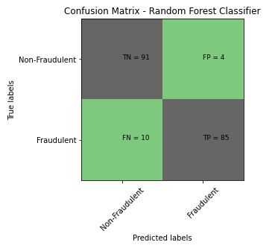
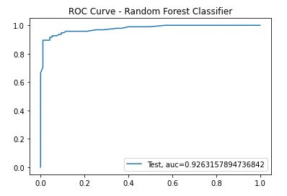
RANDOM FOREST CLASSIFIER (UNDER SAMPLING)
UNDERSAMPLING:

Slide 16
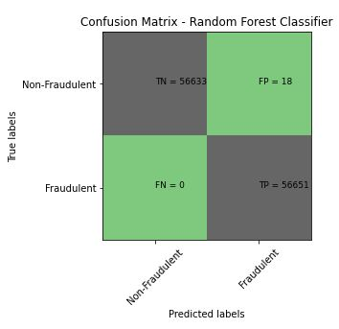
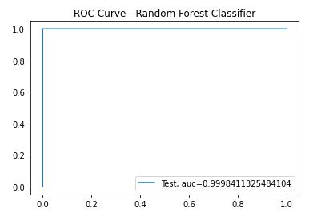
RANDOM FOREST CLASSIFIER (OVER SAMPLING)
OVER SAMPLING:

Slide 17
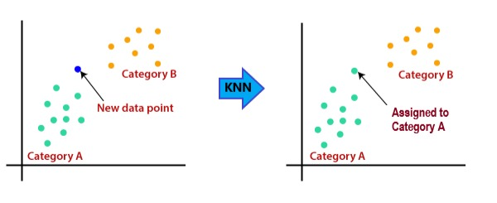
KNN Classifier:

Slide 18
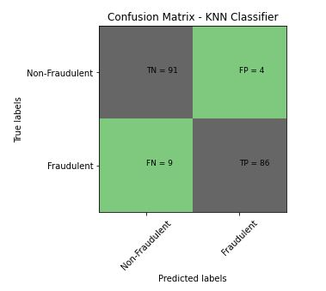
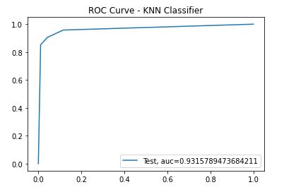
KNN CLASSIFIER (UNDER SAMPLING)

Slide 19
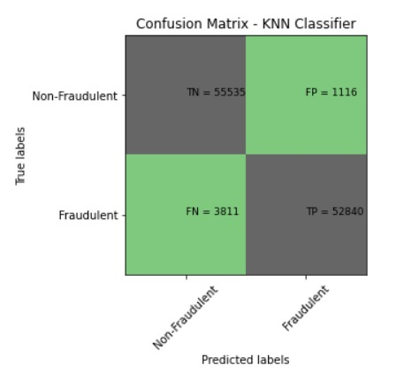
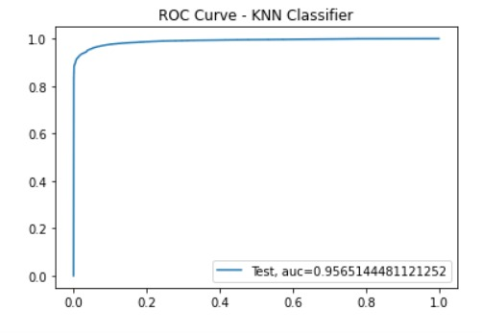
KNN CLASSIFIER (OVER SAMPLING)

Slide 20
CONCLUSION
In this project, we have two types of data preprocessing, namely Under sampling and Over sampling. We have applied three models for both Under sampling and Over sampling. In the case of Under sampling ,Logistic Regression has the highest accuracy of 94.21% with precision 95.65%. In case of Over sampling, there is an improvement in the accuracy of Random Forest Classifier with the highest accuracy of 99.98% with precision 99.96%.In the case of precision also, we see that Over sampling is better than under sampling.
In Under sampling, we cut down the values to the minimum requirement which effects our results. In the case of over sampling we have large data to process with and it gives us better results.
We have also out performed all the accuracies that were referred before. This project’s highest accuracy is 99.98% and average accuracy of our project is 96.6%.

