Slide 1


YouTube Video Comment
Sentiment Analysis
CIS-600 Social Media and Data Mining
Project Presentation
Pranay Kumar Verma
Prateek Sahu

Slide 2

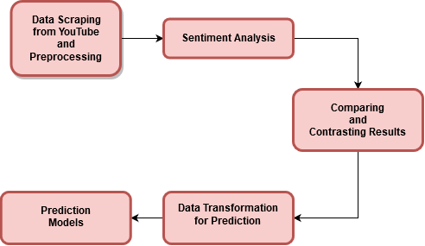
Agenda
Notes:
Such a wide variety of viewing content makes it difficult for a user to choose the content. Choosing the content just on the basis of likes and dislikes is often difficult for users, likes and dislikes are sometimes misleading.

Slide 3

Introduction
Founded in 2005, YouTube is the most popular platform for sharing and watching videos. The content until February 2020 amounts up to 6.5 million hours viewing (750 years).
With the onset of the COVID-19 pandemic and restrictions in place forcing people to stay at home, YouTube witnessed a huge spike in viewing traffic, so much so that it had to reduce the default streaming quality.
Such a huge viewing time generates exponential ad revenue. Hence, motivating many people to pursue YouTube as a career option.
Notes:
Such a wide variety of viewing content makes it difficult for a user to choose the content. Choosing the content just on the basis of likes and dislikes is often difficult for users, likes and dislikes are sometimes misleading.

Slide 4
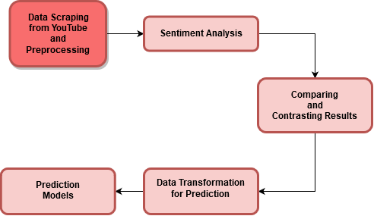
Notes:
Such a wide variety of viewing content makes it difficult for a user to choose the content. Choosing the content just on the basis of likes and dislikes is often difficult for users, likes and dislikes are sometimes misleading.

Slide 5
All About Data
Dataset is extracted using the YouTube Data API v3.
The baseline data was made by extracting 1200 comments from multiple YouTube channels and manually classifying them into positive, negative and neutral comments.
Extracted 2500 most recent comments for each of the 200 videos of a YouTube channel based on user input.
Feature selection: Video ID, Title, Comments, their last update date, etc.
Preprocessing the dataset includes removing punctuations, special characters, stop words, tokenizing and stemming.

Slide 6
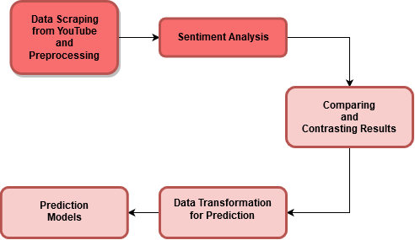
Notes:
Such a wide variety of viewing content makes it difficult for a user to choose the content. Choosing the content just on the basis of likes and dislikes is often difficult for users, likes and dislikes are sometimes misleading.

Slide 7


Sentiment Analysis
Models used
Vader - Lexicon and rule-based sentiment analysis which is specifically attuned to sentiments expressed in social media. It works on a complete sentence analyzing text in addition to punctuations and emojis.
Afinn - Builds up a score for a sentence word by word after tokenizing, removing the stop words and stemming the text.
NRC Lexicon - Lexicon based approach used for its ability to grasp actual emotion rather than positive or negative.

Slide 8
Sentiment Analysis
Baseline accuracy:
We selected various sentiment analysis models such as Vader and Afinn and ran them on baseline data for validation of performance.
On analysis, Vader showed more promising results in comparison to Afinn.
Model | Accuracy
Vader | 78.79%
Afinn | 70.88%

Slide 9
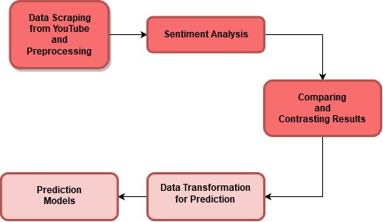
Notes:
Such a wide variety of viewing content makes it difficult for a user to choose the content. Choosing the content just on the basis of likes and dislikes is often difficult for users, likes and dislikes are sometimes misleading.

Slide 10
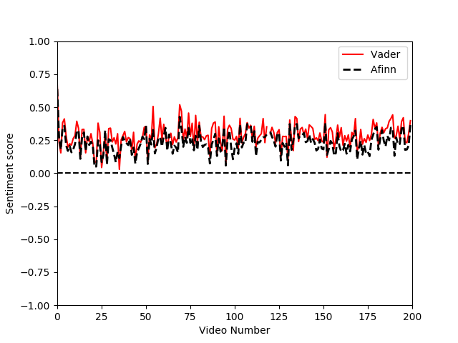
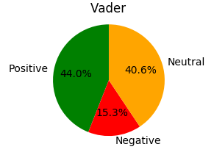
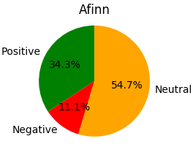
Vader V/S Afinn

Slide 11
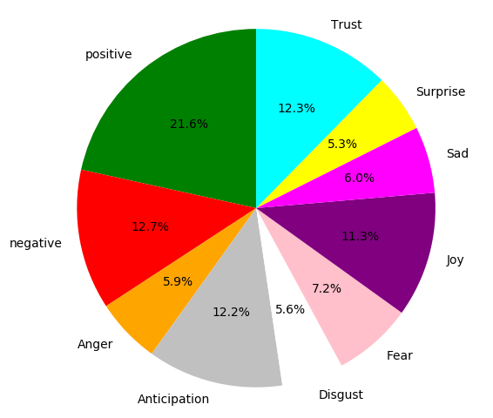
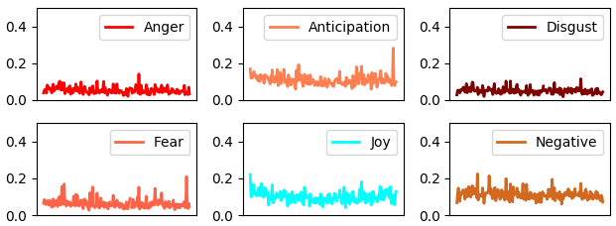
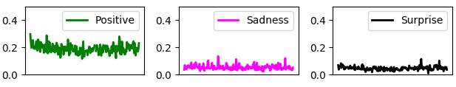
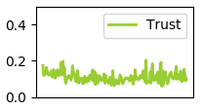
NRC Lexicon

Slide 12
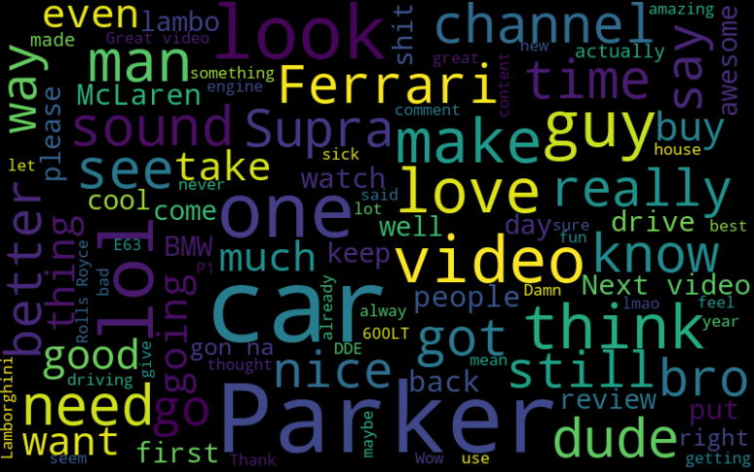
WordCloud

Slide 13
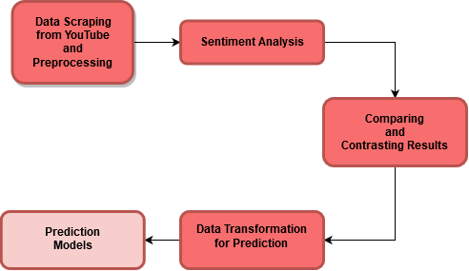
Notes:
Such a wide variety of viewing content makes it difficult for a user to choose the content. Choosing the content just on the basis of likes and dislikes is often difficult for users, likes and dislikes are sometimes misleading.

Slide 14
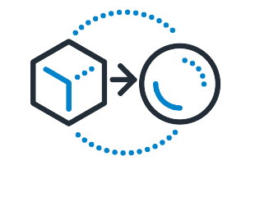
Data Transformation
Transformation to Time-Series dataset
The comments as well as sentiment analysis scores are now transformed by grouping based on dates for creating a time-series dataset.
This dataset is now used for performing time series prediction using simple Machine Learning algorithms as well as Neural Networks.

Slide 15
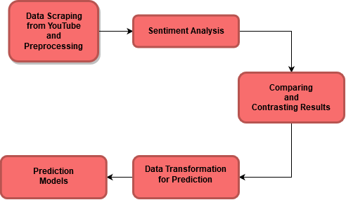
Notes:
Such a wide variety of viewing content makes it difficult for a user to choose the content. Choosing the content just on the basis of likes and dislikes is often difficult for users, likes and dislikes are sometimes misleading.

Slide 16
Prediction Models
What we aim to achieve?
The goal is to identify how the comments posted on a specific day vary in sentiment.
Observing the past trends, we aim to make a reasonable prediction on the sentiment in the upcoming days and months.
This in turn will help the channel owners to alter their content accordingly to keep the viewers happy.

Slide 17
Prediction Models (Cont.)
Models Used
Linear Regression - One of the most basic Machine Learning Algorithm, used to fit linear relations
Polynomial Regression - Fits a nonlinear relationship.
LSTM (Long Short Term Memory) - An advanced part of Artificial Neural Networks, which is also recurring, the previous state is preserved.

Slide 18
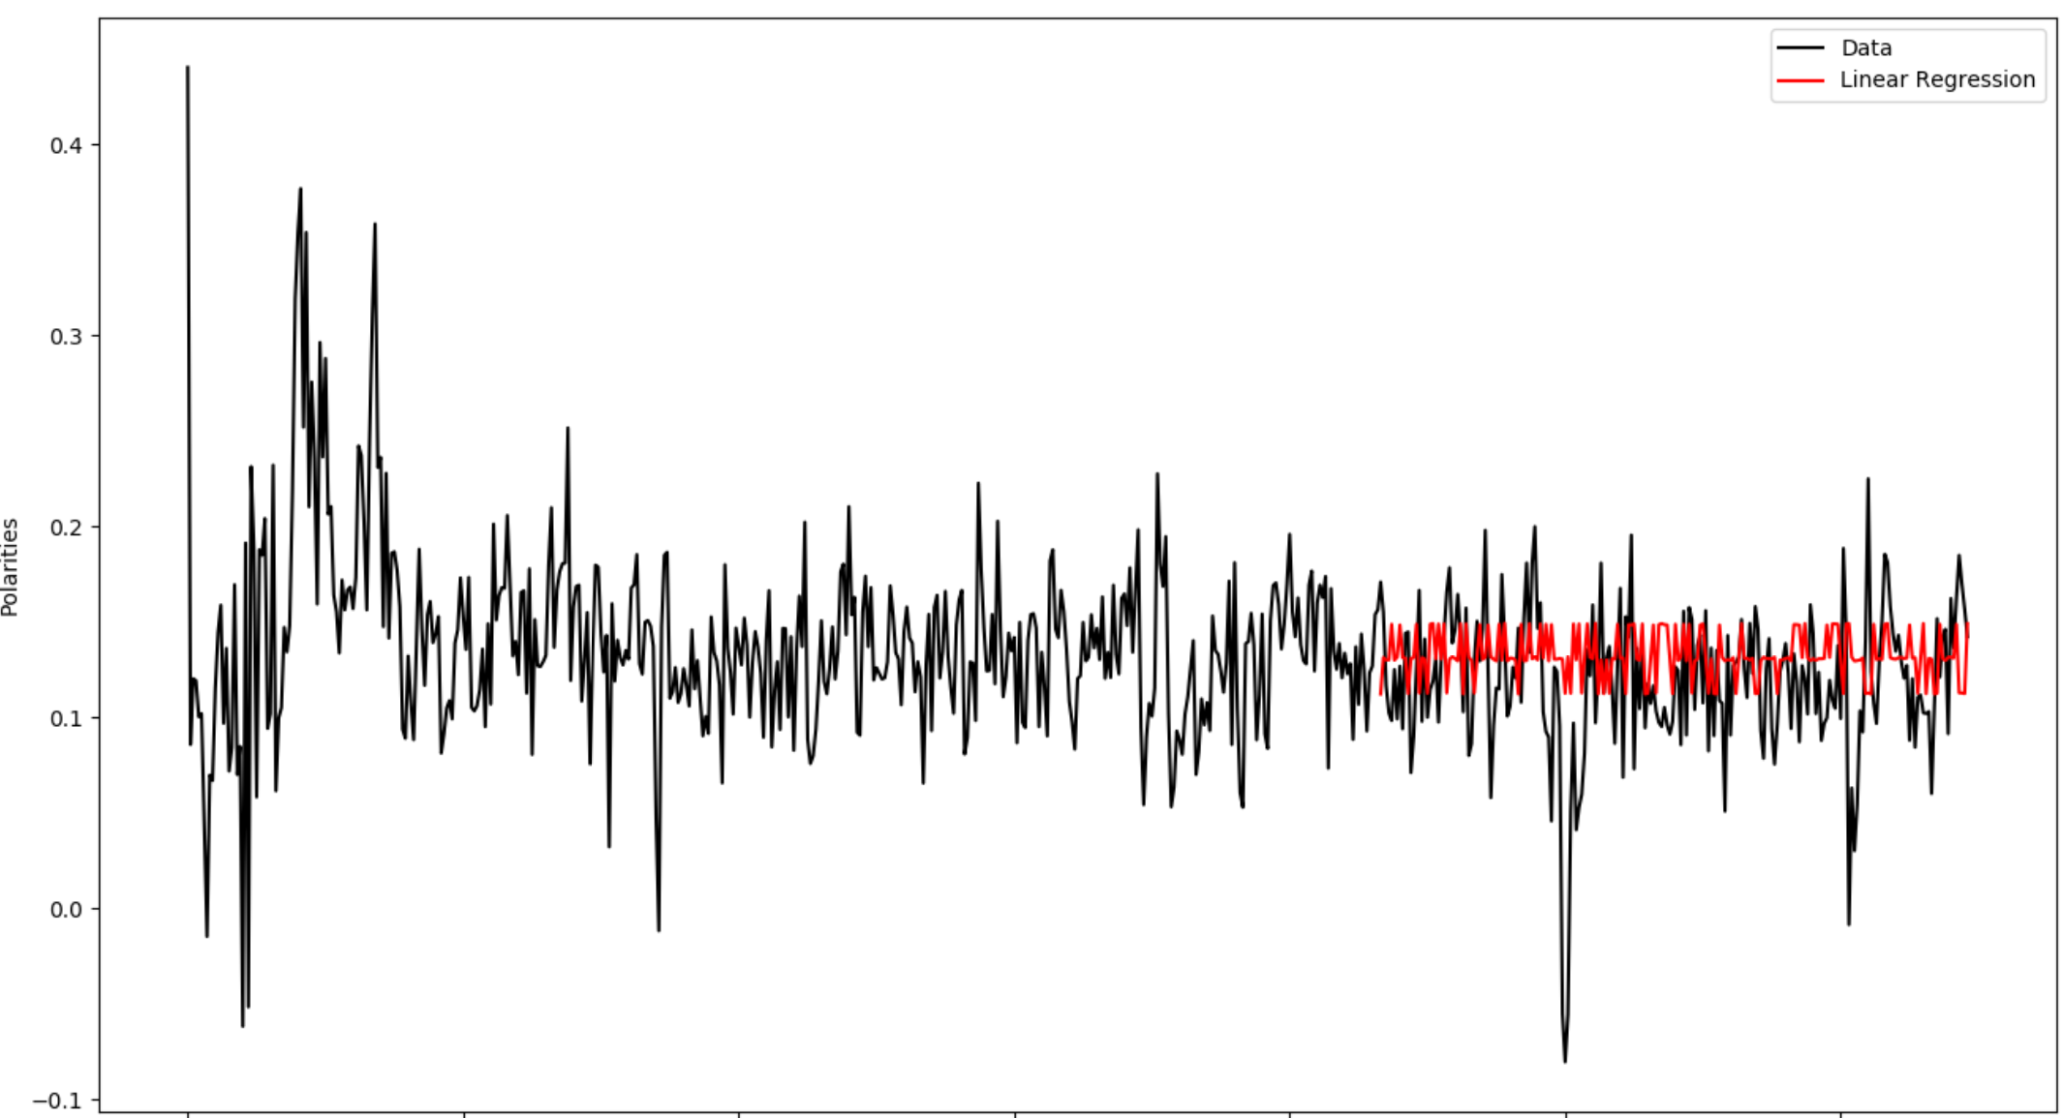
Linear Regression Vader
Vader RMSE: 0.085

Slide 19
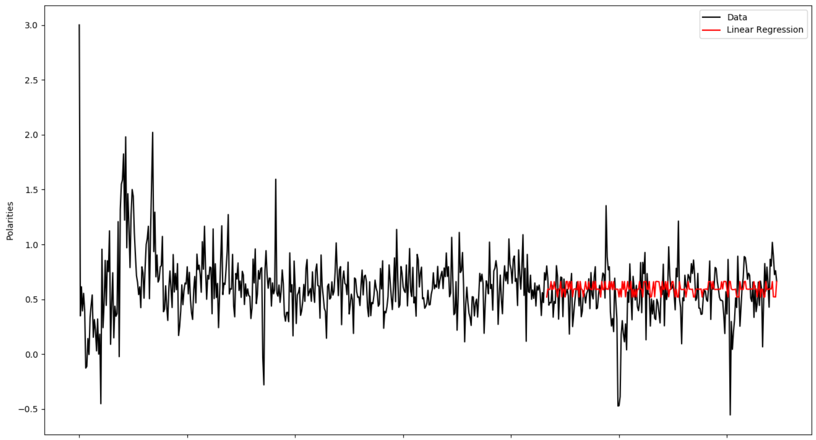
Linear Regression Afinn
Afinn RMSE: 0.1590

Slide 20
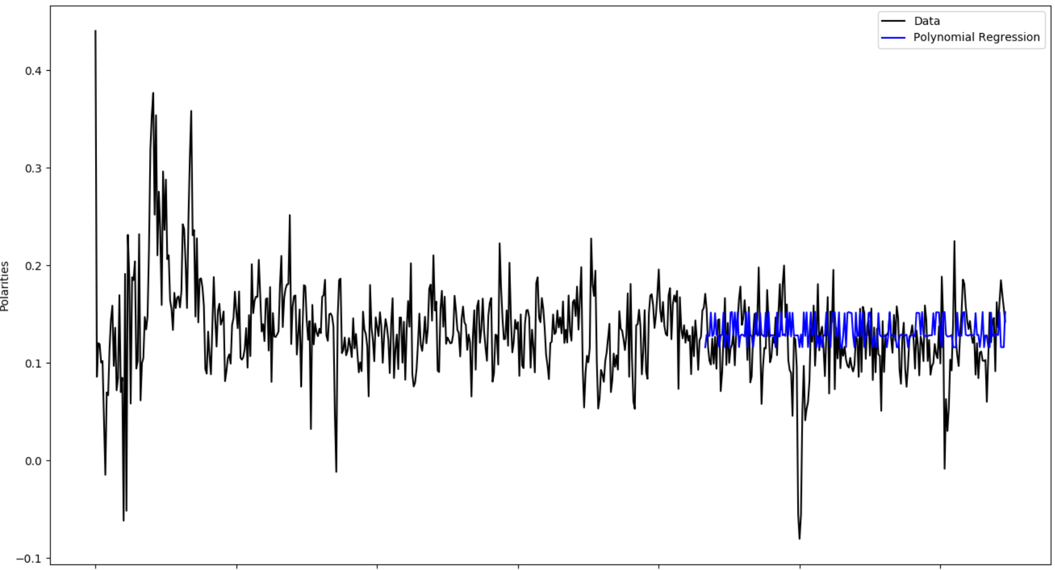
Polynomial Regression Vader
Vader RMSE: 0.0823

Slide 21
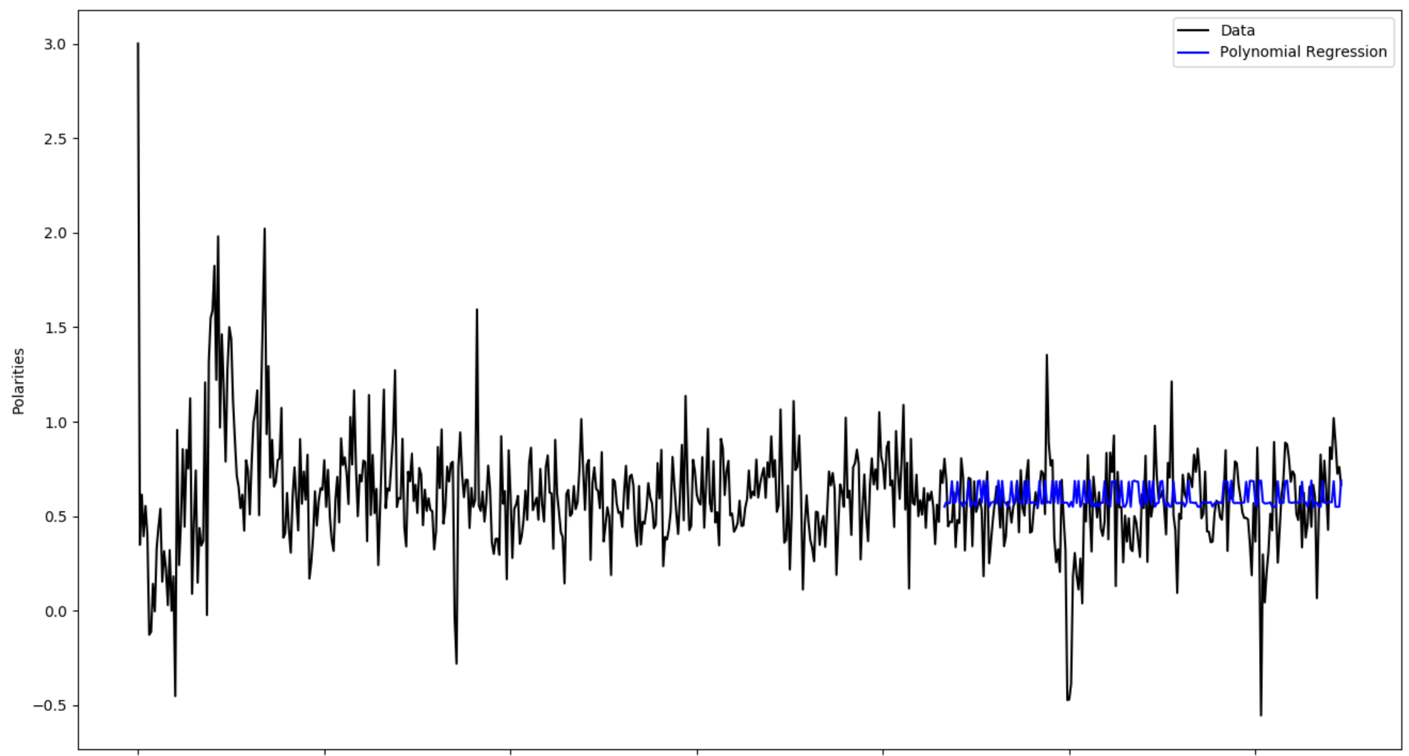
Polynomial Regression Afinn
Afinn RMSE: 0.1497

Slide 22
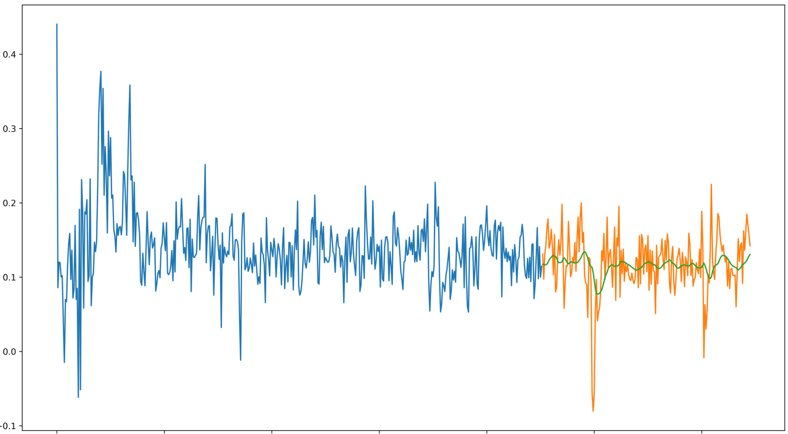
LSTM Vader
Vader RMSE: 0.0477

Slide 23
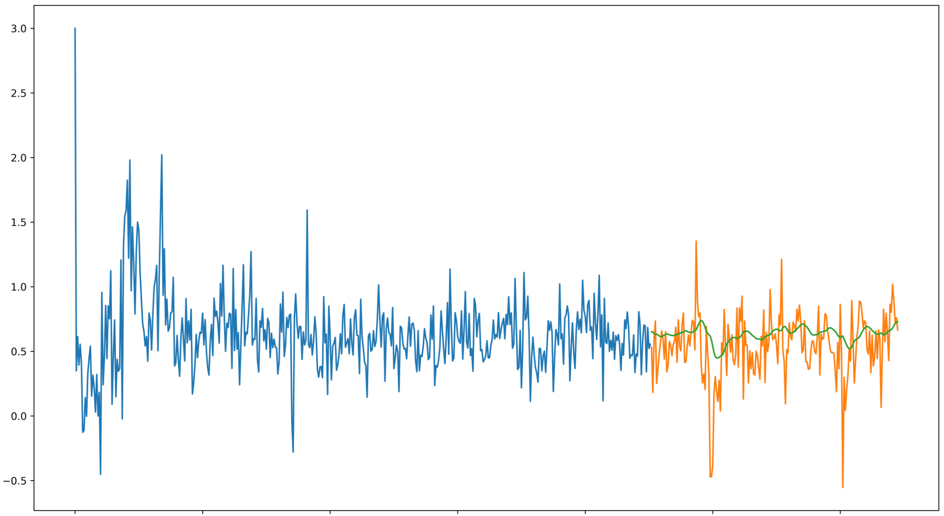
LSTM Afinn
Afinn RMSE: 0.0780

Slide 24
Which Performs Best?
As per our baseline analysis as well as the predictions performed, Vader constantly outperforms Afinn.
The results of the model rank from best to worst are:
  LSTM (approx. 4.7% off the mark)
  Polynomial Regression (approx. 8.2% off the mark)
  Linear Regression (approx. 8.5% off the mark)

Slide 25
Additional Analysis
The common belief is that the like/dislike ratio can project how the sentiment of the comments is.
But is this really the case?
We used the sentiment analysis in conjunction with the view count and comment count of a video to try and predict the likes/dislikes ratio.
What we found was interesting, in that the comments are not necessarily in line with the likes and dislikes.

Slide 26
Future Scope
Obtain access to YouTube Analytics API and get historical data like subscriber count, like/dislike count and average playtime which is currently not possible with data API.
Using this, we can predict how fast the channel will grow in future.
With average play time at our disposal we can also predict the if the channel will have monetary gains.

Slide 27
Questions?

Slide 28
References
https://saifmohammad.com/WebPages/NRC-Emotion-Lexicon.htm
https://developers.google.com/youtube/v3
https://medium.com/analytics-vidhya/simplifying-social-media-sentiment-analysis-using-vader-in-python-f9e6ec6fc52f
https://machinelearningmastery.com/time-series-prediction-lstm-recurrent-neural-networks-python-keras/

