Slide 1
Trash Detection and Cleanliness Assessment
using YOLOv8 and an Interactive Assistant
Odra Bira – 50678448
Sai Rohith Bharadwaj – 50658865
Pranay Lachuluri – 50652406
Project focus
Detect litter, visualize hotspots, and estimate cleanliness.
1

Slide 2
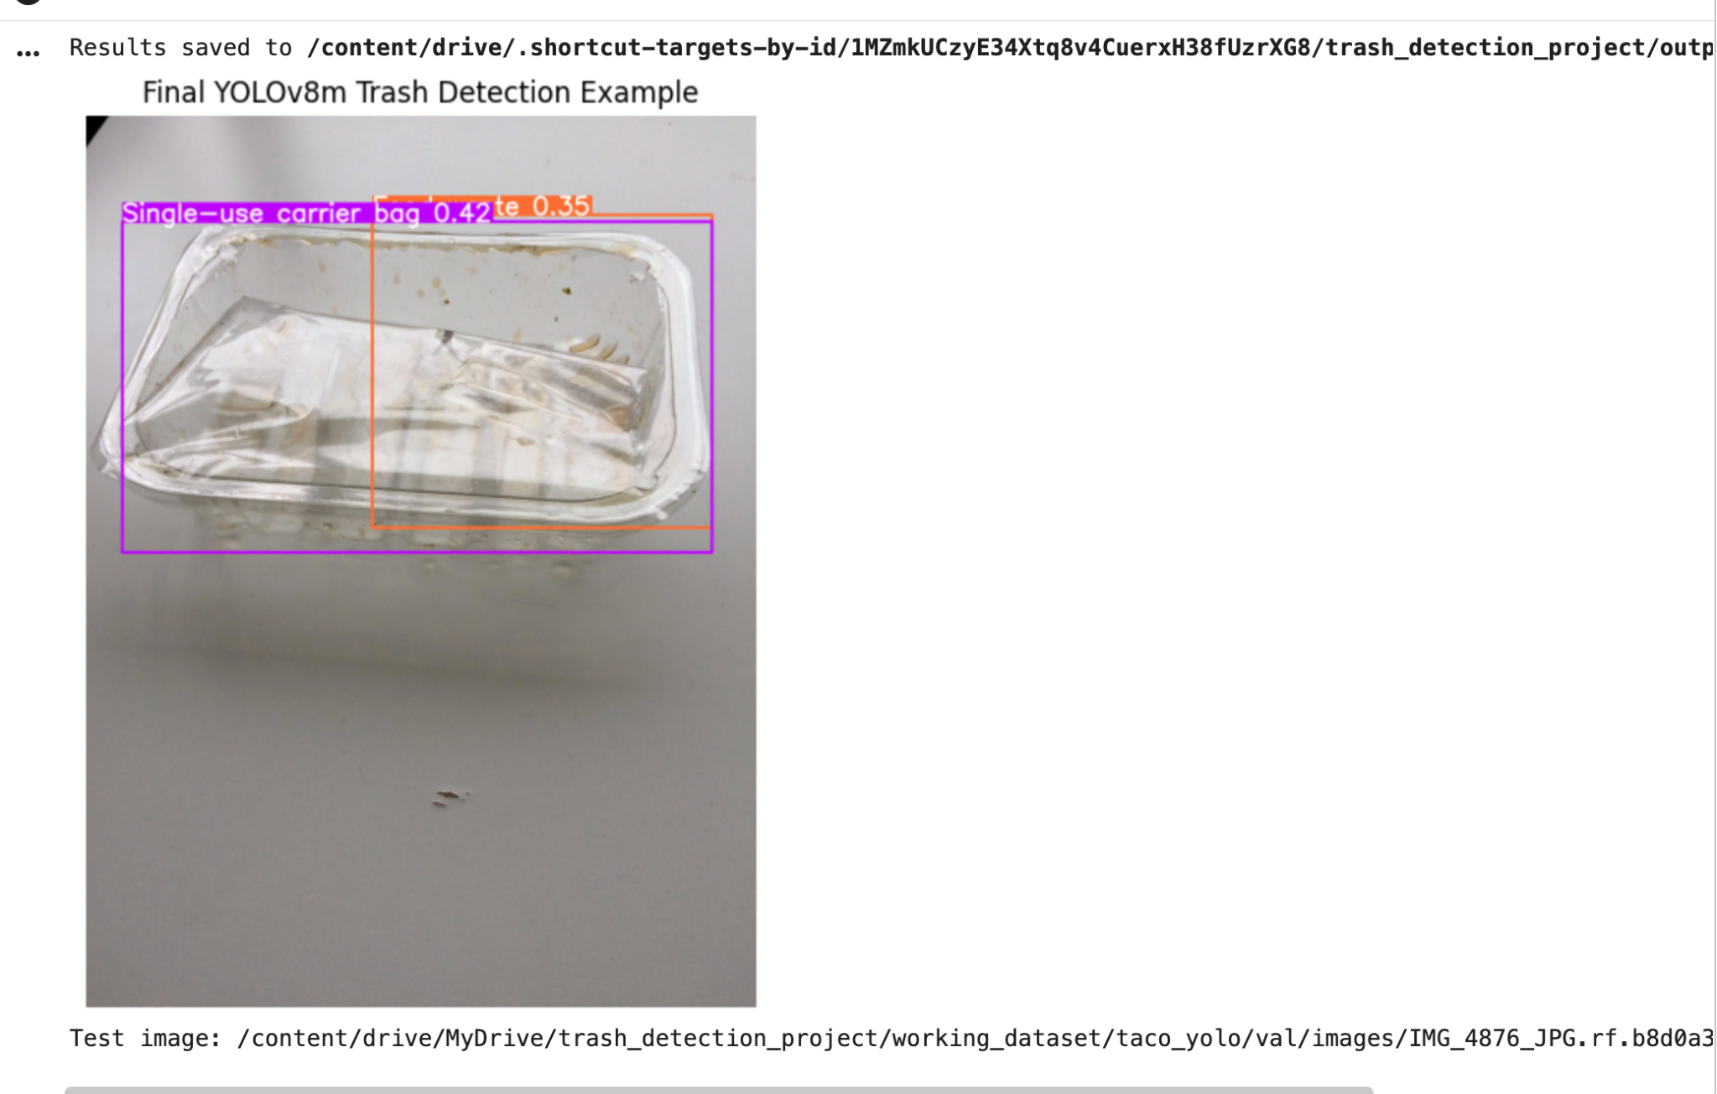
1. What is the aim of the project?
A practical AI system for trash detection and environmental assessment
Main aim
Use deep learning to detect litter objects in real-world scenes and support environmental cleanliness monitoring.
Why this matters
Manual inspection is slow, inconsistent, and hard to scale across large public spaces.
Final output
An assistant that shows detections, hotspot heatmaps, cleanliness score, and a short interpretation.
Detection example
Detect trash categories using YOLOv8 object detection.
Localize litter with bounding boxes.
Highlight polluted regions using a heatmap overlay.
Summarize the scene using a 0–100 cleanliness score.
2

Slide 3
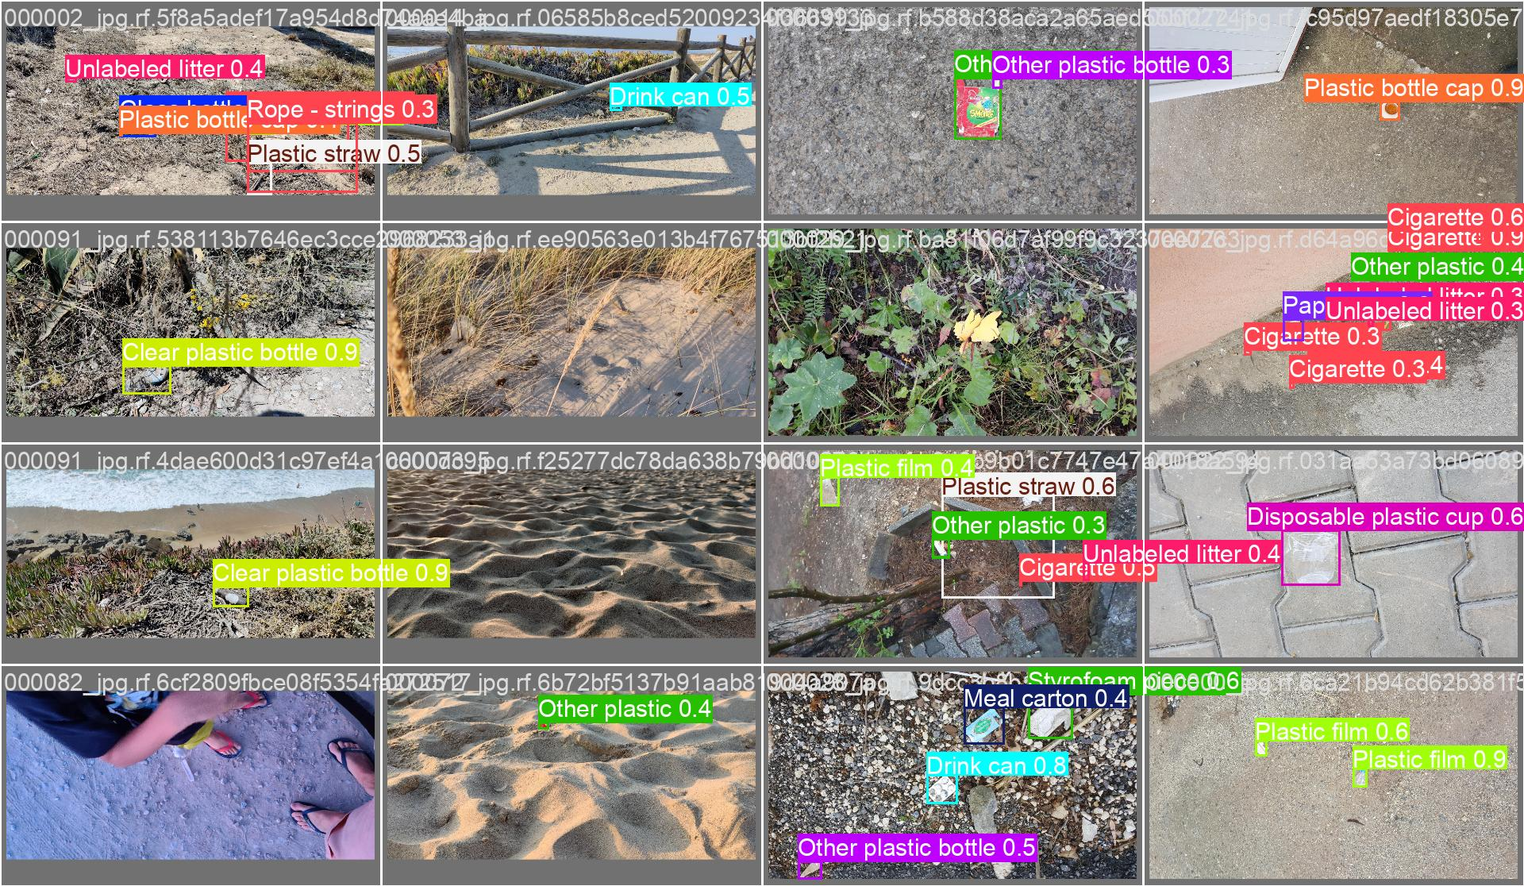
2. Background theory: object detection
Why this is different from a normal image classification problem
Classification
Answers: “What is in the image?”
Example: trash / no trash.
Object detection
Answers: “What objects are present and where are they?”
Output: class + bounding box.
Why detection is harder
The model must classify each object and draw an accurate box around it.
Multiple objects in cluttered scenes
A single image may contain multiple trash objects.
Each object can belong to a different class.
Objects may be small, rotated, partly hidden, or camouflaged by background.
Evaluation uses precision, recall, F1 score, and mAP rather than only “accuracy.”
3

Slide 4
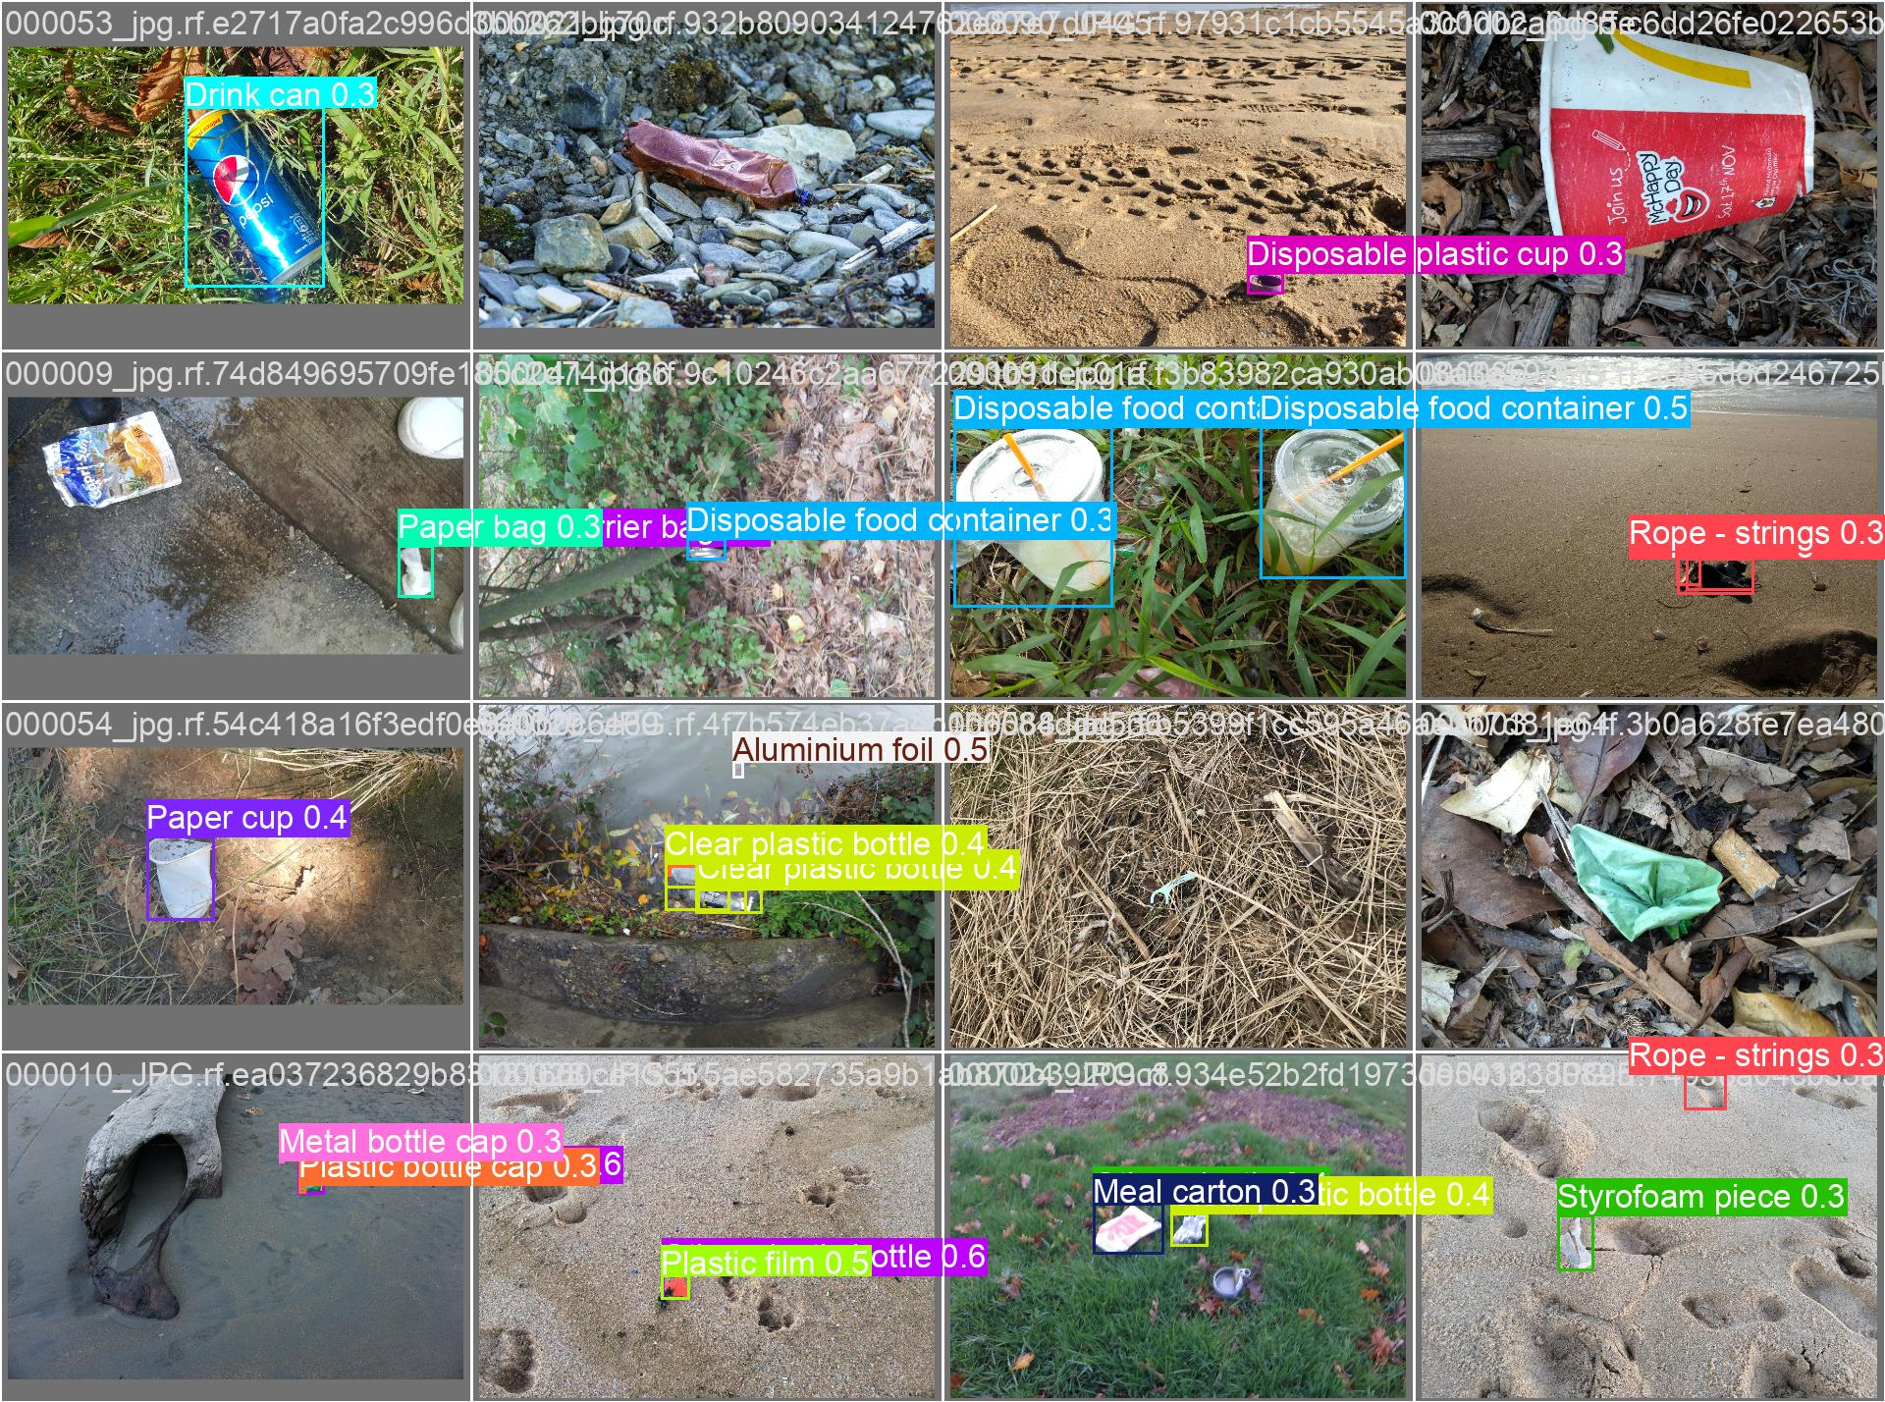
3. Dataset used in the project
TACO-style litter detection dataset prepared in YOLO format
Dataset type
Real-world litter images with object-level bounding box annotations.
Classes
59 trash categories such as plastic bottles, cans, cups, wrappers, bags, caps, and unlabeled litter.
Split used
1200 training images and 299 validation images after our dataset preparation step.
Dataset examples
Images contain outdoor backgrounds such as roads, grass, sand, leaves, and public spaces.
YOLO label files store class id plus normalized bounding box coordinates.
We verified image/label counts before training to avoid broken dataset paths.
This dataset is realistic, but challenging because trash objects are often small and visually similar.
4

Slide 5
4. Dataset preparation work
What we did before model training
Step 1
Mounted Google Drive and organized the project directory.
Step 2
Extracted and inspected image and label folders.
Step 3
Created validation split and fixed data YAML paths.
Step 4
Copied dataset locally for faster training where possible.
This work was important because an incorrect path or missing split can make training results invalid.
We checked the exact number of train and validation images before running YOLOv8.
The final YAML pointed YOLO to the correct train/images and val/images folders.
The dataset preparation stage made later experiments repeatable and easier to validate.
Train set
1200 images + matching labels
Validation set
299 images + matching labels
Final YAML
path + train + val + 59 names
5

Slide 6
5. YOLOv8 model theory
Why YOLOv8 was selected for this system
YOLO = You Only Look Once
YOLOv8n
Lightweight baseline model for initial training.
YOLO performs object localization and classification in one forward pass.
It is suitable for practical applications because it is fast and easy to deploy.
Pretrained weights allow transfer learning from general object features to trash detection.
YOLOv8 provides training outputs such as losses, precision/recall curves, prediction batches, and confusion matrices.
YOLOv8s
Improved model with higher resolution and stronger augmentation.
YOLOv8m
Final stronger model used for the main demonstration.
best.pt
Final model checkpoint selected from validation performance.
6

Slide 7
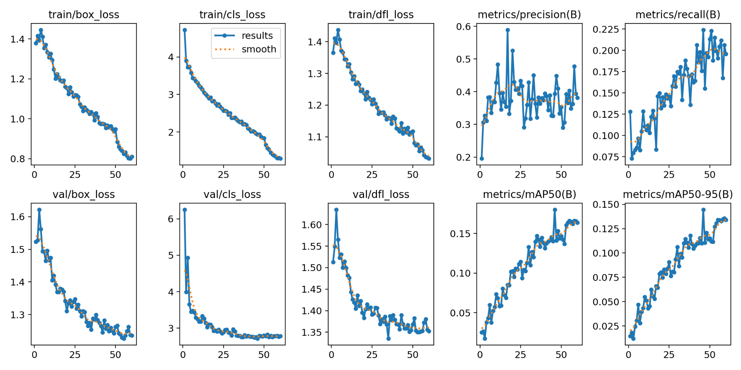
6. What work has already been conducted?
Summary of completed technical work
Training curves from final model
Researched litter detection and selected a YOLOv8-based object detection pipeline.
Prepared the TACO-style dataset in YOLO format and fixed the training/validation structure.
Implemented baseline YOLOv8n training and then improved configurations with YOLOv8s and YOLOv8m.
Tested higher image resolution, stronger augmentation, AdamW optimizer, and longer training.
Generated model outputs: prediction images, training curves, confusion matrices, heatmap, cleanliness score, and Gradio interface.
Final prediction output
7

Slide 8
7. Model improvement strategy
How we moved beyond the baseline
Higher image size
Used larger image sizes to help the model see smaller trash objects more clearly.
Augmentation
Used color, scale, translation, flip, mosaic, and mixup style training settings for robustness.
Stronger model
Moved from YOLOv8n baseline to YOLOv8s and YOLOv8m for higher model capacity.
Training progress
We kept the original 59-class detection task rather than simplifying the problem into one class.
This made the task harder, but preserved category-level trash recognition.
The final model was trained up to epoch 86 before runtime interruption; the saved best checkpoint was used for final reporting.
This approach shows experimentation, not just a single training run.

Slide 9
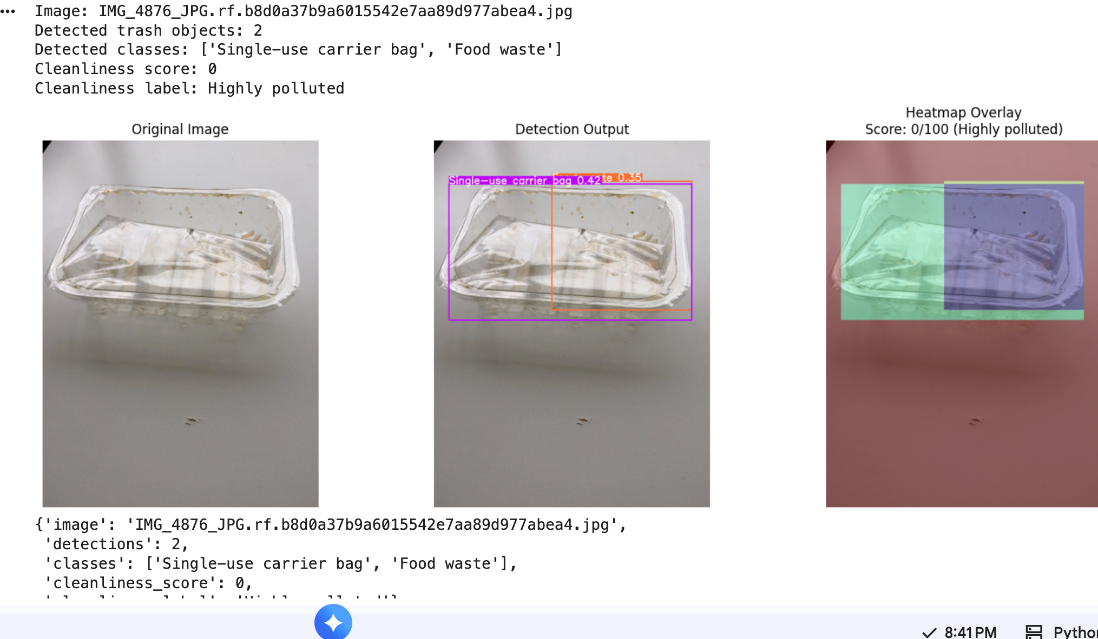
8. What value additions have we contributed?
Original contributions beyond a standard YOLO notebook
Value addition 1
A complete multi-model training and comparison workflow.
Value addition 2
Heatmap overlay showing where litter is concentrated.
Value addition 3
Cleanliness score that converts detections into a simple 0–100 interpretation.
Value addition 4
Gradio assistant for upload, detection, heatmap, and summary.
Value addition 5
Presentation-ready visual analysis: prediction batches, confusion matrix, and training curves.
Detection + heatmap + score output
9

Slide 10
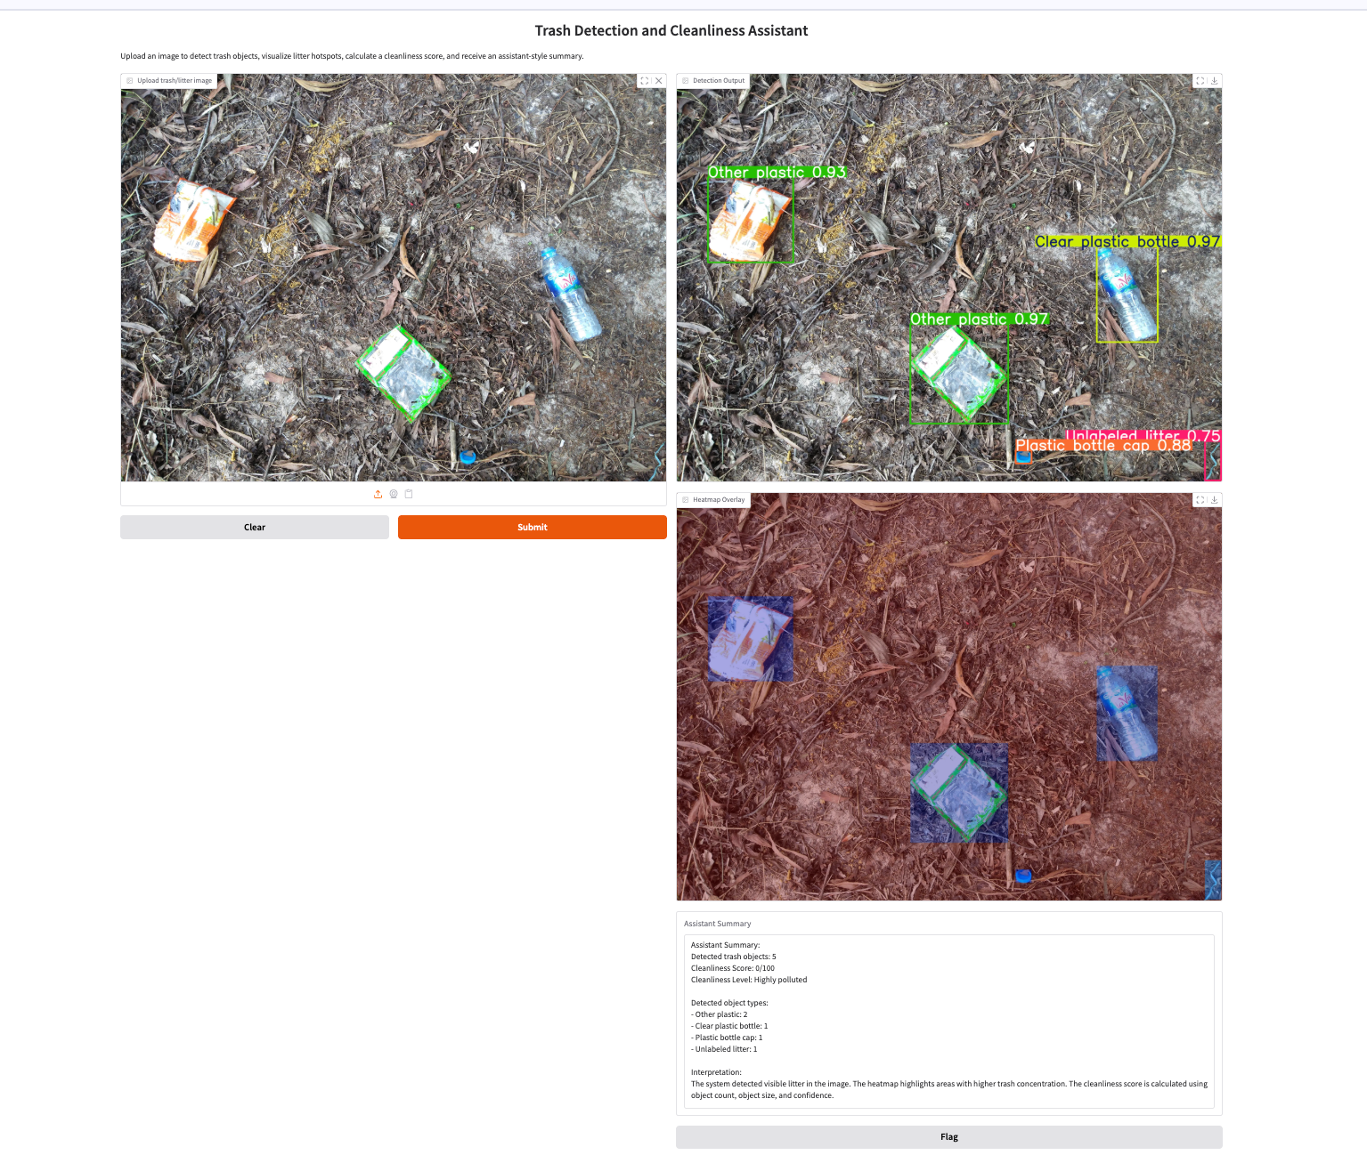
9. What results did we achieve?
Main outcomes without overloading the slide with tables
Training and validation progress
The system detects multiple trash objects and provides class labels with bounding boxes.
The final model showed learning progress: training losses decreased and validation metrics improved across epochs.
The strict localization metric improved compared with the initial baseline, showing better box quality and overall detection behavior.
The assistant produced interpretable outputs: object count, trash categories, cleanliness level, and heatmap visualization.
Assistant result example
10

Slide 11
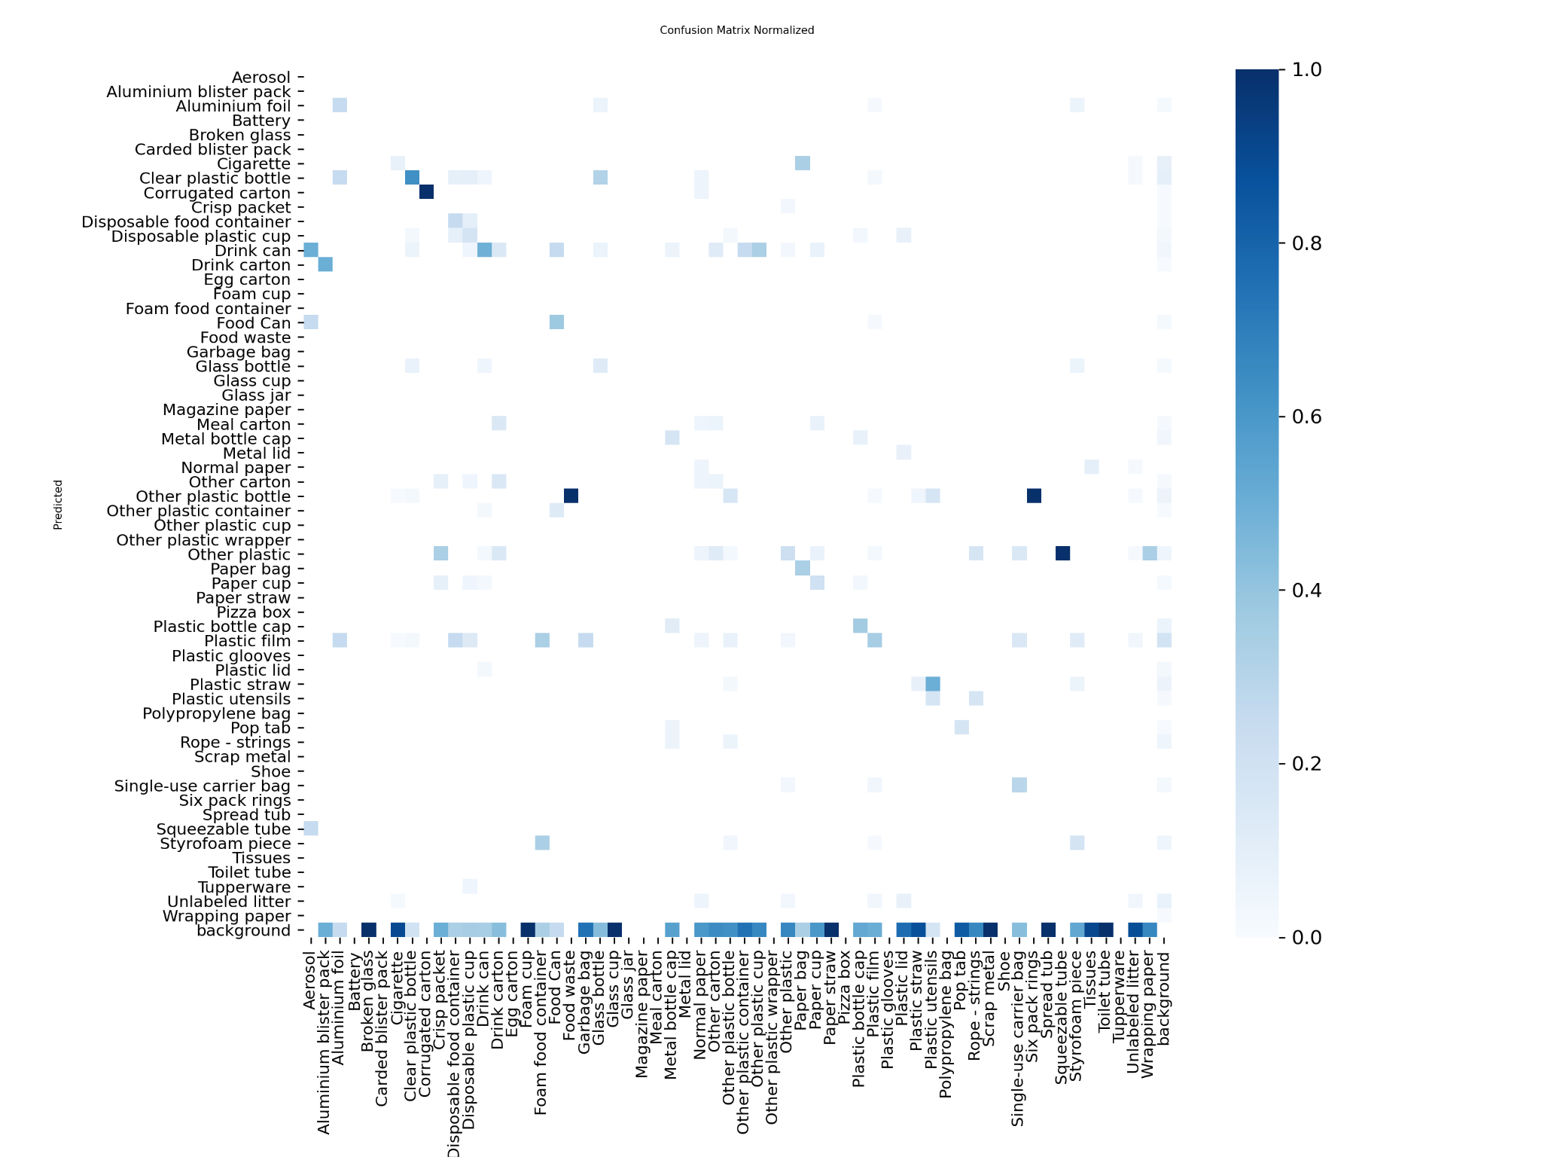
10. Evaluation visual: confusion matrix
Understanding where the model succeeds and struggles
Normalized confusion matrix
Useful for diagnosing class-level confusion.
Strong diagonal entries indicate correctly learned classes.
Many off-diagonal/background entries reflect the difficulty of small and similar trash categories.
This analysis guided our discussion of limitations and future work.
Key takeaway
The project is technically challenging because many trash classes overlap visually and are unevenly represented.
11

Slide 12
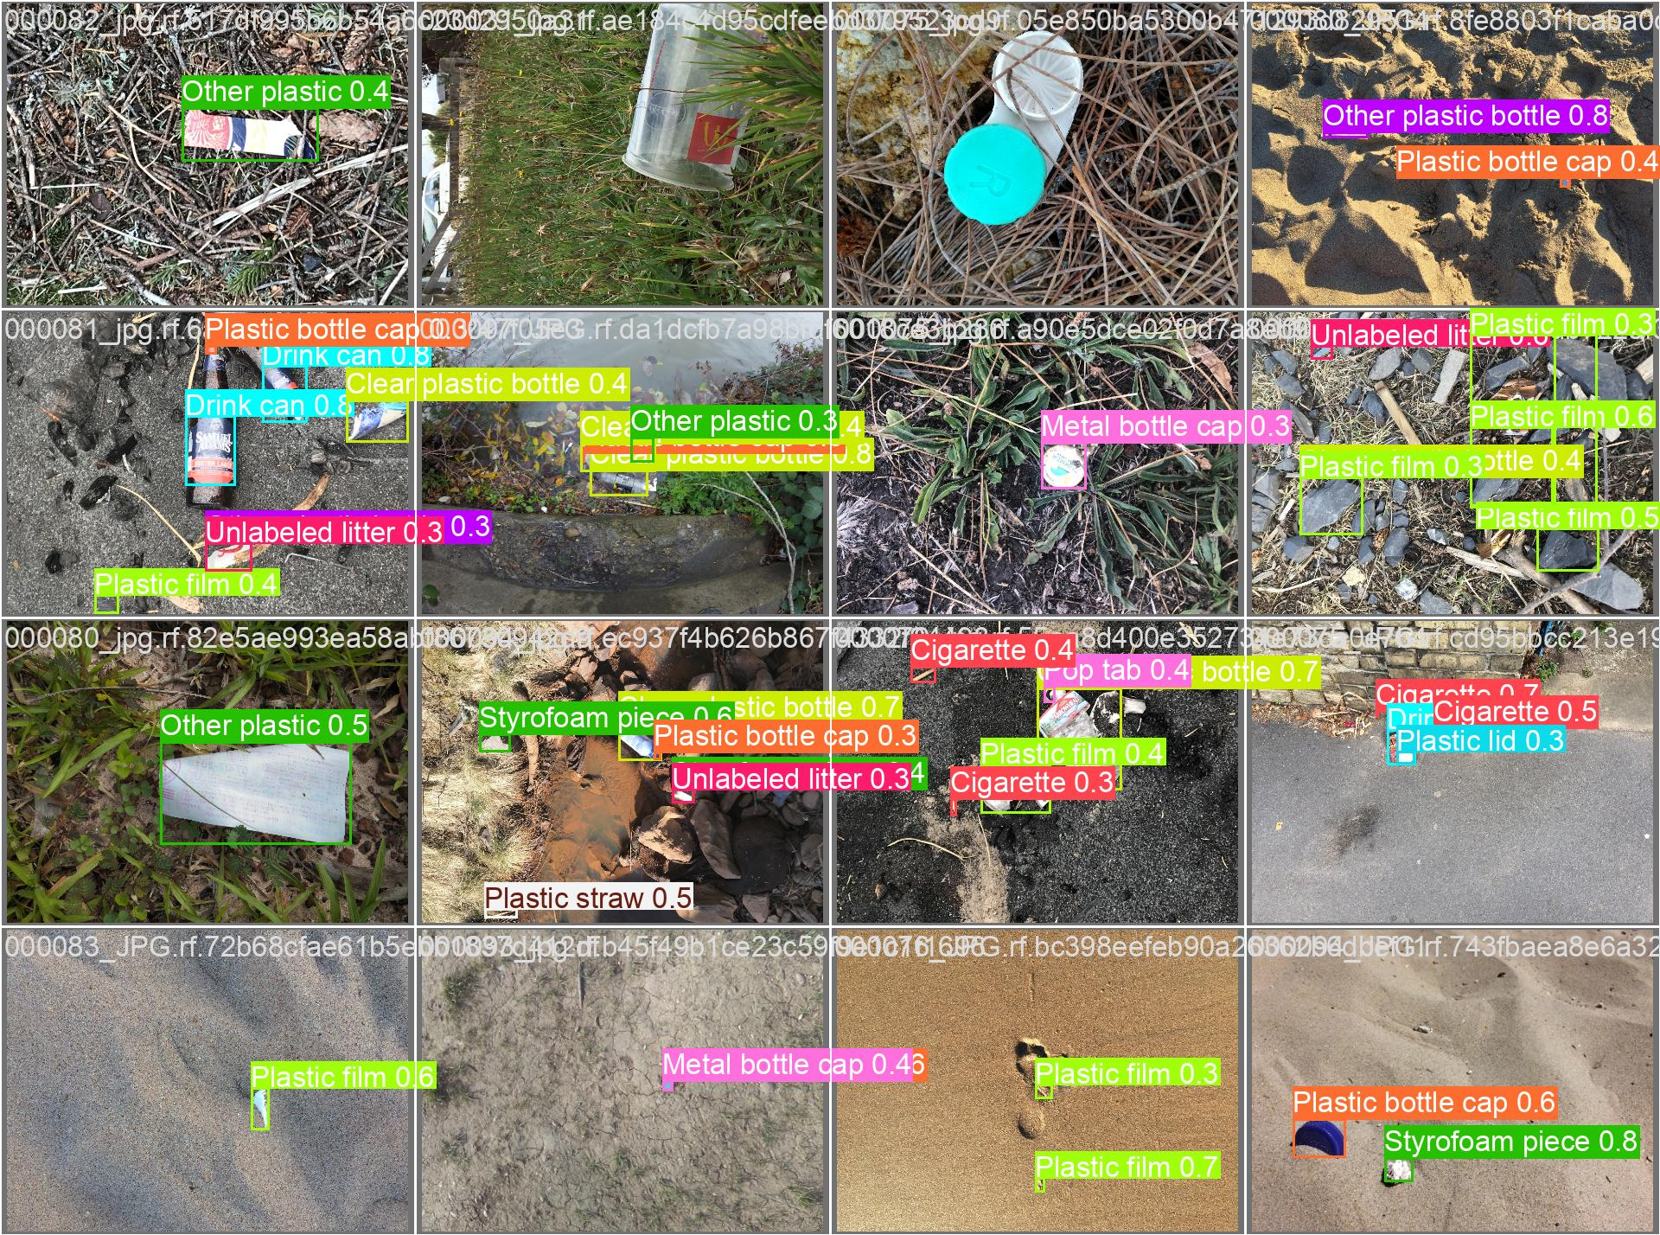
11. Qualitative detection results
Representative visual outputs from the trained detector
Batch output A
Batch output B
Batch output C
Single prediction example
Visual outputs confirm that the model localizes several common litter items.
Some detections overlap or misclassify similar trash types, which is expected for 59 classes.
These examples are useful for explaining both strengths and limitations clearly.
12

Slide 13
12. Heatmap generation theory
Turning detections into spatial insight
Heatmap output
How the heatmap works
Each detected bounding box contributes intensity to its image region.
Higher-confidence detections contribute stronger heat.
Overlapping or clustered detections form visible hotspot areas.
The output helps users see not only what trash is present, but where it is concentrated.
Originality point
This is a value-added analytics layer on top of the YOLOv8 detector, making the system more useful for environmental monitoring.
13

Slide 14
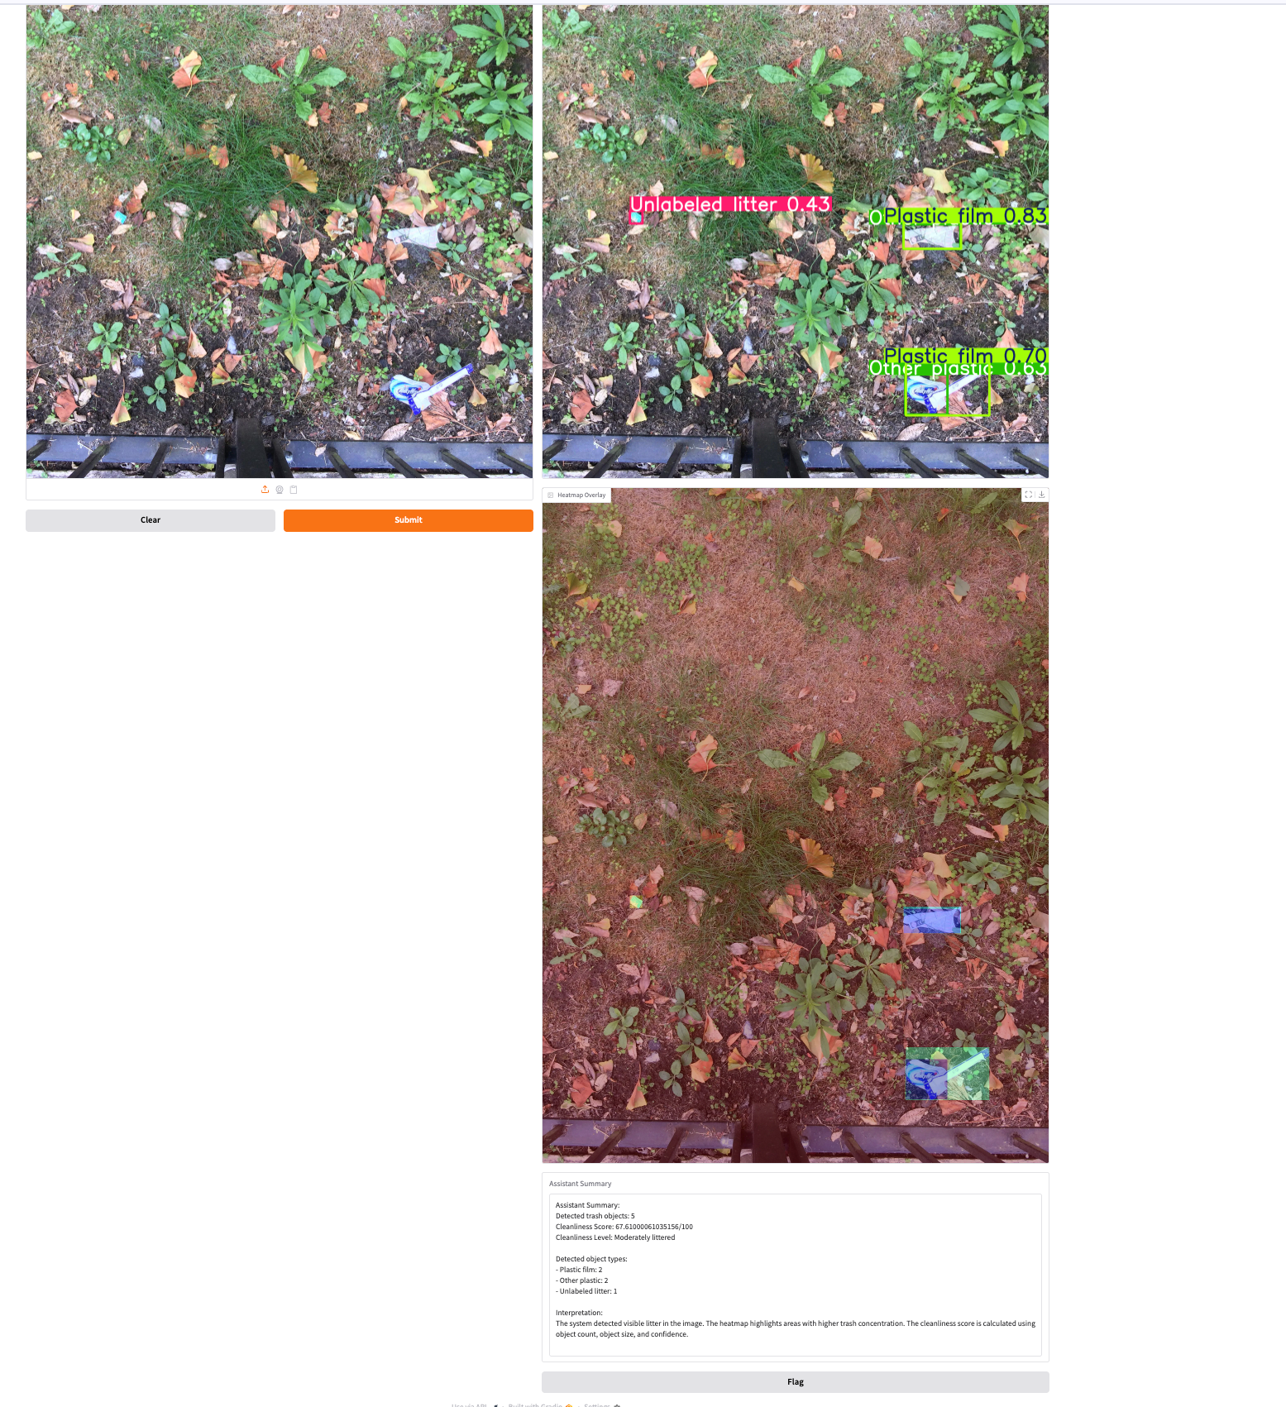
13. Cleanliness score theory
A simple interpretation layer for non-technical users
Input to score
Number of detected objects, object area, and confidence values.
Score meaning
Higher score means cleaner scene; lower score means higher litter concentration.
Output labels
Clean, moderately littered, polluted, or highly polluted.
Assistant summary with score
The score is not meant to replace formal environmental auditing.
It is a lightweight decision-support indicator derived from detection outputs.
It makes the model result easier to understand for users who do not work with object detection metrics.
The score can support quick comparison across images or locations.
14

Slide 15
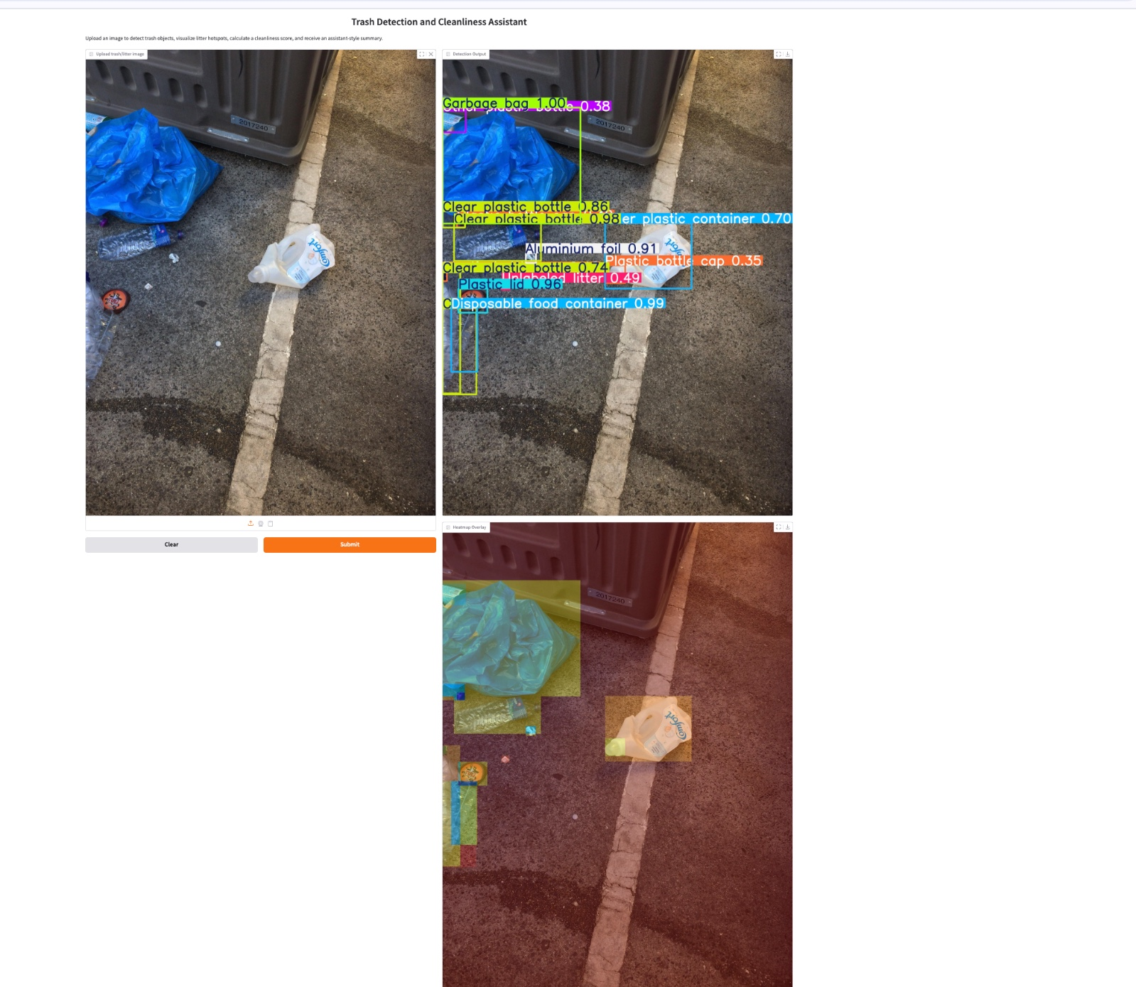
14. Interactive assistant example 1
Multiple objects near a bin
Gradio assistant screenshot
User uploads an image.
The assistant displays detection boxes.
A heatmap shows litter concentration.
The system presents the result in an accessible visual interface.
15

Slide 16
15. Interactive assistant example 2
Ground litter scene with assistant summary
Gradio assistant screenshot
The assistant gives detected object types and counts.
The cleanliness score communicates the scene condition.
This demonstrates the project as a usable application, not only a model training notebook.
16

Slide 17
16. Interactive assistant example 3
Moderately littered outdoor scene
Gradio assistant screenshot
Shows the interface working on another environment.
Visual detections and heatmap remain easy to interpret.
This supports classroom demonstration and future real-world deployment ideas.
17

Slide 18
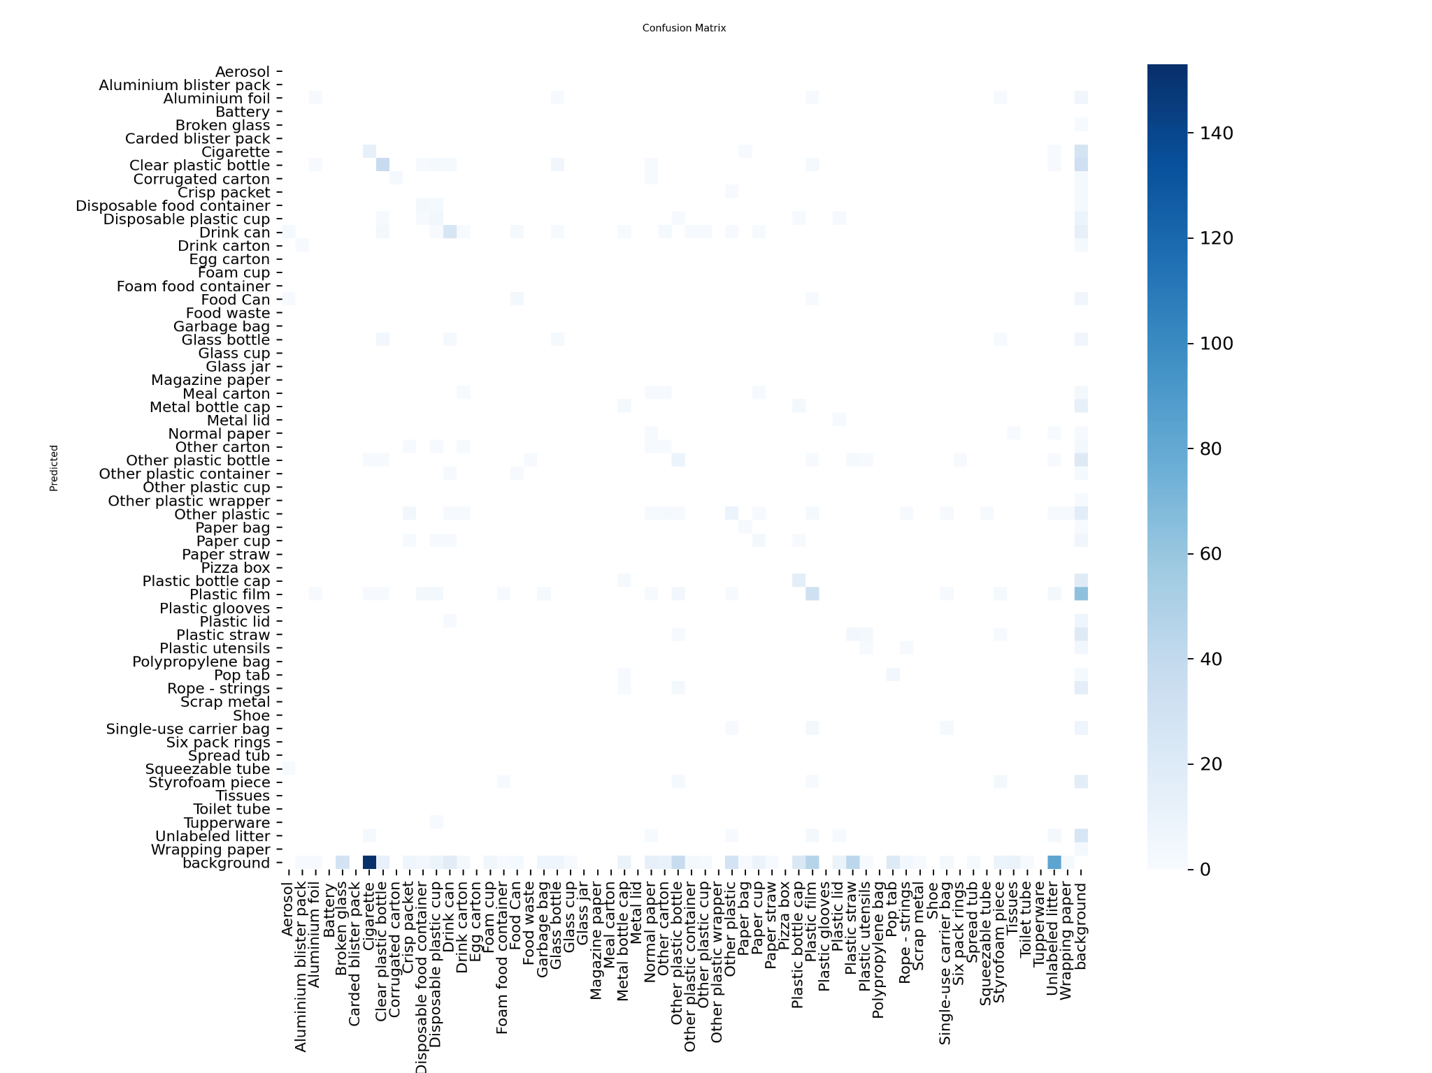
17. Challenges, limitations, and learning
A realistic discussion of model performance
Dataset challenge
59 classes, imbalance, small objects, and visually similar trash types.
Training challenge
Colab GPU limits, runtime disconnects, and long training time.
Evaluation challenge
Object detection metrics are stricter than classification accuracy.
Evidence of class-level confusion
The final model is useful, but not perfect; some rare categories remain difficult.
Small objects such as caps, straws, and cigarette butts are especially hard to detect.
The model can confuse similar plastic categories, which is expected in cluttered scenes.
Future work can improve this using more balanced data, targeted augmentation, and additional training time.
18

Slide 19
18. Evaluation criteria alignment
How the project addresses technical quality, originality, and communication
Technical Quality
YOLOv8 training pipeline, dataset preparation, model comparison, validation outputs, and working inference demo.
Originality
Added heatmap generation, cleanliness scoring, and interactive assistant on top of object detection.
Communication
Presentation emphasizes aim, prior work, value additions, results, and limitations in a clear structure.
We can demonstrate the system live using the Gradio interface.
Detailed metrics are available in the notebook if requested.
The main presentation focuses on system contribution and interpretation rather than a dense accuracy table.
19

Slide 20
19. Future work
How the system can be improved after this project
Future-ready interface
Collect more balanced samples for rare trash categories.
Use targeted augmentation for small objects such as caps, wrappers, and straws.
Experiment with higher-resolution training when GPU resources are available.
Try two-stage design: general trash detector first, detailed class classifier second.
Deploy the assistant as a web application for mobile or municipal use cases.
Long-term vision
Use AI to support cleaner public spaces through faster detection and easier reporting.
20

Slide 21
20. Conclusion
Final message for class presentation
Aim achieved
We built a complete trash detection and cleanliness analysis system.
Value added
We added heatmap visualization, cleanliness scoring, and a user-facing assistant.
Result achieved
The system produces interpretable outputs and is ready for live demonstration.
Thank you
Odra Bira · Sai Rohith Bharadwaj · Pranay Lachuluri
Questions?
21

