Slide 1

DATA ANALYTICS PROJECT
Balaji Fast Food
Sales Analysis
Exploratory data analysis of 1,000 transactions to uncover product, revenue,
and customer purchasing patterns
Team Ignis
GMR Institute of Technology (GMRIT)

Slide 2
PROBLEM STATEMENT
Why This Project
"
The project aims to analyze Balaji Fast Food sales data to identify data quality issues, sales trends, customer behavior, and product performance. Using Python, Pandas, Matplotlib, and Seaborn, the data will be cleaned, analyzed, and visualized to generate useful insights and recommendations for improving revenue and business operations.
TOOLS & LIBRARIES USED
Python
Pandas
Matplotlib
Seaborn
Balaji Fast Food Sales Analysis
2

Slide 3
TEAM DETAILS
Team Ignis
Name | Roll Number | Role
L. Pranay | 23341A1266 | Team Lead
P. Srikar | 23341A1288 | Member
S. Haneesh | 23341A12B0 | Member
V. Bhargav Raju | 23341A12C9 | Member
GITHUB REPOSITORIES
L. Pranay
pranaylekkala5390/
GenAI-Assignment
P. Srikar
srikar0119/
GenAI-Assignment
S. Haneesh
Haneesh-Srirama/
GenAI-Assignments
V. Bhargav Raju
bhargav123321/
GenAI-Assignments
Balaji Fast Food Sales Analysis
3

Slide 4
PROJECT WORKFLOW
Steps of the Project
1
2
3
Data Inspection
Data Preprocessing
Data Visualization
Reviewed dataset shape: 1,000 rows x 10 columns
Checked column data types and null counts
Summarized categorical & date columns
Verified no missing values or duplicate rows
Converted date column to datetime format
Validated transaction amounts & flagged outliers
Built 9 charts: bar, pie, line, histogram, box plot
Analyzed sales by product, type, time & staff
Identified trends, top performers & outliers
Balaji Fast Food Sales Analysis
4

Slide 5
STEP 1
Data Inspection
1,000
10
0
348
Rows
Columns
Duplicates
Unique Dates
Dataset Structure
Key Categorical Findings
10 columns: order_id, date, item_name, item_type, item_price, quantity, transaction_amount, transaction_type, received_by, time_of_sale
transaction_type had 893 of 1,000 non-null values; all other columns fully populated
Date range: 01-04-2022 to 30-03-2023, with 05-09-2022 the most frequent date (8 orders)
Cold Coffee was the most-ordered item (161 orders); Night was the busiest time_of_sale (205 orders)
Balaji Fast Food Sales Analysis
5

Slide 6
STEP 2
Data Preprocessing
Missing Values
Duplicate Records
0 missing values found after preprocessing (checked with df.isnull().sum())
0 duplicate rows found (checked with df.duplicated().sum())
Date Conversion
Negative / Zero Values
date column converted from object to datetime64 for time-series analysis
None found in item_price, quantity, or transaction_amount
Amount Validation
Outlier Detection
item_price x quantity matched transaction_amount exactly - no mismatches
IQR method flagged 44 outliers (bounds: -240 to 720); retained as valid high-value sales
Balaji Fast Food Sales Analysis
6

Slide 7
STEP 3
Data Visualization
9
5
Charts Built
Chart Types
Nine charts were built with Matplotlib and Seaborn to explore product performance, revenue split, transaction patterns, and sales trends over time.
CHART TYPES USED
Bar Chart
Pie Chart
Line Chart
Histogram
Box Plot
Balaji Fast Food Sales Analysis
7

Slide 8
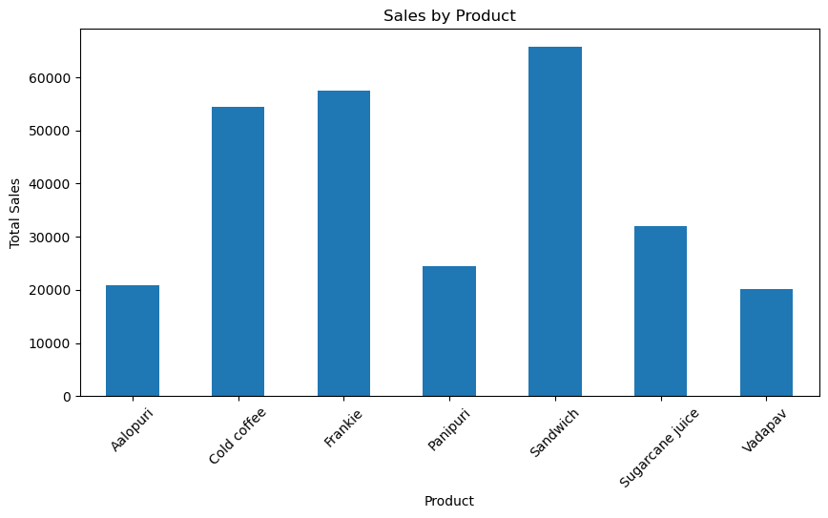
VISUAL 1 OF 9 · BAR CHART
Sales by Product
Compares total revenue generated by each of the seven menu items
Highlights which products are the strongest and weakest performers
Balaji Fast Food Sales Analysis
8

Slide 9
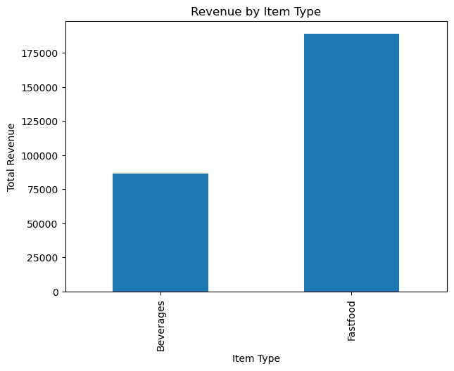
VISUAL 2 OF 9 · BAR CHART
Revenue by Item Type
Compares revenue split between the Fastfood and Beverages categories
Shows which item type contributes more to total revenue
Balaji Fast Food Sales Analysis
9

Slide 10
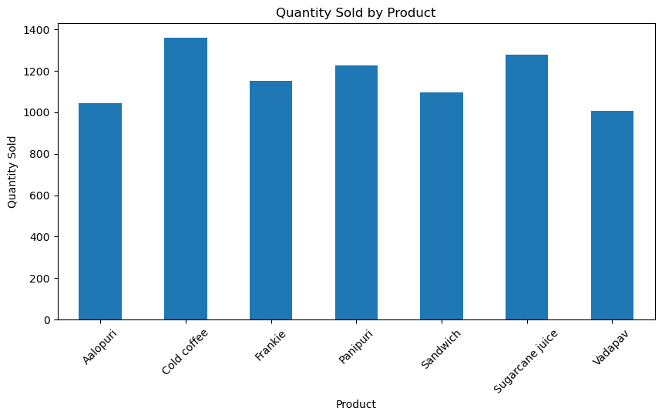
VISUAL 3 OF 9 · BAR CHART
Quantity Sold by Product
Compares the number of units sold for each product
Identifies the most and least frequently sold items
Balaji Fast Food Sales Analysis
10

Slide 11
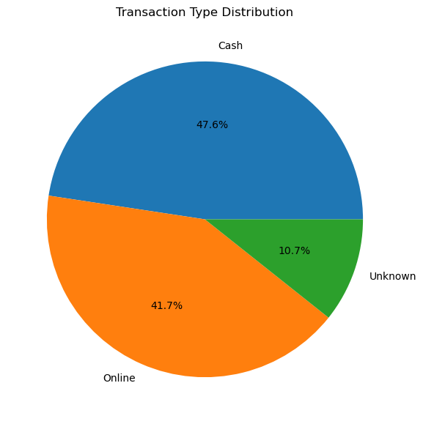
VISUAL 4 OF 9 · PIE CHART
Transaction Type Distribution
Breaks down transactions by payment method: Cash, Online & Unknown
Cash was the most common method, at roughly 48% of transactions
Balaji Fast Food Sales Analysis
11

Slide 12
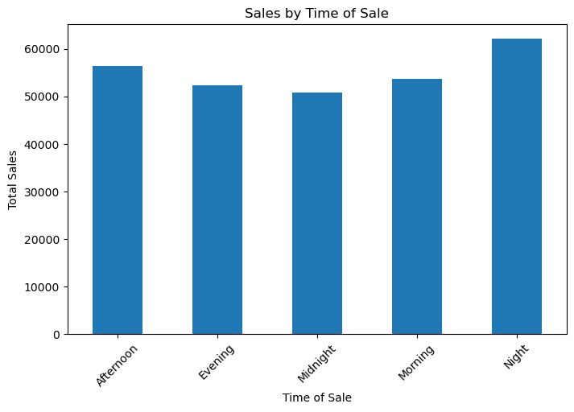
VISUAL 5 OF 9 · BAR CHART
Sales by Time of Sale
Compares total sales across five time-of-day periods
Night was the busiest period, generating the highest total sales
Balaji Fast Food Sales Analysis
12

Slide 13
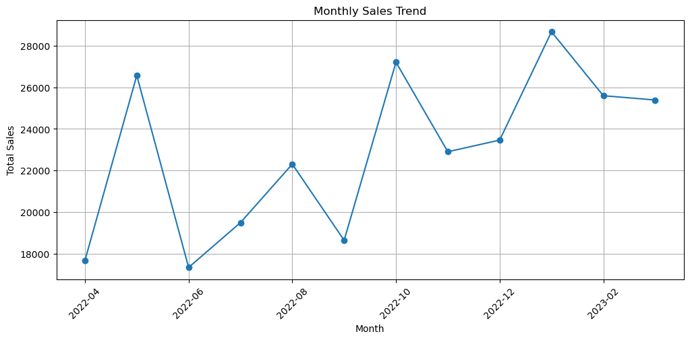
VISUAL 6 OF 9 · LINE CHART
Monthly Sales Trend
Tracks total sales across 12 months, from Apr 2022 to Mar 2023
Reveals the overall trend along with seasonal peaks and dips
Balaji Fast Food Sales Analysis
13

Slide 14
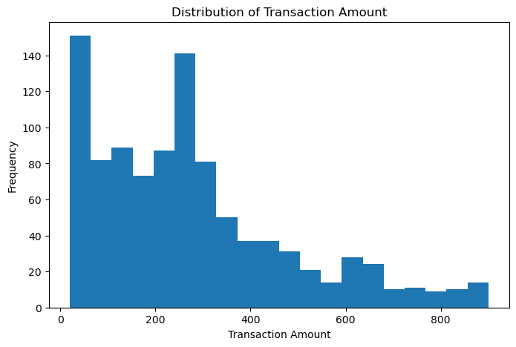
VISUAL 7 OF 9 · HISTOGRAM
Transaction Amount Distribution
Shows how frequently different transaction amounts occur
Most transactions cluster within a common mid-range value band
Balaji Fast Food Sales Analysis
14

Slide 15
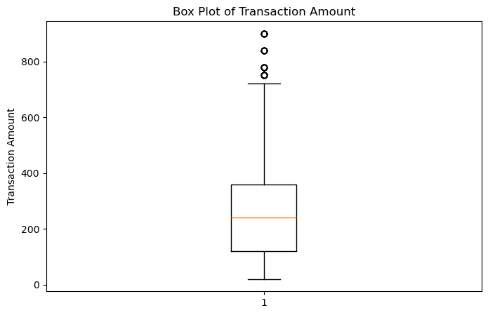
VISUAL 8 OF 9 · BOX PLOT
Transaction Amount Outliers
Visualizes the spread of transaction amounts and flags outliers
44 outliers lie outside the IQR bounds of -240 to 720, kept as valid high-value sales
Balaji Fast Food Sales Analysis
15

Slide 16
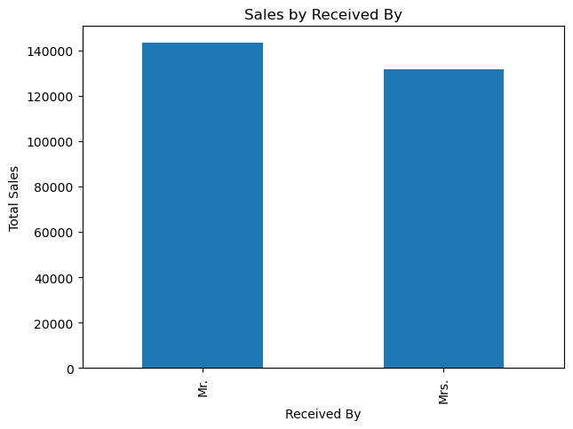
VISUAL 9 OF 9 · BAR CHART
Sales by Received By
Compares total sales handled across the received_by staff categories
Shows the difference in sales volume associated with each category
Balaji Fast Food Sales Analysis
16

Slide 17
Thank You
Balaji Fast Food Sales Analysis · Team Ignis
GMR Institute of Technology (GMRIT)

