Slide 1
MACHINE LEARNING PROJECT
EV Charging Energy
Consumption Prediction
A regression machine learning model that predicts how much energy (kWh) an EV charging session will consume, using information available before the session ends.
Team Ignis
GMR Institute of Technology (GMRIT)

Slide 2
TEAM DETAILS
Presented By
Name | Roll Number | Role
L. Pranay | 23341A1266 | Team Lead
P. Srikar | 23341A1288 | Member
S. Haneesh | 23341A12B0 | Member
V. Bhargav Raju | 23341A12C9 | Member
EV Charging Energy Consumption Prediction
2

Slide 3
PROBLEM STATEMENT
Why This Project Matters
This project builds a regression model that predicts energy_consumed_kWh using only information genuinely available before or as charging begins — battery capacity, initial charge level, charging power, vehicle type, and station/session context.
TOOLS & LIBRARIES USED
Python
Pandas
Scikit-learn
Matplotlib
Seaborn
EV Charging Energy Consumption Prediction
3

Slide 4
STEP 1 · DATA INSPECTION
Dataset Overview
8,354
27
0
0
ROWS
COLUMNS
DUPLICATES
MISSING VALUES
FEATURE GROUPS
12 numerical features — battery capacity, initial SOC, charging power, queue length, station load, electricity price and more
9 categorical features — vehicle type, station ID, location type, weather, traffic density, day of week and more
Timestamp columns kept for feature engineering; every column fully populated
EV Charging Energy Consumption Prediction
4

Slide 5
STEP 2 · DATA PREPROCESSING
Cleaning, Leakage Removal & Feature Engineering
Leakage Removal
Feature Engineering
final_soc & charging_duration dropped — both are algebraically derivable from the target
arrival_hour, day-of-week, is_weekend & time_period extracted from arrival_time
Outlier Decision
Missing & Duplicates
High-energy sessions kept as valid — large-battery vehicles, not data errors
0 missing values and 0 duplicate rows found across all 8,354 sessions
EV Charging Energy Consumption Prediction
5

Slide 6
STEP 3 · DATA VISUALIZATION
Exploring the Data
8
4
Charts were built with Matplotlib and Seaborn to explore how battery, charging and station-level factors relate to energy consumption — and to evaluate the final model's predictions.
VISUALS FEATURED
CHART TYPES
CHART TYPES USED
Histogram
Box Plot
Bar Chart
Scatter Plot
EV Charging Energy Consumption Prediction
6

Slide 7
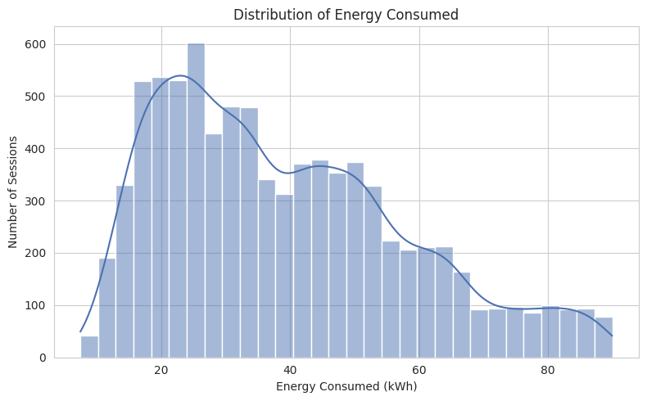
VISUAL 1 OF 8 · HISTOGRAM
Energy Consumption Distribution
Compares: the frequency of sessions across energy-consumption levels
Built from: the energy_consumed_kWh column alone, across all 8,354 sessions
Conclusion: right-skewed — most sessions fall in the 20–55 kWh band (mean 39.1, median 35.1 kWh)
EV Charging Energy Consumption Prediction
7

Slide 8
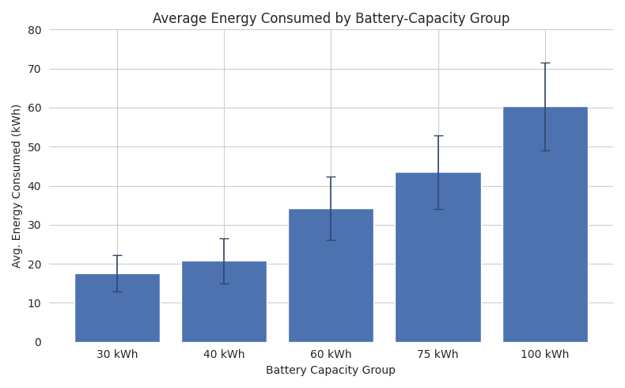
VISUAL 2 OF 8 · BAR CHART
Energy Consumed by Battery-Capacity Group
Compares: average energy consumed across battery-capacity groups (30, 40, 60, 75 & 100 kWh packs)
Built from: battery_capacity_kWh binned into groups, plotted against energy_consumed_kWh
Conclusion: larger battery-capacity groups consume more energy per session — the strongest predictor
EV Charging Energy Consumption Prediction
8

Slide 9
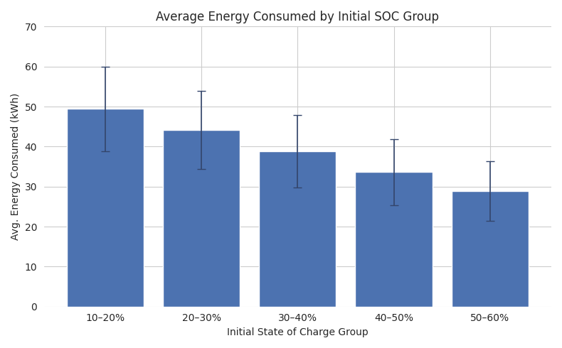
VISUAL 3 OF 8 · BAR CHART
Energy Consumed by Initial SOC Group
Compares: average energy consumed across initial state-of-charge groups (10–60%, in 10% bands)
Built from: initial_soc binned into groups, plotted against energy_consumed_kWh
Conclusion: lower initial-SOC groups consume more energy — an inverse relationship matching charging logic
EV Charging Energy Consumption Prediction
9

Slide 10
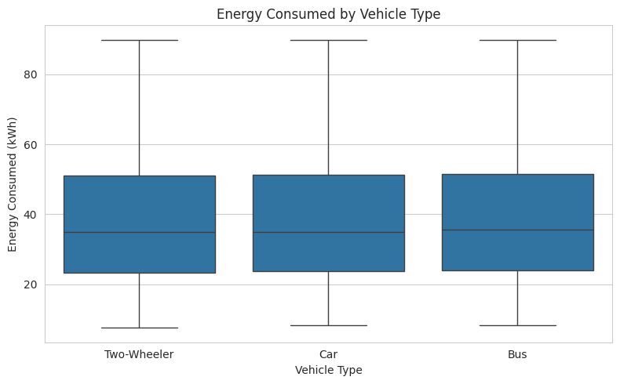
VISUAL 4 OF 8 · BOX PLOT
Energy Consumed by Vehicle Type
Compares: the spread of energy consumption across Bus, Car & Two-Wheeler sessions
Built from: vehicle_type plotted against energy_consumed_kWh
Conclusion: similar median consumption (~35 kWh) across types — kept as a categorical feature
EV Charging Energy Consumption Prediction
10

Slide 11
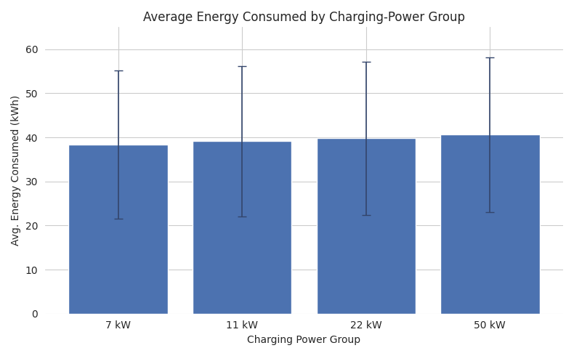
VISUAL 5 OF 8 · BAR CHART
Energy Consumed by Charging-Power Group
Compares: average energy consumed across charging-power groups (7, 11, 22 & 50 kW)
Built from: charging_power_kW binned into groups, plotted against energy_consumed_kWh
Conclusion: a weak, gradual relationship — power alone tells only part of the story, but is still included since it's known pre-session
EV Charging Energy Consumption Prediction
11

Slide 12
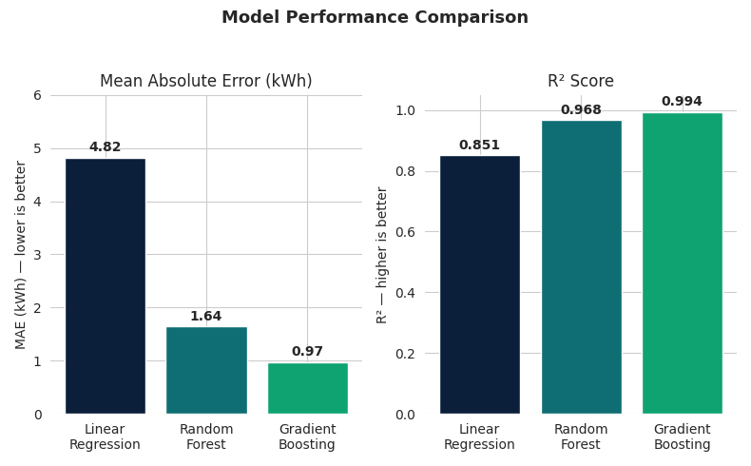
VISUAL 6 OF 8 · BAR CHART
Model Performance Comparison
Compares: MAE and R² across the three trained models — Linear Regression, Random Forest & Gradient Boosting
Built from: each model's predictions vs. actual energy_consumed_kWh on the held-out test set
Conclusion: Gradient Boosting wins on both metrics (MAE 0.97 kWh, R² 0.994) and was selected as the final model
EV Charging Energy Consumption Prediction
12

Slide 13
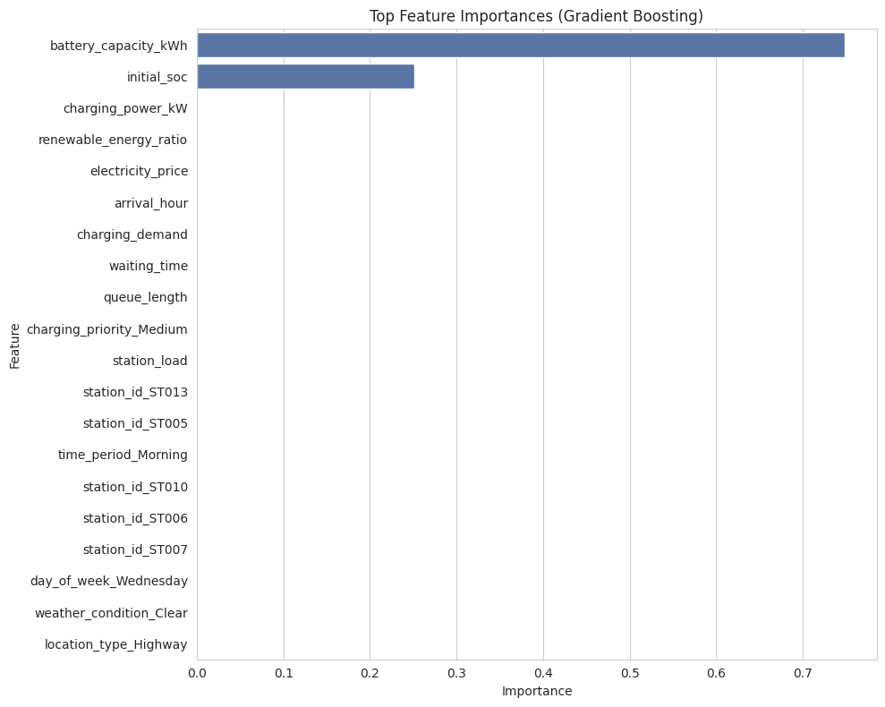
VISUAL 7 OF 8 · BAR CHART
What Drives the Model's Predictions
Compares: the relative importance of each input feature in the final model
Built from: the Gradient Boosting model's feature-importance scores across all model inputs
Conclusion: battery capacity & initial SOC dominate — guides which inputs matter most in deployment
EV Charging Energy Consumption Prediction
13

Slide 14
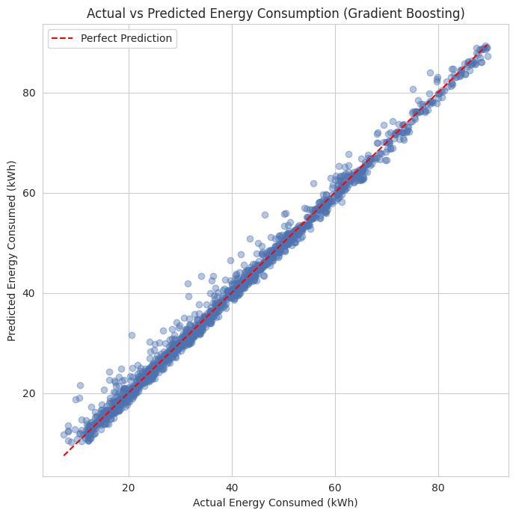
VISUAL 8 OF 8 · SCATTER PLOT
Actual vs. Predicted Energy Consumption
Compares: Gradient Boosting's predicted energy consumption against the actual test-set values
Built from: predicted vs. actual energy_consumed_kWh for every session in the held-out test set
Conclusion: points cluster tightly along the perfect-prediction line, confirming strong real-world accuracy
EV Charging Energy Consumption Prediction
14

Slide 15
STEP 4 · MODEL TRAINING
Training Three Regression Models
Train/Test Split
Shared Preprocessing Pipeline
80% train / 20% test split, with a fixed random_state for reproducible, comparable results
Identical encoding & scaling pipeline applied to all three models before fitting, so comparisons stay fair
Models Trained
Target Variable
Linear Regression (baseline), Random Forest & Gradient Boosting — three complementary regression approaches
energy_consumed_kWh, predicted only from features available before or at the start of charging
EV Charging Energy Consumption Prediction
15

Slide 16
STEP 5 · EVALUATION & SELECTION
Comparing Models & Selecting the Best
Metrics Used
Model Comparison
Mean Absolute Error (MAE) and R² score, both computed on the held-out test set
Gradient Boosting outperformed Linear Regression & Random Forest on both metrics (see Visual 6)
Final Model Selected
Why It Wins
Gradient Boosting — MAE 0.97 kWh, R² 0.994 on unseen test sessions
Captures the non-linear relationships between battery capacity, SOC & power that the linear model misses
EV Charging Energy Consumption Prediction
16

Slide 17
PROJECT WORKFLOW
Steps of the Project
1
Data Inspection
2
Cleaning & Leakage Removal
3
Feature Engineering
8,354 rows × 27 columns reviewed; 0 missing or duplicate values
Deterministic leakage columns dropped before modeling
Time-based features extracted from the arrival timestamp
4
Exploratory Analysis
5
Model Training
6
Evaluation & Selection
9 charts built to study the drivers of energy consumption
3 regression models trained through one shared pipeline
Gradient Boosting selected — MAE 0.97 kWh, R² 0.994
EV Charging Energy Consumption Prediction
17

Slide 18
Thank You
EV Charging Energy Consumption Prediction · Team Ignis
GMR Institute of Technology (GMRIT)

