Slide 1
Potato Leaf Disease Classification Using Deep Learning
KALAKONDA AKASH RAO – 21BAI1536
PANDIRI PRANAY KUMAR – 21BAI1504

Slide 2
ABSTRACT
This project explores the automated classification of potato diseases using deep learning and convolutional neural network (CNN) models. The study employs a diverse dataset comprising images of healthy potatoes and those afflicted with common diseases such as late blight and early blight. Through meticulous preprocessing and fine-tuning of pretrained CNN models, including , ResNet-50, VGG-19, the research aims to discern the most effective model for accurate disease classification. Remarkably, after extensive evaluation, ResNet-50 emerges as the top performer, achieving an outstanding accuracy rate of 99.71%.
This exceptional accuracy underscores ResNet-50's ability to distinguish subtle differences between healthy and diseased potato plants, highlighting its potential for precise disease diagnosis in agriculture. The findings hold promise for revolutionizing disease management practices, offering farmers efficient tools to mitigate yield losses and ensure food security. By leveraging deep learning techniques, this research contributes to the development of real-time systems for on-field disease detection, enabling timely interventions and targeted agricultural practices.
Moreover, the study sets a precedent for employing advanced technology in agricultural sectors, emphasizing the importance of machine learning in addressing pressing challenges faced by farmers worldwide. Ultimately, the successful implementation of deep learning models in potato disease classification signifies a significant step forward in enhancing agricultural productivity and sustainability, paving the way for a more resilient and efficient food production system in the face of evolving environmental and economic pressures.

Slide 3
INTRODUCTION
The agricultural industry plays a crucial role in global food production, with plants serving as the backbone of agricultural output. Potato cultivation is a significant agricultural activity globally, contributing to food security and economic stability. However, potato plants are susceptible to various diseases, which can reduce crop yield and quality. Timely detection and classification of these diseases are crucial for effective disease management. In this project, we aim to develop a system that uses Convolutional Neural Networks (CNN) and deep learning techniques to classify potato diseases accurately and assist farmers in making informed decisions about disease control and treatment.
Traditional methods for potato disease classification have often relied on manual inspection, which can be time-consuming and prone to errors. With the advancement of deep learning techniques, there is a significant opportunity to transform potato disease classification by automating the process with high accuracy and speed.
Deep learning, particularly Convolutional Neural Networks (CNNs), has emerged as a powerful tool for image classification tasks, including disease detection in plants. By leveraging the hierarchical features learned from data, CNN models can automatically extract relevant features from images and make predictions with high accuracy. In the context of potato leaf disease classification, CNN models offer the potential to provide rapid and reliable identification of diseases, allowing farmers and agricultural experts to take appropriate actions to mitigate disease spread and minimize crop losses. The images in the dataset pertain to various categories of potato diseases, each with distinct symptoms and visual markers. The model used for training is based on a well-established CNN architecture like resnet model, a computer vision model. Pre-trained weights of the model are leveraged and customized to perform potato disease classification.

Slide 4
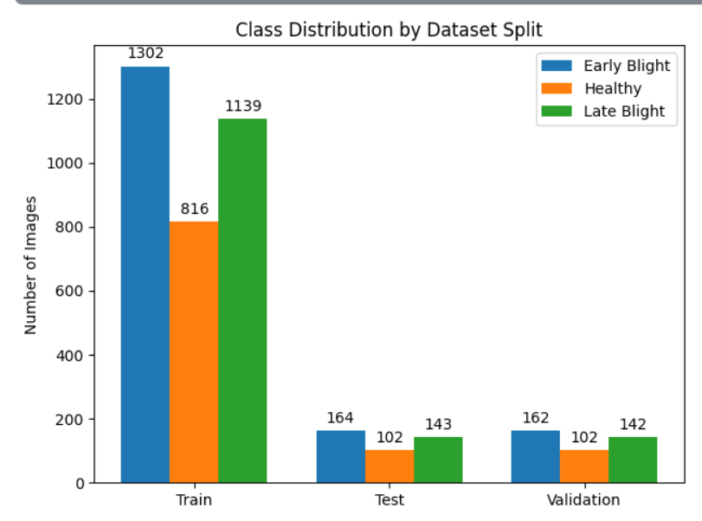
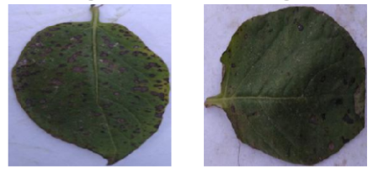
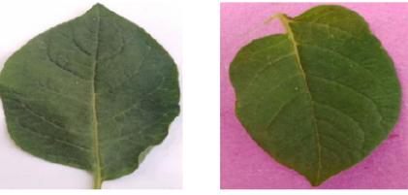
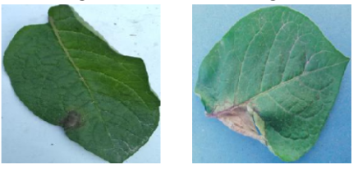
Distribution of the Classes
The dataset utilized in this study comprises chest potato leaf images sourced from the Potato Leaf Diseases dataset. This dataset is organized into three main directories: train, test, and validation.
Each directory contains subdirectories corresponding to the classes of interest: 'Early Blight’, ‘Late Blight’, and ‘Healthy' . These classes represent the presence or absence of disease in the potato leaf images, thus constituting a multi classification problem.
As we can see the distribution of the images is skewed to the side of the Potato leaf Images.
This results in an imbalance in the dataset.
We solve this imbalance by augmenting the dataset for increasing the number of images and decreasing the imbalance.
Early Blight
Healthy
Late Blight

Slide 5
LITERATURE SURVEY
S.NO | TITLE | PERFORMANCE METRICES USED | PERFORMANCE ATTAINED | LIMITATIONS | SCOPE OF FUTURE WORK
1. | Potato Leaf Disease Classification Based on Distinct Color and Texture Feature Extraction | Includes accuracy, precision, recall, F1 score, specificity, ROC curves, AUC-ROC, confusion matrices, Kappa statistic, MAE, and MSE. | The method outperforms baseline methods in accuracy, as confirmed by experiments with 300 potato leaf images. | Feature extraction, color space transformation sensitivity, k-means clustering effectiveness, feature scope, generalization, and scalability. | Refining feature extraction, exploring alternative methods, integrating additional features, leveraging advanced techniques, diversifying datasets, and addressing real-world implementation challenges.

Slide 6
S.NO | TITLE | PERFORMANCE METRICES USED | PERFORMANCE ATTAINED | LIMITATIONS | SCOPE OF FUTURE WORK
2. | Potato Leaf Disease Detection Using Deep Learning | The potato leaf disease classification model utilizes metrics like accuracy, precision, recall, and F1 score for evaluation. The CNN model achieves an outstanding accuracy of 98.72% | The CNN model achieved an outstanding accuracy of 98.72% in classifying potato leaf diseases, aiding Indian farmers in preventing economic losses caused by plant diseases. | Limitations encompass technology dependence, regional effectiveness variability, update requirements, cost barriers, and interpretability challenges. | Improving technology access, expanding datasets, optimizing deep learning methods, and collaborating with agricultural experts to develop user-friendly solutions for Indian farmers.
3. | Potato Leaf Disease Classification Using Deep Learning Approach | Performance metrics include accuracy, with an average of 91%, demonstrating the effectiveness of the deep learning approach for potato disease classification. | The system achieved 91% accuracy in classifying four types of potato diseases based on leaf conditions using deep learning with VGG16 and VGG19 models. | Limitations include narrow focus, variable effectiveness, data reliance, interpretability challenges, and resource requirements. | Expanding disease coverage, improving accuracy across environments, enhancing model interpretability, and developing user-friendly tools for farmers.

Slide 7
S.NO | TITLE | PERFORMANCE METRICES USED | PERFORMANCE ATTAINED | LIMITATIONS | SCOPE OF FUTURE WORK
4. | A Convolutional Neural Network Based Potato Leaf Diseases Detection Using Sequential Model | Model accuracy, at 94.2%, was the key metric. The Convolutional Neural Network (CNN) successfully identified potato leaf diseases, aiding in early detection and loss prevention for Bangladeshi farmers. | The model achieved 94.2% accuracy in detecting potato leaf diseases using image processing and a Convolutional Neural Network | Reliance on automation, variability in model effectiveness, and challenges in interpretability and generalization. | Enhancing automation, improving disease detection, reducing costs, and developing advanced image processing
5. | Detecting Diseases in Potato Leaves using Deep Learning and Machine Learning Approaches | Deep Learning and Machine Learning models to diagnose potato leaf diseases efficiently, aiming to enhance crop yield and reduce financial losses for Indian farmers. You | Particularly Deep Neural Networks, diagnose potato leaf diseases early to boost crop yield and cut financial losses for Indian farmers. | Costly and labor-intensive conventional disease-spotting methods pose limitations | Early potato leaf disease diagnosis in India, aiming to cut losses, boost yields, and ease farmer burdens, enhancing food security.

Slide 8
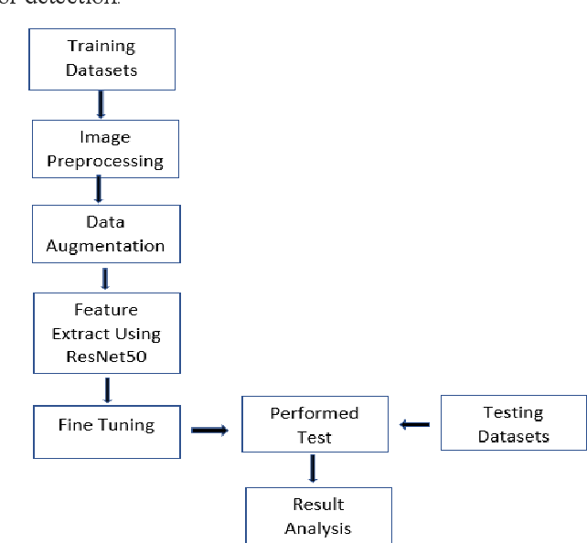
BLOCK Diagram
Dataset Consisting of Images of Potato leaf images: This is the initial dataset containing potato leaf images, serving as input data.
Data Preprocessing and EDA: Images undergo preprocessing (resizing, normalization) and exploratory data analysis for insights.
Model Building: Definition of the deep learning model architecture.
Resnet50 with Transfer Learning: Utilizing pre-trained Resnet50 for feature extraction, accelerating training and enhancing performance.
Fine-tuning: Adjusting model parameters for disease detection task and dataset characteristics.
Evaluation: Assessing model performance using metrics like accuracy, precision, recall.

Slide 9
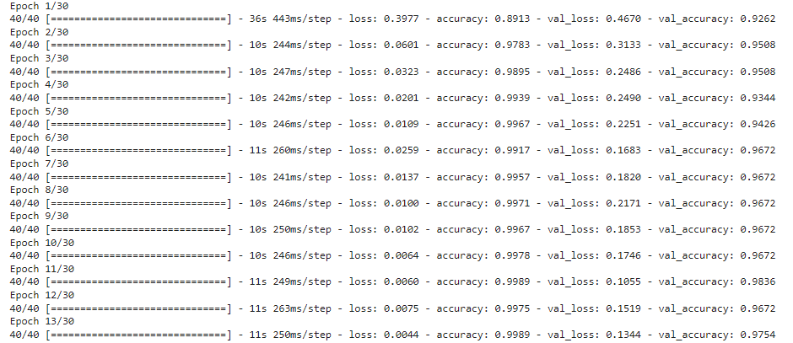
Results
Using Resnet model

Slide 10
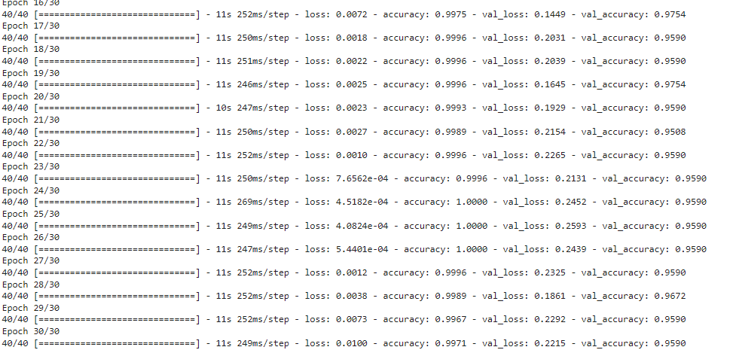
We have trained the model with emphasis on accuracy score as the model’s metrics,
The training accuracy after training for 30 epochs has reached 0.9971 and the loss in the training data is at 0.0100
The validation accuracy has reached 0.9521 and validation loss is at 0.2215

Slide 11
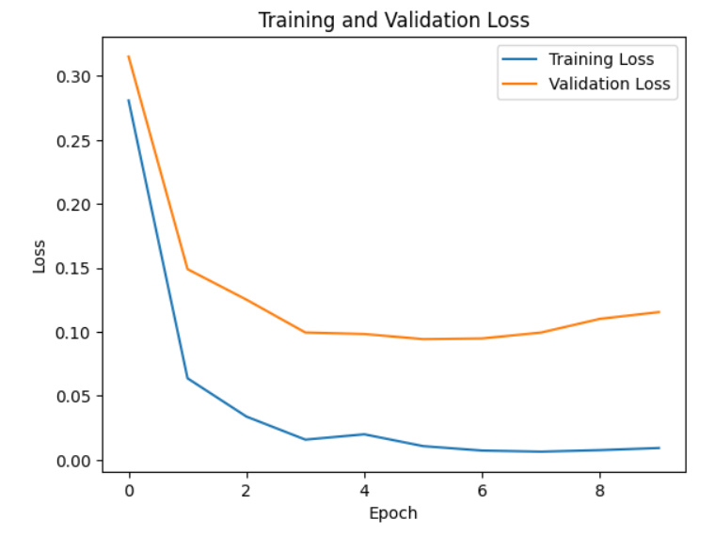
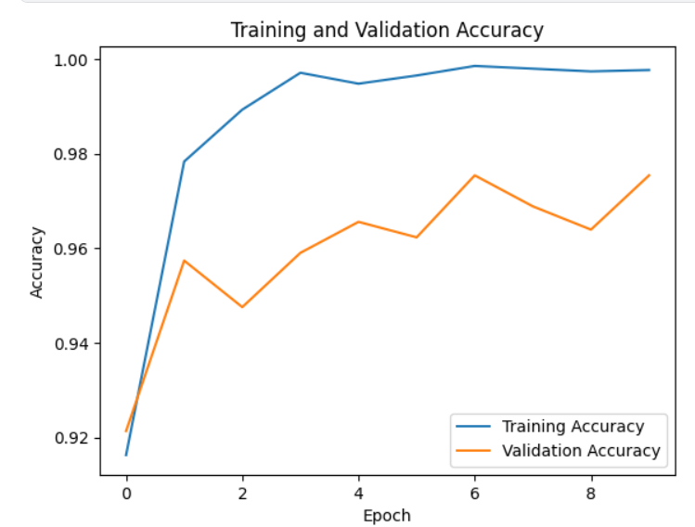
Graphs of Loss and accuracy Over the Epochs
Plotting loss over epochs helps us track how well our model is learning from the data, ensuring it minimizes errors effectively during training.
Graphing accuracy over epochs provides insights into the model's ability to discriminate between classes, guiding adjustments to enhance its performance in classification tasks.
Graph depicts the model's decreasing loss over 30 epochs, indicating improved accuracy as training progresses.
Curve shows accuracy stability or increase over epochs, reflecting the model's ability to distinguish between classes.

Slide 12
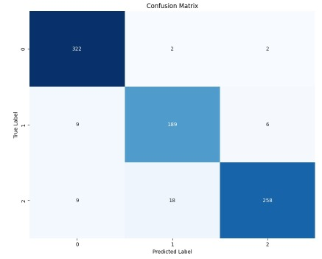
Confusion Matrix
Accuracy: The model demonstrates an accuracy of approximately 99.71%,
Precision: About 93% of the cases predicted as early blight or late blight by the model are indeed healthy leaves.
Recall (Sensitivity): The model identifies around 86.70% of actual early blight or late blight,
F1-score: The F1-score of approximately 91%,

Slide 13
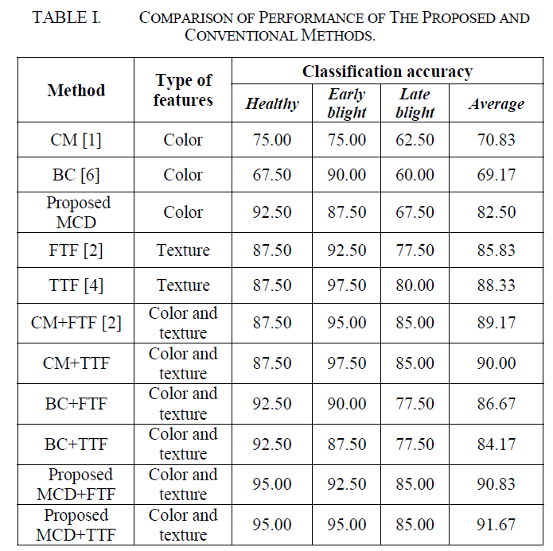
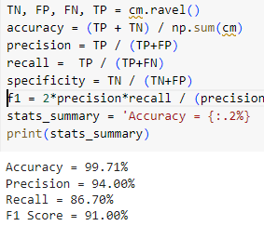
Comparison with other Papers
Paper-1: https://ieeexplore.ieee.org/abstract/document/8905128
In the paper the highest accuracy is 91.67%
In our model we have achieved accuracy is 99.71%
In all the cases our model is equal to or if not greater than the one in the given research paper.
Result of our model
Results in the Paper

Slide 14
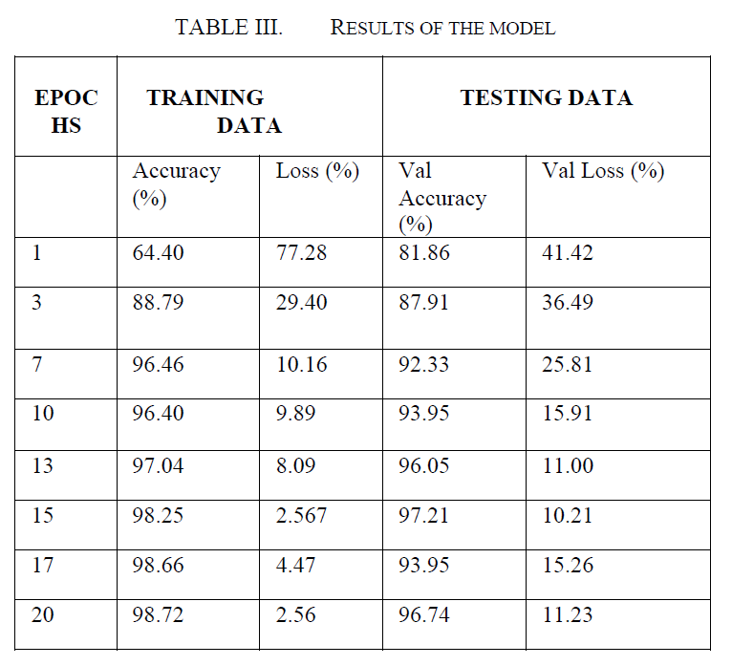
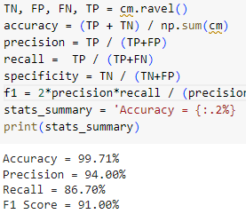
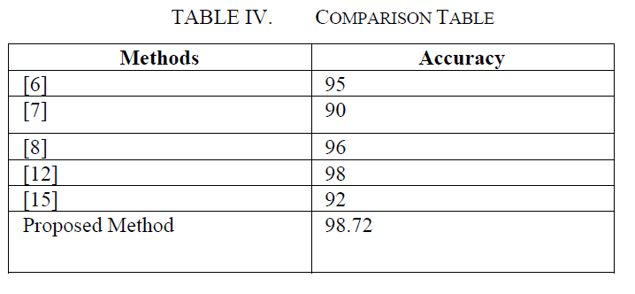
Paper-2: https://ieeexplore.ieee.org/document/10263960
In the paper the highest accuracy is 98.72%
In our model we have achieved accuracy is 99.71%
In all the cases our model is equal to or if not greater than the one in the given research paper.
Result of our model
Results in the Paper

Slide 15
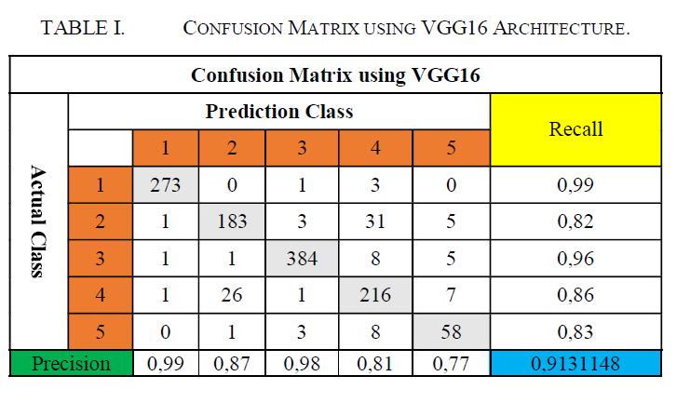
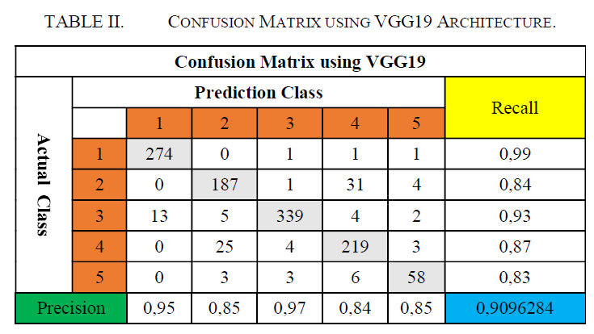
Paper-3: https://ieeexplore.ieee.org/abstract/document/9231784
In the paper the highest accuracy is 91.13% and 90.96
In our model we have achieved accuracy is 99.71%
In all the cases our model is equal to or if not greater than the one in the given research paper.
Result of our model
Result in the paper

Slide 16
Thank You

