Slide 1
Loan Default Prediction
MMA2026WT
Team Danforth

Slide 2
Project Introduction-Loan Default Prediction
Background
Objective
Dataset Summary
SuperLender uses credit risk models to assess applicants’ willingness and ability to repay, aiming to predict loan defaults and support responsible lending decisions.
Making responsible lending decisions by predicting defaults before they happen.
3 different datasets for both train and test.
Demographic data
Performance data
Previous loans data

Slide 3
Overview of Missing Values
01
Customer demographic information
bank_branch_clients — 99.06%
level_of_education_clients — 85.88%
employment_status_clients — 14.60%
02
Current loans performance
referredby — 86.56%
03
Previous loans performance
referredby — 94.36%

Slide 4
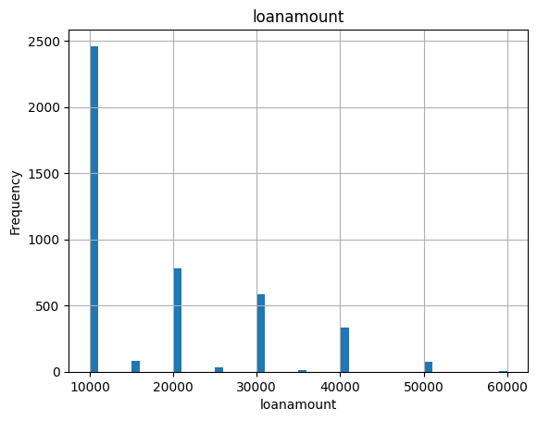
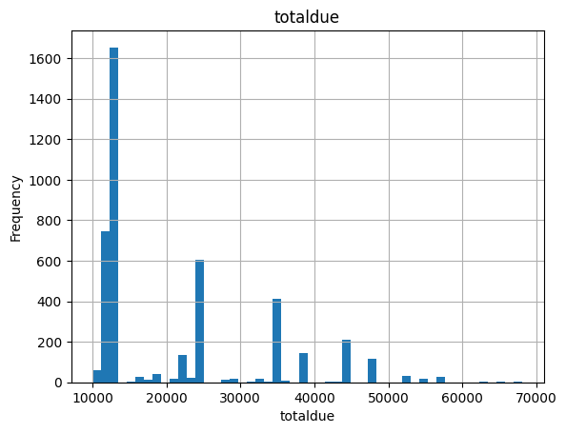
Exploration of Numerical Features

Slide 5
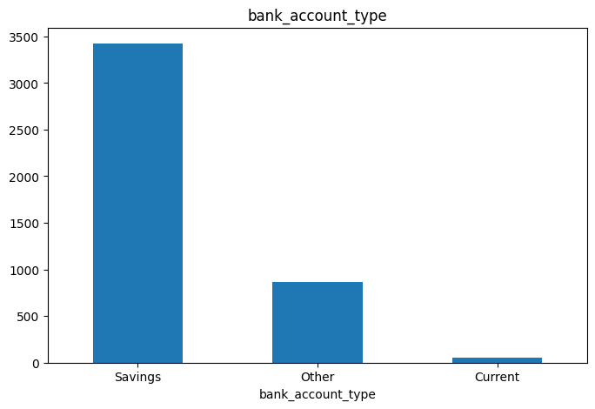
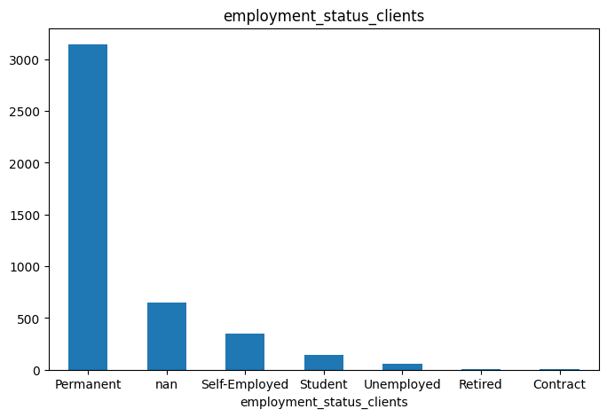
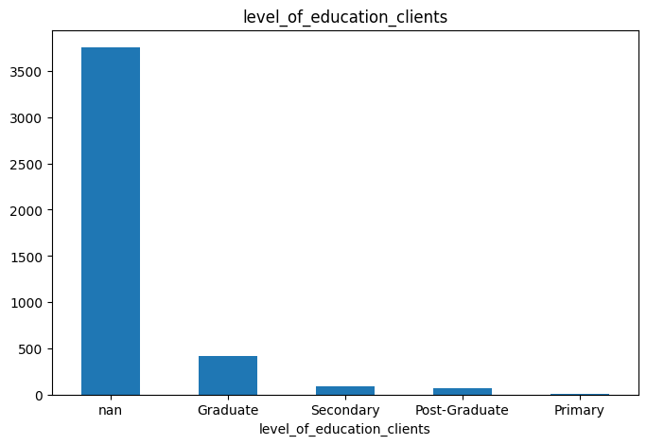
Exploration of Categorical Features

Slide 6
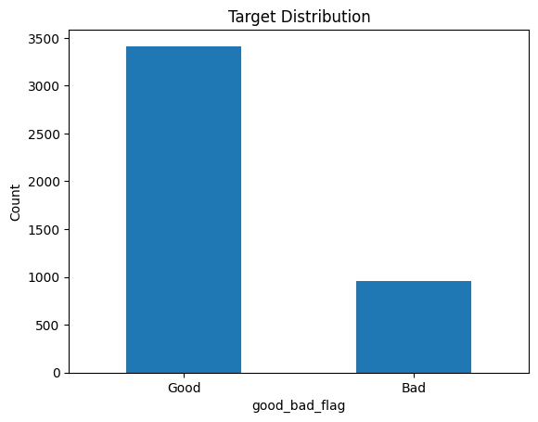
Data preprocessing
Target variable mapping
Aggregation
good_bad_flag: 1=good, 0=bad
Aggregates previous loans data by customerid to compute:
prev_loan_count: number of prior loans
prev_loan_amt_mean: average historical loan amount
prev_term_mean: average historical loan term (days)
prev_delay_mean: average delay from application to first repayment
Merged with current loan & demographics → full modeling table

Slide 7
Model Comparison Overview
We experimented with four models to compare predictive accuracy and select the most effective one for our task.
Non - Trees
Trees
Logistic Regression
KNN
LightGBM
Catboost
Baseline

Slide 8
Model Comparison Overview
We experimented with four models to compare predictive accuracy and select the most effective one for our task.
10 - folds cross-validation
Criterion: Accuracy ( i.e. 1 - Error)
Models | CV Accuracy | Zindi Score | Difference
Logistic Regression (Baseline) | 0.7429 | - | -
KNN | 0.7832 | - | -
LightGBM | 0.7889 | 0.7874 | 0.0015
CatBoost | 0.7919 | 0.7931 | 0.0012

Slide 9
Feature Engineering - All Models
Data Aggregation
Date Manipulation
Feature Selection
Covert previous loan dataset into previous loan behaviours columns to aggregate on custom level
Birthday into Age
Approval_delay
= Approval_date - Creation_date
Manually drop some columns which don’t have predict value:
custome_id
system_id

Slide 10
Feature Engineering - Non-trees
One Hot Encoding
Categorical Values
k-1 levels for LR
k levels for KNN
III
Missing Values
Numerical: column median
Categorical: “Missing”
I
II
Standardization
Numerical Values
Remove the impact of different scales

Slide 11
Feature Engineering - Trees
Missing Value - Catboost only
Fill Categorical NaN with “Missing”
Features derived from original dates
Approved_date
2017-07-05 5:04:41 PM
Approved_month | Approved_day | Approved_dayofweek
7 | 5 | 3
Steps didn’t help much - decrease the performance
Interaction terms: edu x employment
Log transformation
Drop less important features

Slide 12
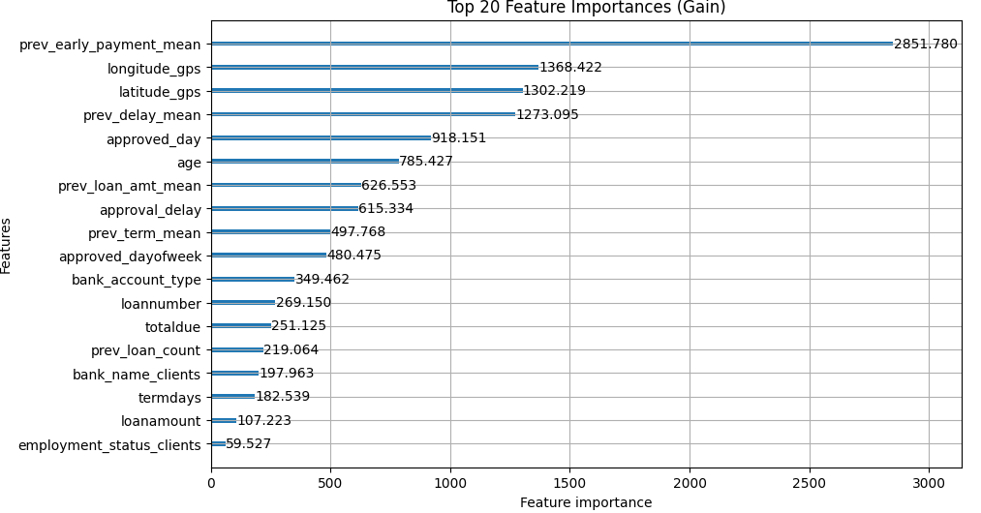
Feature Engineering - LightGBM Overview

Slide 13
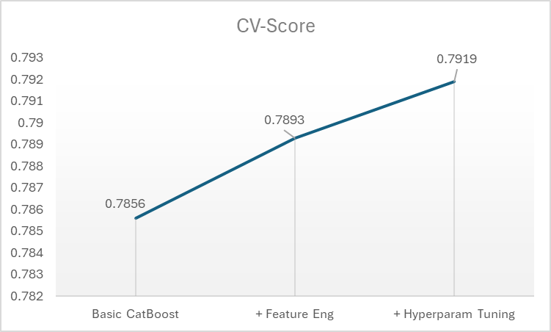
Hyperparameter Tuning - Catboost
Tuning Methods
RandomizedSearchCV
GridSearchCV
Improvement
Feature Engineering: +0.0037
Tuning: +0.0026

Slide 14
Hyperparameter Tuning - Catboost
Tune 12 Hyperparameters
Snippet:
Parameter | Range | Learning
depth | [2, 3, 4, 6, 8, 10] | kept the model moderately complex
learning_rate | [0.01, 0.03, 0.1, 0.2, 0.4] | the model could learn quickly
iterations | [50, 100, 300, 500] | reached good performance early
12_leaf_reg | [1, 3, 5, 7, 9, 11, 13, 15, 17, 19, 21] | strong penalty
auto_class_weights | ["Balanced", "SqrtBalanced", "None"] | other hyperparameters are good enough

Slide 15
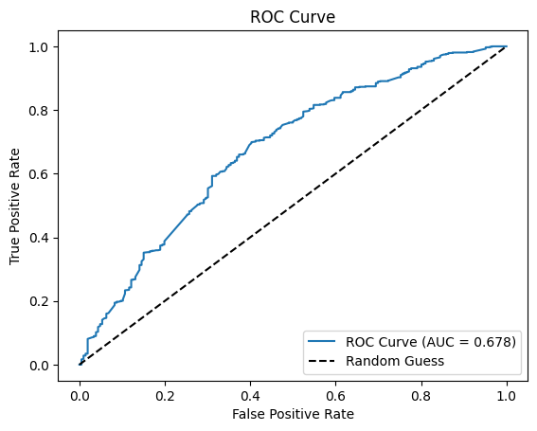
Model Validation (80/20 split)
Classification Report:
precision recall f1-score support
0 0.49 0.09 0.15 206
1 0.78 0.97 0.86 668
accuracy 0.76 874
macro avg 0.63 0.53 0.51 874
weighted avg 0.71 0.76 0.69 874
AUC Score: 0.678
Confusion Matrix
Predicted 0
Predicted 1
Actual 0
18
188
Actual 1
19
649
Notes:
So now we’re going to talk a little bit about our best model and its performance. Our production model was evaluated using 5-fold cross-validation, but for illustration purposes we ran an additional train/test split of 80/20 on our training data and scored it to produce the metrics you see here.
The key takeaways are that:
While our model performed relatively well, we still seem to favour the majority class of no-default. This is evidenced by our 9% recall of defaulted loans.
It's good at spotting non-default (97% recall).
The model is right overall 76% of the time

Slide 16
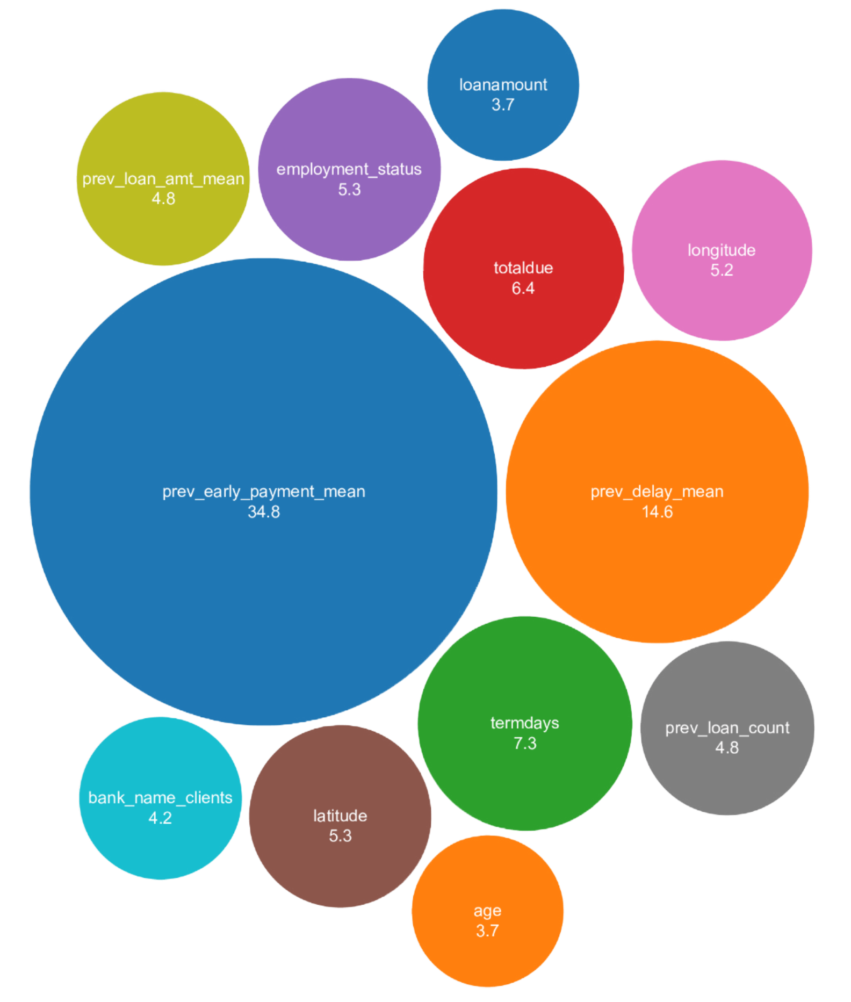
Prior loan history was most important
Key Feature Takeaways
Metrics derived from previous loan auxiliary dataset were most important (55.2%)
Effects of employment were relatively muted.
Default rates were lower in relatively affluent southern Nigeria, as opposed to the north.
We dropped level of education, previous loan term mean, referral status, and month and date of loan approval or creation.
Notes:
Here we have an illustration depicting all our features, with the bubble size indicating each feature’s relative importance. The bubbles in the chart sum to 100 when not rounded, so each feature can be considered the percentage of total importance assigned to that feature when making a prediction.
Intuitively, previous loan history helps predict defaults because it shows how someone handled loans in the past. If they’ve missed payments or defaulted before, there’s a higher chance they might do it again. On the flip side, a good repayment track record suggests they’re more likely to pay back future loans. It’s kind of like checking someone’s track record before trusting them again—it gives clues about what they might do next.
Not so intuitively, employment status didn’t seem to account for a whole lot, despite having a value for most instances. Students had an almost identical rate of loan default as permanent employees. Loan reasons were not specified in this dataset, so this could potentially be because the loans were student loans providing the recipient with greater earning power.
Level of education was another feature that didn’t have much prediction power, but this was likely because most instances were missing a value. Referrals also didn’t matter, neither did the time of year loans were created and approved.

Slide 17
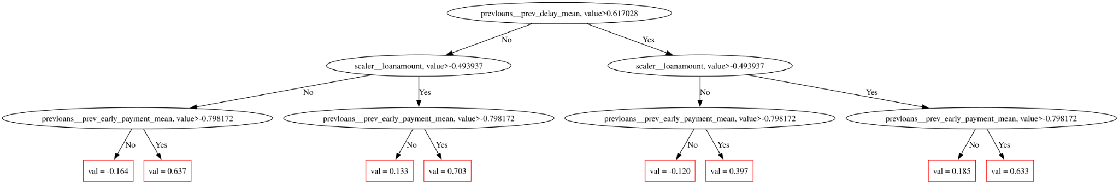
Our (simplified) decision tree, visualized
(this is the production one)
Notes:
CatBoost actually allows us to print out our trees, which I thought was cool, so here it is.
The mouldy looking image at the bottom is one of our production trees, which as you can see is a bit unwieldy. Since it’s an ensemble model, many more of these so called “weak learner trees” were created, with the average prediction being used. For illustration purpose, we stripped down the model to generate a simpler tree to illustrate how it was making decisions.

Slide 18
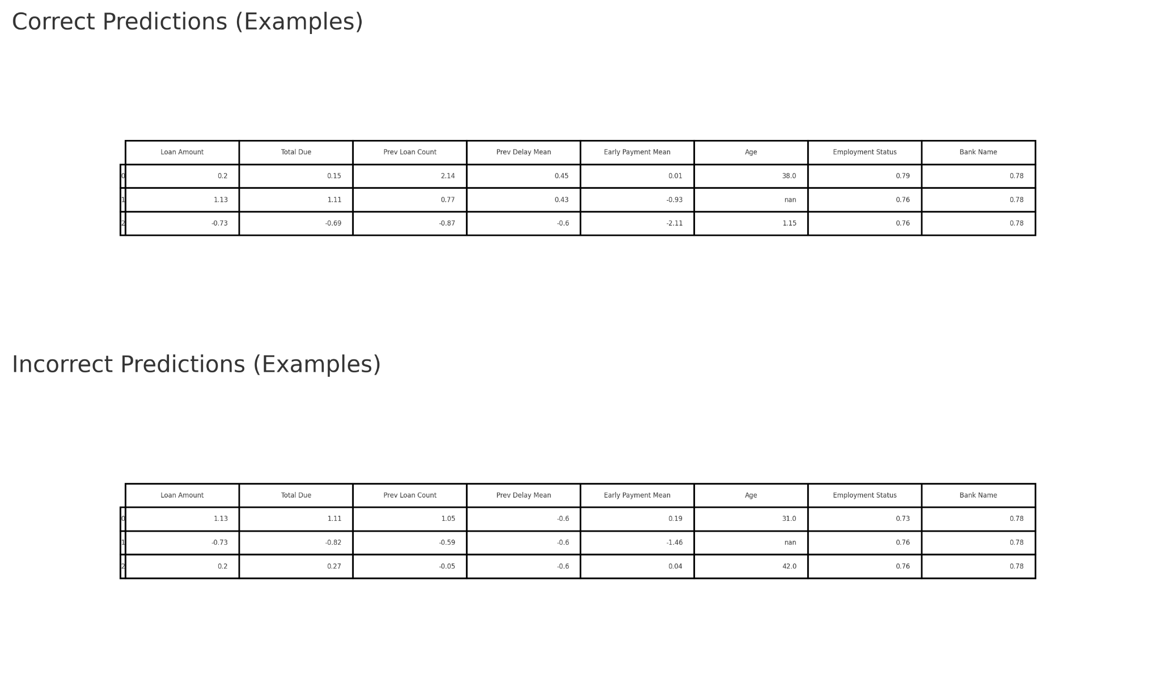
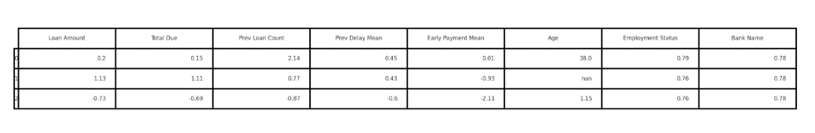
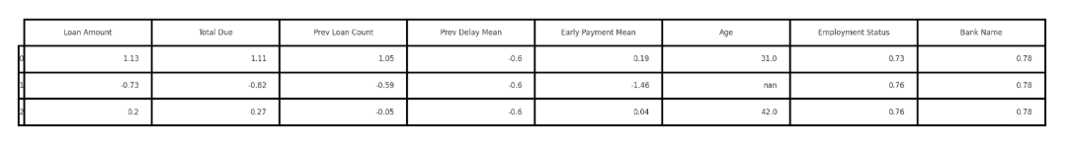
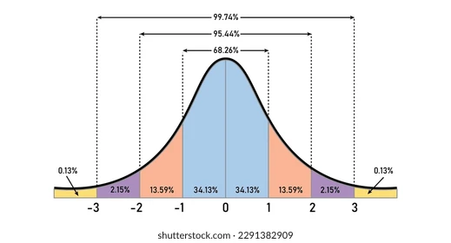
Example predictions
* Numerical values were transformed by removing the mean and scaling to unit variance.
Notes:
Here are a few examples of correctly and incorrectly predicted instances. Some numeric features have have been scaled so they follow a standard gaussian distribution, so values below zero indicate a value below than the feature mean and higher values indicate a value higher. Each integer in either direction is a single standard deviation from the feature mean, so a value of 1 indicates it’s one standard deviation higher than the feature mean. The categorical features, employment and bank name, were converted to numerical values using target encoding, which assigns each category the mean of the target variable for all instances with that category. As we see from the tree on the prior slide, the approval delay was one of our most important features. Unfortunately it’s come back to bit us with this sample of incorrect predictions, each having a delay smaller than the mean.

Slide 19
Lessons Learned
Use sklearn.pipelines.Pipelines for preprocessing, fitting, and predicting.
Tuning is very data-driven, not always what we would expect in theory
Preprocessing + FE > Model selection
Notes:
Using sklearn.pipeline.Pipeline helps keep your machine learning workflow clean, consistent, and less error-prone. It chains preprocessing and modeling steps together so you can treat everything as a single object. That means you avoid data leakage, since transformations are fit only on the training data. It also makes cross-validation and grid search easier because the entire pipeline can be tuned at once. The consistent API simplifies your code and makes it more maintainable. And when it’s time to deploy, the same pipeline ensures your preprocessing and model logic stay exactly the same—no need to rebuild steps manually.
Tuning involves a lot of guesswork and iteration. Optimal parameter values aren’t always intuitive, so trying as many parameters as you can run in a reasonable amount of time. For example, in this project we found class balancing didn’t improve prediction accuracy at all, despite target categories being extremely imbalanced.
We found most classification models performed in roughly the same ballpark. What really moved the needle was a greater focus on data cleaning and preprocessing and feature engineering. At the beginning it was tempting to spam model hyperparameter combinations, but if I were doing it again I’d stick to a couple simple models for validation, refine and iterate on features, then introduce the full gambit of model hyper-parameter combinations to optimize it.

Slide 20
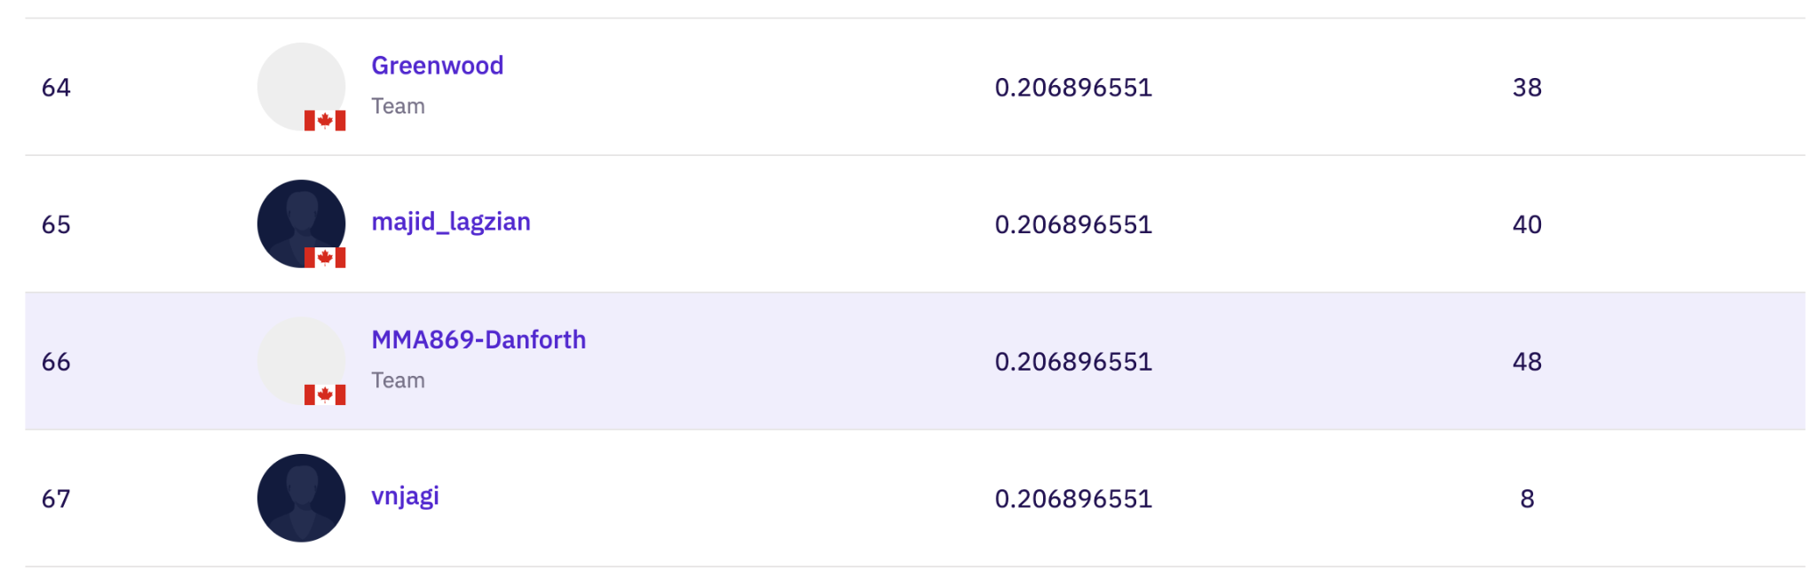
Appendix — Leaderboard position

Slide 21
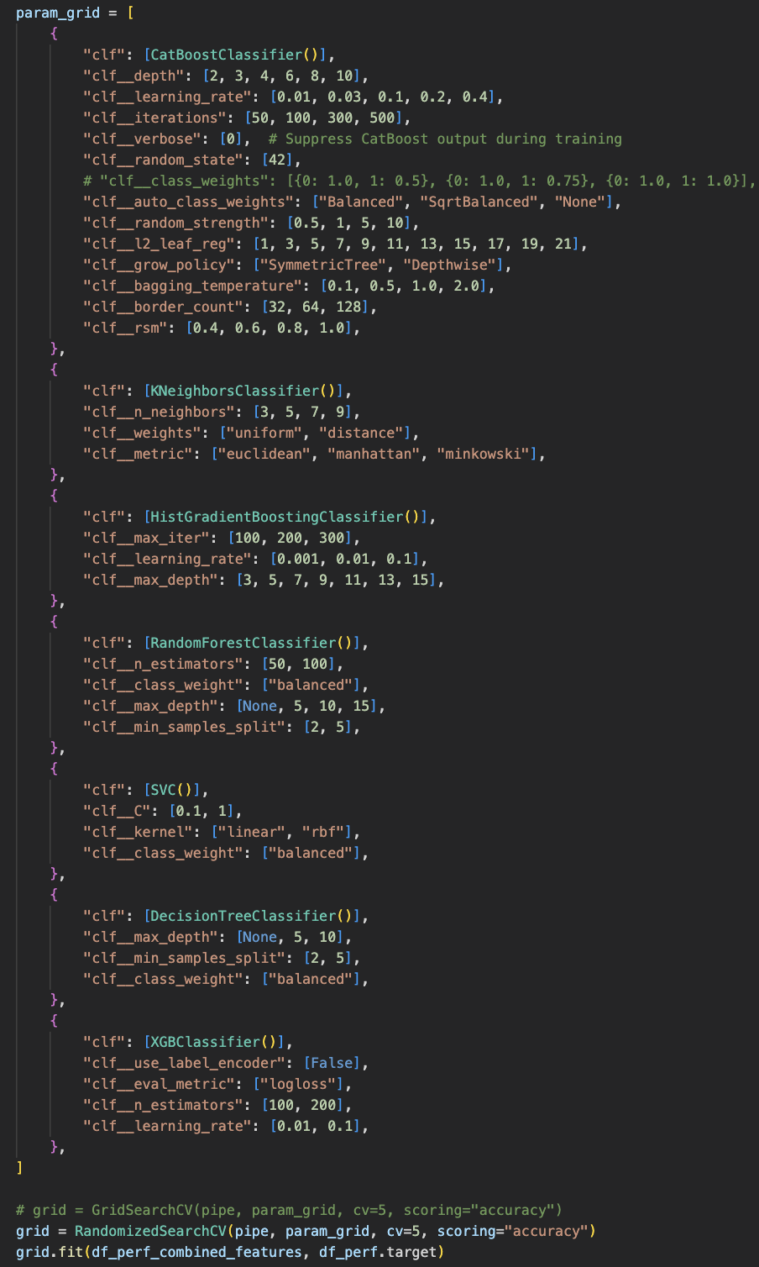
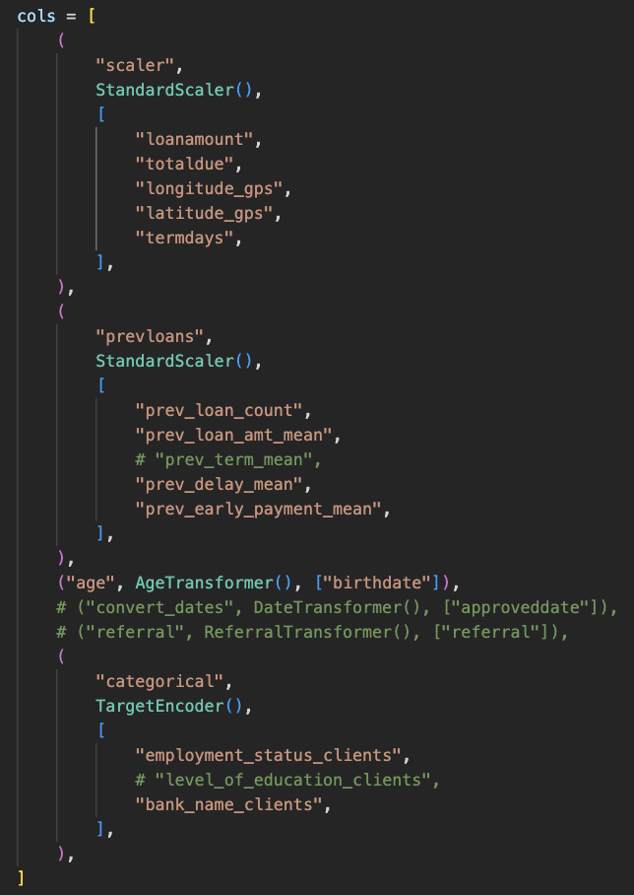
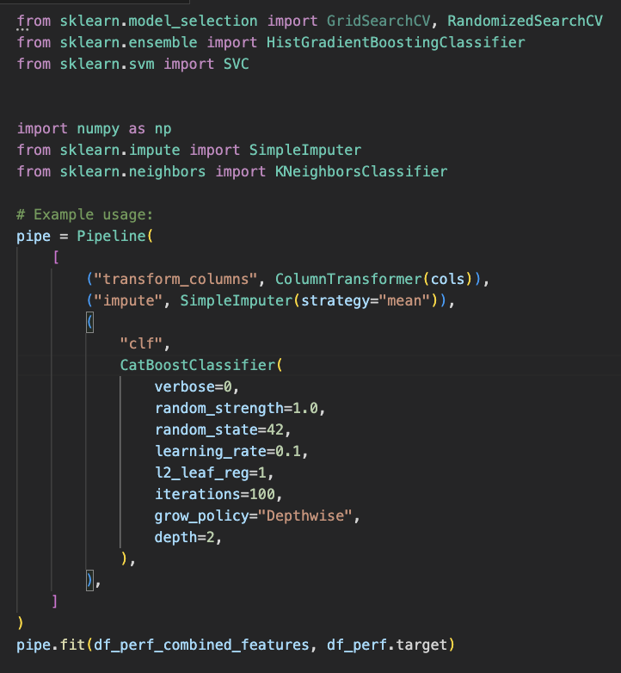
Appendix — Code Snippets

Slide 22
Appendix - CatBoost Hyperparameter Tuning List
Parameter | Range
depth | [2, 3, 4, 6, 8, 10]
learning_rate | [0.01, 0.03, 0.1, 0.2, 0.4]
iterations | [50, 100, 300, 500]
verbose | [0]
random_state | [42]
auto_class_weights | ["Balanced", "SqrtBalanced", "None"]
random_strength | [0.5, 1, 5, 10]
rsm | [0.4, 0.6, 0.8, 1.0]
12_leaf_reg | [1, 3, 5, 7, 9, 11, 13, 15, 17, 19, 21]
bagging_temperature | [0.1, 0.5, 1.0]
grow_policy | ["SymmetricTree", "Depthwise"]
border_count | [32, 64, 128]

Slide 23
Questions?

